Slide 1


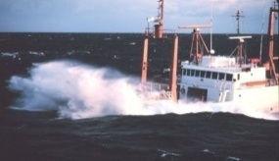
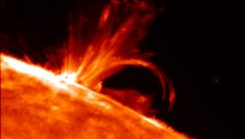
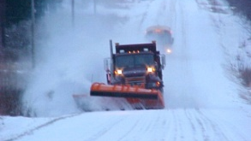
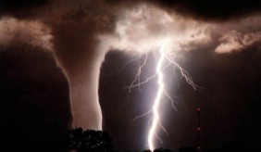
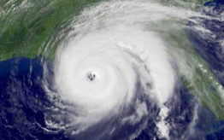

Advancing Forecast Capabilities:
Thoughts on the Global Observing System
Dr. Louis W. Uccellini
NOAA Assistant Administrator for Weather Services and
Director, National Weather Service
NASA Global Precipitation Measurement Mission Workshop
College Park, Maryland
November 12, 2013

Slide 2
Outline
Building a Weather-Ready Nation
NWS Operational Forecast Process
Advancing Forecast Skill
Current Global Observing System
Ongoing Efforts to Improve Forecast Capabilities: Priorities for the Global Observing System
Summary

Slide 3


Building a Weather-Ready Nation
Decrease Vulnerability by Increasing
Resilience and Preparedness
Increase resilience to and preparedness for increasing vulnerability to extreme weather
Impact-based Decision Support Services
  Better understanding of societal impacts; connecting the social science component to forecast advancements
  Making our information more relevant to decision makers.
  Participating directly in decision making for those decisions fundamental to the role of government, especially the protection of life and property.
  Counting on market forces to provide diverse decision-support services across the entire economy, e.g., multiple communication pathways.
IDSS requires NWS culture shift

Slide 4
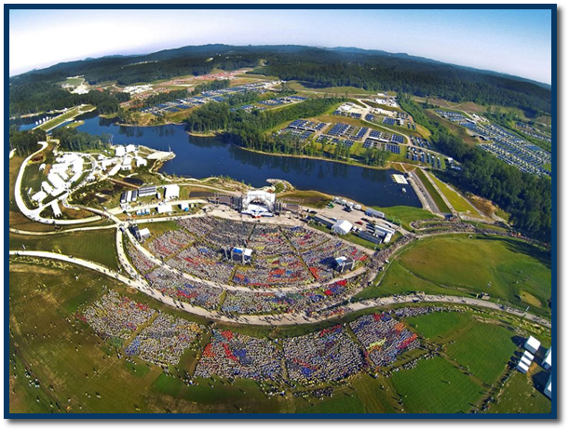
NWS Strategic Outcome:
Weather-Ready Nation Strategic Goals
Strategic Outcome:
Weather-Ready Nation
Ready
Responsive
Resilient
  NWS Strategic Goals
  Improve Weather Decisions Services
  Improve Water Forecasting Services
  Enhance climate services and adapt to climate-related risks
  Improve sector-relevant information in support of economic productivity
  Enable environmental forecast services supporting healthy communities and ecosystems
  Sustain a highly skilled, professional workforce equipped with training, tools, and infrastructure to meet mission
NAPA Embraces WRN: “NWS Can’t Do It Alone”

Slide 5
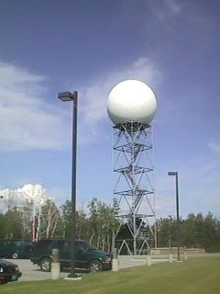


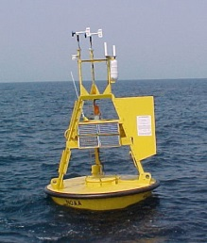

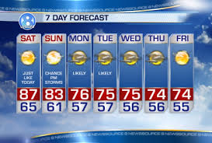
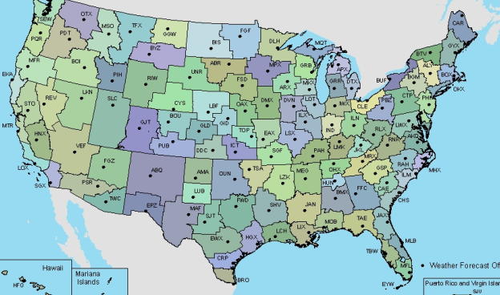
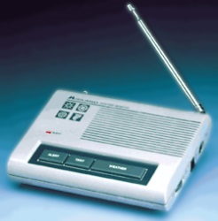
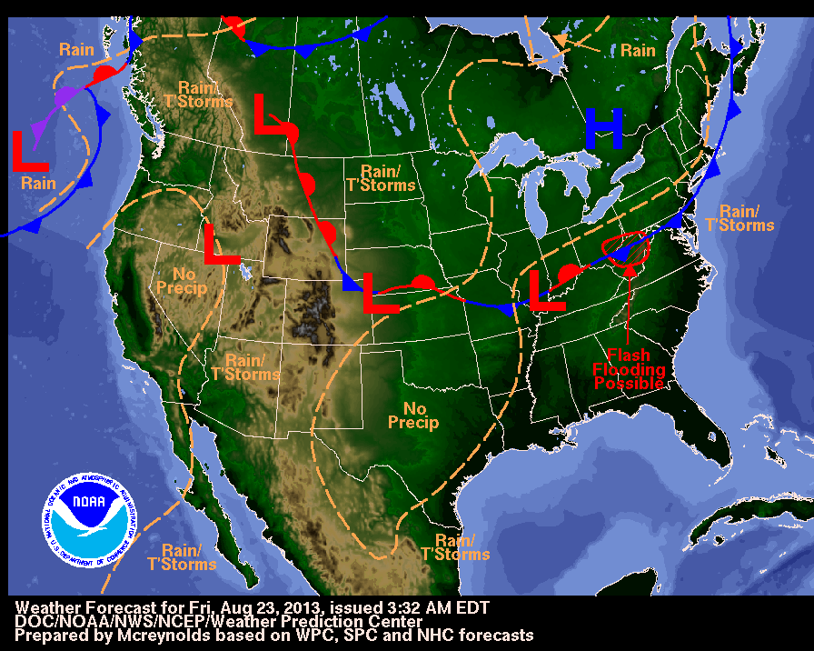
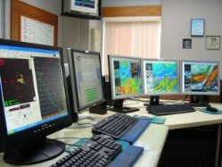


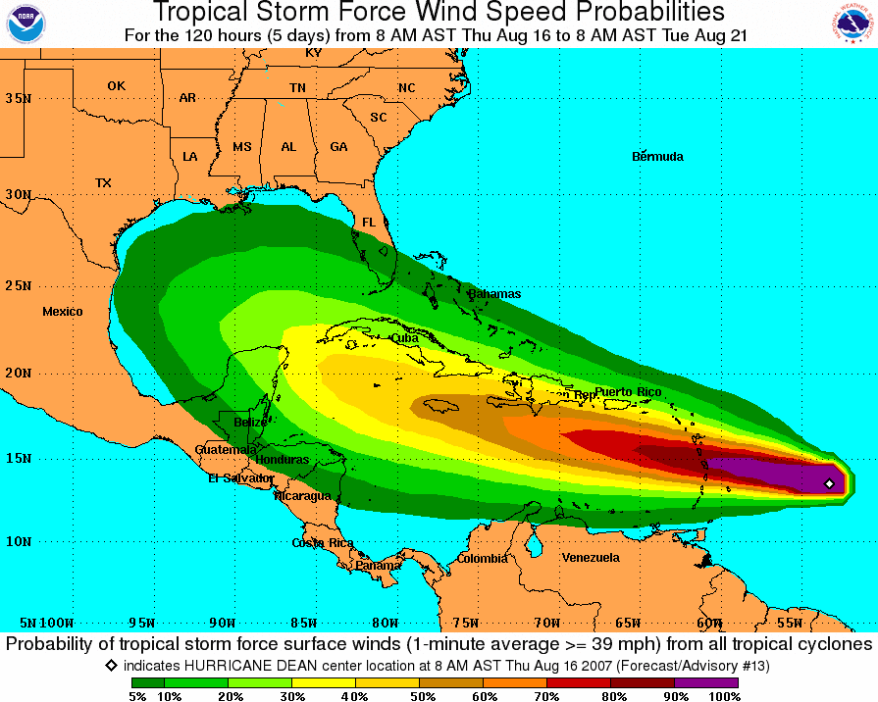
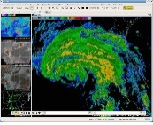
NWS Operational Forecast Process
Science &
Technology
Integration
R2O
O2R
Observations
Dissemination
Analyze, Forecast, & Support
Central
Processing
Central
Guidance
Local
Forecasts

Slide 6
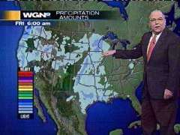
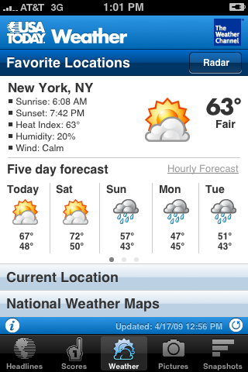



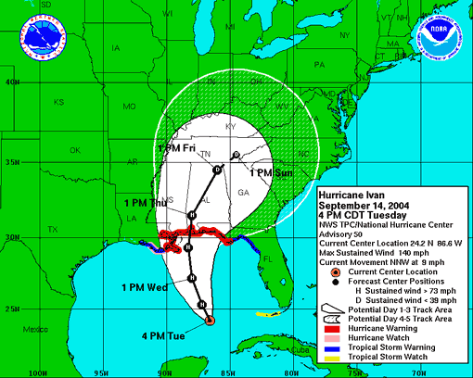
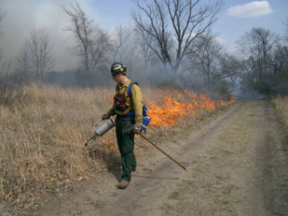
Today’s Weather Forecast
Everything you read, see or hear about weather, climate and ocean forecasts is based on numerical prediction models
Four Essential Components of the Prediction Enterprise
Global Observing System
Computers (supercomputers,
work stations)
Data Assimilation & Modeling/
Science
Forecaster Skill
Notes:
6

Slide 7
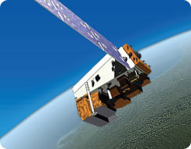
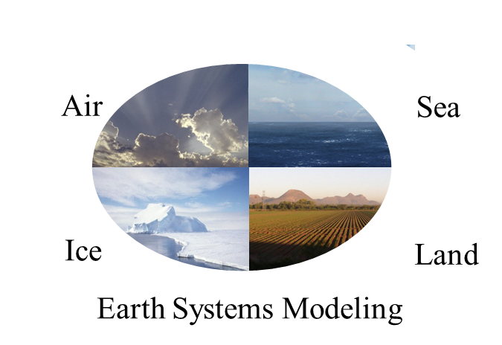

Operational Numerical
Prediction Enterprise
Observations
  ~2 billion/day
  99.9% remotely sensed, mostly from satellites
NWS Models
  Earth System model; coupled
  Global resolution (27km)
  North American resolution (4km)
NOAA Operational Computer
  2012
  Primary/backup 15 minute switchover
  73 trillion calc/sec – IBM Power 6
  2013 (transition on July 28)
  208 trillion calc/sec – IBM iDataPlex
  Intel/Linux
Forecasters: Increasingly rely on multi-model approach

Slide 8
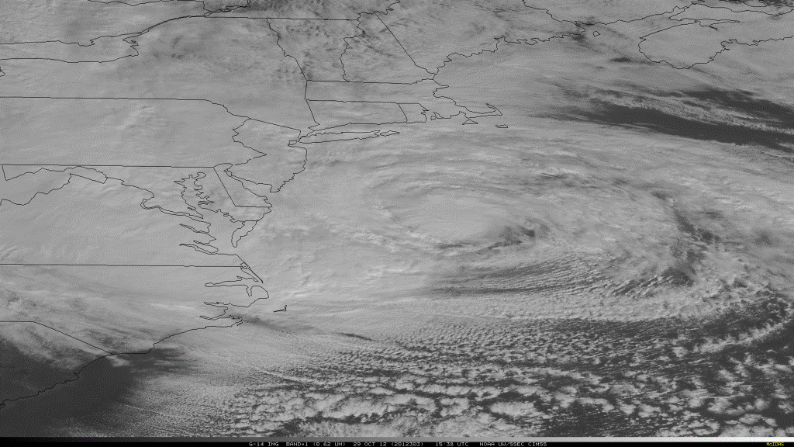
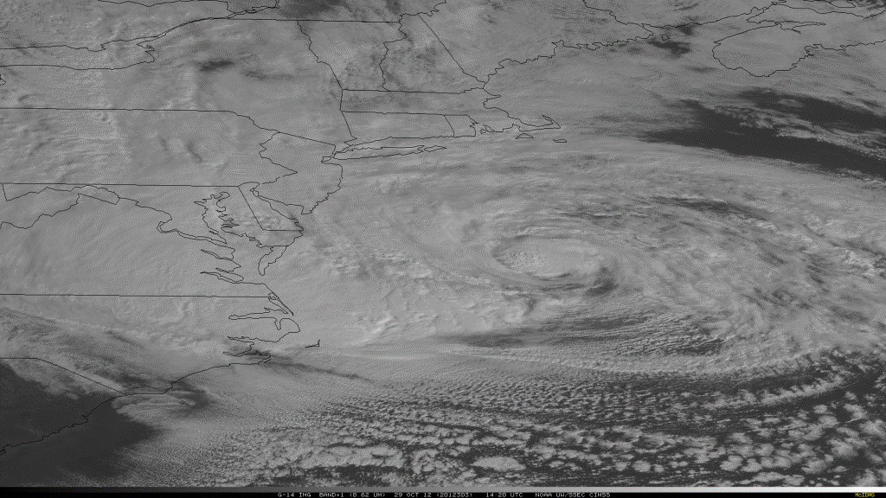


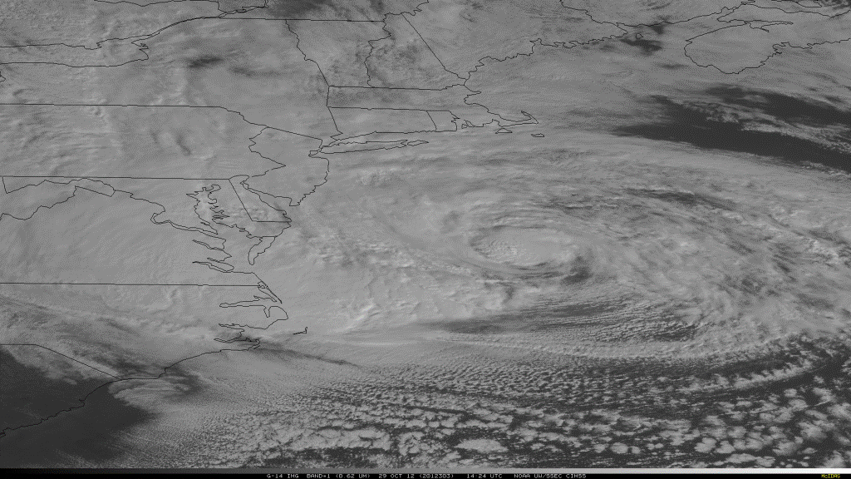
















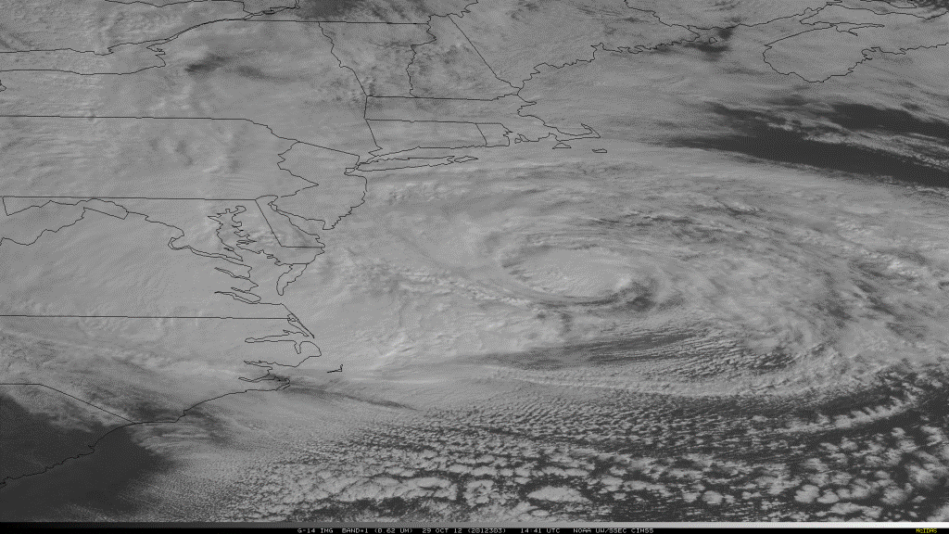
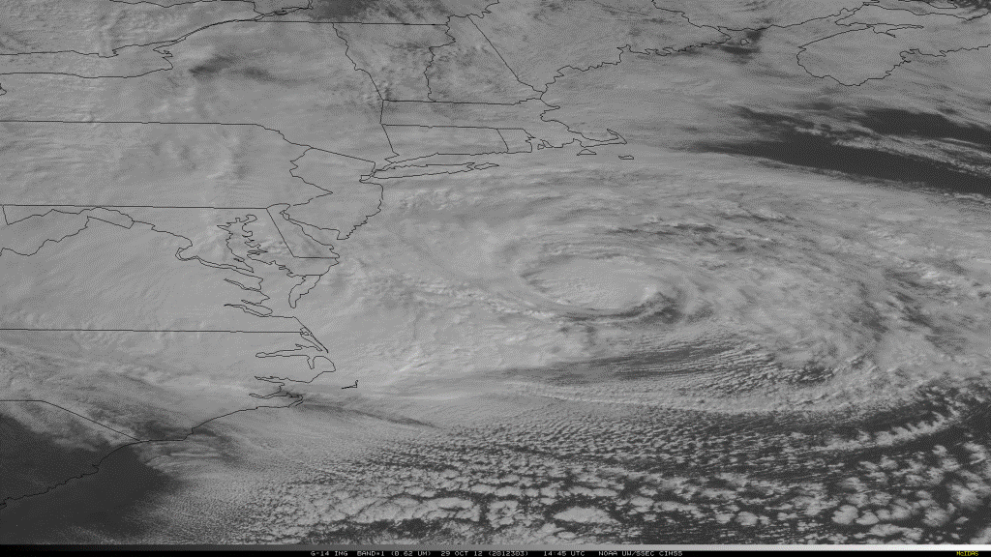
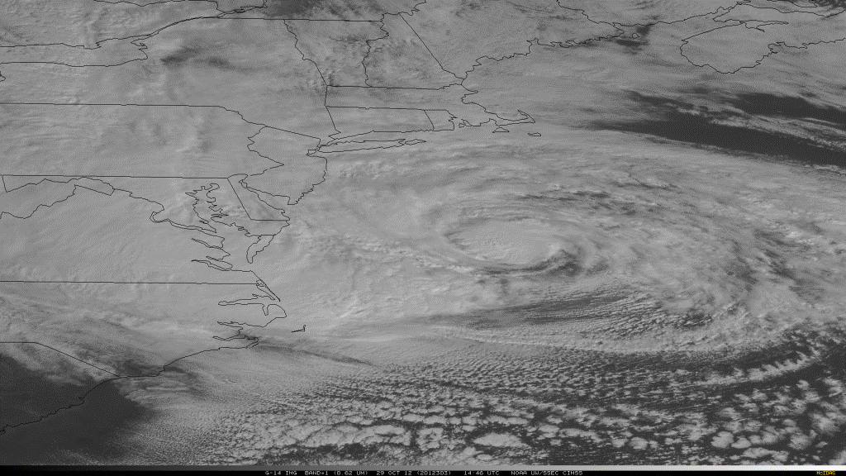










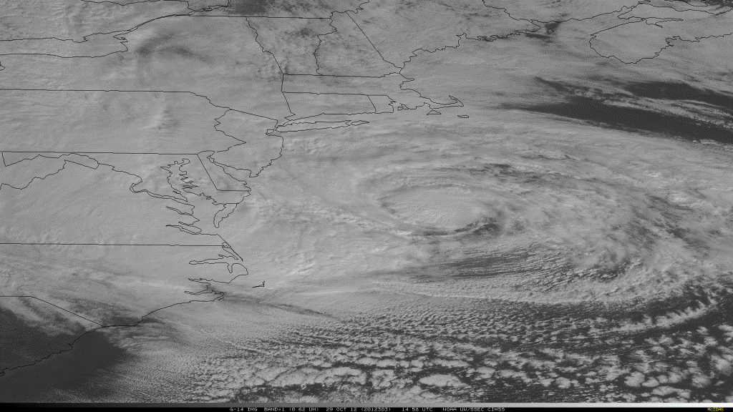

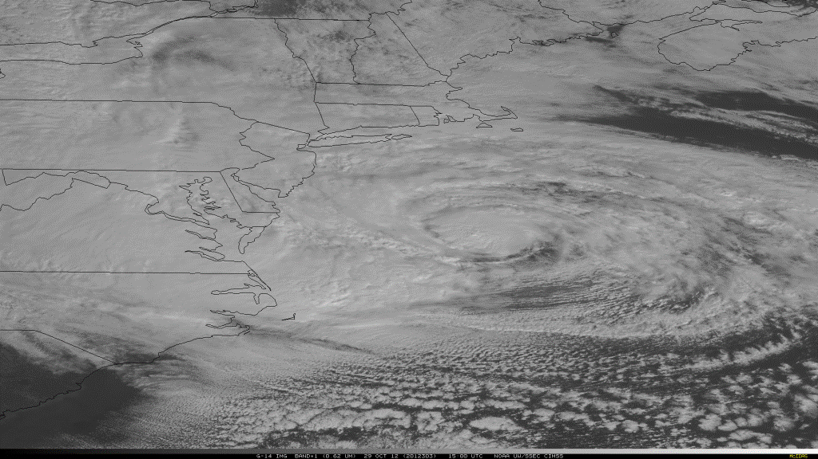






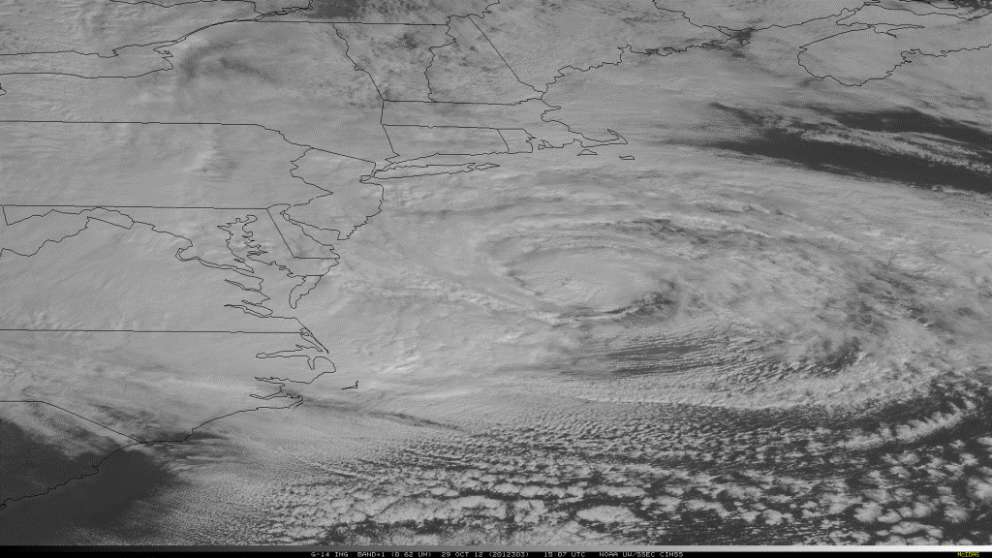
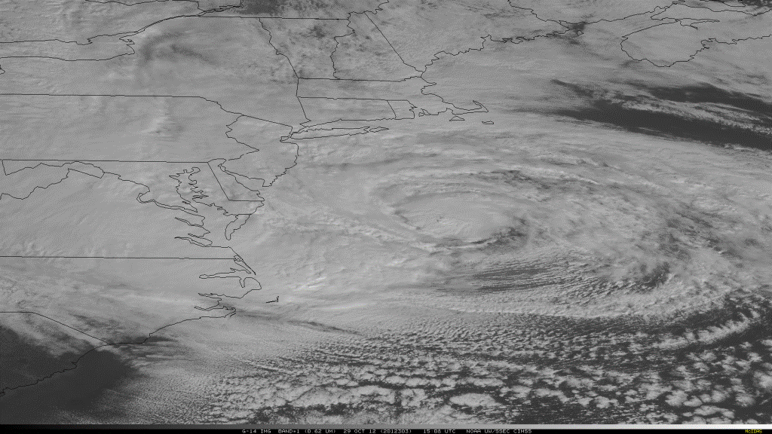
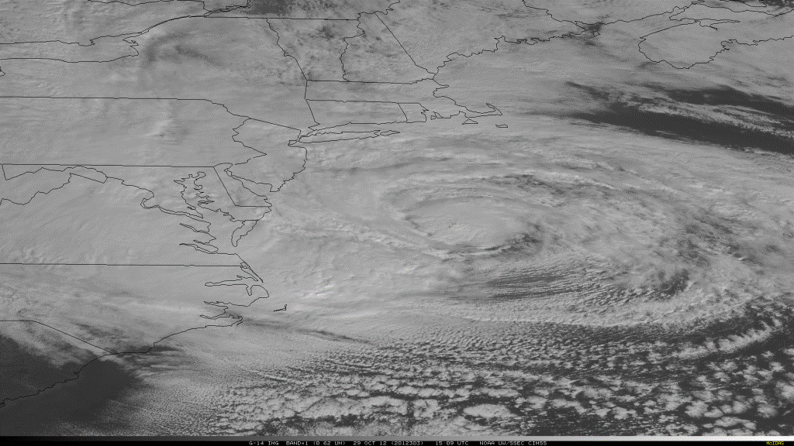




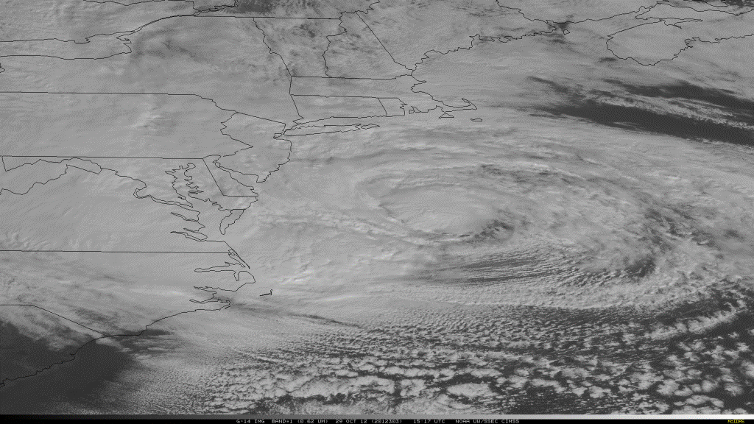

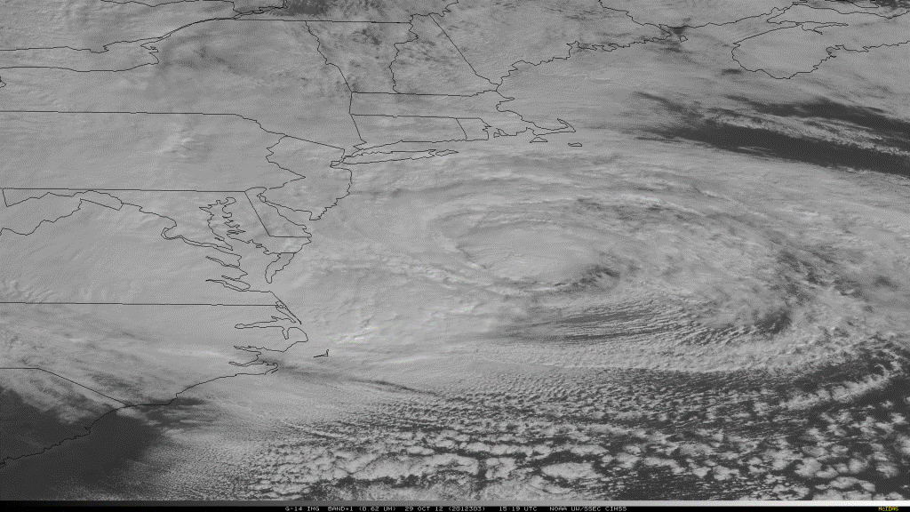













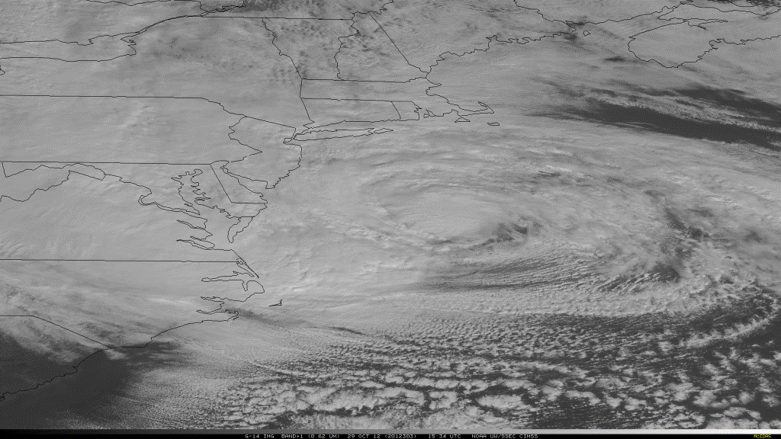



Advancing Forecast Skill
Sandy
Hurricane Sandy – GOES-14 SRSO – October 29, 2012 1430-1530 UTC
8
NOAA Satellite and Information Service: National Environmental Satellite, Data, and Information Service (NESDIS)
8

Slide 9
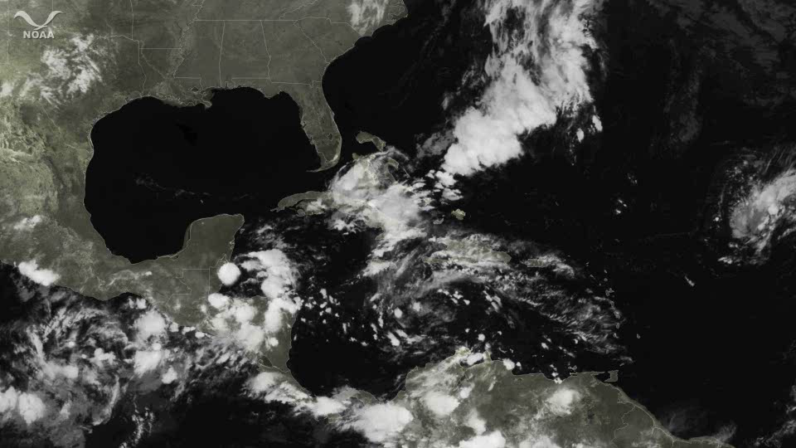
Hurricane Sandy
October 21, 2012 0345Z through October 31, 2012 1315Z
National Hurricane Center's 5 day forecast track
Issued at 11 a.m. EDT on Thursday, October 25
9

Slide 10
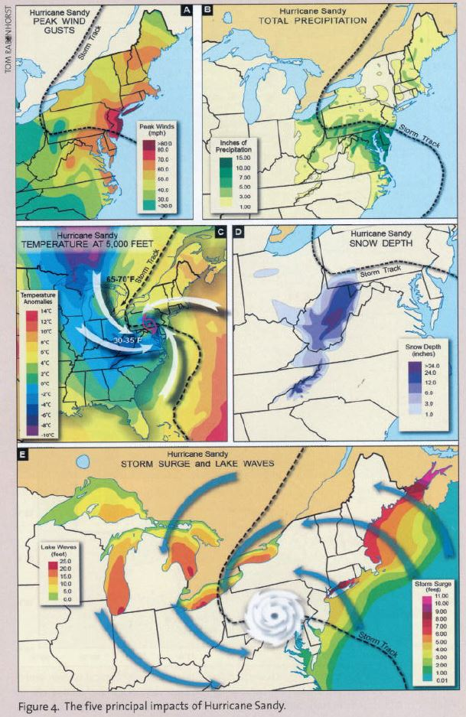
Four Principal Impacts of Hurricane Sandy
Peak Wind Gusts
Total Precipitation
Temperature at 5,000 Feet
Snow Depth
Storm Surge and Lake Waves
*Taken from March/April 2013 Weatherwise

Slide 11

Hurricane Sandy: Communication Strategy
Messaging: Impact-Based Decision Support Services
  Unique nature of storm (tropical to
  extratropical transition)
  Large area affected by strong winds
  East to west track toward NJ
  Record surge/inundation in NJ→ NYC→ SE New England
  Threats emphasized “particularly
  dangerous storm,” “worst case
  scenario” compared to the Perfect Storm
  Record blizzard in Appalachian Mountains & WV
  Forecast/Communication Strategy Saved Lives
Notes:
11

Slide 12
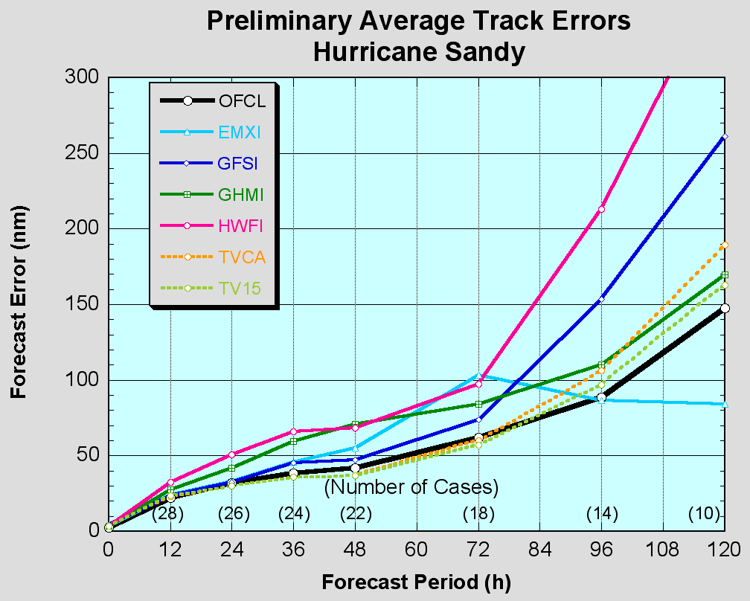
NHC Review of model performance for the entire 2012 Atlantic Hurricane Season by NHC lead hurricane forecaster Richard Pasch
“Busy season for the NHC;445 TC forecasts issued for Atlantic Basin (long term mean is ~340)”
“GFS (slightly) better than ECMWF at most forecast intervals in the Atlantic for track and was generally the best individual model; kudos to EMC”
ECMWF outperformed all models at four days and beyond

Slide 13
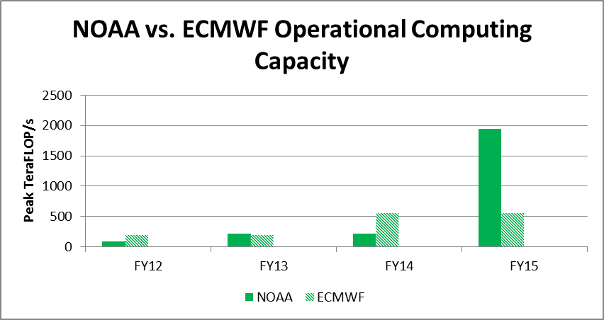
FY14 Plans:
Sandy Supplemental Augmentation
1900
73
208
208

Slide 14
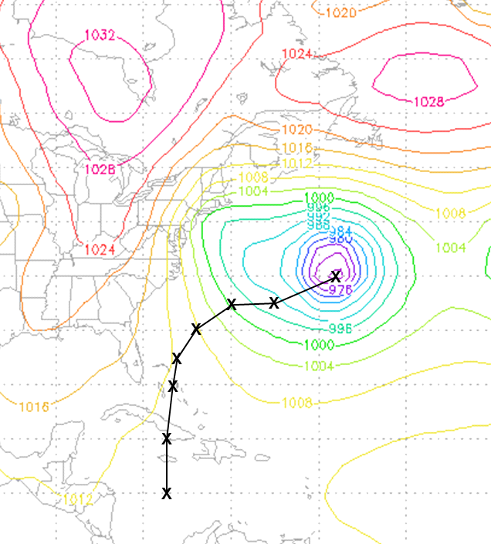
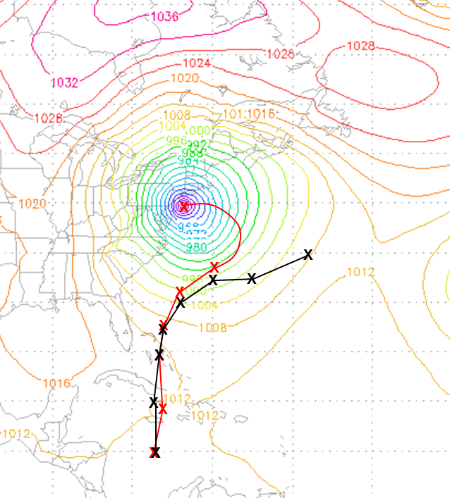
Increasing NCEP Global Model
Horizontal Resolution Improves Hurricane
Sandy Track Guidance
Model Initialized at 00UTC 24 October 2012
7-Day Sea level Pressure (mb) Forecast valid at 00UTC 31 October 2012
Hurricane Position Shown Every 24h
Operational (T574~ 27km)
Experiment (T1500~ 13km)
Note: Last 24h of the high resolution experiment track based on 6h model output
Hypothesis: Increased horizontal resolution resolves complicated Atlantic blocking pattern, slows simulated hurricane, and allows it to curve toward the East Coast

Slide 15
Current Global Observing System

Slide 16
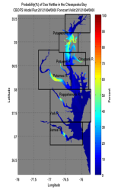
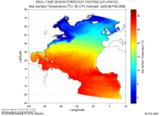
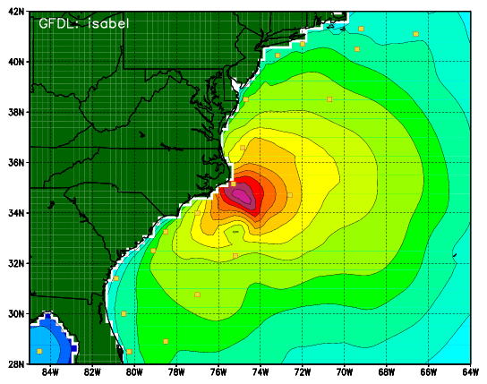
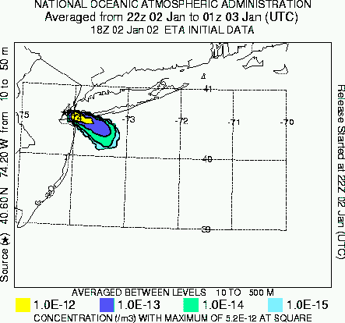
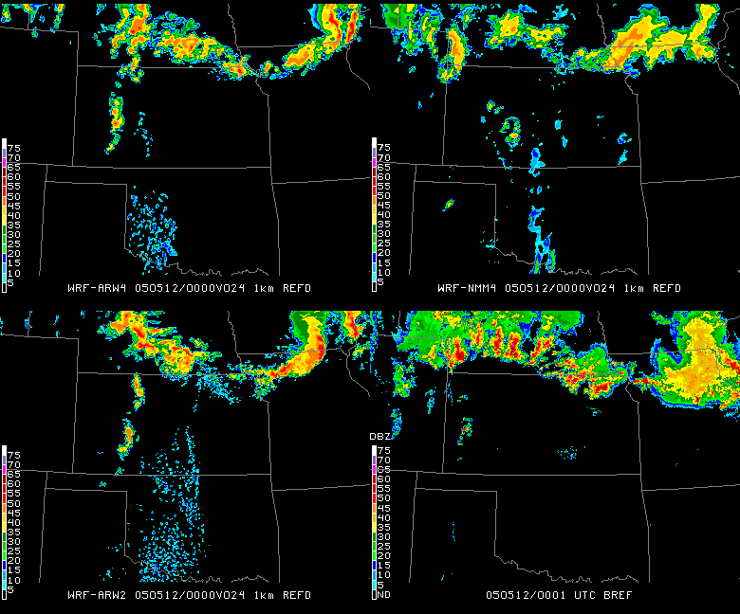
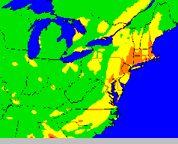
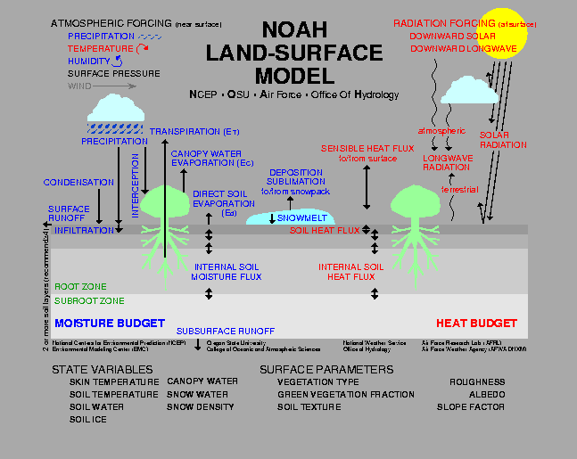
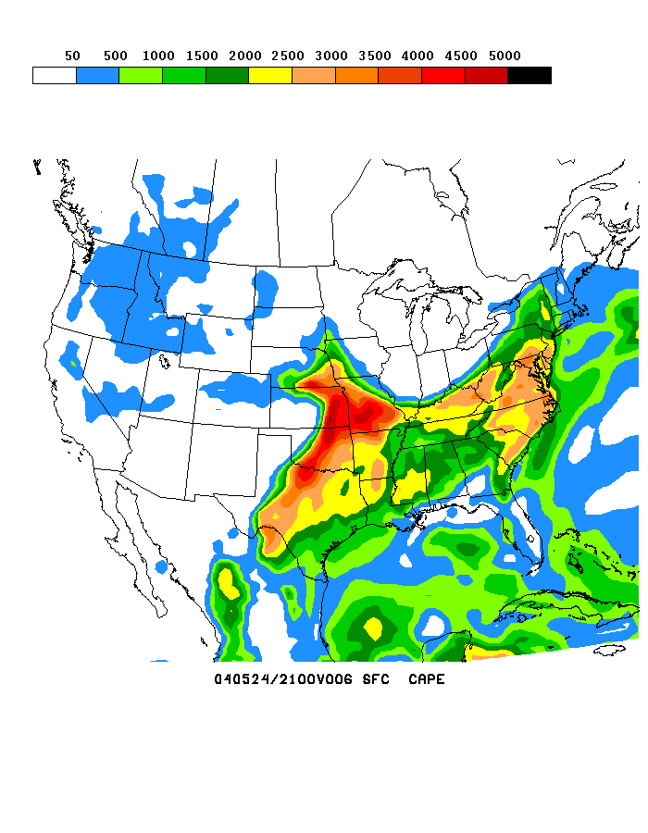
NOAA’s Model Production Suite
Climate Forecast
System
NOS – OFS
Great Lakes
Northern Gulf of Mex
Columbia R.
Bays
Chesapeake
Tampa
Delaware
Oceans
HYCOM
WaveWatch
III
GFS MOM4
NOAH Sea Ice
Hurricane GFDL
HWRF
Coupled
Sea Nettle
Forecast
~2B Obs/Day
Satellites + Radar
99.9%
Regional NAM
WRF NMMB
Dispersion
ARL/HYSPLIT
Global
Forecast
System
Regional
DA
Global Data
Assimilation
Severe Weather
WRF NMM/ARW
Workstation WRF
Short-Range
Ensemble Forecast
Space
Weather
North American Ensemble Forecast System
Regional DA
WRF: ARW, NMM
NMMB
Air Quality
GFS, Canadian Global Model
ENLIL
NAM/CMAQ
Forecast
Rapid Refresh
for Aviation
16
NOAH Land Surface Model
Notes:
16

Slide 17
Global Observations Used for NWP
In situ
  “Earth-based”
    RAOBs, sondes, aircraft, surface, gauges, ships, buoys, etc.
Remotely Sensed
  Large data volumes
  Multiple space-based sensors
    Operational
    Research
  Ground based
    Radar, lidar, etc.

Slide 18
Joint Center for Satellite Data Assimilation
  Mission: To accelerate and improve the quantitative use of research and operational satellite data in weather, ocean, climate and environmental analysis and prediction systems.
  NASA, NOAA, DoD working together
  Focus includes operational and research satellites used in operational models
  Development of common tools (Data Assimilation/GSI; CRTM …)

Slide 19
Satellite Data Used in Operational NWP
HIRS sounder radiances
AMSU-A & B sounder radiances
ATMS sounder radiances
CrIS sounder radiances
AIRS* sounder radiances
IASI sounder radiances
GOES sounder radiances
GOES, Meteosat, GMS winds
TRMM* precipitation rates
SSM/I ocean surface wind speeds
Quikscat* ocean surface wind vectors
JASON ocean surface altimetry
AVHRR SST
AVHRR vegetation fraction
AVHRR surface type
Multi-satellite snow cover
Multi-satellite sea ice
SBUV/2 ozone profile & total ozone
MODIS* polar winds
GPS Radio Occultation
  COSMIC, METOP/GRAS, CNOFS, GRACE,* SAC-C*, TerraSAR-X*
SSMIS
OMI*
AMSR/E*
MSG SEVIRI
* Indicates Research Satellite or Sensor

Slide 20
Measuring Impact of Observations
Forecast System Diagnostics
  i.e. Adjoint method
Observation System Experiments (OSEs)
  Statistically based Data Denial, Data Addition
Case Studies
  Data denial studies
Observation System Simulation Experiments (OSSEs)

Slide 21
Operational ECMWF system September to December 2008. Averaged over all model layers and entire global atmosphere. % contribution of different observations to reduction in forecast error.
Note:
1) Sounders on Polar Satellites reduce forecast error most
2) Results are relevant for other NWP Centers, including NWS/NCEP
Forecast error contribution (%)
Courtesy: Carla Cardinali
and Sean Healy, ECMWF
Notes:
21

Slide 22
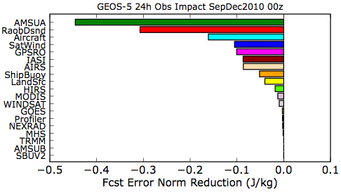

Impact of Various Observing Systems in GEOS-5
01 Sep – 31 Dec 2010 00z
Total Impact
AMSU-A radiances have
the largest impact globally,
but conventional data
(raob, aircraft) still very
important. GPSRO now a
significant contributor.
Impact Per Observation
Raobs get large weight in
the analysis and have large
IPO. Ship obs are few, but
are located where there
are few other in-situ data.
Total Impact
beneficial
Impact Per Observation

Slide 23


500 hPa Anomaly Correlations
15 Aug – 30 Sep 2010
Importance of Satellite Data (OSE)
No Satellite / No Conventional Data
Northern Hemisphere
Southern Hemisphere

Slide 24
Summary of NCEP Data Denial Studies
(No Polar Satellite in P.M. Orbit)
Case Study | Findings
Case 1: “Snowmageddon” Storm February 2010 | Data denial runs significantly degraded; Experiment predicted a less intense storm, slightly further east and producing ½ of precipitation at 5, 4, 3 days before the event; in DC and Mid-Atlantic coast, model data denial runs did not forecast this paralyzing event and under-forecasted snow by at least 10 inches
Case 2: NYC and Blizzard December 2010 | Data denial runs significantly degraded; Experiment under-predicted the storm that hit the NY area. The coastal low pressure was much weaker and the storm track was shifter further to the east well offshore of the NYC and New England areas resulting in less precipitation and snowfall for the area at 5, 4, 3 days before the event
Case 3: Northern Pacific Alaskan Coastal Storm – April 2011 | Data denial runs largely unchanged
Case 4: Tornado Outbreak April 14-16, 2011 | Data denial runs largely unchanged
Case 5 – Tornado Outbreak April 25-28, 2011 | Data denial runs largely unchanged
Case 6 – Hurricane Irene August 2011 | Data denial runs largely unchanged
Case 7 – Hurricane Katia August 2011 | Data denial runs produced a slightly degraded forecast; the track and center of the storm was consistently further East than the Operational forecast

Slide 25



Forecasts of Hurricane Sandy without polar satellites
ECMWF forecasts of Mean Sea Level Pressure, 5 days in advance of the 30th October 2012 for the landfall of Hurricane Sandy. Forecasts from an assimilation system with no polar satellites fail to predict the landfall of the storm on the US east coast.
ECMWF OPS
NO POLAR SAT
VERIFICATION
5 day forecast: Base time 2012-10-25-00z Valid Time: 2012-10-30-00z

Slide 26
Ongoing Efforts to Improve Forecast Capabilities
Priorities for the Global Observing System
Operational: JPSS, GOES-R
Research: GPM, SMAP
Assessments and implementation recommendations through JCSDA

Slide 27

Priority Research Satellites:
Global Precipitation Mission

Slide 28
GPM Extends Current Capability
GPM Core
  Unique primary sensors
    GPM Microwave Imager (GMI – contributed by NASA)
      13 channel (10-183 GHz) conically scanning radiometer
        Successor to TRMM TMI
      Enhancement for cold season precipitation over land
    Dual-frequency Precipitation Radar (DPR – contributed JAXA)
      Ka/Ku band radar
        Successor to TRMM PR
      Dual frequency helps improve vertical structure of precipitation
      Dual frequency improves sensitivity to lighter precipitation

Slide 29
TRMM vs. GPM
TRMM vs. GPM
General |  | TRMM | GPM
 | Orbit Altitude | 350 km | 407 km
 | Inclination Angle | 35˚ | 65˚
 | Revisit Frequency | 11-12 hrs | 3hrs
 | Track Speed | 6.9 km/s | 7.2 km/s
 | Coverage | Tropics | Global
Microwave Imager
 | Swath | 758.5 km | 885 km
 | Incident Angle | 52.8˚ | 52.8˚
 | Number of Channels | 9 | 13
Precipitation Radar
 | Swath | 215 km | 245 km
 | Number of Channels | 1 | 2
 | Spatial Resolution | 4.3 km | 5 km
 | Range Resolution | 250 m | 250, 500 m

Slide 30


GPM Data Use in NWS
GPM will provide
  Precipitation Processing System (PPS)
    Transitioning NASA’s research to NOAA’s operations – (Enterprise PPS) – Data Fusion
    Anchor for multi-satellite precipitation products
      GOES and LEO
    Anchor for multi-sensor precipitation products
        Satellite, radar, gauges
        TPW River example
  Inter calibrated radiances
    For NWP data assimilation
    Enhanced CMORPH for Land surface forcing of NWP
GPM Core Satellite Launch Feb 2014
SSM/I satellite 7 Nov 2006
From Neiman et al. in Mon. Wea. Rev., 2008

Slide 31
Challenges to the Next Group of Research Satellites
Making new research satellites relevant to improving operational models is becoming more difficult
  More satellite data within current observational data
  New operational satellites (JPSS, GOES-R) will raise the bar
Unique aspects of GPM and SMAP will put interesting demands on data assimilation groups. Start working with them now! Not after launch.
Results/decisions now linked to the provision of decision support services, not just 500 mb scores.

Slide 32
Summary
Historic improvement of weather forecasting into week 1 timeframe, especially for extreme events
Four essential components of the prediction enterprise:
  Global Observing System
  Computers (supercomputers,
  work stations)
  Data Assimilation & Modeling/
  Science
  Forecaster Skill
Need a balanced approach to advance the entire enterprise toward a Weather-Ready Nation
Satellites/LEO provide the backbone of the Global Observing System
Future—JPSS/GOES-R raises the bar
Highest priority research satellites: GPM/SMAP
  Will be assessed in operational models through the Joint Center for Satellite Data Assimilation
Results will be measured in terms of forecast improvements and provision of decision support services

Slide 33
Questions?
Thank you for your interest in building a Weather-Ready Nation.
Your contributions are vital.

Slide 34

Example: Hurricane Forecasting
National Hurricane Center’s biggest forecast challenge is rapid intensity change
New satellite data will be used to improve Tropical Cyclone intensity forecast models
  Sounding data from ATMS and CrIS
  High res Atmospheric Motion Vectors (AMV winds) from GOES-R
  GPM QPE

Slide 35


Future Emphasis: JPSS
Leverage S-NPP
  ATMS
    SDRs in GFS 5/22/12
  CrIS
    SDRs in GFS 8/20/13
    Note low noise (below)
  VIIRS
  OMPS

Slide 36

Future Emphasis: GOES-R
Advanced Baseline Imager (ABI, right)
  16 Channels (vs 5 GOES)
    0.5 – 2 km resolution
  Full Disk – 4 per hour
  CONUS – 12 pre hour
  Mesoscale – 30 seconds
Global Lighting Mapper
Space Wx Sensors
High refresh and low latency
Push for Hybrid 4D Data Assimilation
Investigating assimilation of ABI
radiances in case of S-NPP to JPSS gap

Slide 37


Priority Research Satellites:
Soil Moisture Active Passive
Active
  High-resolution radar over land
Passive
High-resolution radiometer
Instantaneous soil moisture
  More direct, integrated SM
  Enhanced CPC-MORPH for land forcing of NWP

