Slide 1
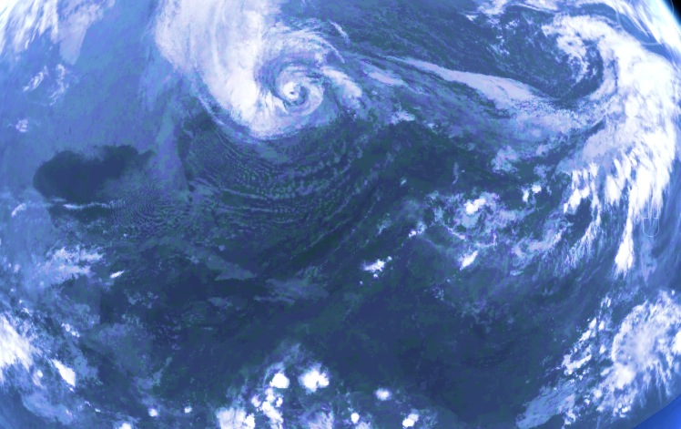
The GPM mission – an invaluable source for model evaluation and forecast improvement:
Focus on the high-resolution hurricane models
S. Hristova-Veleva, P. P. Li , F. J. Turk,
B. Knosp , Q. Vu, W. Poulsen, T.-P. Shen,
B. Lambrigtsen, Z. Haddad, S. Tanelli, N. Niamsuwan
November 12th, 2013

Slide 2

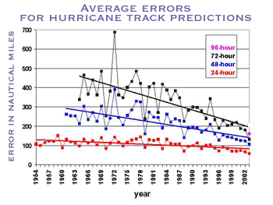
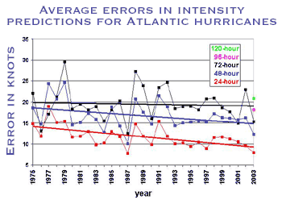
Current state-of-the-art hurricane prediction
25% reduction in 48 hour track error over the past 6 years
Intensity forecasts have not improved.
But WHY ???
  What are the sources of the intensity errors?
  Do the models properly reflect the physical processes and their interactions?
    Is the representation of the precipitation structure correct?
    Is the storm scale and asymmetry reflected properly
    Is the environment captured correctly
    Is the interaction between the storm and its environment represented accurately
Recognizing an urgent need for more accurate hurricane forecasts, NOAA recently established the multi-agency 10-year Hurricane Forecast Improvement Project (HFIP).
1/8/09
Graphs: Hurricane Research Division
Notes:
2

Slide 3
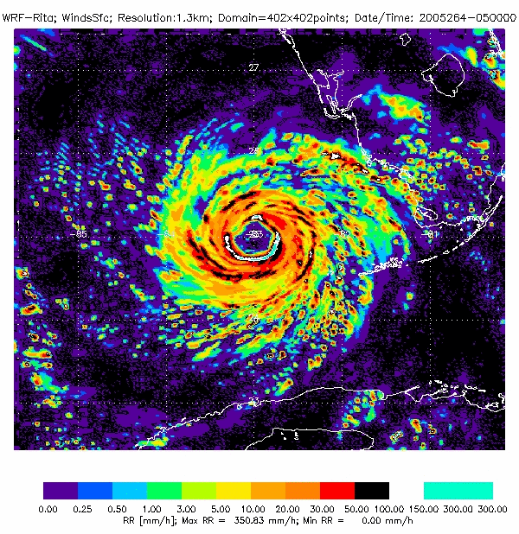
Inner-core dynamics are important
Need to properly reflect small scale complex processes
  Using high-resolution models
  With realistic physical parameterizations
Model Simulations
RITA, September, 2005
Note:
Small scale features
With high variability in time
To validate such models we need
High-resolution observations
With frequent coverage
That see through the clouds
GPM is uniquely capable of providing such information through:
A constellation of PMW satellites for rapid revisit time
The GPM core satellite with
  Higher-resolution PMW
  Dual-frequency precipitation radar for detailed vertical structure

Slide 4
Geostationary IR provides frequent observations
….. but does not see through the clouds
HS3 Portal – NRT in 2012, Atlantic (http://hs3.jpl.nasa.gov)
The Power of the Satellite Observations

Slide 5
The Power of the constellation of Satellite Observations
HS3 Portal – NRT in 2012, Atlantic (http://hs3.jpl.nasa.gov)
The Power of the Satellite Observations

Slide 6
GPM - “Painting the world in microwave”
The Power of the constellation of Satellite Observations

Slide 7
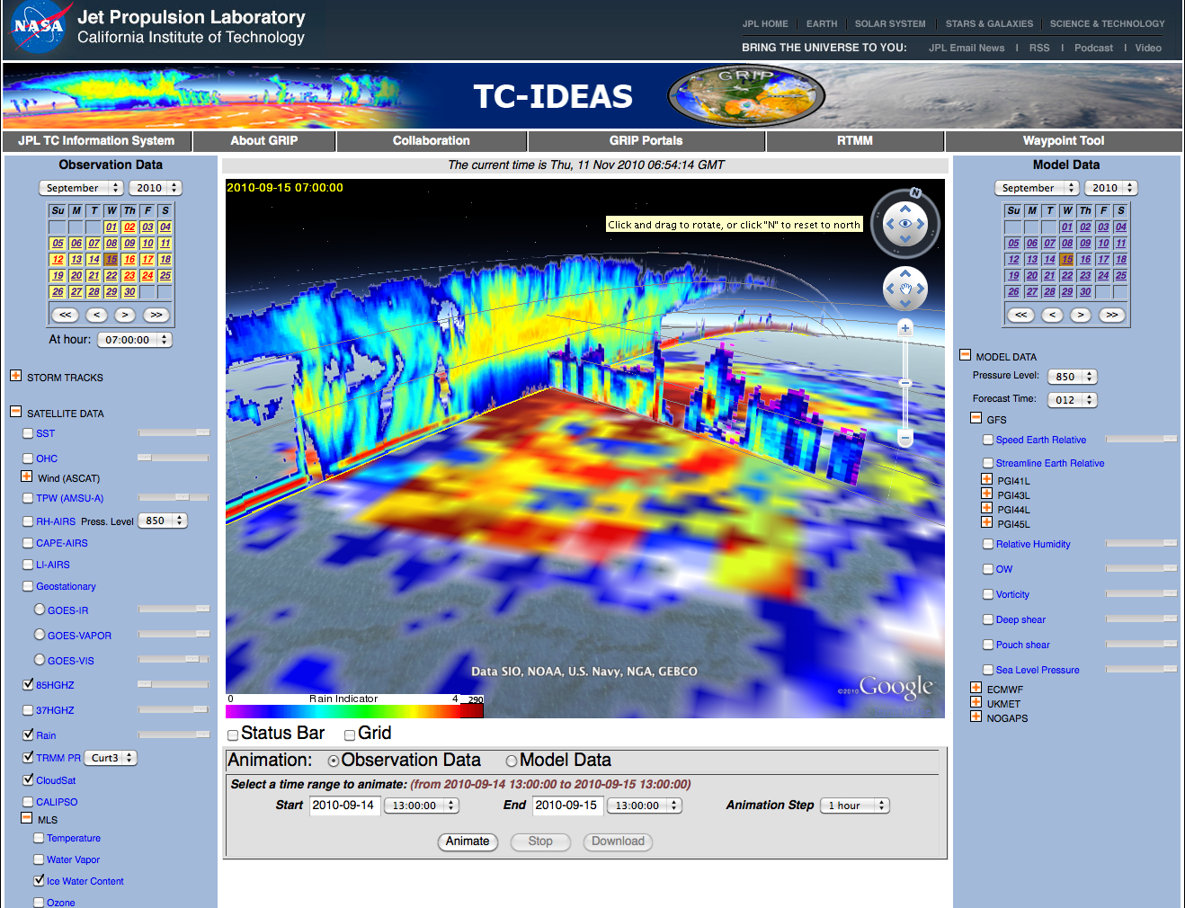
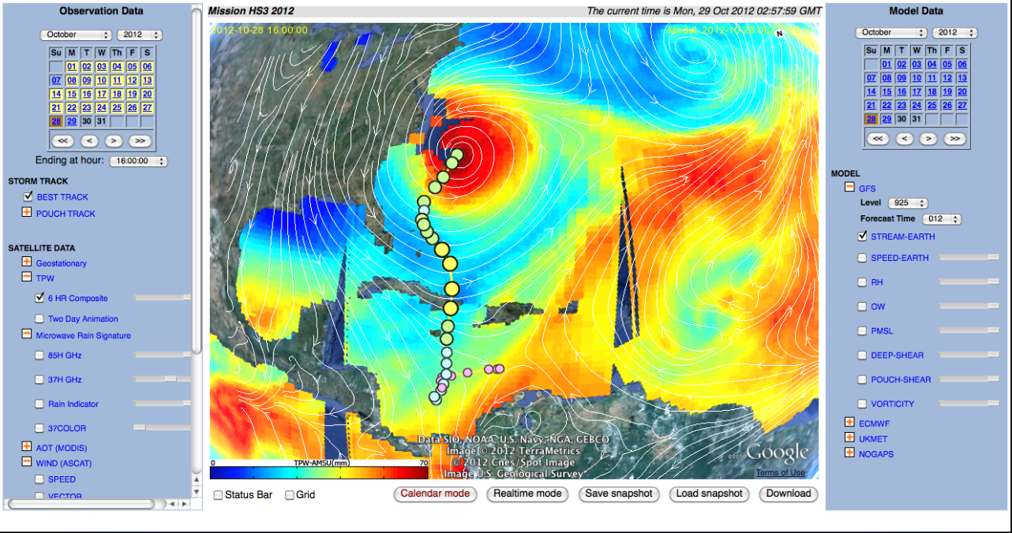
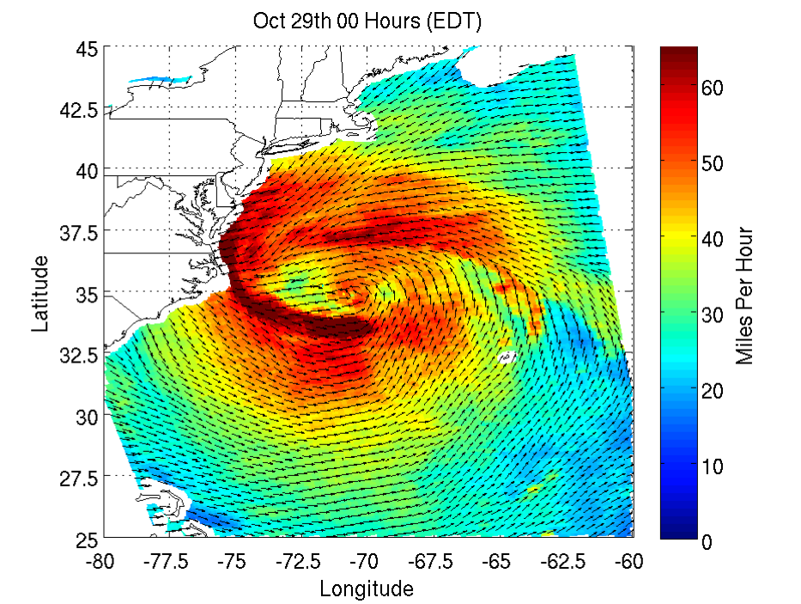
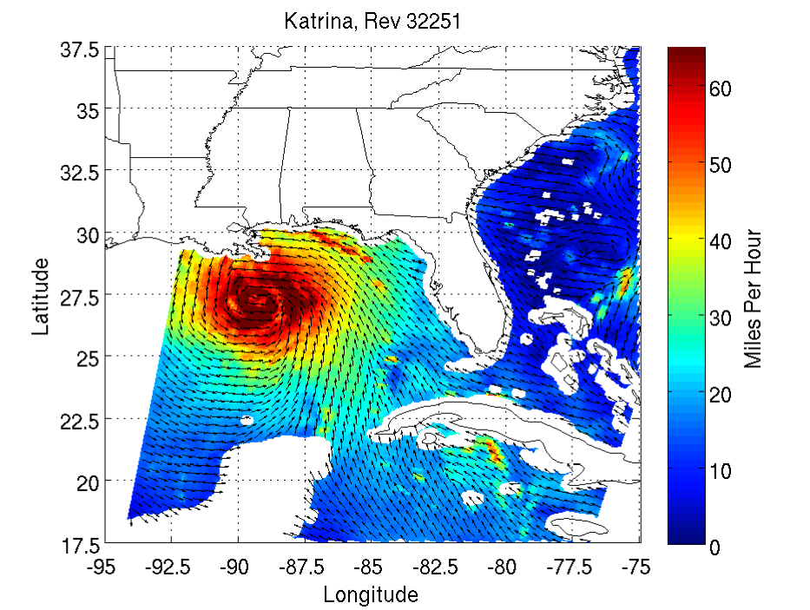
The critical pathways to hurricane forecast improvement
    Is the representation of the precipitation structure correct?
    Is the environment captured correctly?
    Is the interaction between the storm and its environment realistic?
  Validation and improvement of hurricane models through the use of satellite data
  Development and implementation of advanced techniques for assimilation of satellite observations inside the hurricane core.
Despite the significant amount of satellite observations today, they are still underutilized in hurricane research and operations, due to complexity and volume.
CloudSAT
TRMM
    Is the storm scale and asymmetry reflected properly?
Hurricane Sandy
As seen by the
ISRO’s OSCAT
Hurricane Katrina
As seen by the
NASA’s QuikSCAT

Slide 8
How to use the data
for model evaluation ?

Slide 9
How to Evaluate the Models
Focus on the microphysics
In situ microphysical observations to distinguish between different modeling approaches and improve on the most promising ones.
These point measurements cannot adequately reflect the space and time correlations characteristic of the convective processes.
An alternative approach to evaluating microphysical assumptions is to use multi-parameter remote sensing observations.
In doing so, we could compare modeled to retrieved geophysical parameters. The satellite retrievals, however, carry their own uncertainty.
To increase the fidelity of the evaluation results, we should
  bring model and observations into a common analysis system
  use instrument simulators to produce satellite observables from the model fields and compare to the observed.
  Improve model forecast through data assimilation that also uses the instrument simulators

Slide 10
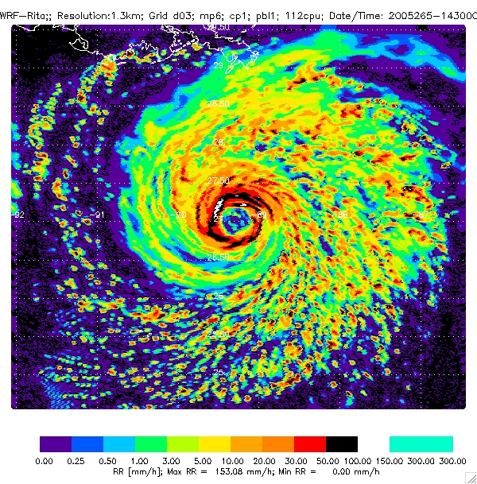
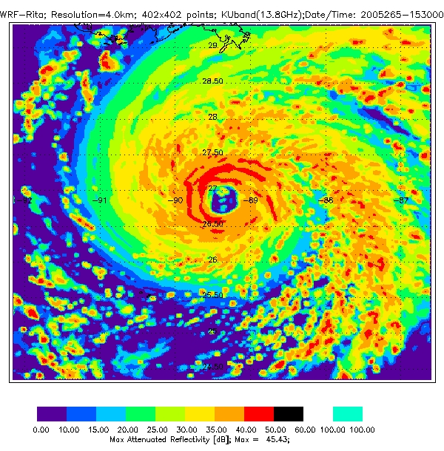
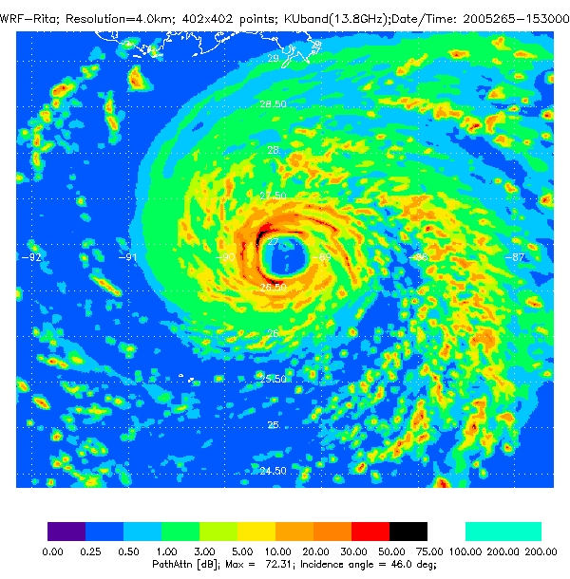
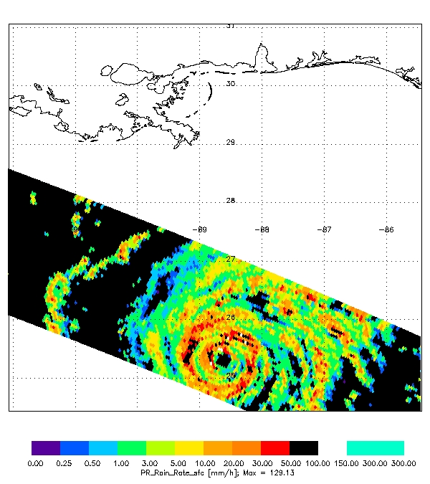
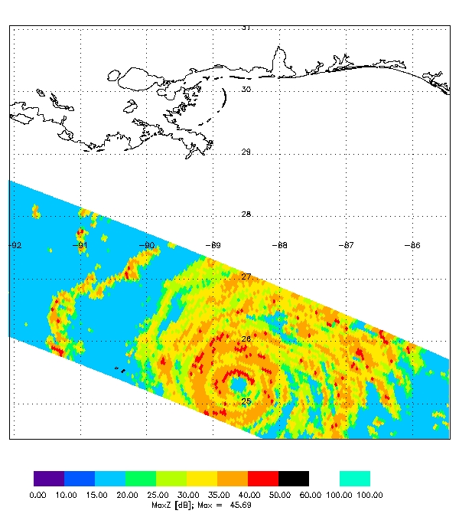
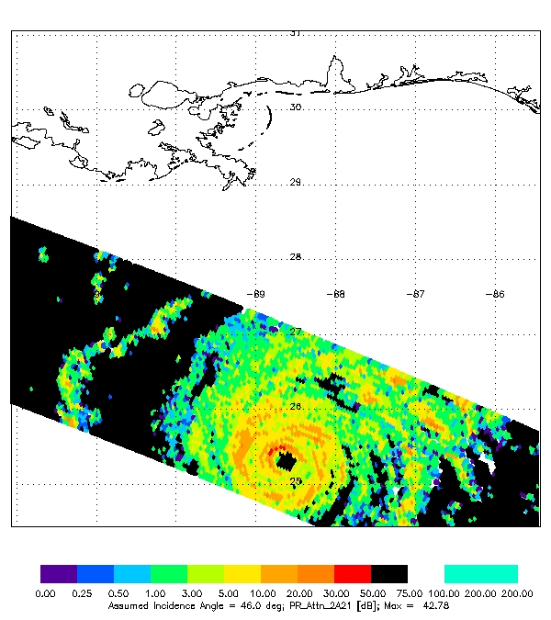
Instrument Simulators (like NEOS³)
for model evaluation and mission design
WRF - Rain Rate
WRF - max reflectivity
WRF - Path Attenuation
KU band - Rain Backscatter
C band - Rain Backscatter
TRMM
Rain Rate
TRMM
max reflectivity
TRMM
Path Attenuation
Notes:
10

Slide 11
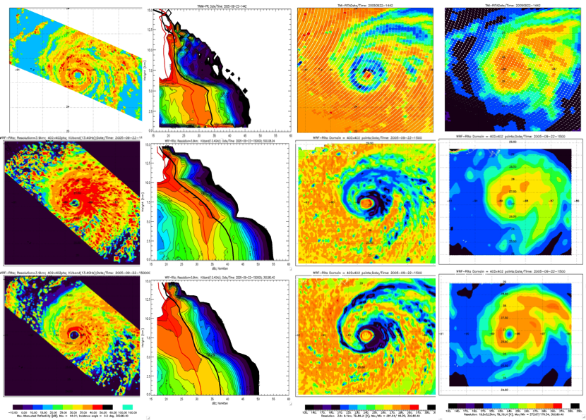
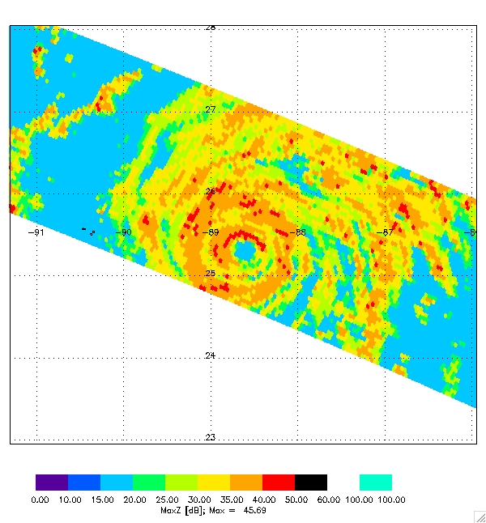
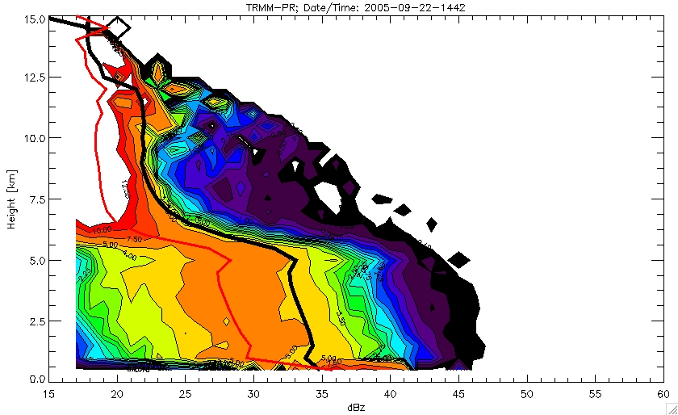
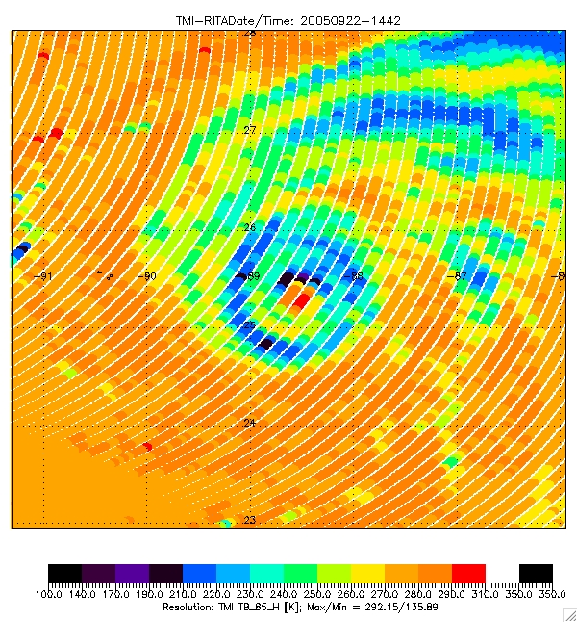
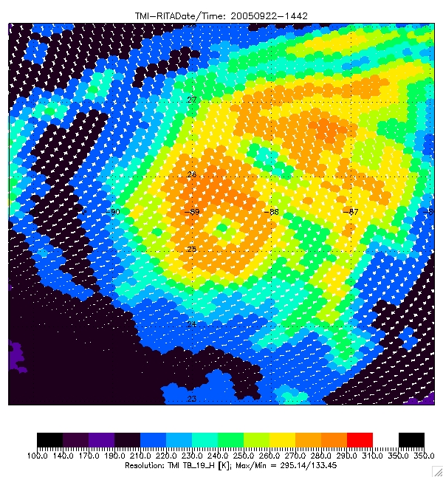
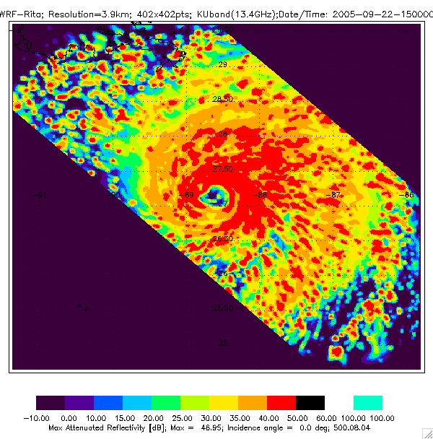
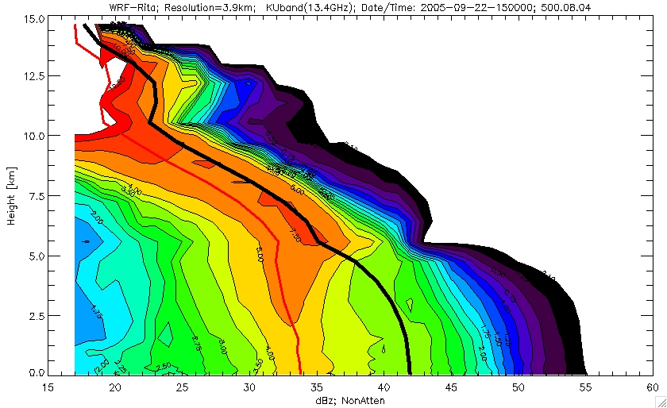
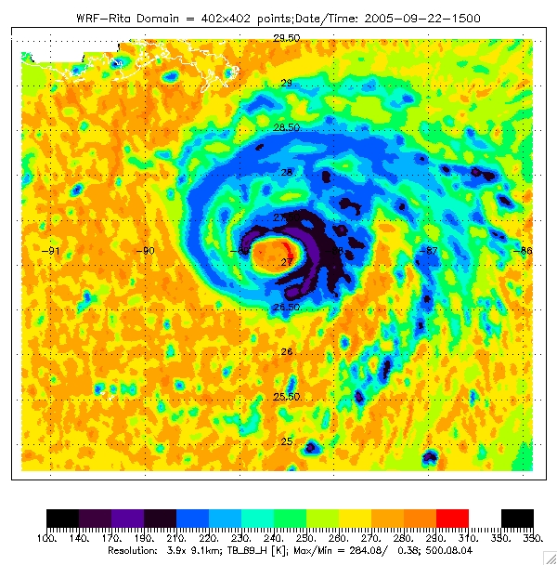
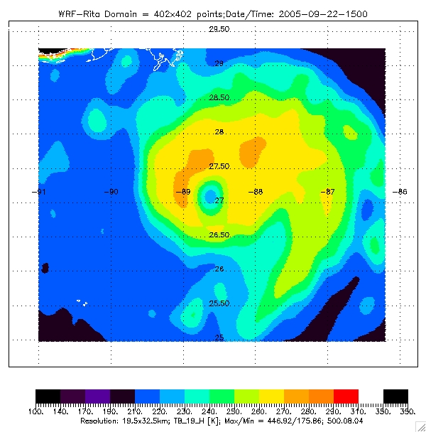
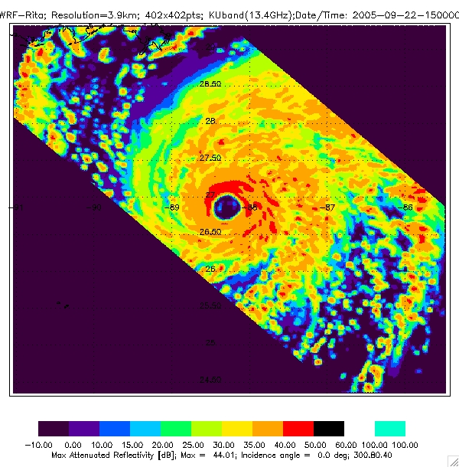
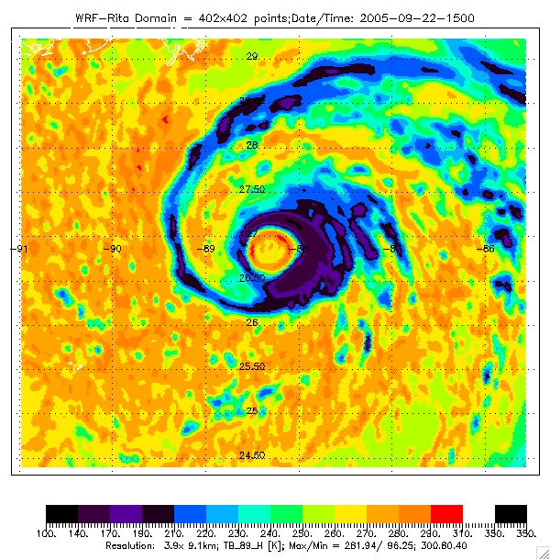
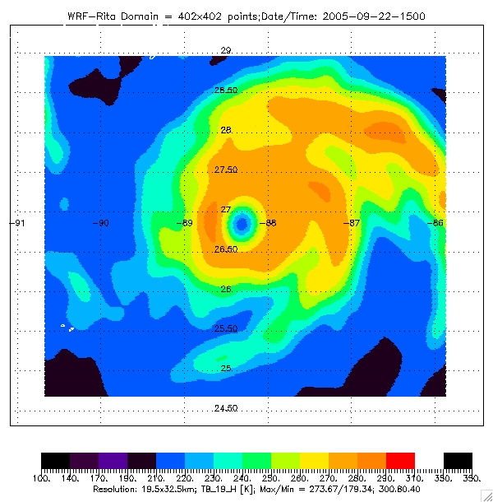
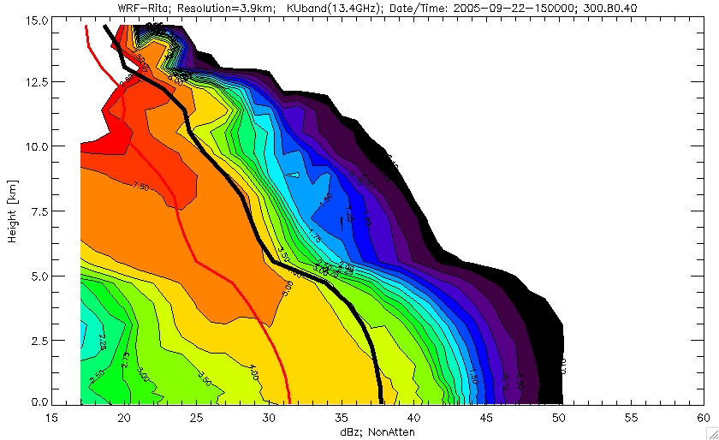
Example of MODEL EVALUATION – the Microphysics
- Individual model forecast versus individual storm observation
Max dBz
CFAD dBz
85 GHz
19 GHz
TRMM
WRF
WSM3
WRF
WSM6
New PSD
Max Attn Reflectivity
CFAD Reflectivity
85 GHZ Hpol
19 GHZ Hpol
TRMM-PR
TRMM-TMI
TRMM-TMI
TRMM-PR
TRMM-PR
TRMM-PR
TRMM-PR
WRF-WSM3
WRF-WSM3
WRF-WSM3
WRF-WSM3
WRF-WSM3
WRF-WSM3
WRF-WSM3
WRF-WSM6
New PSD
WRF-WSM6
New PSD
WRF-WSM6
New PSD
WRF-WSM6
New PSD
WRF-WSM6
New PSD
WRF-WSM6
New PSD
WRF-WSM6
New PSD

Slide 12
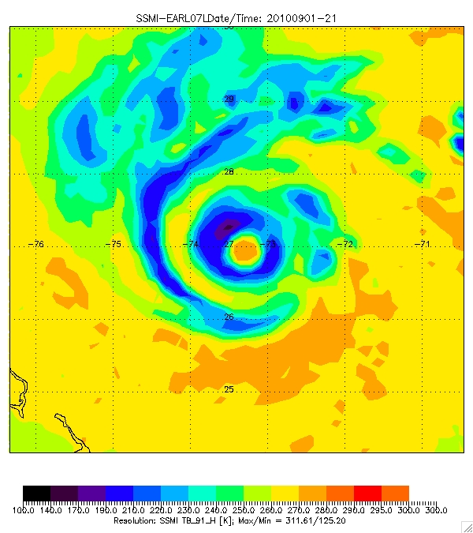
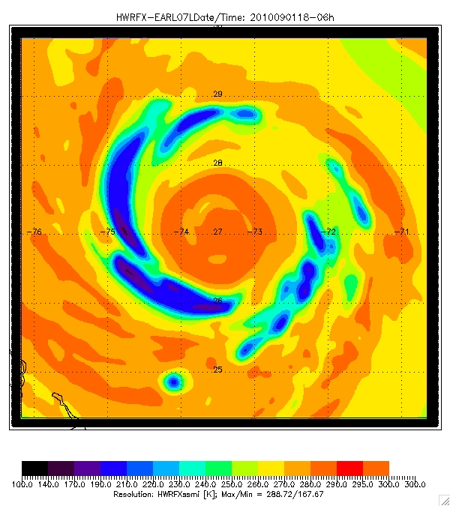
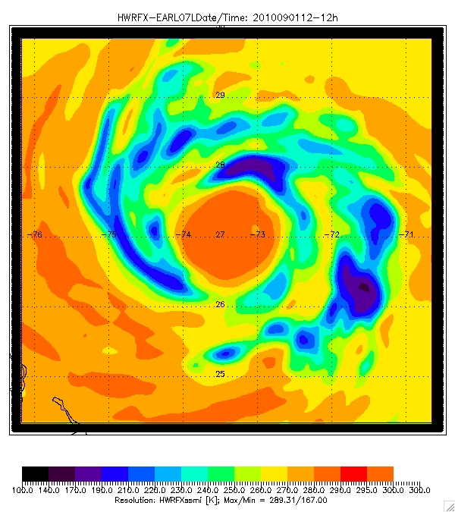
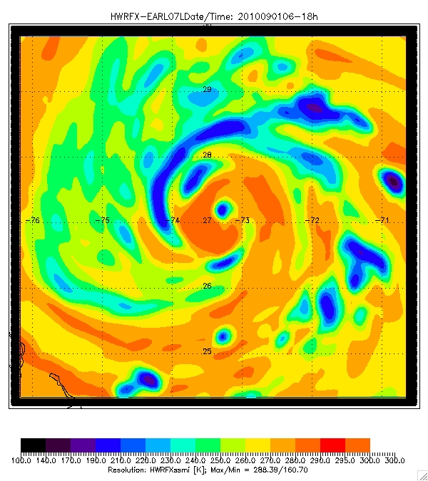
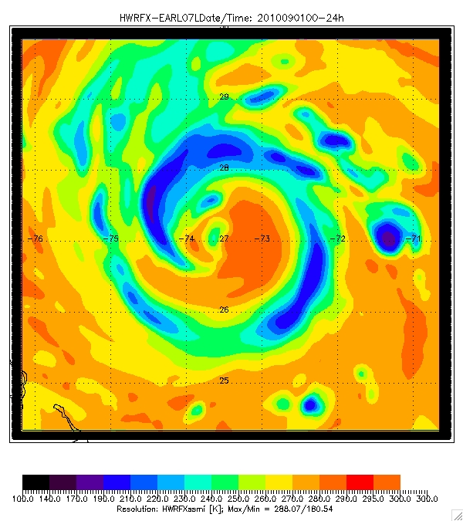
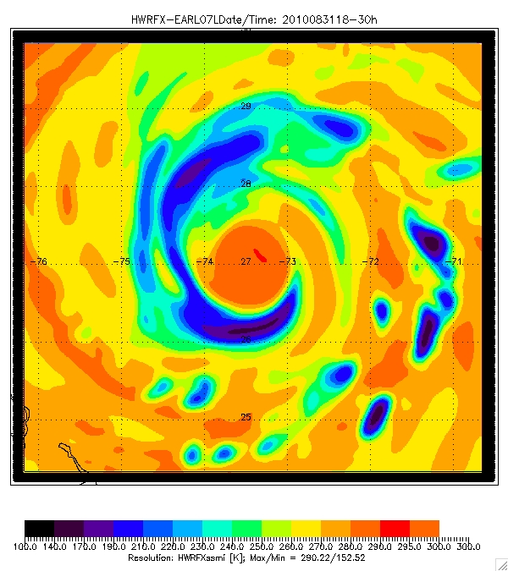
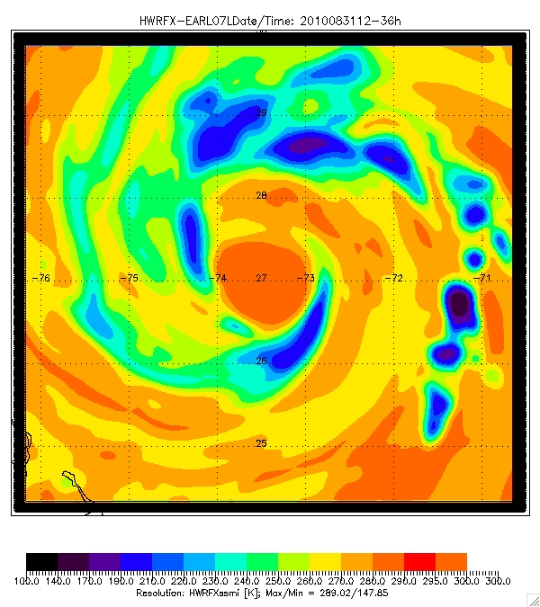
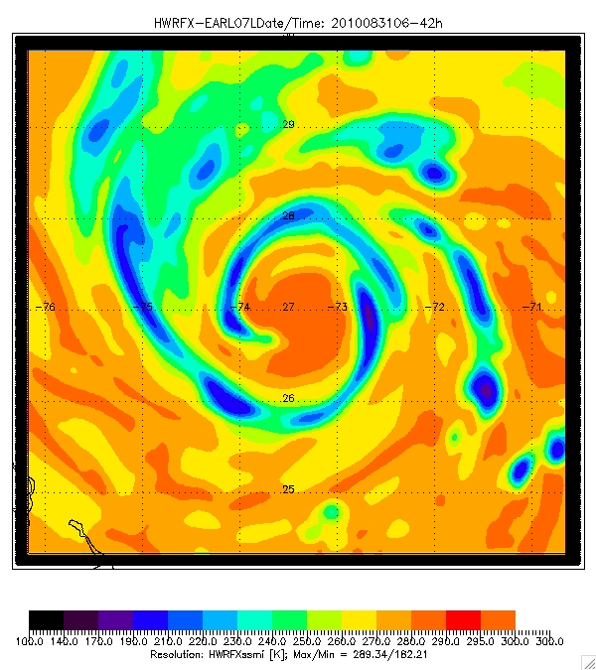
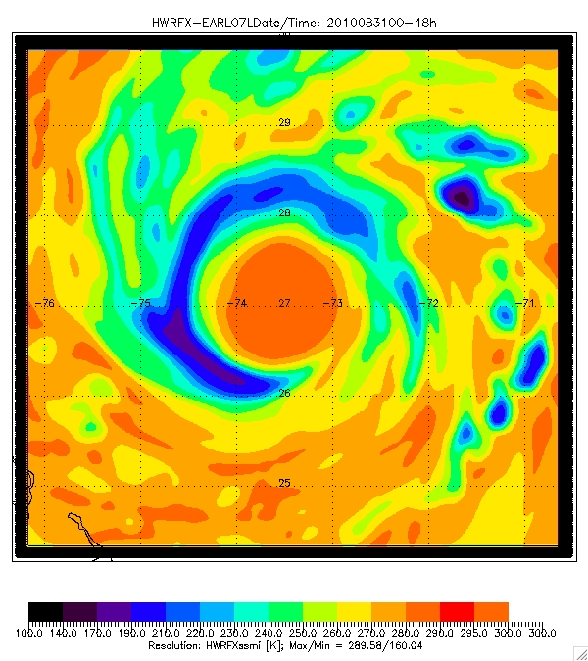
HWRFx STRUCTURE of Earl
85/91 GHz H pol (sat. resolution) – 02 Sept. 2010
Observed
Note that the realistic storm structure does not develop until 12-18h into the forecast cycle
The realism decreases after the 42h forecast
The model has a very large eye and does not show the observed eyewall replacement cycle
06h
12h
18h
24h
30h
36h
42h
48h

Slide 13
How to use the data for forecast improvement??
Data assimilation of passive microwave observations
Inside the precipitating regions
Currently:
very nonlinear
each of these parameters is a single value
each of these represents a volume-element mean value of the prognostic variables
Alternative:
Σ T^{’(n)} exp( -[y₁-y₁^{(n)}]² -[y₂-y₂^{(n)}]² -[y₃-y₃^{(n)}]²)
T_{b}’(p₁, p₂, …, p₅₀₄) = ___________________________________________________
Σ exp( -[y₁-y₁^{(n)}]² -[y₂-y₂^{(n)}]² -[y₃-y₃^{(n)}]²)
with the sum over a database containing many combis of realistic λ
and the y are judiciously defined combis of the p

Slide 14
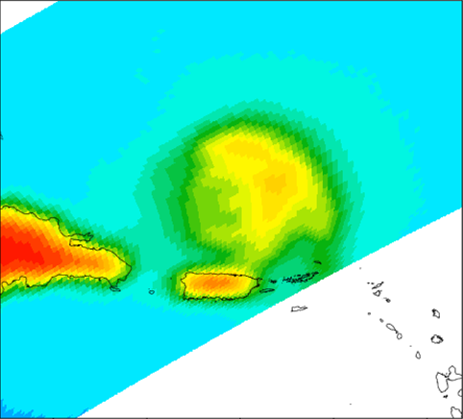
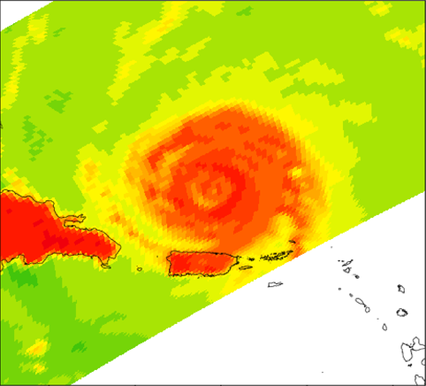
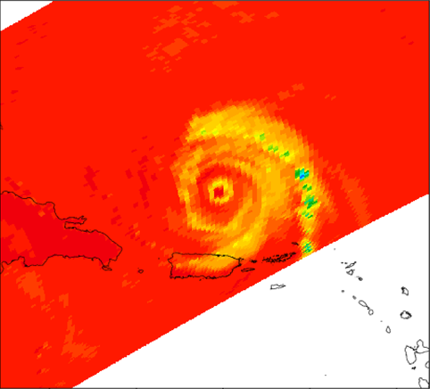
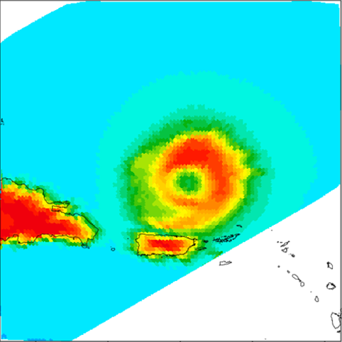
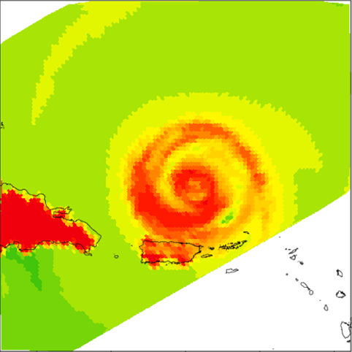
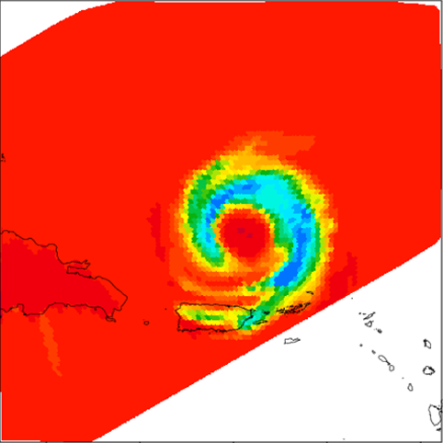
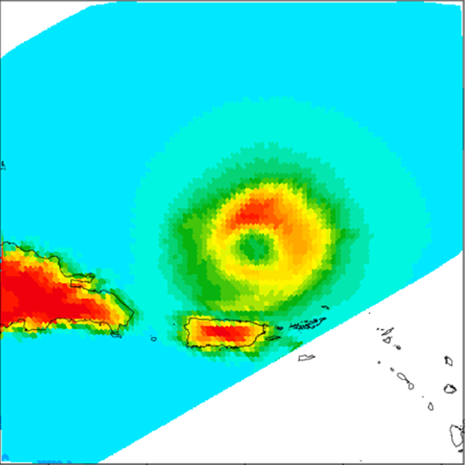
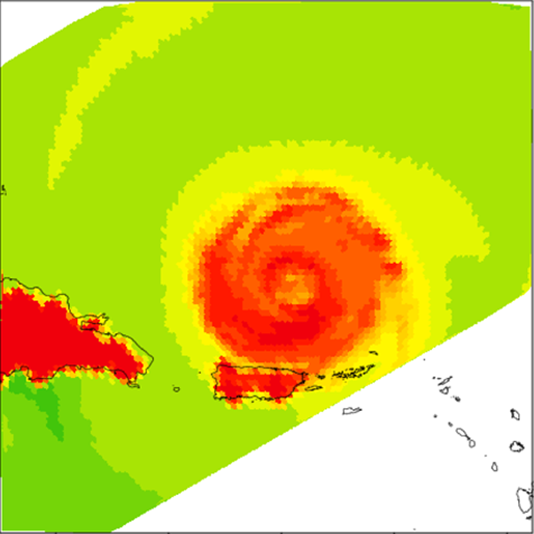
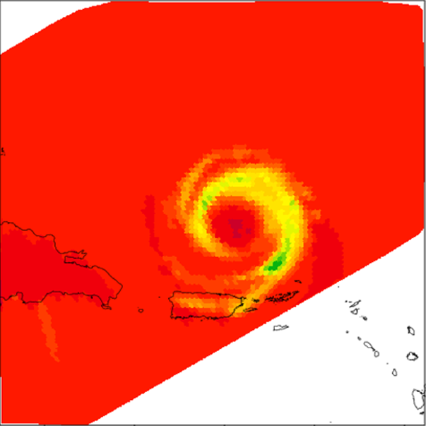
10H
37H
85.5V
TRMM - TMI
Calculated TBs using CRTM, with “HWISS model 2” microphysical parameter values
10H
37H
85.5V
Calculated TBs using CRTM, with adjusted microphysical parameters
(smaller rain drops, smaller and less dense graupel)
10H
37H
85.5V

Slide 15
10H
37H
85.5V
10H
37H
85.5V
Note how
rain emission decreases (10.7)
10H
37H
85.5V

Slide 16
10H
37H
85.5V
10H
37H
85.5V
Note how
rain emission decreases (10.7)
and
scattering decreases
(37, 85.5)
10H
37H
85.5V

Slide 17
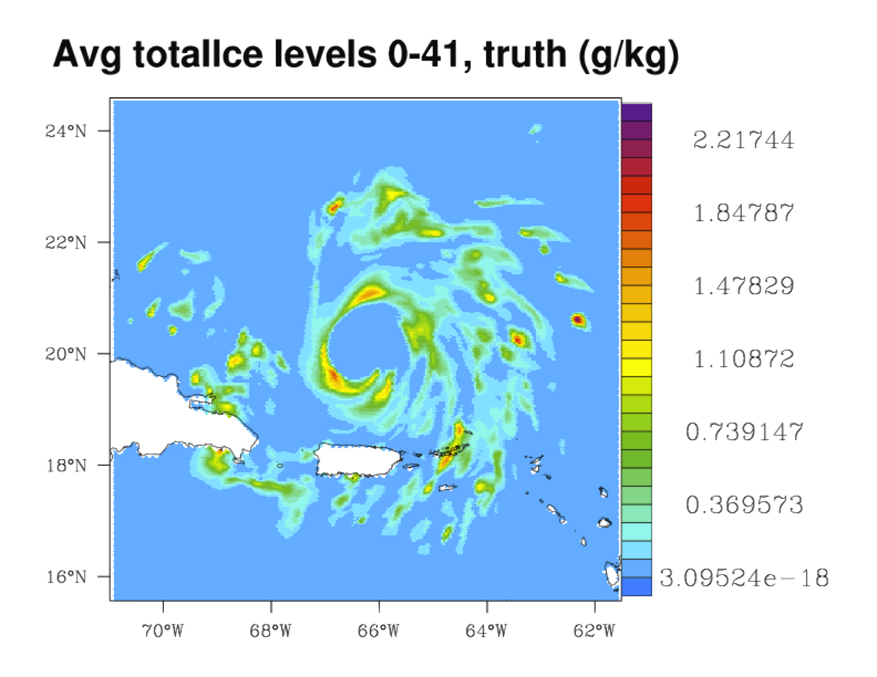
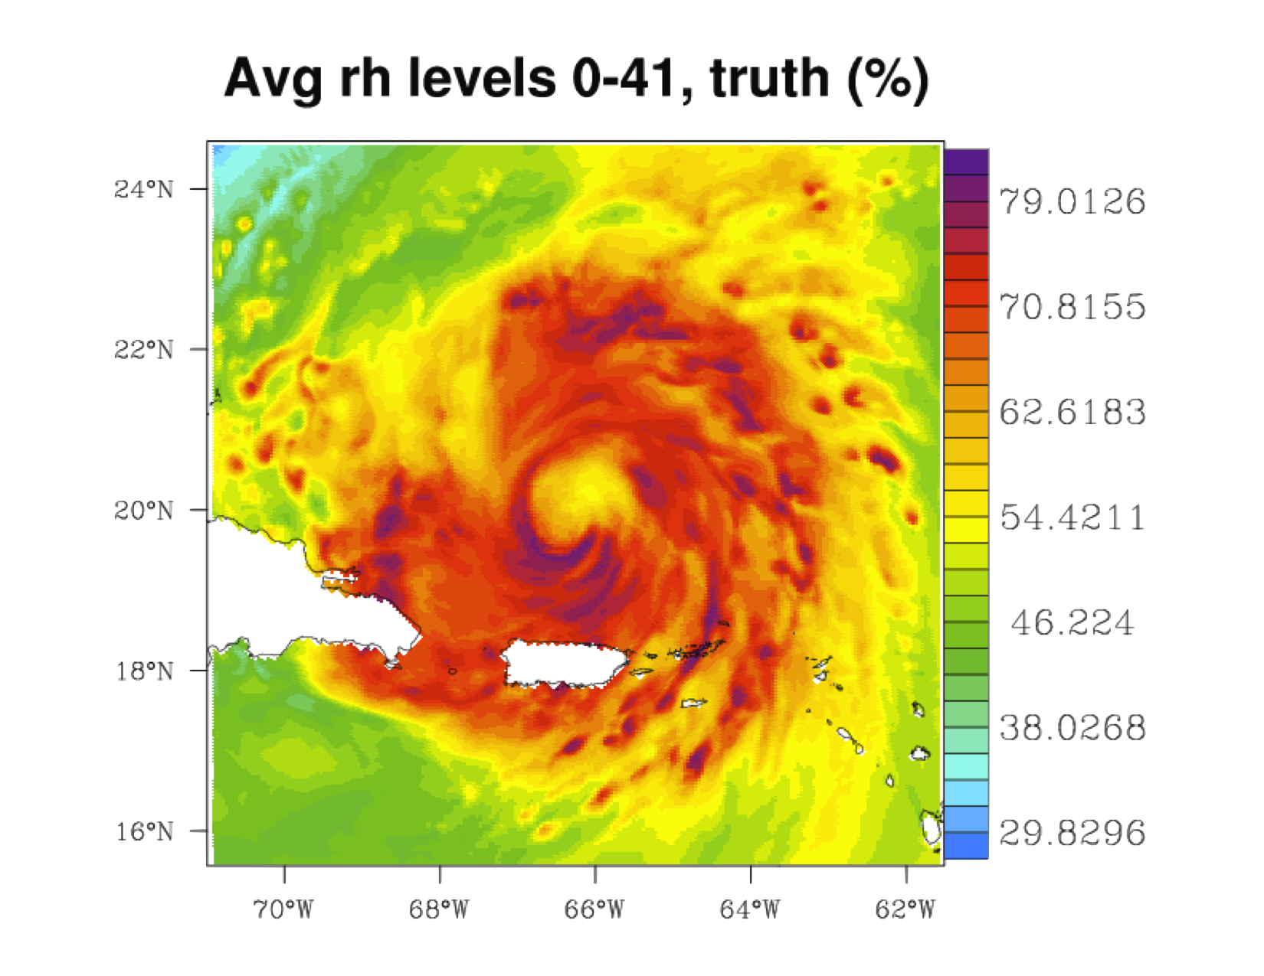
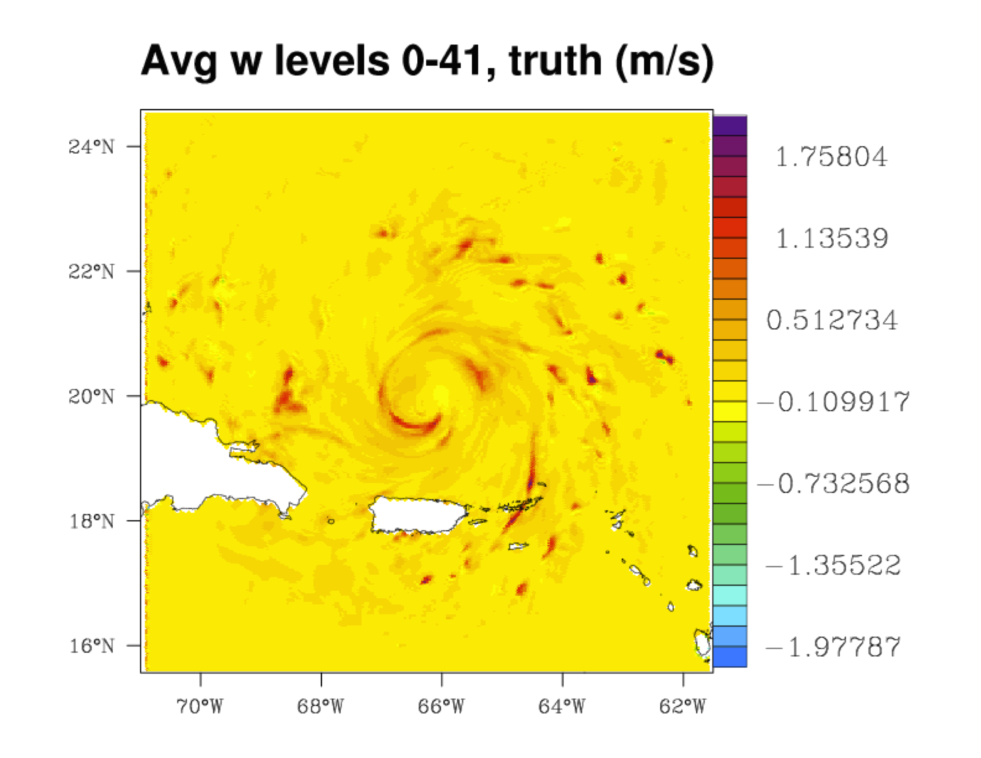
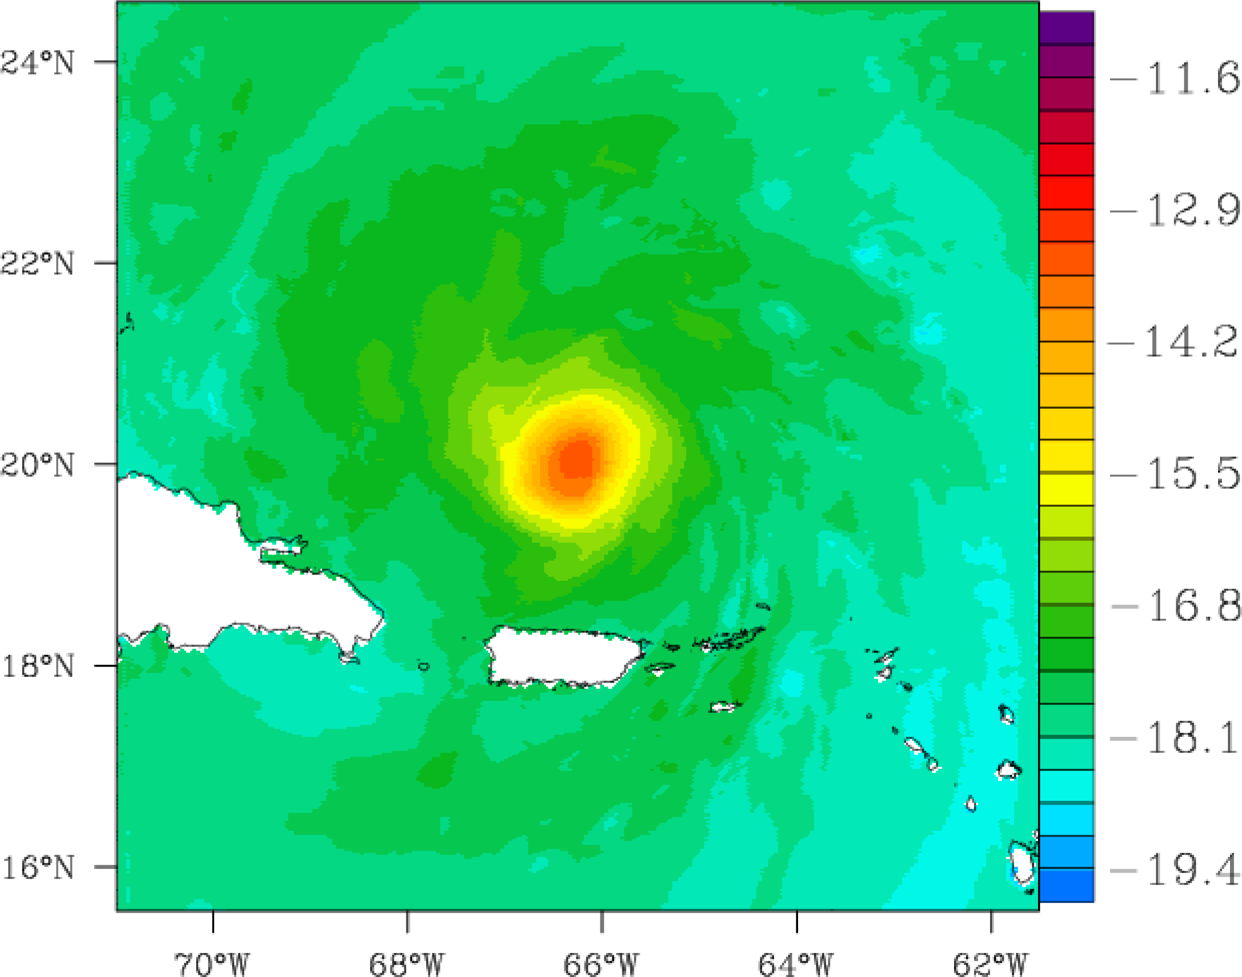
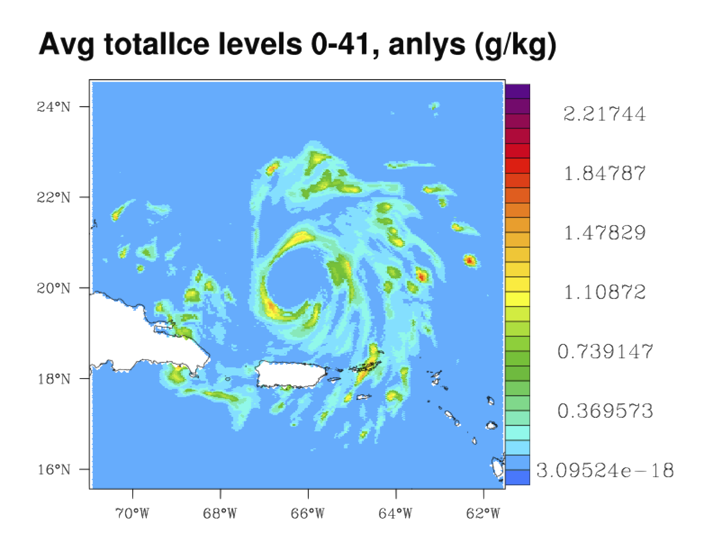



Use the first two CCVs to classify regime, then compute conditional statistics and 3 CCVs within each region (3 obs per column).
Test with an idealized OSSE based on hi-res CRTM observations of HWRF model; data is outside training set
Start with uniform background, assimilate forward-calculated TMI T_{b}
actual
Temperature
analyzed

Slide 18
The JPL Tropical Cyclone Information System
(TCIS)
http://tropicalcyclone.jpl.nasa.gov
Objective of the TCIS
To provide a one-stop place that facilitates fusion of multi-parameter, multi-instrument observations (satellite, airborne and in-situ) and model output, relevant to both the large-scale and the storm-scale hurricane processes, in the atmosphere and in the ocean.
Goal – a tool for:
- Hurricane research - help understand the physical processes that determine hurricane genesis, intensity, track and impact on large-scale environment
- Model evaluation - help improve hurricane forecast accuracy by facilitating validation and improvement of hurricane models through comparison with observations and development of new data assimilation techniques
- enable studies aimed at Developing new algorithms, sensor systems and missions.

Slide 19
Tropical Cyclone Data Archive
Satellite depictions of hurricanes over the globe
12-year record (1999-2010) First phase released 05/2012
offers both data and imagery, making it a unique source to support: hurricane research; forecast improvement; algorithm development; instrument design.
GRIP Portal – NRT in 2010, Atlantic
Integrates model forecasts with satellite and airborne observations from a variety of instruments and platforms, providing good spatial and temporal context for the high-resolution, but limited in space and time, airborne observations.
essential knowledge for the experiment design, flight planning, and a very rich information source in the analysis stage of the experiment.
Allows interrogation of a large number of atmospheric and ocean variables to better understand the large-scale and storm-scale processes associated with hurricane genesis, track and intensity changes.

Slide 20
Satellite depictions of hurricanes over the globe
12-year record (1999-2010)
Offers both data and imagery, making it a unique source to support hurricane research.
JPL TCIS – The Tropical Cyclone Data Archive
http://tropicalcyclone.jpl.nasa.gov
Timeline
View and download
Storm-scale
data
Earl, 2010
Download
all data from
this
Instrument
(TMI)
Download
Selected large-scale
data from
this day

Slide 21
At this time
Download
NetCDF
All data on
this day

Slide 22
Passive Microwave Observations from TRMM-TMI

Slide 23


  9-year statistics from AMSR-E observations
Azimuthal/Range Distributions of Rain Index from 2002-2011; North Atlantic Hurricanes
Cat 1-3; Front Left
Cat 1-3; Front Right
(PMW Rain Index as a function of:
distance from storm center (y-axis)
days from maximum intensity (x-axis) .
Storm Movement Direction
Cat 1-3; Back Left
Cat 1-3; Back Right
Cat 4-5; Front Left
Cat 4-5; Front Right
Cat 1-3 have rain fields that are less symmetric in both space and time.
Cat 4-5; Back Left
Cat 4-5; Back Right

Slide 24
The NRT Interactive PORTALS
Two near-real-time (NRT) web portal
Developed to facilitate the hurricane field campaigns:
  GRIP in 2010 – http://grip.jpl.nasa.gov
  HS3 in 2012-2014 – http://hs3.jpl.nasa.gov
Integrates model forecasts with satellite observations from a variety of instruments and platforms.
The unique features of the portal allow users to interrogate a large number of atmospheric and ocean variables to better understand the large-scale and storm-scale processes associated with hurricane genesis, track and intensity changes.
By including a diverse set of satellite observations and model forecasts, it provides a good spatial and temporal context for the high-resolution, but limited in space and time, airborne observations.
Such knowledge is essential for the experiment design, providing critical input for the flight planning and serving as a very rich source of information in the analysis stage of the airborne experiment

Slide 25
HS3 Portal – NRT in 2012, Atlantic (http://hs3.jpl.nasa.gov)
The Power of the Satellite Observations

Slide 26
HS3 Portal – NRT in 2012, Atlantic (http://hs3.jpl.nasa.gov)
The Power of the Satellite Observations

Slide 27
HS3 Portal – NRT in 2012, Atlantic (http://hs3.jpl.nasa.gov)
The Power of the Satellite Observations

Slide 34
CloudSat
TRMM-TMI
TRMM-PR

Slide 35




Fusion of Hurricane Models and Observations: Developing the Technology to Improve the Forecasts
PI: Svetla Hristova-Veleva, JPL
Objective
Satellite Observations
Develop the technology to provide the fusion of observations and operational model simulations to help improve the understanding and forecasting of hurricane processes.
  Develop processing techniques to enable multi-source data fusion across hurricane forecast models, satellite data, and in situ sensors.
  Develop tools to manage the validation and assessment of model comparisons to more easily evaluate the performance of different numerical models.
  Develop interactive visualization techniques to enable analysis of highly complex systems.
Synthetic
Observations from Model
Facilitating critical model evaluation for forecast improvement
Approach
Integrate the NASA Earth Observing System Simulator Suite (NEOS³) with operational hurricane forecast models and incorporate simulated satellite observables into the existing database of satellite and airborne observations.
Develop a set of advanced analysis tools.
Develop data immersion technology to enable real-time interaction with the models and visualization of highly complex systems.
Co-Is/Partners:
JPL: P. Li, B. Knosp, J. Turk, S. Tanelli, B. Lambrigtsen, Q. Vu
NOAA: R. Rogers, S. Gopalakrishnan, F. Marks, T. Vukicevic, V. Tallapragada
AIST-11-0027

Slide 36
AIST project:
Fusion of Models and Observations
Now: Integrating hurricane model forecasts with satellite & airborne observations from a variety of instruments and platforms
  Operational HWRF model forecasts are used as input to NEOS³
    Considered are: - the model microphysical assumptions - the instrument characteristics and sampling
  The synthetic “satellite observations” are:
    Incorporated in the database of satellite obs.
    Visualized in the portal
Satellite Observations
Synthetic Observations from Model

Slide 37
AIST project:
Fusion of Models and Observations
Now: Integrating hurricane model forecasts with satellite & airborne observations from a variety of instruments and platforms
  Operational HWRF model forecasts are used as input to CRTM
    Considered are: - the model microphysical assumptions - the instrument characteristics and sampling
  The synthetic “satellite observations” are:
    Incorporated in the database of satellite obs.
    Visualized in the portal
Satellite Observations
Synthetic Observations from Model

Slide 38

Next: Developing analysis tools for model validation
Preparation for the next year Milestones
Interactively select region
Gather data from observed and synthetic
  brightness temperatures
  radar reflectivity
Statistical comparisons
  Storm-relative coordinates
  EOFs, CFADs
  Azimuthal averages =f(r)
  Wave-number analysis =f(r)
Storm Structure
  Object classification
  Metrics for model/obs object
Visualization of analysis

Slide 39









PDF of the relation 85V-19V
TRMM-TMI
M3-500.08.04
M6-500.08.04
M6-600.22.10
M6-400.22.10
M6-300.22.10
M6-300.22.22
M6-300.80.80
M6-300.400.200

Slide 40



  Next:
  Analysis tools to allow interrogation of a large number of atmospheric and ocean variables
    To evaluate and improve models
    To better understand the large-scale and storm-scale processes and their interaction
Amplitude of wave #0 as a function of distance from center
Wavenumber analysis tool
First adopted and used by NOAA/AOML/HRD
Developed for us by Z. Haddad and N. Niamsuwan
Direction (from east) of the max amplitude of wave #1

Slide 41
Storm Structure: Object classification and metrics
NHC activities – HFIP annual telecom/meeting 2012
Map a quantity
Identify a pattern
  Thresholds
  gradients
Classify the shape (pattern recognition)
Use metrics to characterize the structure
Develop comparative analysis

Slide 42

  Next:
  Analysis tools to allow interrogation of a large number of atmospheric and ocean variables
    To evaluate and improve models
    To better understand the large-scale and storm-scale processes and their interaction
ARCHER – the storm center finding algorithm
Developed by CIMSS/NRL
We now have a license to run it and have done some preliminary testing

Slide 43
Backup

Slide 44


  Next:
  Analysis tools to allow interrogation of a large number of atmospheric and ocean variables - The Rain Indicator – a multi-channel depiction of the storm structure
Microwave signals at the top of the atmosphere can be classified into two categories depending on how the microwave field interacts with the hydrometeors:
  emission signal - dominant at lower frequencies; warming; better for light rain. Strong emission in the atmosphere reduces the polarization difference (PD) in the ocean surface radiation. Hence, PD is representative of the atmospheric emission.
  scattering signal -dominant at higher frequencies; cooling; better for heavy rain
Hence, both signals have to be incorporated to cover the entire rainfall spectrum.
19 GHz
36 GHz
89 GHz
89 GHz

Slide 45


  10-year statistics from QuikSCAT observations
Azimuthal/Range Distributions of winds from 1999-2009 in the North Atlantic Hurricanes
Cat 1-3; Front Left
Cat 1-3; Front Right
Mean wind speed as a function of:
distance from storm center (y-axis)
days from maximum intensity (x-axis) .
Storm Movement Direction
Cat 1-3; Back Left
Cat 1-3; Back Right
Cat 4-5; Front Left
Cat 4-5; Front Right
Cat 4 & 5 have wind fields that are less symmetric in both space and time.
Cat 4-5; Back Left
Cat 4-5; Back Right
A13L-357 E-poster: “Global Tropical Cyclone Winds from the QuikSCAT and OceanSAT-2 Scatterometers”
B. W. Stiles, R. Danielson, W. L. Poulsen, A. Fore,
M. J. Brennan, T.-P. J. Shen, and S. Hristova-Veleva

Slide 46
S. Hristova-Veleva, P. P. Li, B. Knosp, F. J. Turk, Q. Vu,
B. Lambrigtsen, S. Tanelli, N. Niamsuwan, Z. Haddad
Fusion of hurricane models and observations:
Developing the technology
to improve the forecasts
1/8/09
Notes:
46

