Slide 1
The Weather, Climate and Health Program at NCAR: Using NASA Products for Public Health Applications
Mary Hayden
National Center for Atmospheric Research
Boulder, Colorado, USA
GPM Applications Workshop
November 2013

Slide 2
Acknowledgements
Plague: funded by USAID/CDC
R. Eisen, P. Mead, K. Gage, E. Zielinski-Gutierrez (CDC)
Apangu Titus (UVRI)
A. Monaghan, S. Moore, D. Steinhoff (NCAR)
Ae. aegypti: funded by NSF/NASA
L. Eisen and S. Lozano-Fuentes, K. Kobylinski (Colorado State University)
C. Welsh-Rodriguez, (University of Veracruz)
E. Zielinski-Gutierrez (CDC)
A. Monaghan (PI), L. Delle-Monache, D. Steinhoff, C. Uejio, P. Bieringer (NCAR)
W. Crosson, D. Irwin, S. Estes, M. Estes (NASA/USRA)

Slide 3
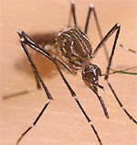
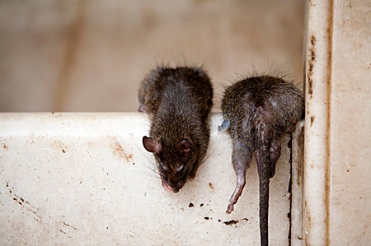
Presentation Outline
Human plague in Uganda
  TRMM data/spatial modeling
  Collaboration with Traditional Healers
The dengue virus vector mosquito, Aedes aegypti, in Mexico
  TRMM data/container modeling
  Outreach/participatory epidemiology

Slide 4
Human Plague in Uganda

Slide 5
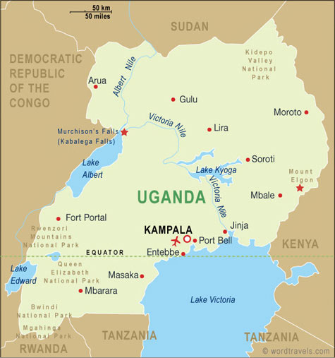
Plague in Northwest Uganda
West Nile region
Plague is a highly virulent and flea-borne disease caused by Yersinia pestis.
Infected fleas travel on rats that intermittently come into contact with humans
Local rat and flea populations fluctuate in response to weather and climate variability

Slide 6
Examples of use of TRMM rainfall data
Modeling Human Plague Dynamics in Uganda
  TRMM precipitation is used to validate atmospheric model simulations that in turn are used for spatial modeling of human plague.
  TRMM precipitation is used as an explanatory variable in models of interannual plague variability.

Slide 7
Validation of WRF Simulations:
2003-2009 Annual Rainfall Comparison

Slide 8
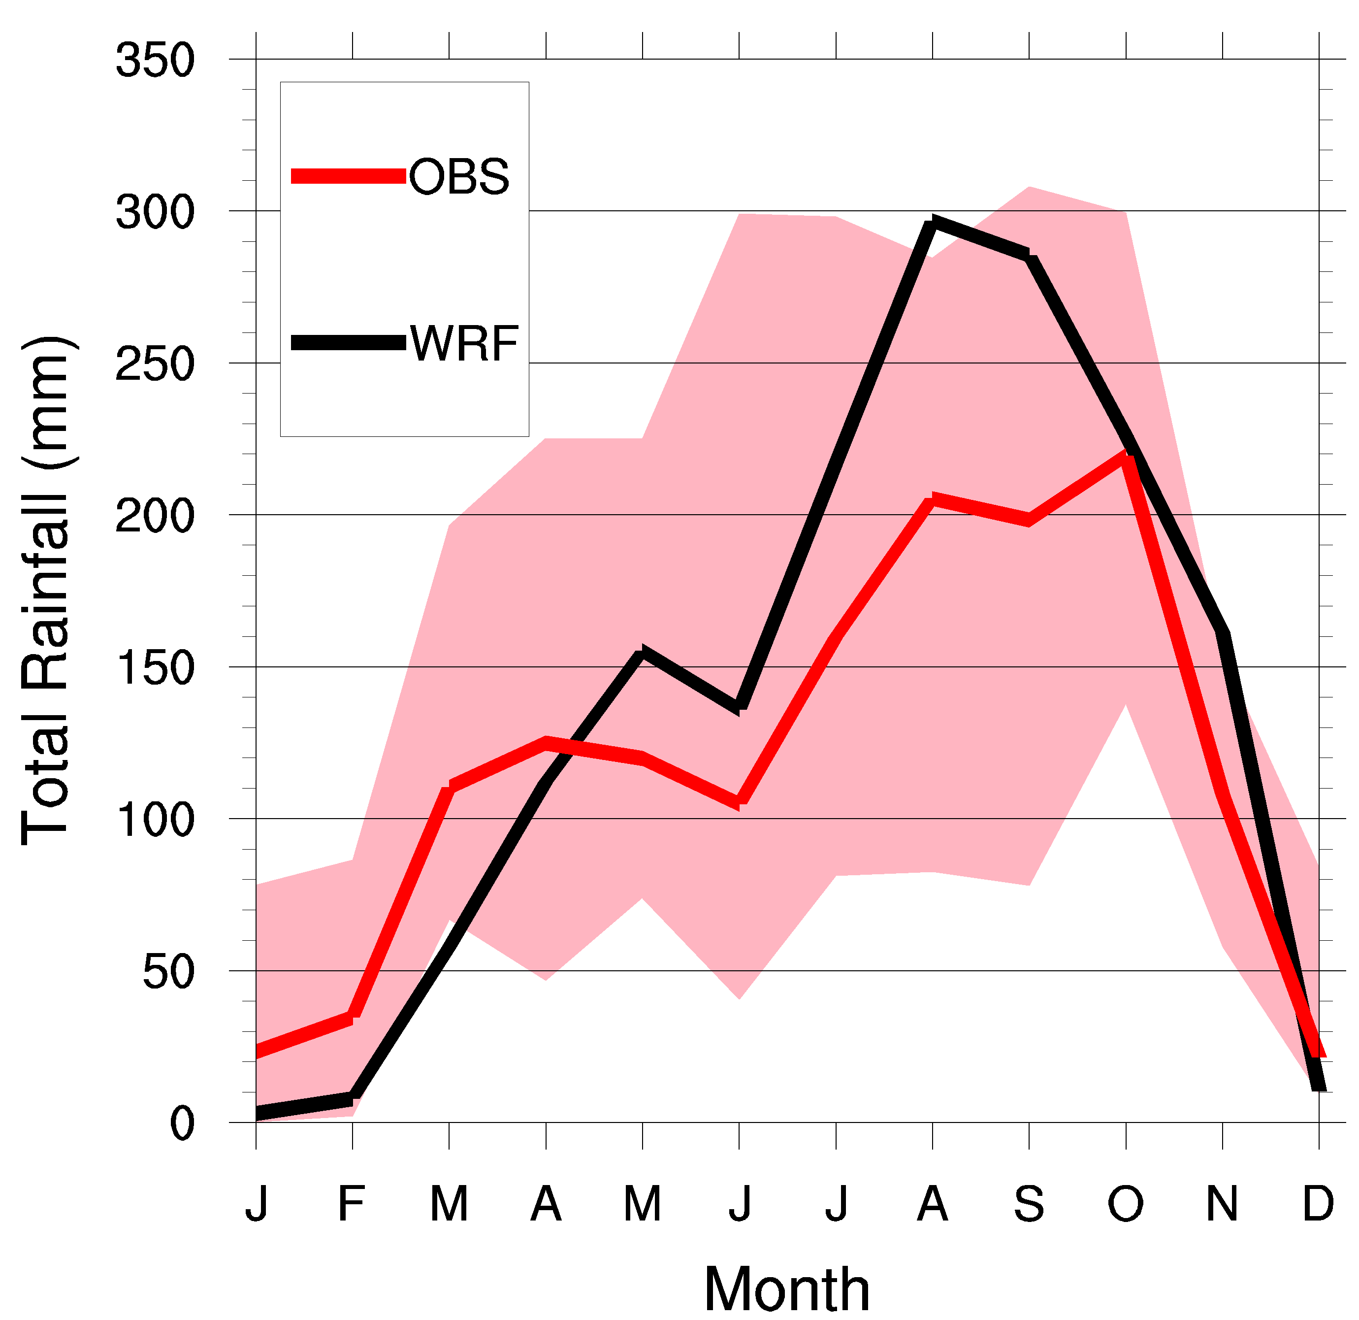
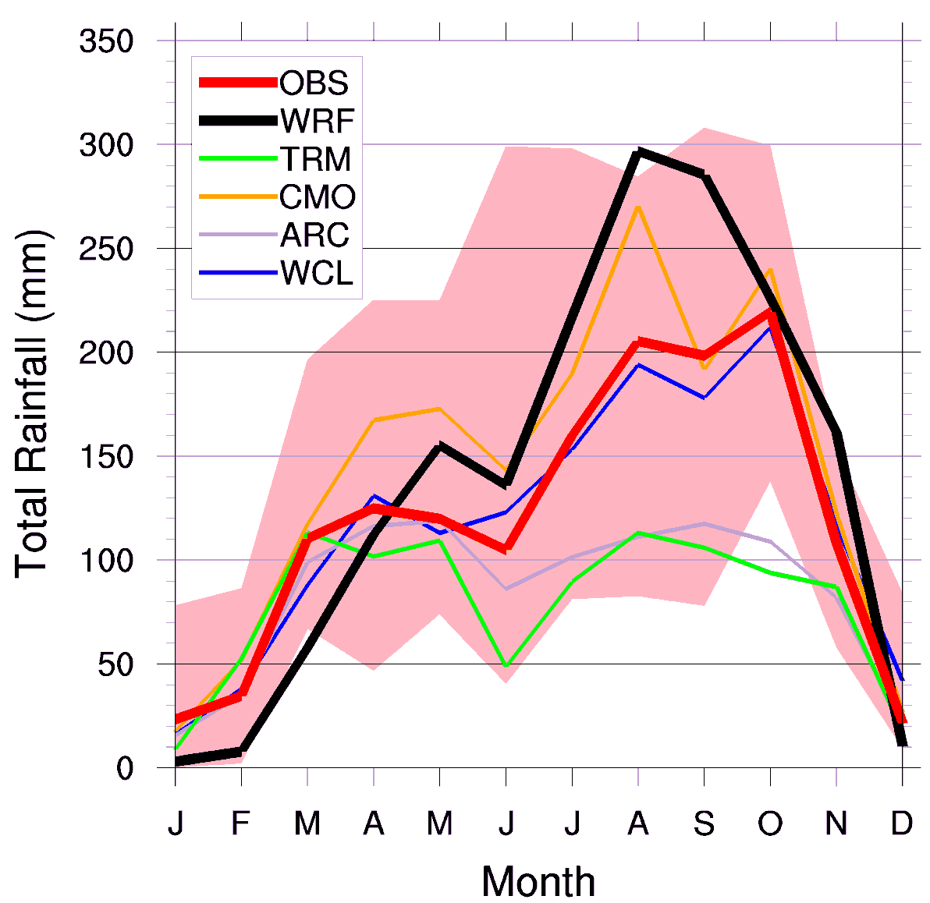
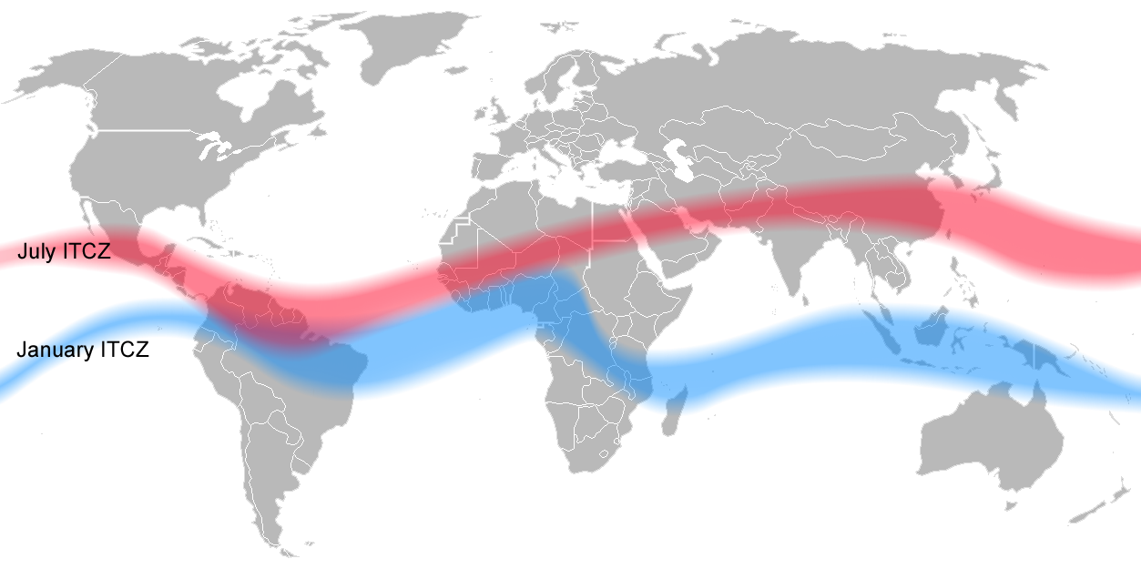
Validation of WRF Simulations:
Mean Annual Cycle of Rainfall, Arua, Uganda
Plague
Season

Slide 9
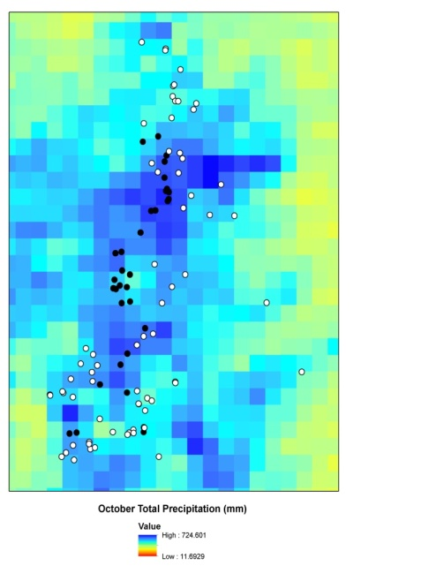
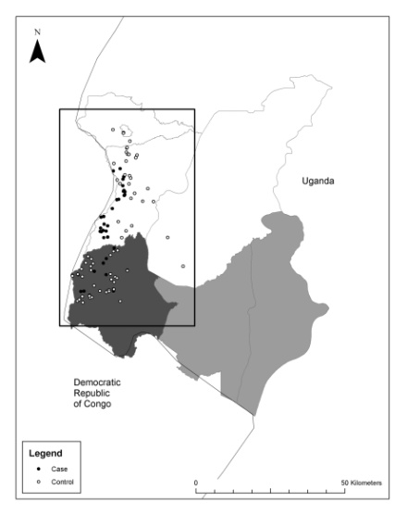
Observed Plague Cases in Uganda
Cases are associated with wetter, cooler regions
Monaghan et al. 2012; MacMillan et al., 2012
Notes:
Need notes here

Slide 10
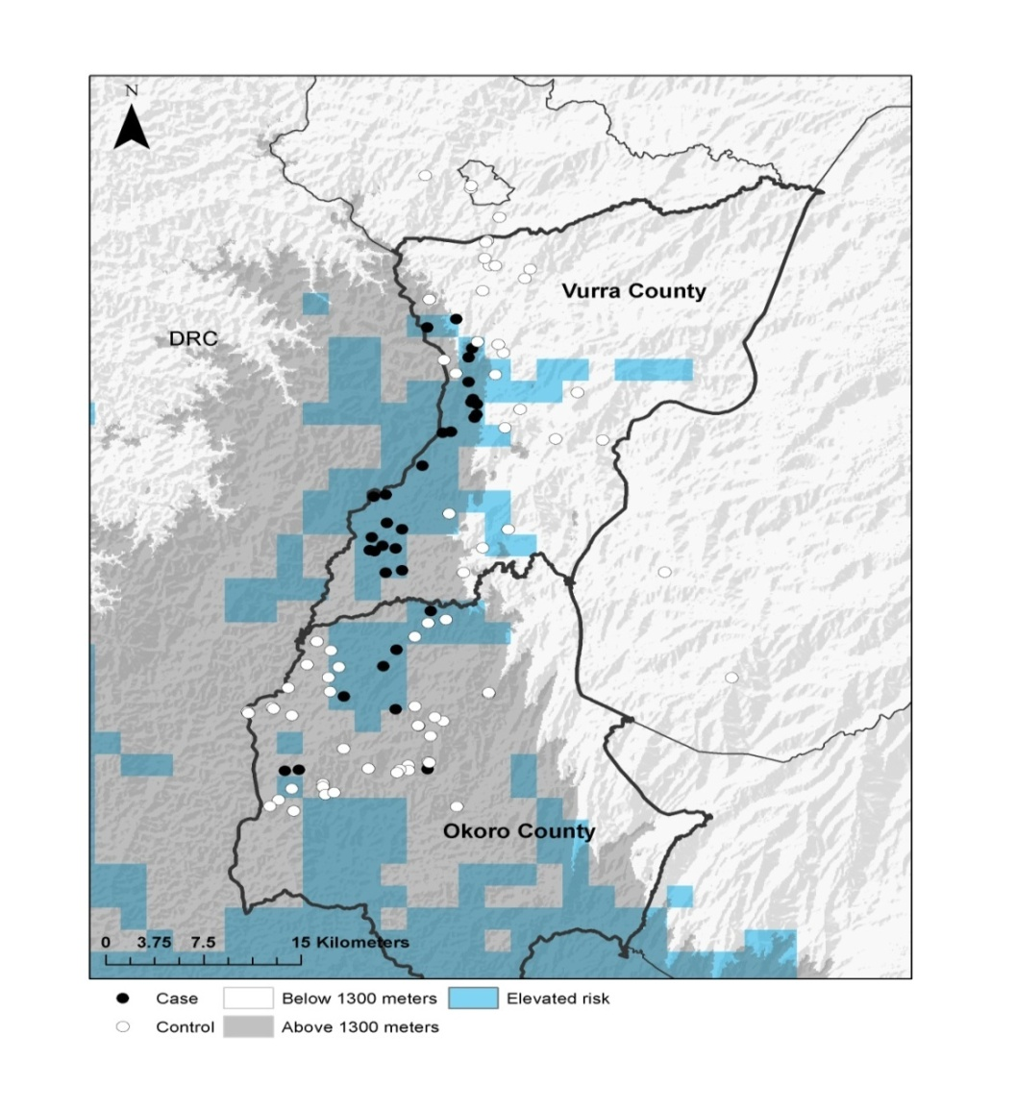
Modeled Spatial Plague Risk, Uganda
Case and control locations were discriminated based on the following climatic variables (10 yr averages).
  Total precipitation at tails of rainy season (+)
  Total precipitation during annual dry spell (-)
  Above 1300 m (+)
Model Accuracy = 94%
Is model valid outside of focus region?
Monaghan et al. 2012; MacMillan et al., 2012
Notes:
Blue squares indicate simulated plague risk areas in West Nile. Black (white) dots are case (control) locations. The overall model accuracy is 94%. From Macmillan et al., in press.

Slide 11
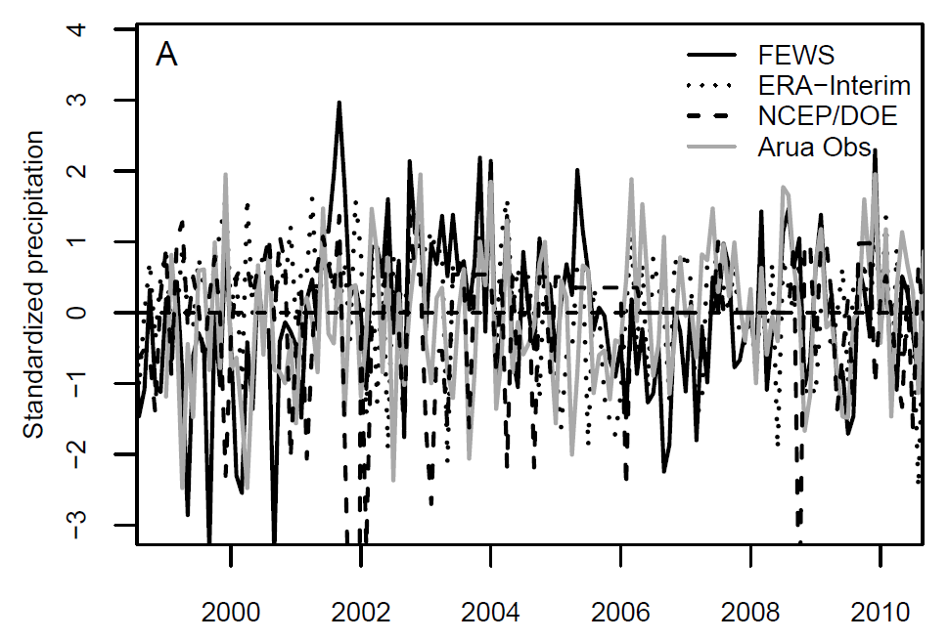
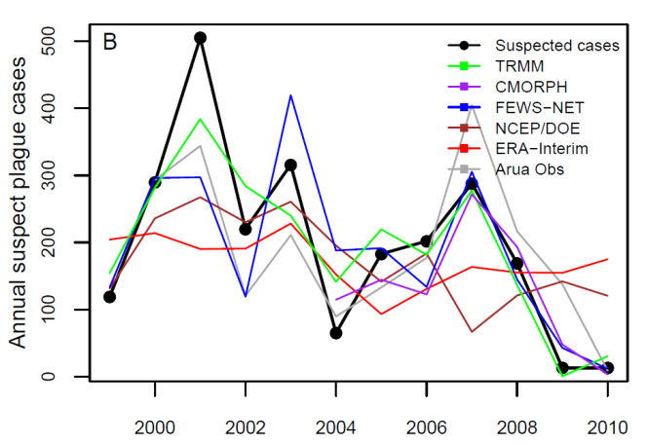
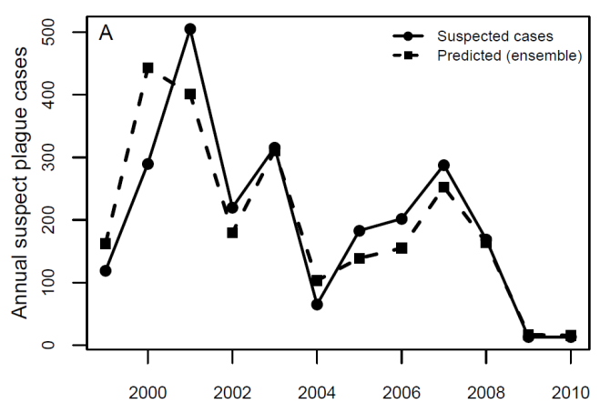
Modeled Temporal Plague Risk, Uganda
Monthly Rainfall
Modeled Annual Risk
(per rainfall dataset)
Meteorological data are highly uncertain in many regions of greatest risk.
Ensemble modeling techniques may help.
Modeled Annual Risk
(ensemble)
Moore et al., PLOS ONE 2012
Notes:
Need notes here

Slide 12
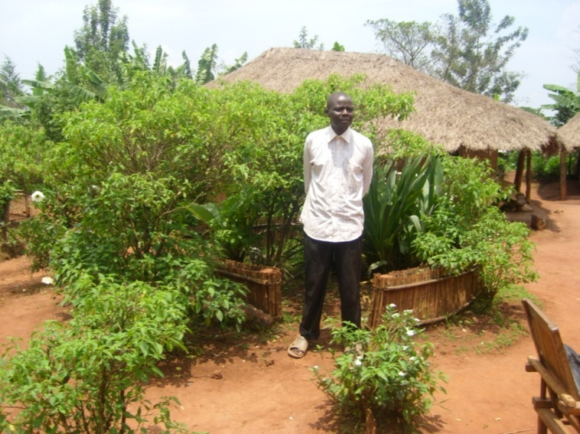
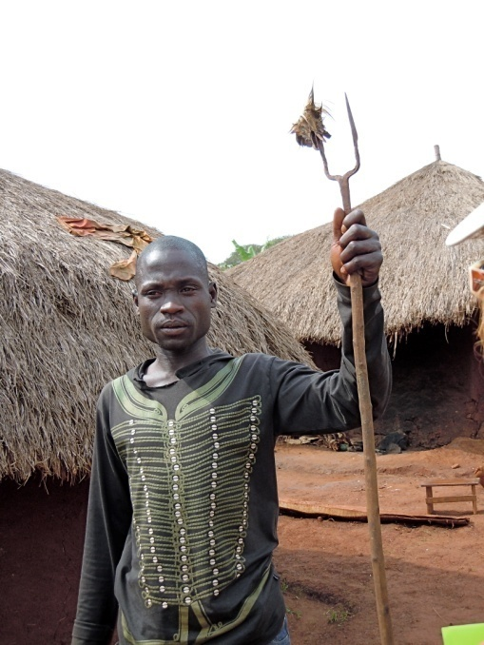
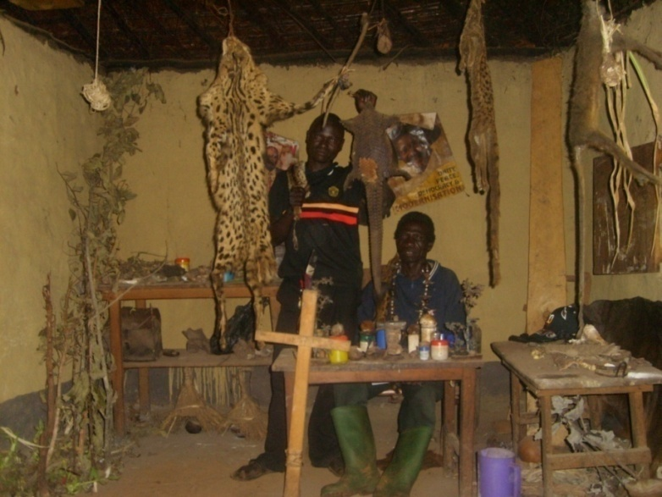
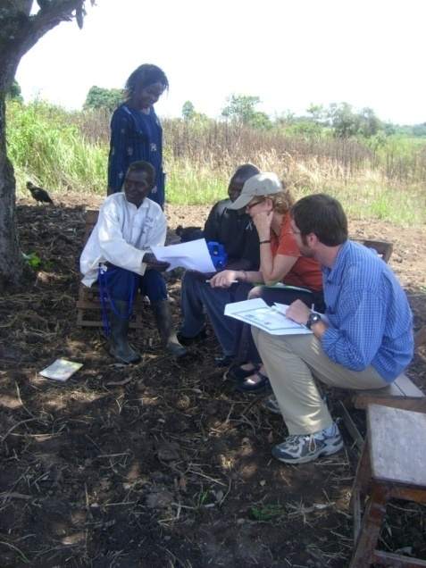
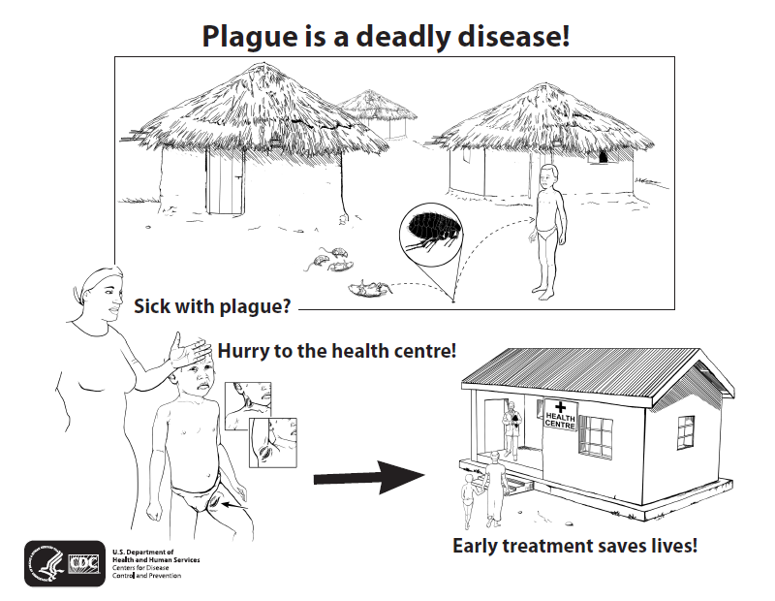
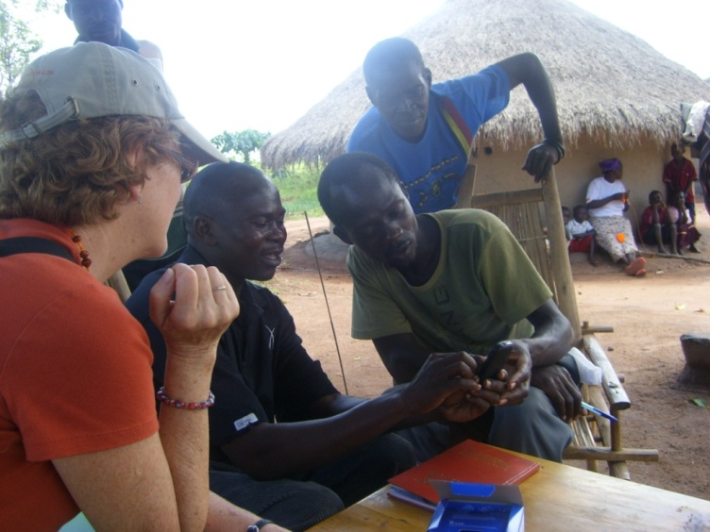
Training Traditional Healers

Slide 13
The dengue virus vector mosquito Aedes aegypti in Mexico

Slide 14
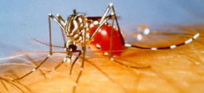
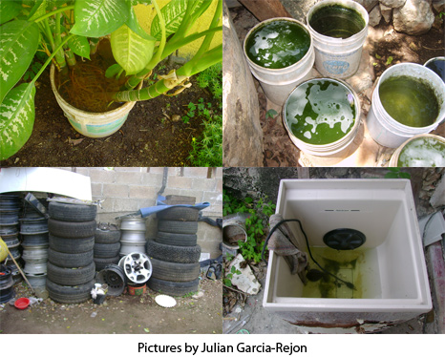
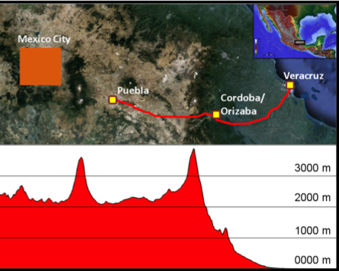
Dengue Fever in Mexico
(Lozano et al. 2012; Lozano et al. 2012)
Notes:
Dengue fever, which affects 50-100 people globally each year, is caused by dengue virus, primarily transmitted by the urban-dwelling mosquito Aedes (Ae.) aegypti. We recently conducted a field study to determine the abundance of Ae. aegypti immatures in containers in communities located along an elevation and climate gradient in central México, ranging from Veracruz City at sea level with highly favorable climatic conditions for the mosquito, to Puebla City in the central highlands (~2,100 m) where a few specimens of Ae. aegypti were encountered but the climate appears to prevent the mosquito from proliferating. Mosquito abundance was strongly correlated with weather parameters along this elevation/climate gradient such as temperature, humidity, and rainfall. This graph shows the strong relationship between the proportion of homes with Ae. aegypti in each town along the transect, and the daily (diurnal) temperature range for the 30-d period preceding the mosquito survey in a given community. Stronger swings between daytime high and nighttime low temperatures, which occur in the higher, drier regions, are associated with fewer mosquitoes. Climate-driven models of Ae. aegypti abundance developed from these data will be used to explore the potential for the mosquito’s range to expand or shift under climate change scenarios.

Slide 15
Examples of use of TRMM rainfall data
Modeling the dengue vector mosquito Aedes aegypti in Mexico
  TRMM precipitation is used along with other weather variables to drive an energy balance model that simulates water dynamics in container habitats exploited by immature mosquitoes.
  TRMM precipitation is used as an explanatory variable for empirical modeling of mosquito presence.
  TRMM precipitation is used along with other weather variables to drive a physically-based model of mosquito abundance.

Slide 16
Climate-based modeling of the dengue virus vector mosquito Aedes aegypti using field data from 600 homes:
BIOMOD Results for Puebla (2100 m ASL)
A small temperature increase of 1ºC has the potential to double the number of premises harboring Ae. aegypti during the peak of the rainy season in the high altitude city of Puebla. A change at least this large is likely to occur within the next 50 years.
The results are relatively insensitive to rainfall changes because water is already quite abundant during the rainy season. Unrealistically large changes in rainfall would be required to make a difference. We do not have a good sense of how rainfall may change in central Mexico.
At lower altitude cities (not shown), we do not see the large projected changes in the % of premises with Ae. aegypti like we do here in Puebla, because these cities already lie well within the middle of the envelope of climatic suitability. So, it’s the marginal cities where we are likely to see the largest changes.

Slide 17
Toward improving simulations of Ae. aegypti abundance:
Modeling Ae. aegypti habitat suitability with WHATCH’EM

Slide 18
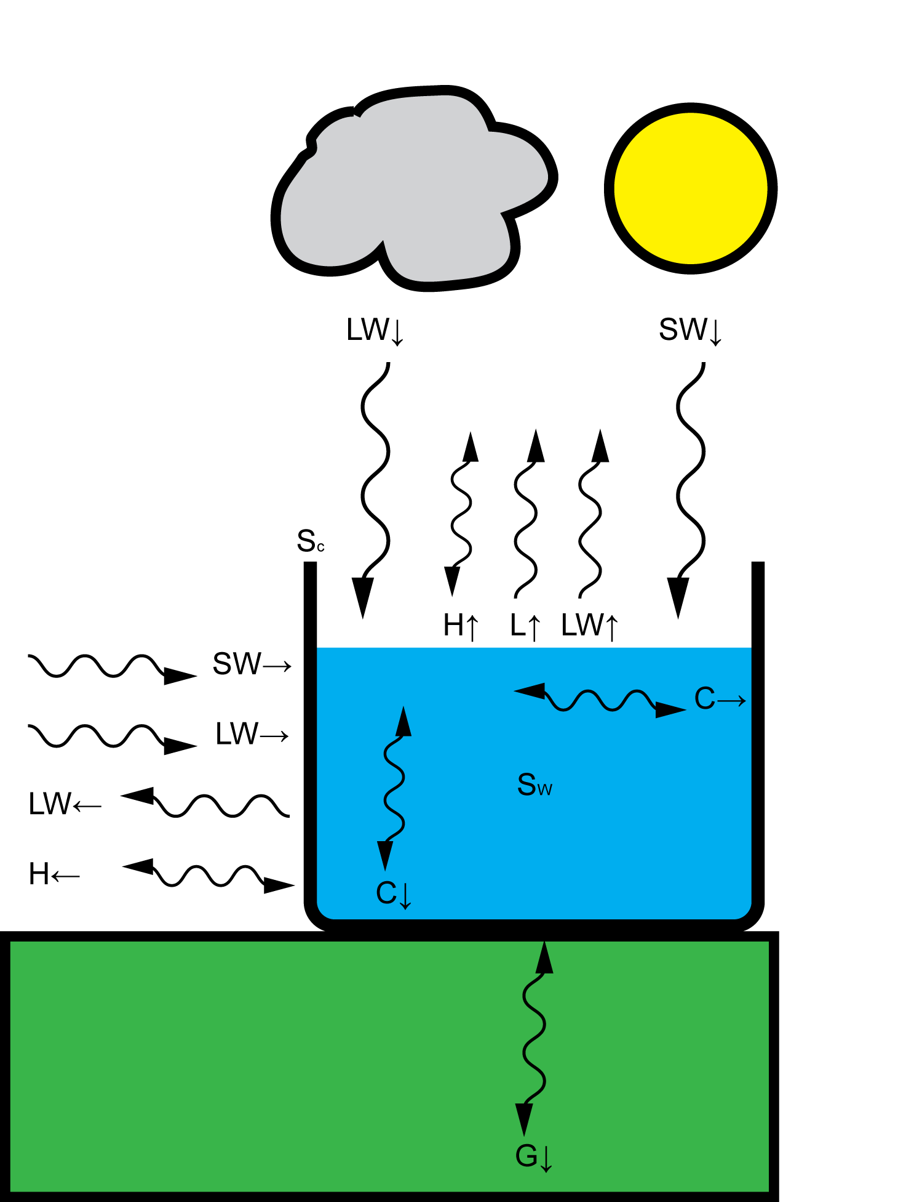
Energy Balance Modeling in Breeding Containers
The heat storage (i.e., change in temperature) in the water container is equal to the balance of energy to/from the container
SW: Shortwave radiation
LW: Longwave radiation
H: Sensible heat
L: Latent heat
G: Ground heat
C: Conduction from container surfaces
S: Heat storage
Units: Power (W, energy per unit time)
Sign convention:
Radiation terms: Positive into container
Other terms: Positive out of container

Slide 19
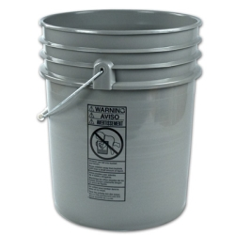
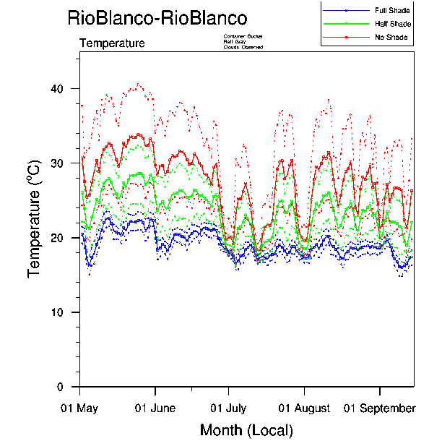
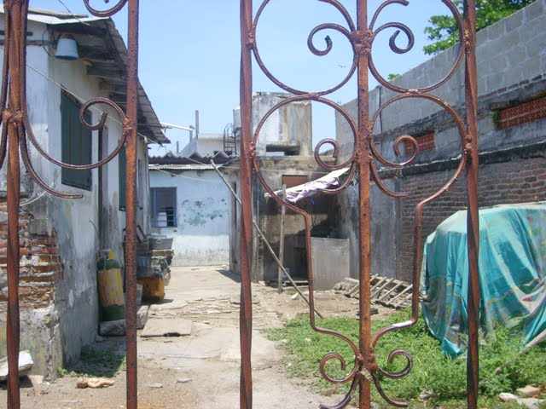
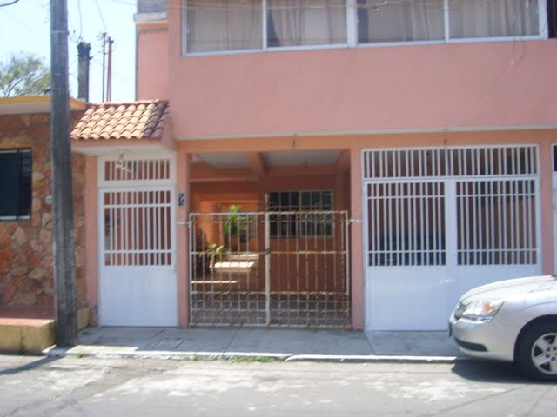
Energy Balance Model Example
Field studies on different sized/colored buckets in shade, partial shade
and full sun in Boulder, CO, Veracruz, MX and Orizaba, MX. HH
collections of pupae and container characterization in summer 2013

Slide 20
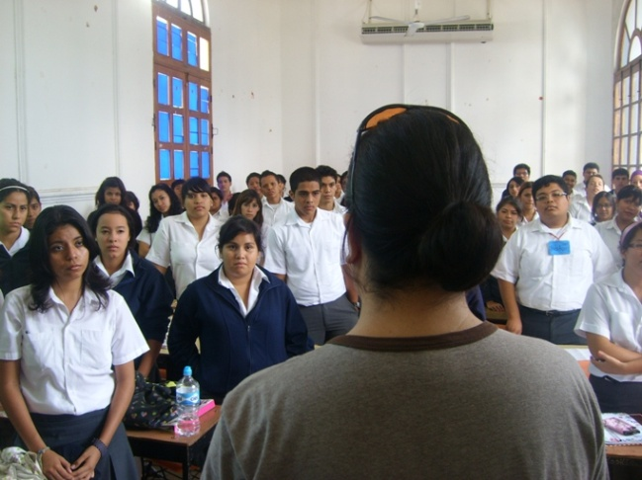
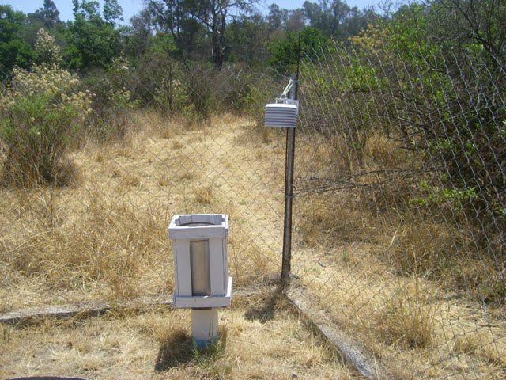
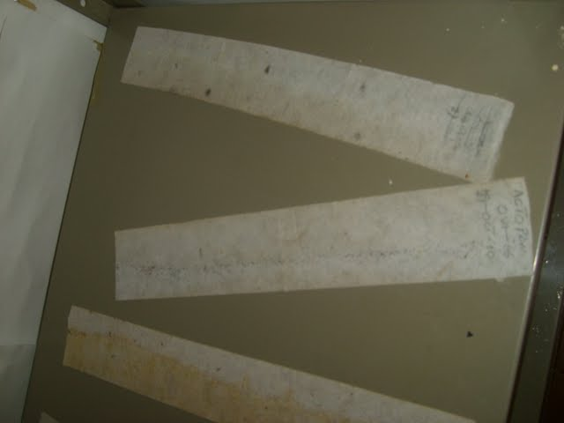
Outreach
Training high school students to collect mosquito and meteorological data and analyze the relationship between the two. (“Empowering the community through participatory epidemiology”).
Hands-on training of undergraduate and graduate university students in field data collection protocol.
Training of a postdoctoral researcher in climate-society-health issues.
SERVIR training workshop was held at the University of Veracruz in March 2012
5. Workshop held in Xalapa at U of Veracruz in May 2013 with all participants
Training Sessions
Meteorological Data
Collected Aedes Eggs

Slide 21
Thank you!
mhayden@ucar.edu

Slide 22
Other applications
  We use products from NASA’s Global Land Data Assimilation System (GLDAS), which integrates TRMM rainfall data.
  We use products from NASA’s Modern Era Retrospective Analysis for Research and Applications (MERRA), which assimilates TRMM Microwave Imager (TMI) rain rate information

