Slide 1
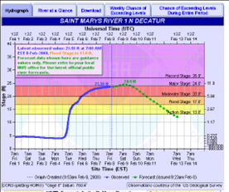
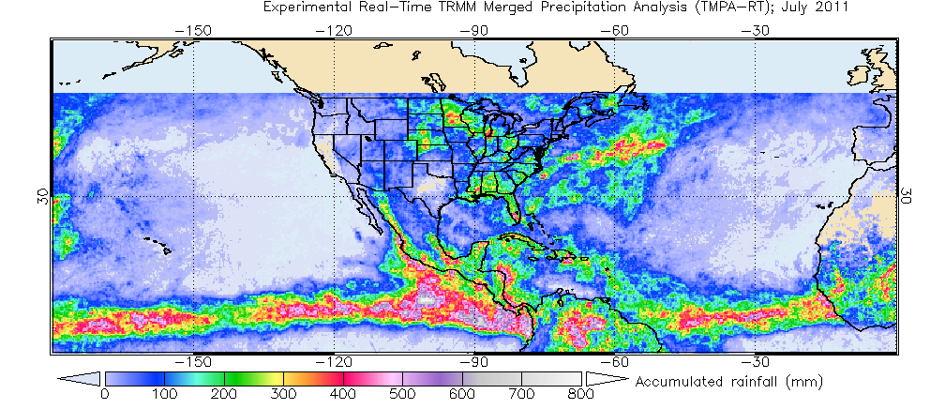
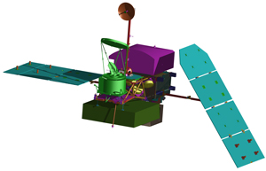
GPM in the NOAA Integrated Water Forecasting Program
Robert Hartman
Acting Director
NWS Office of Hydrologic Development
Notes:
Lower left image is July 2011 total precipitation from the TRMM algorithm package
Lower right image is GPM core satellite assembly (NASA image)

Slide 2
Overview
NOAA Integrated Water Forecasting Program
Precipitation needs for operational water prediction
Needs and opportunities for use of GPM-era satellite precipitation estimates
Recommendations and challenges
2

Slide 3
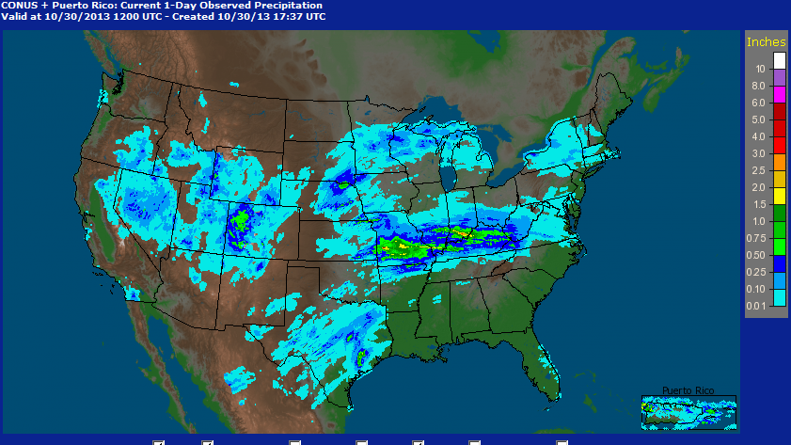
NOAA Integrated Water Forecasting Program
Advanced Hydrologic Prediction Service (AHPS)
Water Resource Outlook
Flood Forecast and Outlook
Precipitation Products
Snow Observations
Integrated Water Resources Science and Services (IWRSS)
A “Summit to the Sea” framework
Align multiple agencies with complementary water-related missions; NOAA, USACE, USGS
4
Notes:
Point out the wide range of water related services being offered through AHPS, and the evolution from AHPS initiative to IWRSS.

Slide 4
Precipitation Needs for Water Forecasting Program
Precipitation estimates and forecasts drive the hydrologic forecast
Requirements for precipitation estimates:
Accurate
High-resolution
Timely (low latency)
Seamless
5
Notes:
Key requirements for precip vary depending on applications. Latency of less than 3 hours is needed for river flood operations, whereas for flash flood it should be less than 15 minutes.

Slide 5
Multisensor Precipitation Estimation at NWS
Principal Sensors
Rain gauges
Ground radars (WSR-88Ds)
GOES infrared
Multisensor Fusion Products
River Forecast Centers (RFCs) use the Multisensor Preciptiation Estimator (MPE) to combine a suite of fused products
RFCs use selected products for River Forecast Operations
NCEP mosaics the RFC products to create the Stage IV national mosaic
6
Notes:
Note
1. the GOES infrared-based rainfall product (Hydro-Estimator) is being used in several RFCs.
2. MPE products from most RFCs are radar-gauge products, with the exception of WGRFC

Slide 6
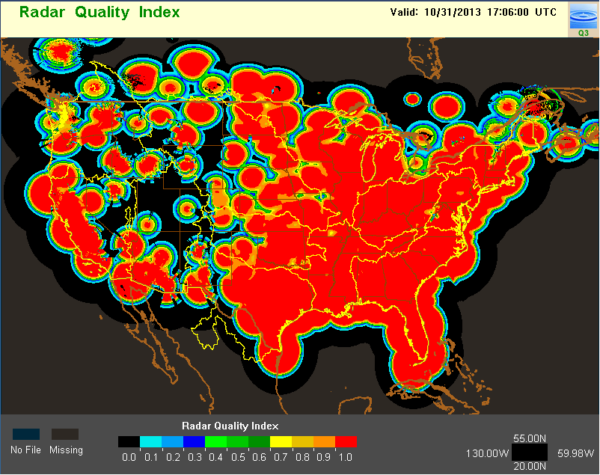
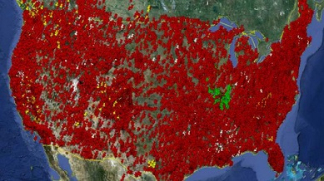
Limitations of Existing Precipitation Products
Radar Coverage and Quality Index
Map of Hourly Gauges
Large coverage gaps over the west for the cool season
Lack of timely data for Northern Mexico
coverage gaps in gauge data
From NOAA National Severe Storms Laboratory: http://nmq.ou.edu
Notes:
This radar quality index is proportional to the error in radar QPE due to beam overshooting above the freezing level, and terrain blockages. Further, the map shows where radar coverage is nonexistent. Coverage is smaller in winter than in summer, due to lower freezing levels. Note the coverage gaps over the intermountain West, the southwestern sector of the WGRFC area, and the upper Columbia basin. There are smaller areas of compromised coverage over the eastern US.
Note this includes both the WSR-88D and Canadian networks.

Slide 7
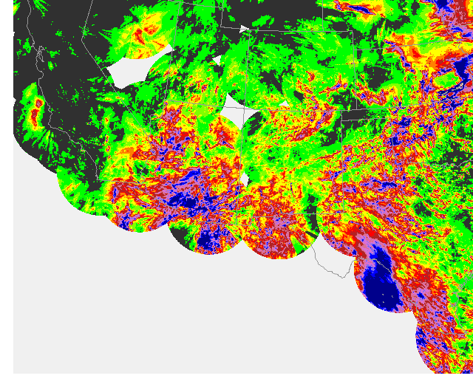
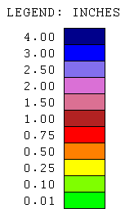
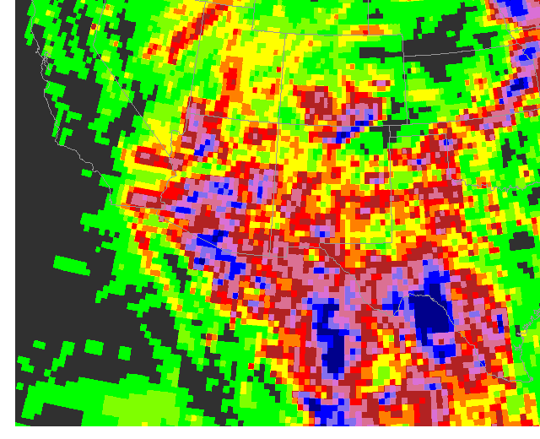
Use of Satellite Product
RADAR
Total rainfall 27-31 Aug 2008
Southwestern US
Lack of radar coverage over area contributing to the Rio Grande.
SATELLITE
Total rainfall 27-31 Aug 2008
Southwestern US and Mexico
Spatially complete coverage from CMORPH products
8
Notes:
A series of heavy rainfall events over Mexico during Aug-Sep 2008 contributed to flooding along the Rio Grande
CMORPH is functionally similar to the upcoming GPM IMERG product. CMORPH is a product of the NCEP Climate Prediction Center.

Slide 8
What can GPM offer?
Direct
Fills in the gaps in radar/gauge coverage
Identify/mitigate conspicuous radar/gauge/IR quality issues
Snow detection in cold regions
Indirect
Better precipitation forecasts from numerical weather/climate prediction models
9

Slide 9
GPM-related Work at OHD
OHD and NESDIS have conducted studies to identify the effects of TRMM (proxy of GPM) on:
Accuracy of a multisatellite rainfall product before and after TRMM Ingest
NESDIS Self-calibrating Multivariate Preciptation Retrieval (SCaMPR)
Hydrologic simulation accuracy using NWS hydrologic models
OHD has worked with NWS field and other NOAA line offices to devise an adaptive multisensor fusion framework that can intelligtently ingest GPM data
10

Slide 10
Impacts on Accuracy of Precipitation Product
Critical Gauge Density
TRMM helps improve CSI for winter/spring
Two SCaMPR products: P (no TRMM) and T(with TRMM) were evluated along with interpolated gauge data
TRMM in general helps improve the accuracy of SCaMPR for winter and spring
SCaMPR products may outperform gauge data when gauge density is low
10
Notes:
Critical gauge density is the gauge density where SCaMPR products are more accurate (measured by Critical Success Index) than gauge-only analysis.

Slide 11
Impacts on Streamflow Simulation
OHD performed hydrologic simulations for 10 Texas basins using SCaMPR products and gauge-only analysis as precipitation input
Peak flow error without (P) and with (T) TRMM ingest
TRMM helps reduce error in peak flow for most basins
SCaMPR / Gauge Peak Flow Error Ratio
SCaMPR-based simulations comparable or better than gauge-based resultas for a minority of basins
11
Notes:
Each data point was derived for one basin over the period of 2005-2007 .
Model (NWS lumped model) was calibrated using the streamflow data for 2001-2004.
Peak flow error is an aggregate metric that weighs the errors of peaks for all flood events (in each event the flow exceeded the flood stages) for each basin.
The y-axis is the ratio. Ratio > 1 indicates that error in SCaMPR simulations is larger than that based on guage-only analysis, and vice versa.
Observations: a) TRMM does lower the error for a majority of basins, and b) SCaMPR underperforms gauge-only analysis but the results are better/close
For several basins.

Slide 12
Challenges and Next Steps
Better O2R paradigm
Does GPM algorithm development address forecast needs?
How does GPM complement the strength of our existing sensor platforms?
Recommendations
Use a test bed environment
Demonstrate/identify the utility of GPM-era QPE for a variety of water resources prediction needs
Increased synergy between NOAA and NASA in developing fusion products that meet the operaional requirements
12
Notes:
Please review “recommendations”, more might be needed

Slide 13
Opportunities
Operations at River Forecast Centers and National Water Center to add value to precipitation products
Development of NCEP Rapid Updating Analysis system
13
Notes:
The proposed Rapid Update Analysis system in NCEP would also integrate precipitation information in generating a detailed 4-D picture of the atmosphere;
NWC to add value (QC and/or gauge information) from a central location, as the RFCs do now

Slide 14
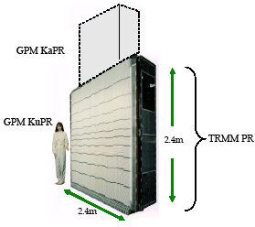
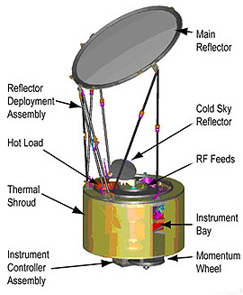
Robert.Hartman@noaa.gov
14
Notes:
NASA images of the GPM core satellite assembly, imager (lower right), 2-band radar (lower left)

