Slide 1

GPM Applications
Public Health
Pietro Ceccato

Slide 2
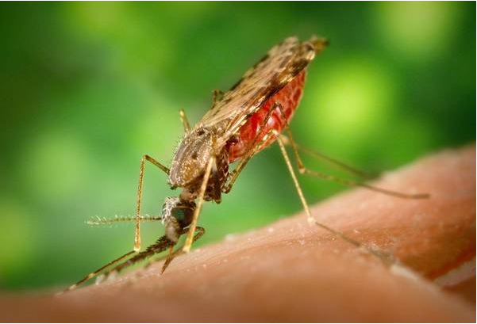
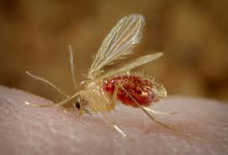
Vector-Borne Diseases
Mosquito
Sandfly
Malaria
Leishmaniasis

Slide 3
How Does Climate Information Help?
Improve understanding of the mechanisms of climate impact on transmission and diseases
Estimate populations at risk (risk mapping)
Estimate seasonality of diseases and timing of interventions
Monitor year-to-year variations in disease incidence (Early Warning Systems)
Improve assessment of the impact of interventions (by removing climate as a confounder)

Slide 4
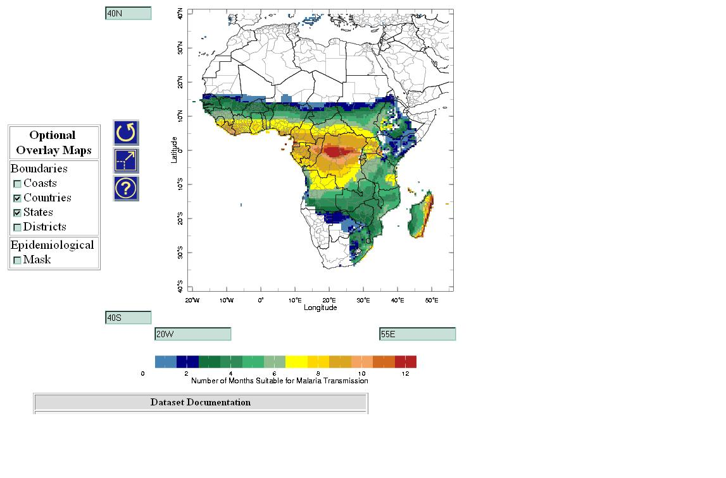
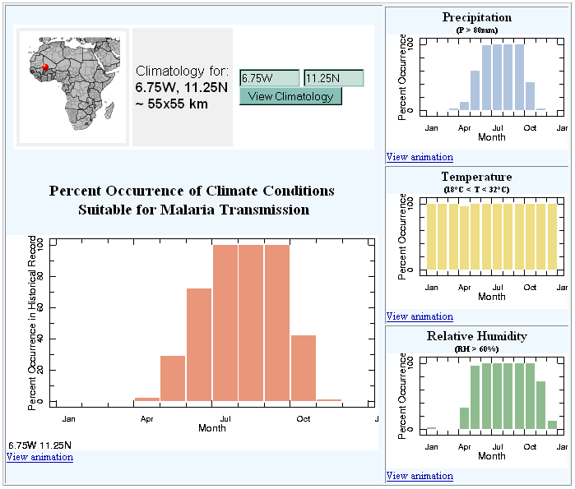
Risk Mapping Seasonality

Slide 5
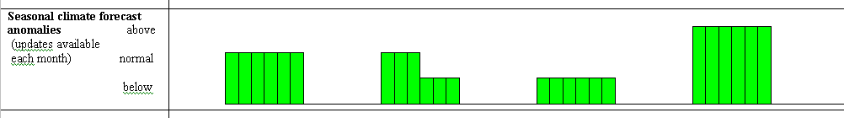
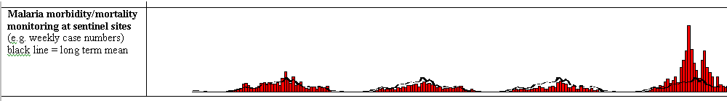
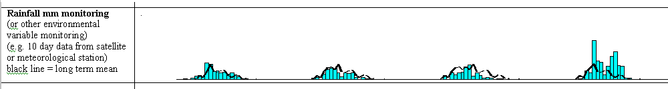
Malaria Early Warning System
Case surveillance alone = late warning

Slide 6
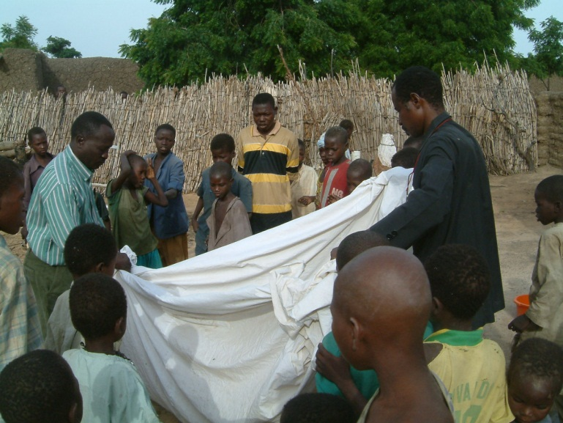
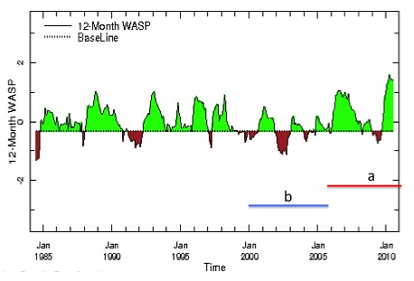
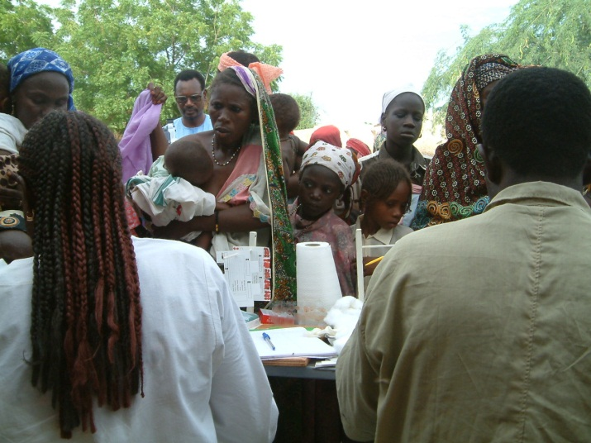
Impact Assessments
Enable USAID/CDC President Malaria Initiative to account for the confounding effect of climate variability when evaluating the national malaria control program’s interventions.
Lyon & Barnston, 2005

Slide 7
Impact Assessments

Slide 8
Which Prec. Products Do We Use for Research?
Products | Time Res | Space Res | Existence
TRMM-3B42 | 3-hourly and Daily | 0.25 deg | 1998-Pres
CMORPH | Daily | 0.25 deg | 2002-Pres
CPC-RFE | Daily | 0.1 deg | 2001-Pres
CPC-ARC | Daily | 0.1 deg | 1995 - 2012
TAMSAT | 10-day | ~0.05 deg | 1983-2013
CPC-RFE | 10-day | 0.1 deg | 1999-Pres
GPCP | Monthly | 2.5 deg | 1979-2010
CMAP | Monthly | 2.5 deg | 1979-2011
TRMM-3B43 | Monthly | 2.5 deg | 1998- 2013

Slide 9
Monthly at 2.5-degree
Validation
N = 360 | GPCP | CMAP | 3B43
CC | 0.92 | 0.92 | 0.92
Bias | 0.80 | 0.91 | 0.92
ME | -30 | -12 | -12
Data: 1998-2004
Dinku et al., 2007; Dinku et al., 2010

Slide 10
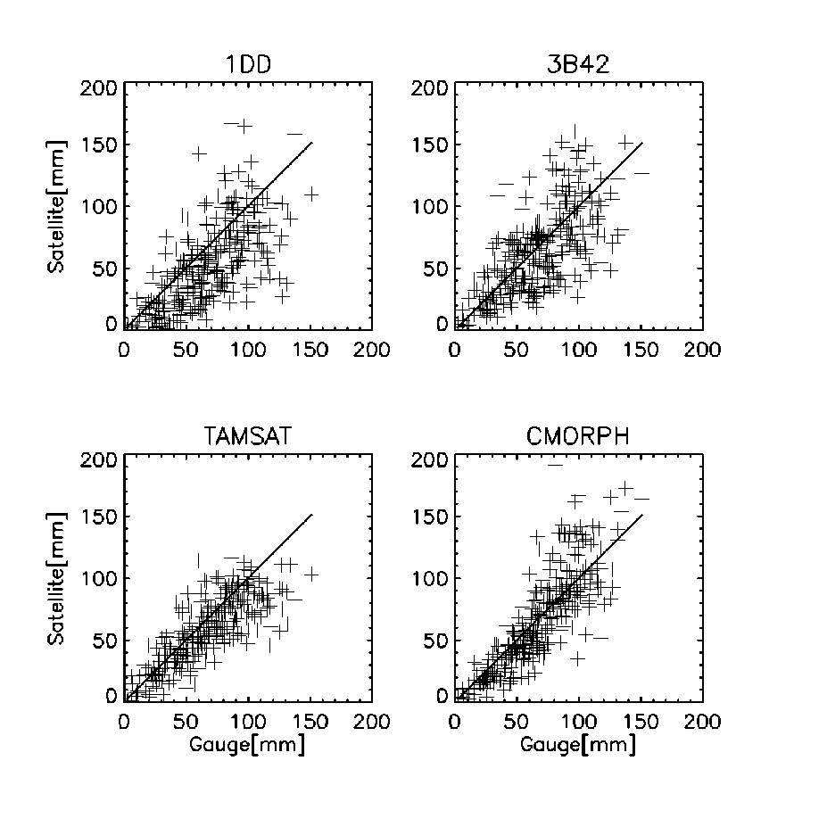
Validation
10 Days at 1ºx1º
N= 306 | 1DD | 3B42 | TAMSAT | CMORPH
CC | 0.68 | 0.68 | 0.79 | 0.83
Bias | 0.77 | 0.94 | 0.86 | 0.98
ME | -16 | -4 | -9 | -1
Dinku et al., 2007; Dinku et al., 2010

Slide 11
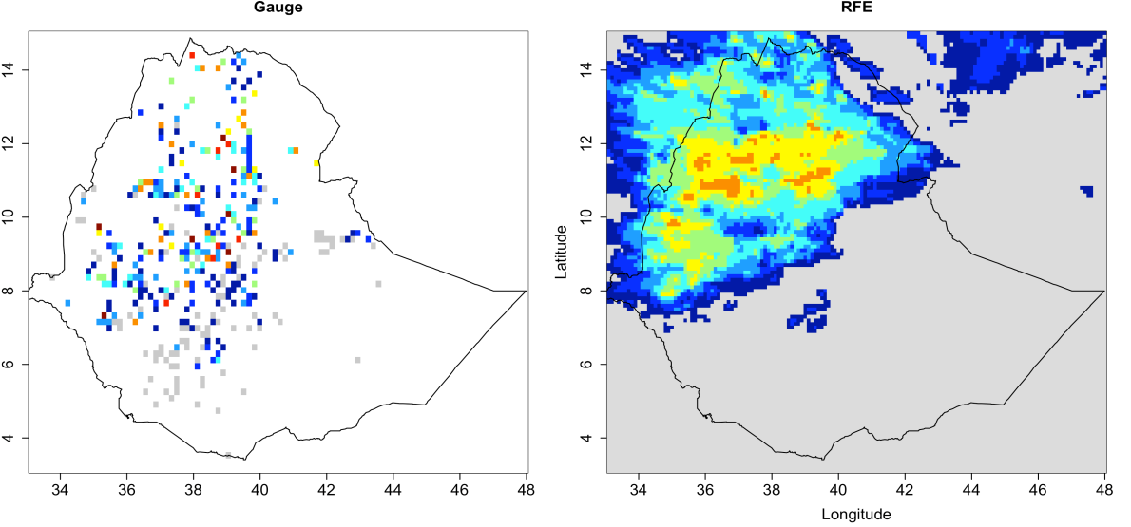
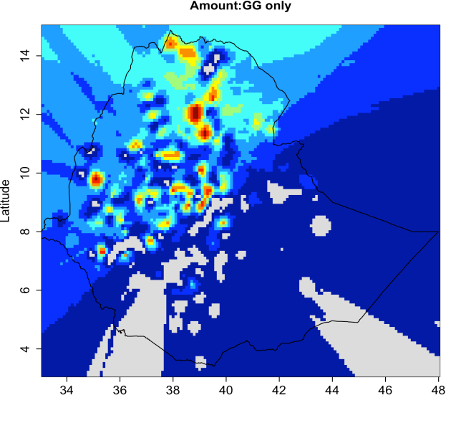
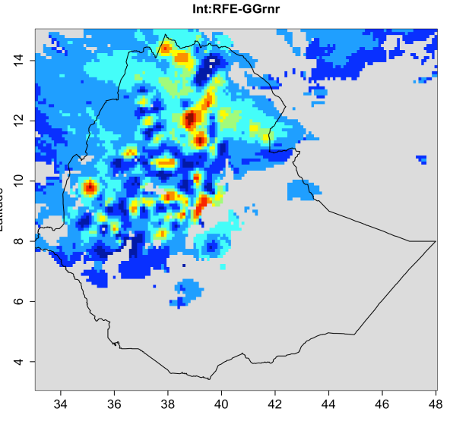
Improvement: IRI works with National Met. Agencies
Enhancing National Climate Services (ENACTS) products
Ethiopia,
Tanzania,
Madagascar,
West Africa (AGRYHMET)
A
B
C
D
Rain gauge data (A), Satellite estimates (B), Gauge-only gridded products(C), and combined gauge-satellite product (D), over Ethiopia

Slide 12
Which Prec. Products Do We Use Operationally?
Products | Time Res | Space Res | Existence
TRMM-3B42 | Daily | 0.25 deg | 1998-Pres
CMORPH | Daily | 0.25 deg | 2002-Pres
CPC-RFE | 10-day | 0.1 deg | 1999-Pres

Slide 13
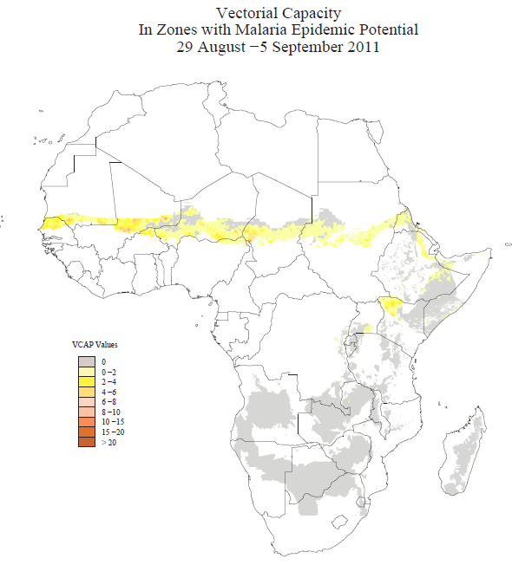
Which Prec. Products Do We Use Operationally?
TRMM and MODIS Land Surface Temperature are combined into a Vectorial Capacity Model for malaria transmission
Vectorial Capacity
Ceccato et al., 2012

Slide 14
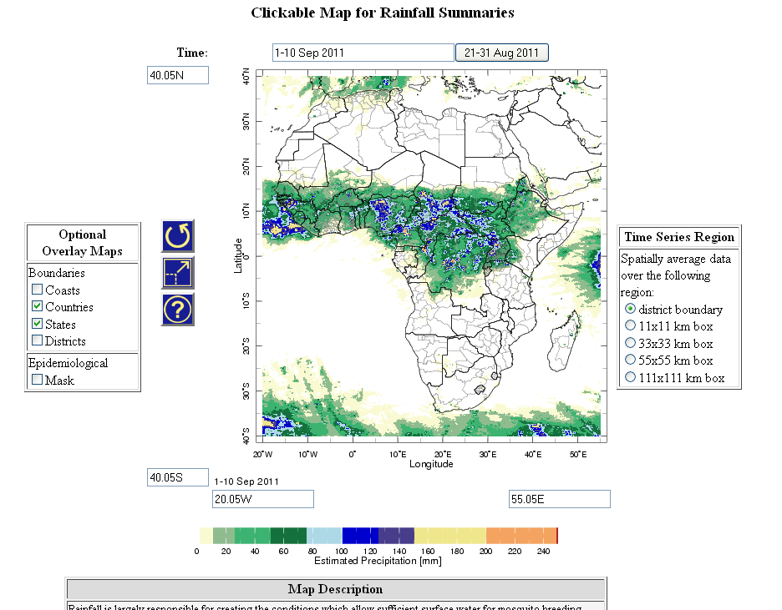
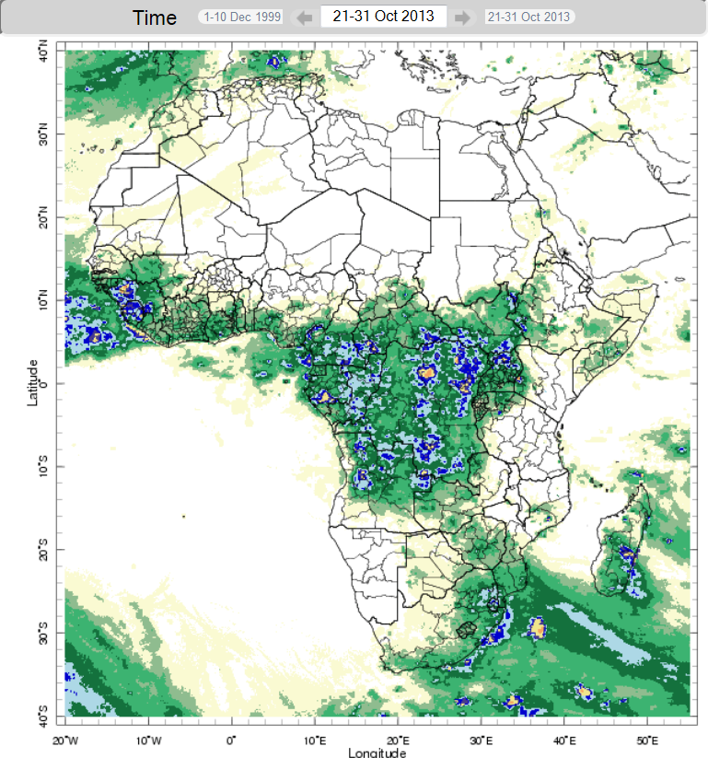
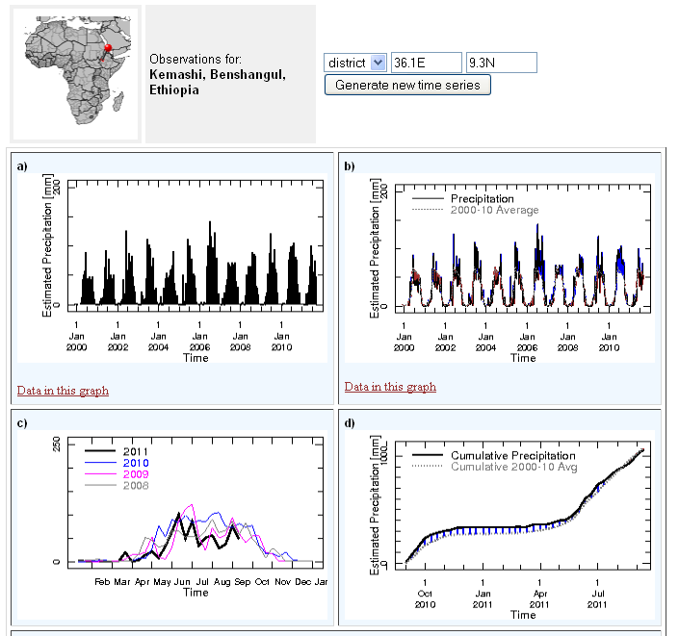
Access to Prec. via the IRI Data Library
Users want:
Easy access (visualization)
Easy download
Easy analysis
Spatial resolution at district level

Slide 15
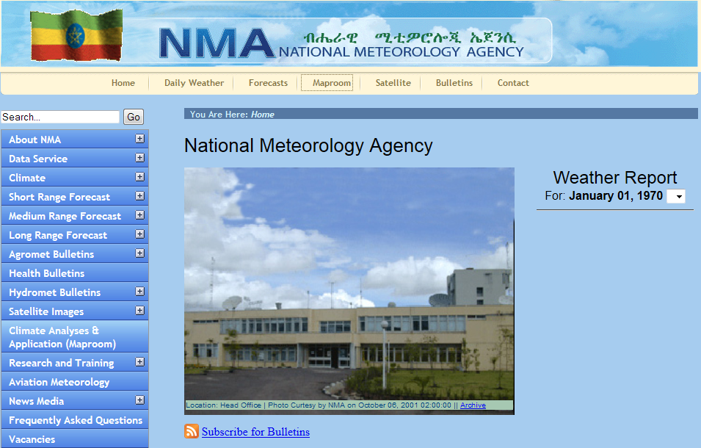
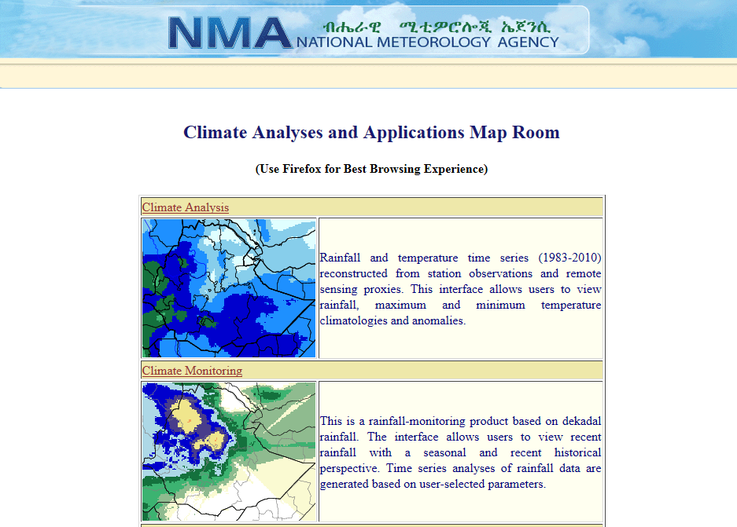
Which Prec. Products Do We Use Operationally?
In specific countries: Enhancing National Climate Services (ENACTS) products.
Ethiopia, Tanzania, Madagascar, West Africa (AGRYHMET)

Slide 16
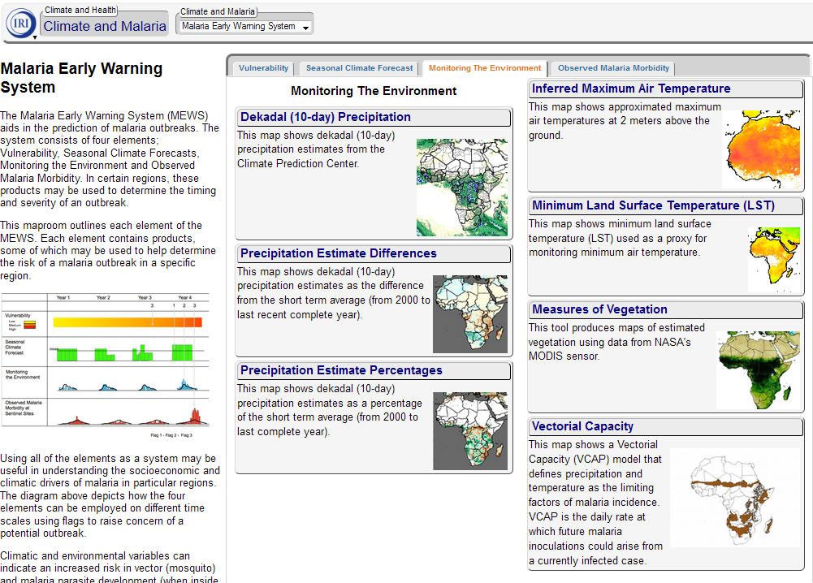
IRI Data Library: Malaria Early Warning System http://iridl.ldeo.columbia.edu/maproom/Health/Regional/Africa/Malaria/System.html

Slide 17
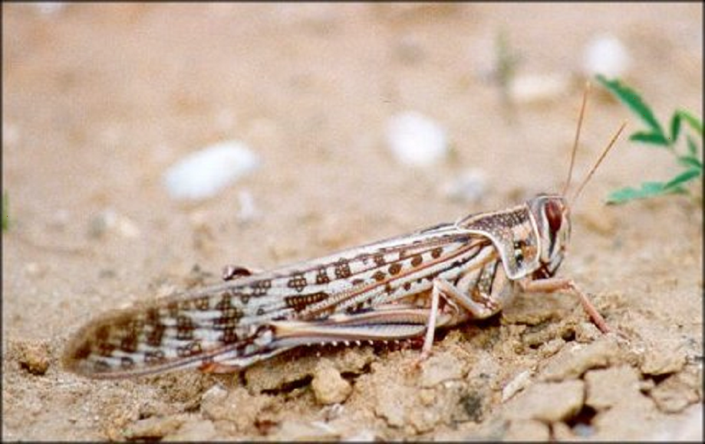
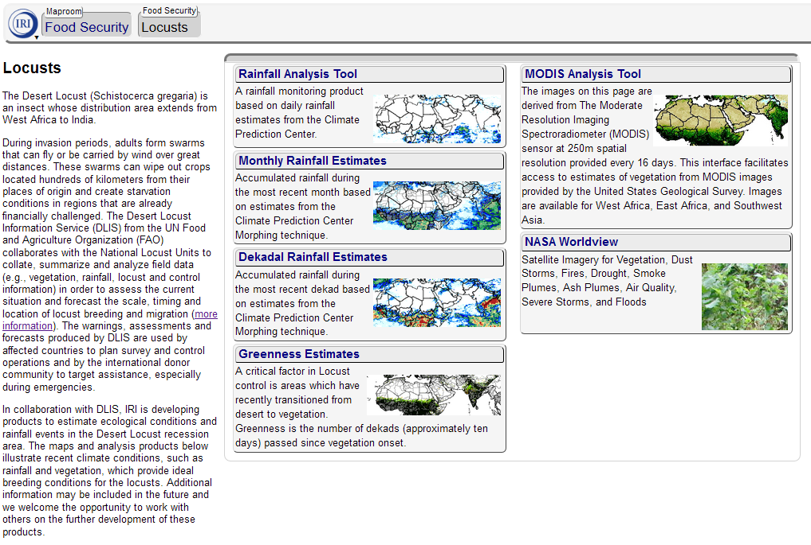

IRI Data Library: Desert Locust http://iridl.ldeo.columbia.edu/maproom/Food_Security/Locusts/index.html

Slide 18
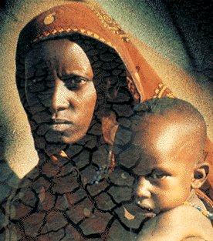
http://iri.columbia.edu
Pietro Ceccato, Stephen Connor,
Tufa Dinku & Madeleine Thomson

