Slide 1
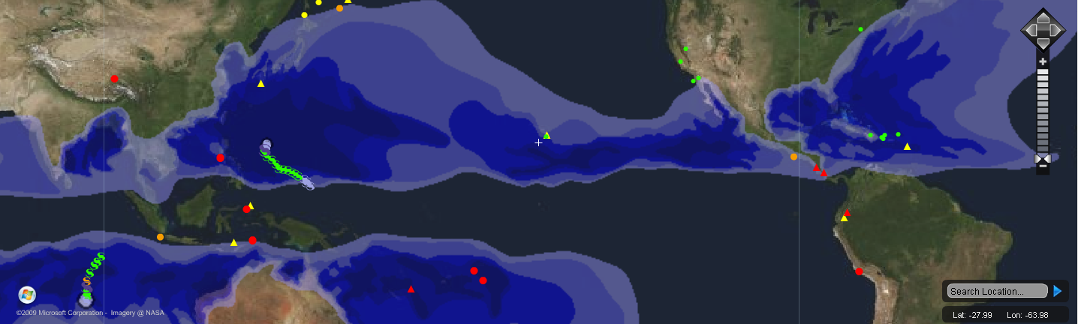

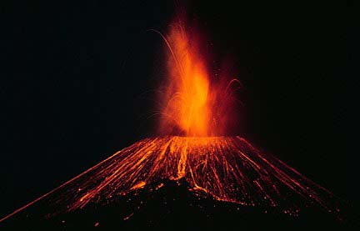
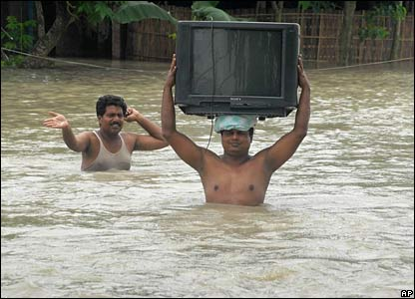



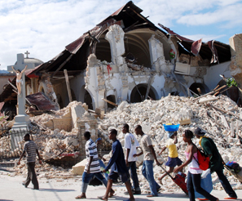
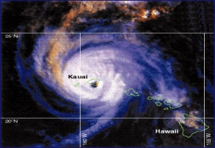

NASA Global Precipitation Measurement Mission (GPM)
2013 GPM Applications Workshop
NOAA Center for Weather and Climate Prediction
College Park, MD
12-13 November 2013
Hazard Detection, Monitoring, Modeling, Assessment and Warning
Chris Chiesa
Deputy Executive Director
Pacific Disaster Center
www.pdc.org
Fostering Disaster-Resilient Communities Through Information, Science, Technology, and Exchange
Fostering Disaster-Resilient Communities …
University of Hawaii: Managing Partnering

Slide 2
Avoid Hazards
=> Disasters
=> Crises
Vision: Safer & More Secure World
  Sustainable communities, safer nations, and a more secure world through Disaster Risk Reducing
Goal: (Increased) Disaster Resiliency
  Foster disaster-resilient communities through information, science, technology, and exchange
Mission: Reduce Disaster Risks
  Provide applied information research and evidence-base analysis supporting development of more effective disaster risk reduction (DRR) policies and practices; and applications and information products supporting Humanitarian Assistance and Disaster Relief (HA/DR) operators and practitioners in the Asia Pacific region and beyond.
  _{Asia} _{Pacific:}
  _{38% of World’s Disasters}
  _{80% of World’s Casualties}

Slide 3
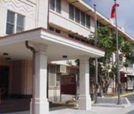
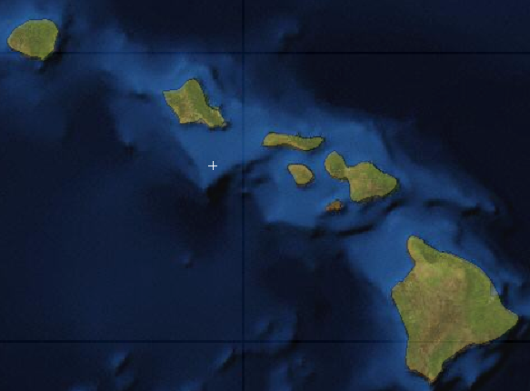
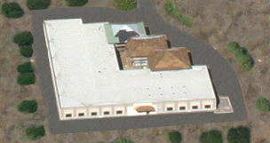
PDC Presence and Composition
Became Operational in 1996
  Managed by University of Hawaii since 2006
60% Public Funds; 40% Contracts/Grants
  Cooperative Agreement (CA) with OSD/P
  USAID, USDTA, DHS/FEMA, NOAA, WB, ADB, …
Nearly 50 full time staff
  Offices
    Hawaii: Maui and Oahu
    Washington DC, Colorado Springs, Miami, SE Asia
  Experts:
    Disaster Management Scientists
    Geospatial Data and Visualization Experts & Analysts
    Information System Engineers & Technologies Experts
    Modeling, Simulation, and Impact Assessment Specialists; Public Health SME
Ft. Shafter
HSCD Diamond Head
Maui HQ

Slide 4
Objective: Building a Bridge
S&T
Community
Decision
Makers
Audience
Comfort with uncertainty
Vocabulary
Associations
Peer Review
The Public
Low
High
Complex
Simple
Technical
Groups
Very
Public

Slide 5
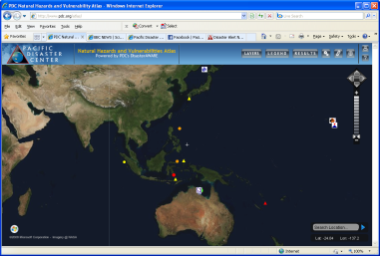
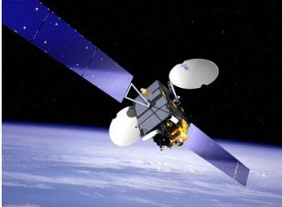
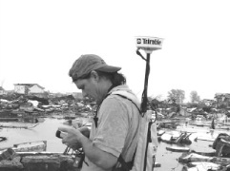
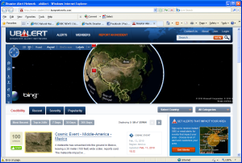
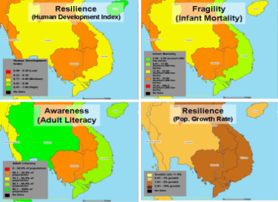
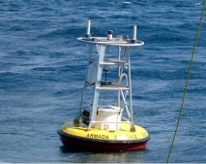

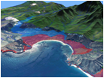

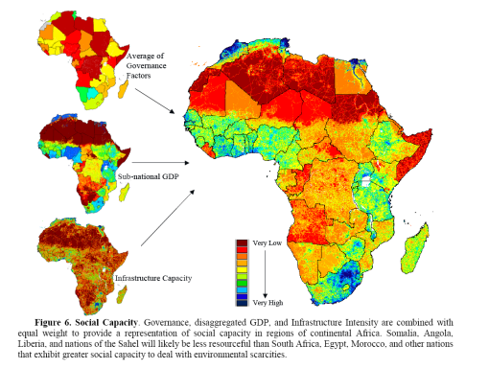
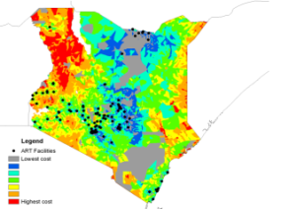
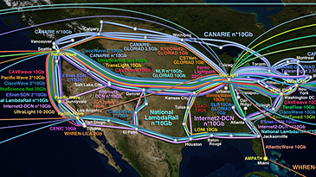
PDC’s Integrated Approach
Applied Science & Technology
Capability Building
Evidence-Based Information Products
  Policy & Decision Makers
  Disaster Managers
  Planners
  Humanitarian Assist. Missions
Observation Systems , Data Collection
Integrating Information, Science, Technology
GIS, Visualization and Display Systems
Improve
Decision-Support Capabilities
Communication Systems and Networks
Advanced Applications, Models, Risk & Vulnerability Assessment

Slide 6
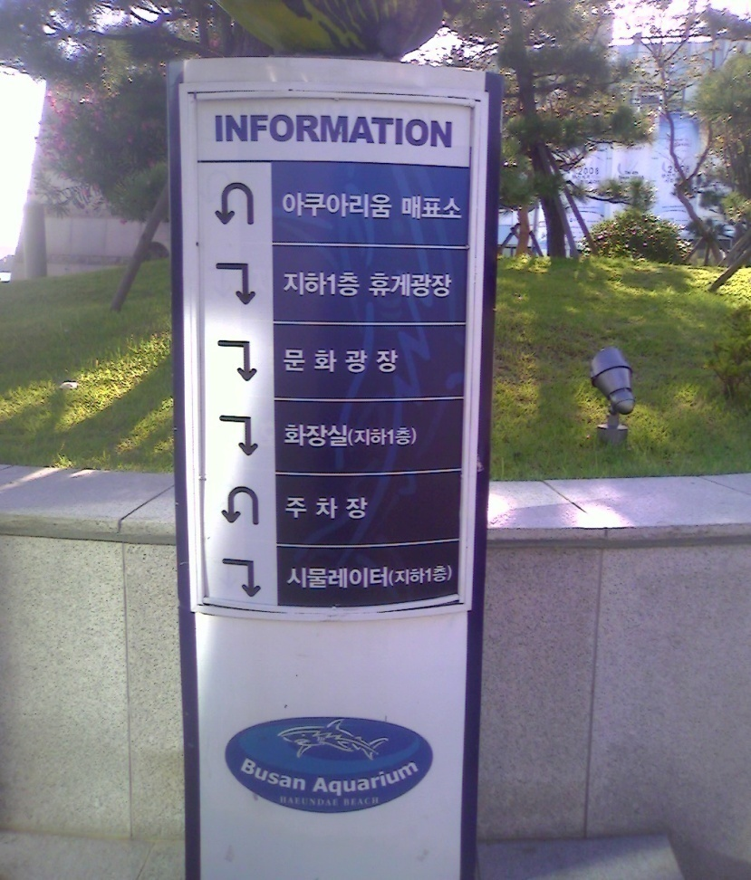
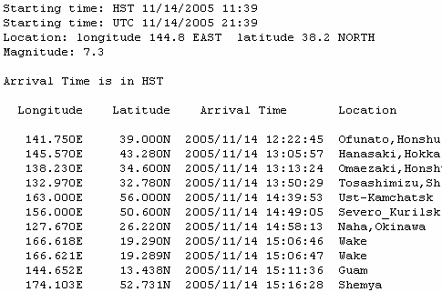
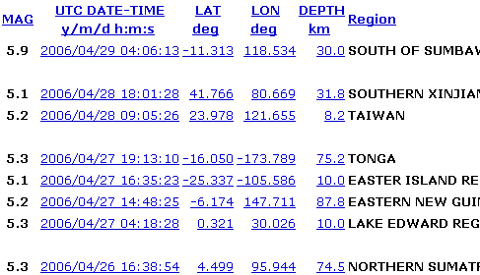
DM Challenges & Gaps …
Inadequate Tools for the Decision Makers
  Information is Scattered
  Warnings are Hard to Quickly Digest
  Lack Situational Awareness
  No Risk Context
  Dissemination is Limited
Time is LIFE
  Information not easily understood isn’t particularly useful ....
Sample Advisories
HURRICANE DAVID FORECAST/ADVISORY NUMBER 15
Hurricane
NATIONAL WEATHER SERVICE MIAMI FL EP0402
0000Z WED AUG 29 1979
Tsunami
HURRICANE CENTER LOCATED NEAR 13.7N 58.0W AT 29/0000Z
POSITION ACCURATE WITHIN 30 NM
PRESENT MOVEMENT TOWARD THE WEST-NORTHWEST OR 285 DEGREES AT 11 KT
ESTIMATED MINIMUM CENTRAL PRESSURE 942 MB
EQ
MAX SUSTAINED WINDS 120 KT WITH GUSTS 135 KT.
WINDS AND SEAS VARY GREATLY IN EACH QUADRANT. RADII IN NAUTICAL
MILES ARE THE LARGEST RADII EXPECTED ANYWHERE IN THAT QUADRANT.
REPEAT...CENTER LOCATED NEAR 13.7N 58.0W AT 29/0000Z
AT 28/2300Z CENTER WAS LOCATED NEAR 13.7N 57.0W
FORECAST VALID 29/0600Z 14.2N 59.2W
MAX WIND 120 KT...GUSTS 135 KT.
64 KT... 35NE 35SE 35SW 35NW.
45 KT... 45NE 45SE 45SW 45NW.
34 KT... 135NE 135SE 135SW 135NW.
FORECAST VALID 29/1200Z 14.8N 60.3W
MAX WIND 125 KT...GUSTS 140 KT.
64 KT... 40NE 40SE 40SW 40NW.
50 KT... 50NE 50SE 50SW 50NW.
34 KT... 130NE 130SE 130SW 130NW.

Slide 7
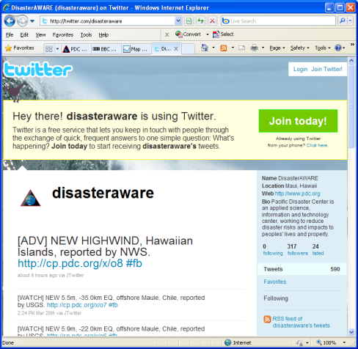
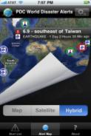



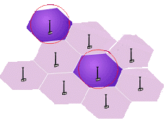
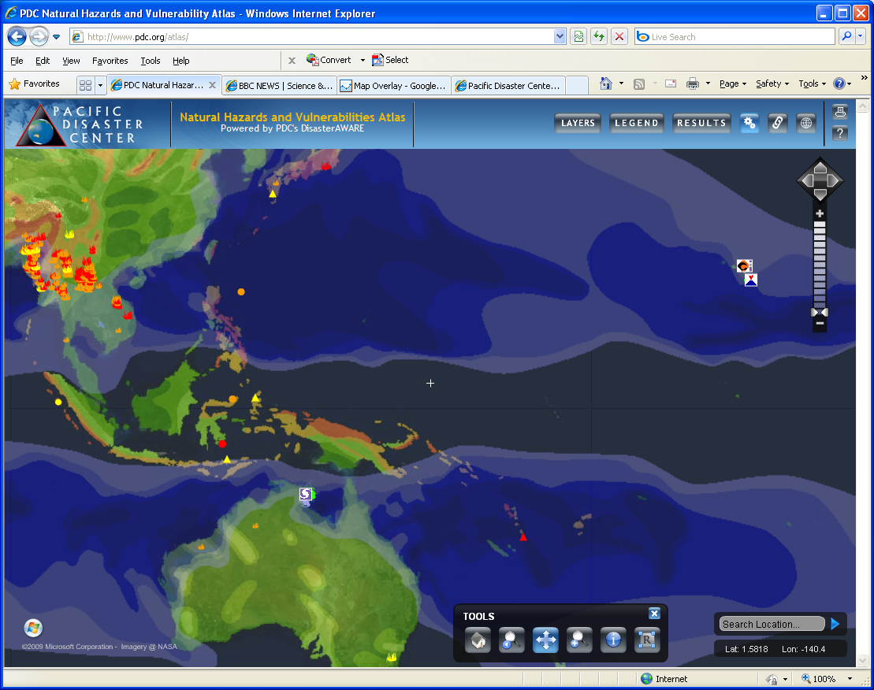
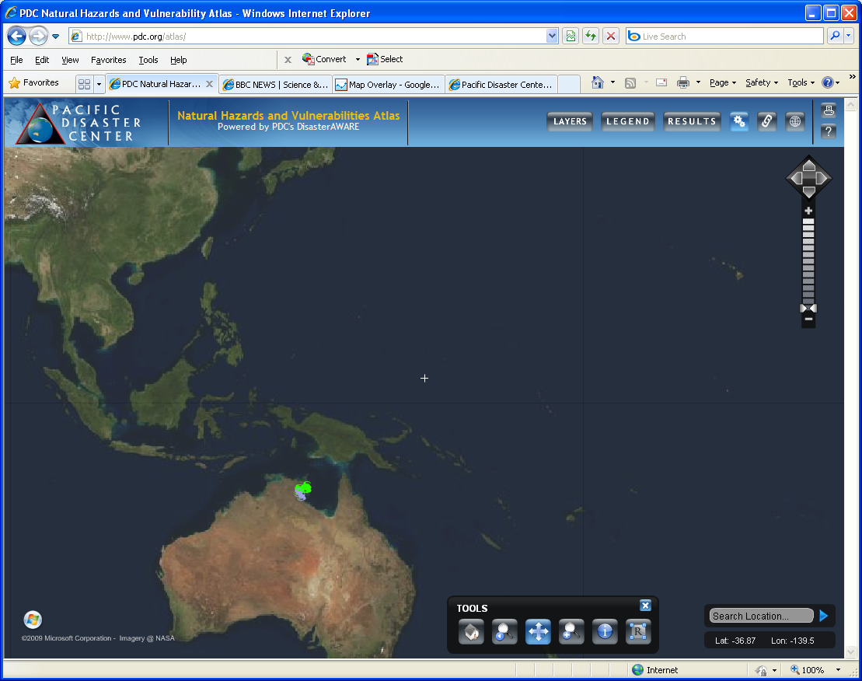
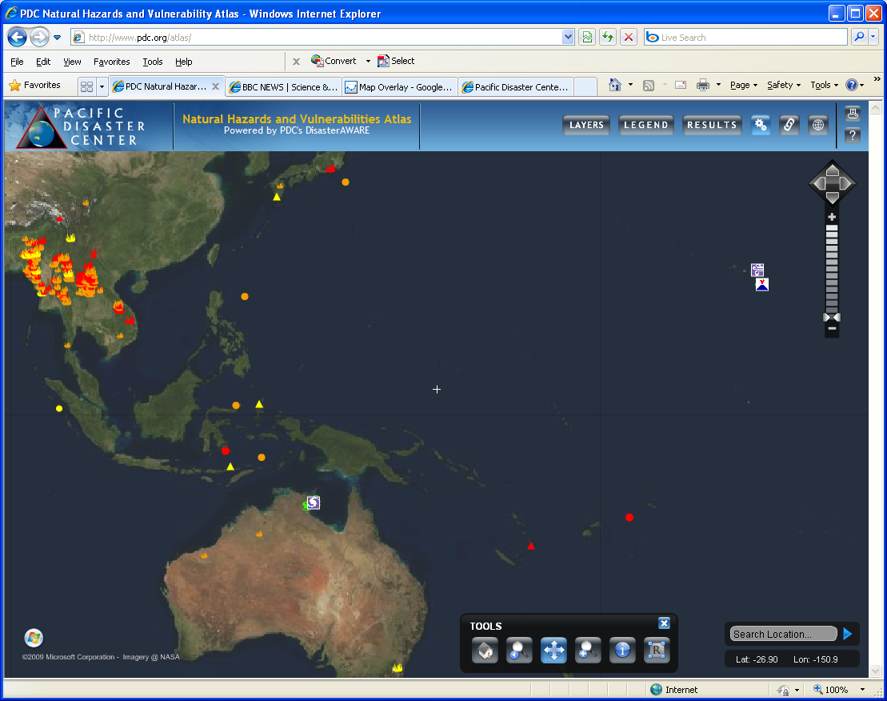

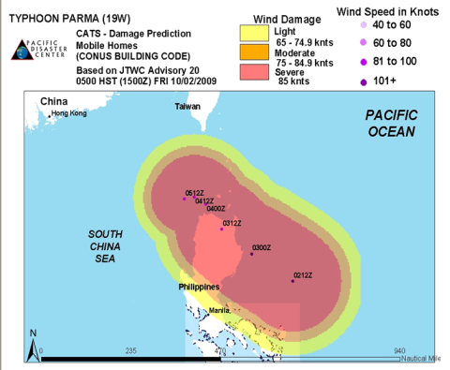
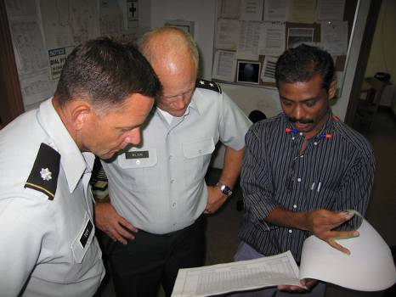
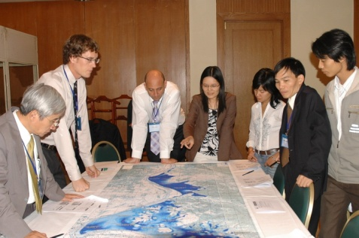
Overcoming Challenges
Mobile Apps, Social Media
Tools for Decision Makers
  Simplify, Integrate, & Expedite Processing
  Understand Exposure
  Disseminate Early Warning
  Support Decisions Based on Latest Assessments
Info for Policy Makers & Planners
  Assess Socio-Econ Risks & Vulnerabilities
Capacity for Practitioners
  Training & Exercise
  Workshops
HURRICANE DAVID FORECAST/ADVISORY NUMBER 15
NATIONAL WEATHER SERVICE MIAMI FL EP0402
0000Z WED AUG 29 1979
Hurricane
Tsunami
HURRICANE CENTER LOCATED NEAR 13.7N 58.0W AT 29/0000Z
POSITION ACCURATE WITHIN 30 NM
PRESENT MOVEMENT TOWARD THE WEST-NORTHWEST OR 285 DEGREES AT 11 KT
ESTIMATED MINIMUM CENTRAL PRESSURE 942 MB
Fires
EQ
MAX SUSTAINED WINDS 120 KT WITH GUSTS 135 KT.
High Surf
WINDS AND SEAS VARY GREATLY IN EACH QUADRANT. RADII IN NAUTICAL
EQ
MILES ARE THE LARGEST RADII EXPECTED ANYWHERE IN THAT QUADRANT.
REPEAT...CENTER LOCATED NEAR 13.7N 58.0W AT 29/0000Z
AT 28/2300Z CENTER WAS LOCATED NEAR 13.7N 57.0W
FORECAST VALID 29/0600Z 14.2N 59.2W
MAX WIND 120 KT...GUSTS 135 KT.
64 KT... 35NE 35SE 35SW 35NW.
45 KT... 45NE 45SE 45SW 45NW.
34 KT... 135NE 135SE 135SW 135NW.
Volcano
Storm
FORECAST VALID 29/1200Z 14.8N 60.3W
MAX WIND 125 KT...GUSTS 140 KT.
64 KT... 40NE 40SE 40SW 40NW.
50 KT... 50NE 50SE 50SW 50NW.
34 KT... 130NE 130SE 130SW 130NW.

Slide 8
Hazard Detection and Modeling

Slide 9
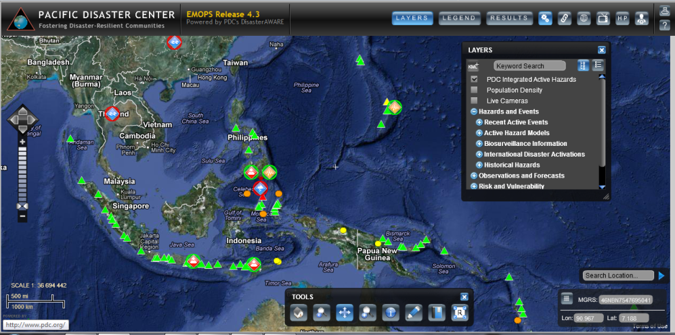
Automated Hazards
Dynamic Data Processing and Publication
    Earthquakes
    Tsunamis
    Tropical Cyclones
    Wildfires
    Volcanoes
    Floods
Stored in Enterprise Geospatial Database
Published as standards-based Map & Data Services
Consumed in Web & Mobile Apps, Social Media, Plug-in Widget

Slide 10
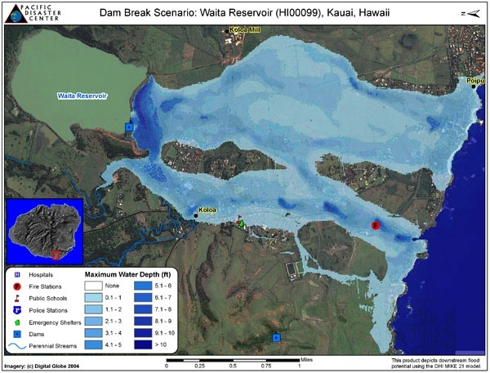
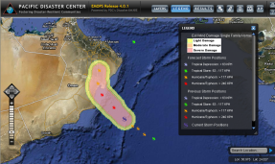
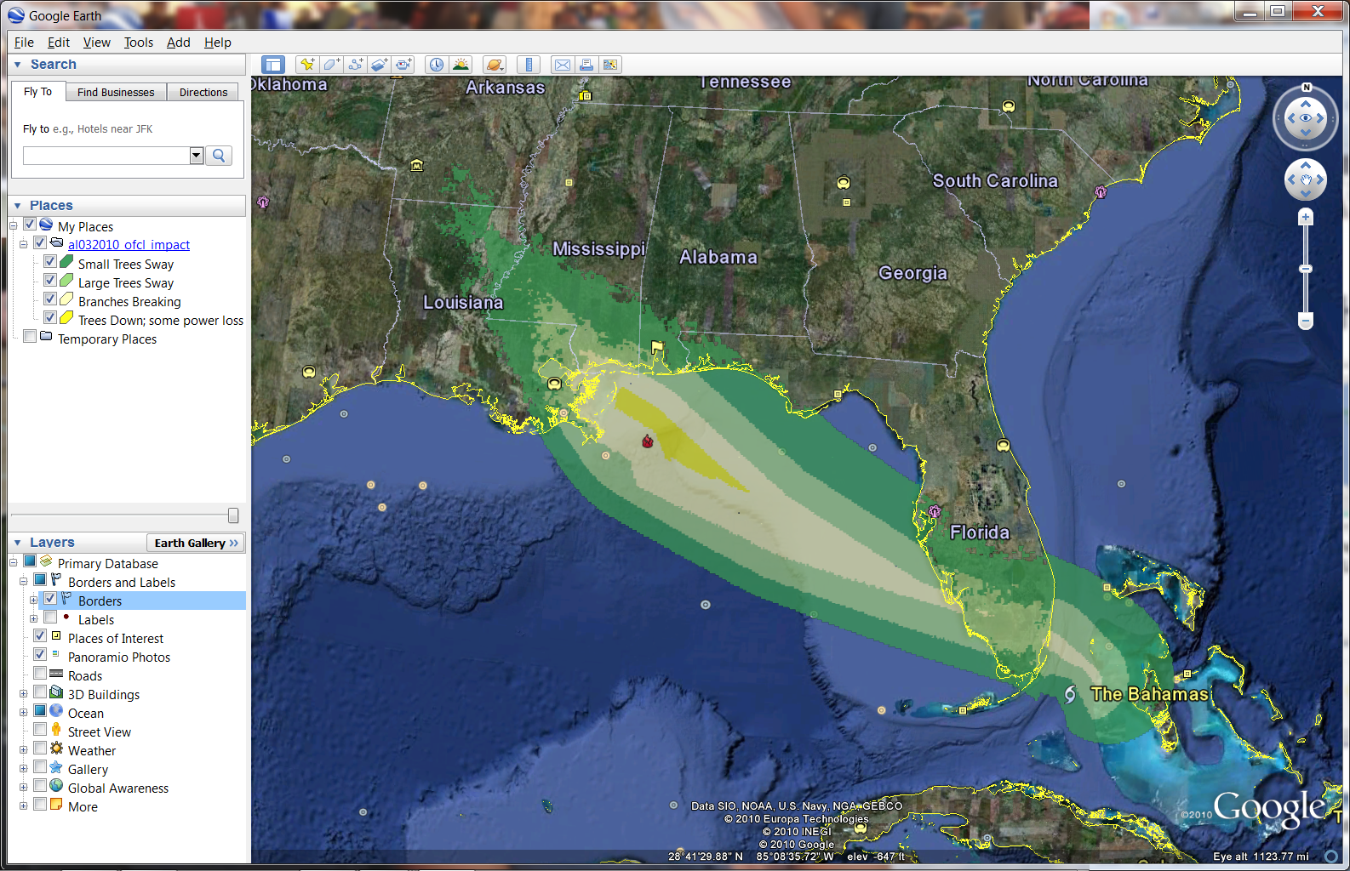
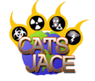
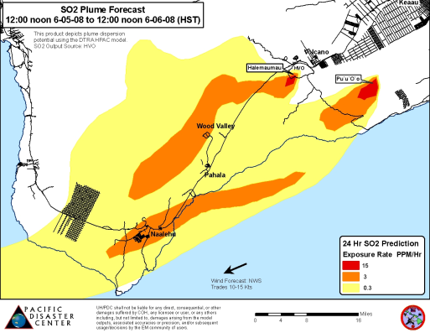
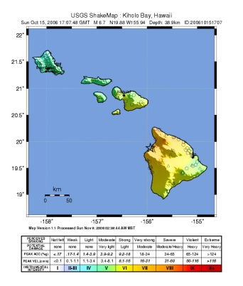
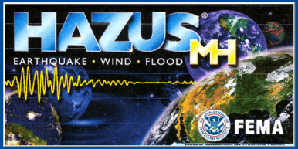
Hazard Modeling Capabilities
Floods / Dam Failures
  “MIKE 11/21” (DHI, inc.)
Hurricanes
  “CATS” (DTRA)
  “TAOS” (KA Corp)
Earthquakes
  “ShakeMap” (USGS)
  “HAZUS-MH” (DHS/FEMA)
Tsunamis
  “TTT” (NOAA)
Plume Modeling
  “HPAC” (DTRA)

Slide 11
Disaster Assessment, Monitoring and Warning

Slide 12
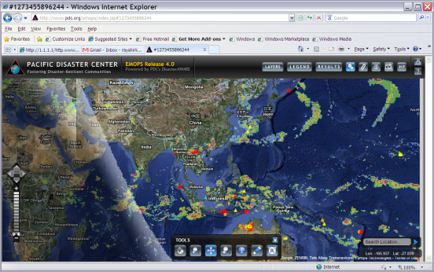
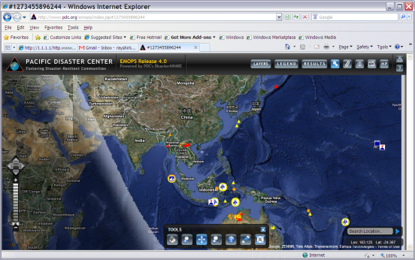
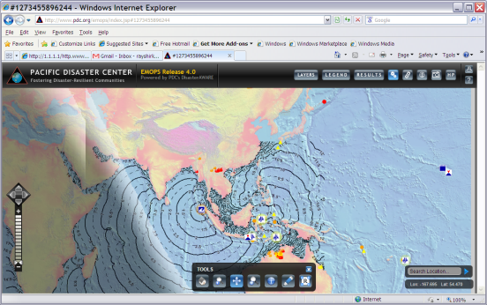
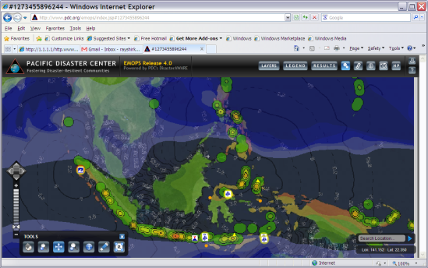
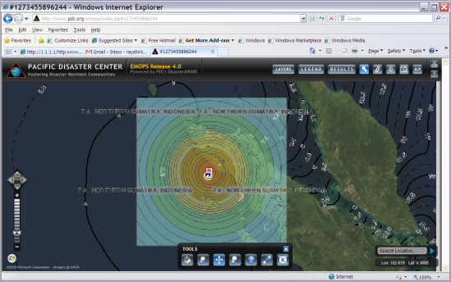
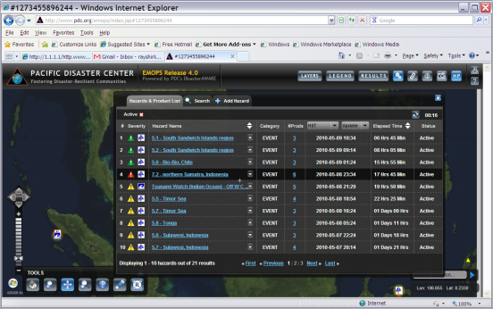
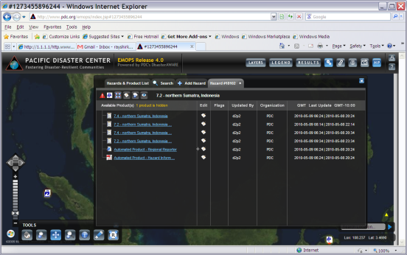
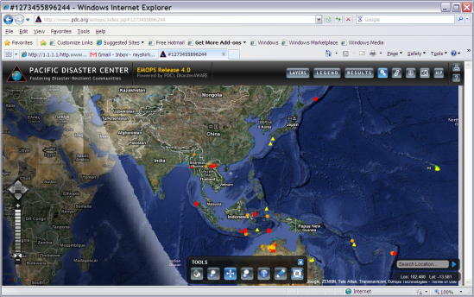
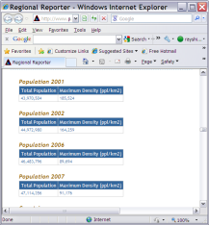
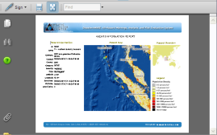
DisasterAWARE
Mobile App
Social Media
Integrated Multi-hazard Hazard Monitoring
Disaster Early Warning
Automated / Integrated Modeling
Exposure (Risk) Maps & Historical Hazard data
Customized Impact Modeling AND
Intra-Agency Info Sharing
  User-provided Situation Reports
  Damage Assessment
Wide Dissemination
  Web
  Social Media
  Mobile Apps
May 10, 2010
Storm, EQ, Volcano Intensity Zones
Tsunami Travel Time
Rain
Info Sharing
Volcano
EQ
Shake Maps (MMI)
Hot Spots
Situation Reports

Slide 13
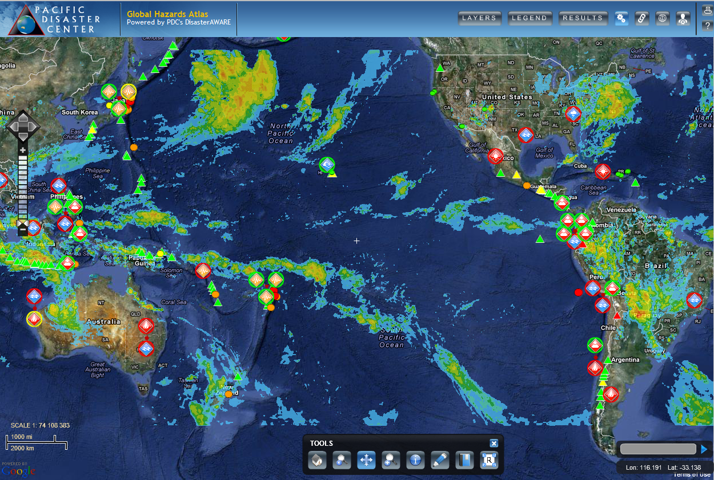
PDC Global Hazards Atlas
http://www.pdc.org/atlas

Slide 14
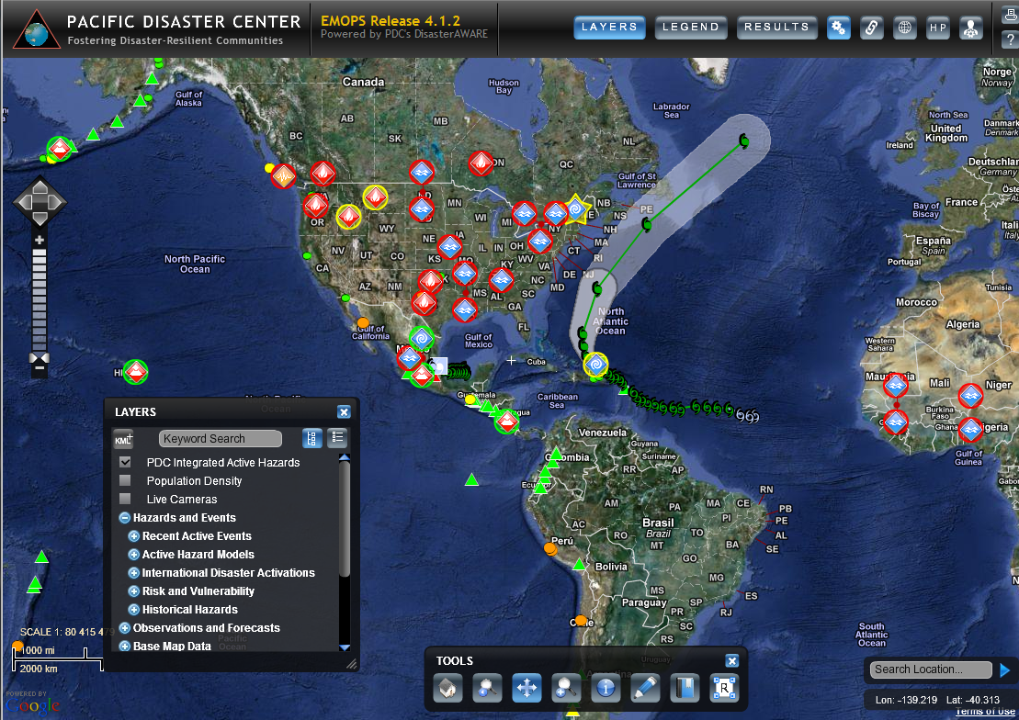



Slide 15

Warning Notification / Subscription

Slide 16



Slide 17



Mobile Public Disaster Alert Application
Disaster Alert provides a listing and an interactive map of Active Hazards occurring around the globe.
Available for Android and iPhone via the Android Market and iTunes on-line stores.
Interactive map
Hazards list
Details of an event
Notes:
Links for access:
http://itunes.apple.com/us/app/disaster-alert-pacific-disaster/id381289235?mt=8
https://market.android.com/details?id=disasterAlert.PDC&feature=search_result

Slide 18
Regional DisasterAWARE Deployments

Slide 19

Caribbean CDERA (2003)

Slide 20



Thailand NDWC (2006 & 2013)

Slide 21



Vietnam DMC (2010; 2012-14)

Slide 22


ASEAN AHA Centre (2012)

Slide 23

Indonesia BNPB (2012-14, in-progress)

Slide 24


NASA FIRMS

Slide 25


PDC/UH Collaboration

Slide 26


Slide 27



Flood Hazard (manual SOP)

Slide 28

PDC/UMD GFMS Collaboration

Slide 29


DFO Collaboration – Large Floods

Slide 30

Super Typhoon Haiyan
Operational Users
USAID OFDA
US State Dept.
USPACOM (JOC and J2 JIOC)
USARPAC COIC
USACE Pacific Office Division
Joint Region Marianas Regional Operations Center (JRM ROC)
USNORTHCOM
NGA
U.S. Embassy in Manila
UN OCHA (Regional and UNDAC)
UN World Food Program
ASEAN AHA Centre
Philippines NDRRMC
Vietnam DMC
Palau NEMO
Office of Environment and Emergency Management (OEEM), Federal Govt. FSM
Disaster Coordinating Office, Yap State, Micronesia (FSM)

Slide 31


Chris Chiesa
cchiesa@pdc.org
Fostering Disaster-Resilient Communities
For more Information:
http://www.pdc.org
Follow us on: DisasterAWARE
Contact us at: info@pdc.org

