Slide 1
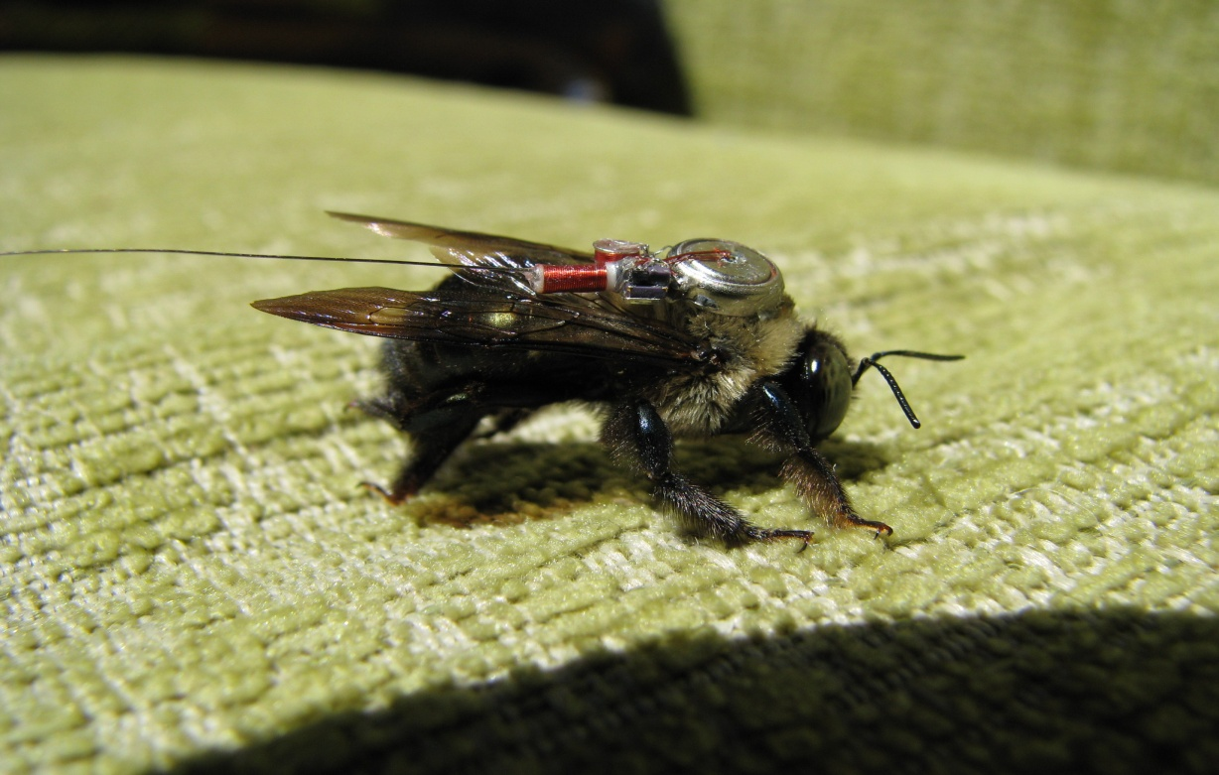
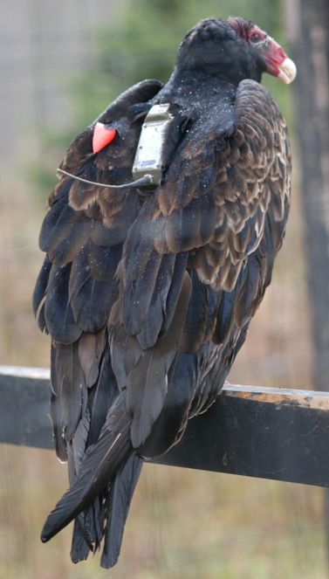
Env-DATA – New Tools for Studying Animal Movement and Their Environment
Gil Bohrer
Assistant Professor for Ecological Engineering
Department of Civil, Environmental & Geodetic Engineering The Ohio State University
GPM Workshop

Slide 2
Movement is tightly linked with the environment – along the path, and the path not taken

Slide 3
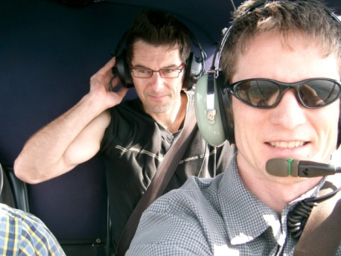
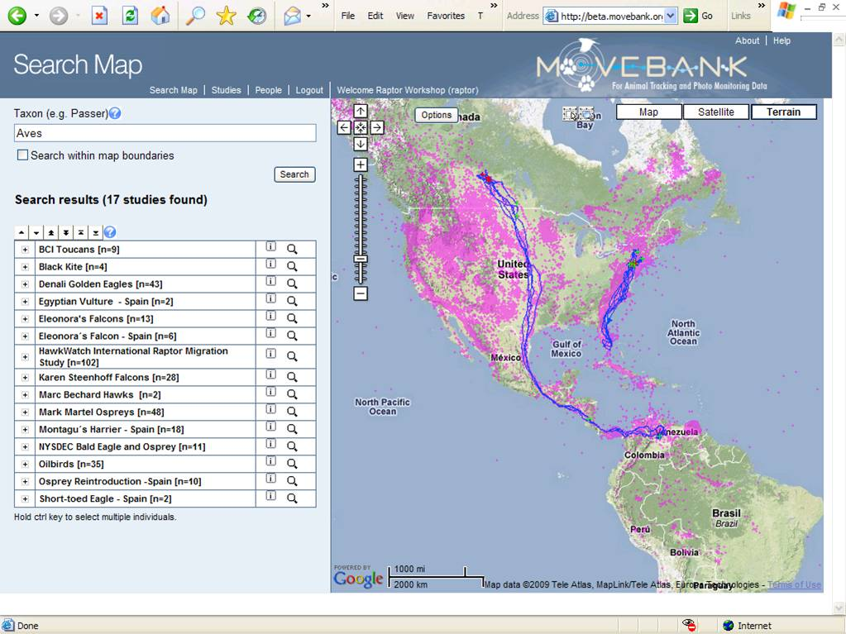
www.movebank.org
What to do with track data?

Slide 4
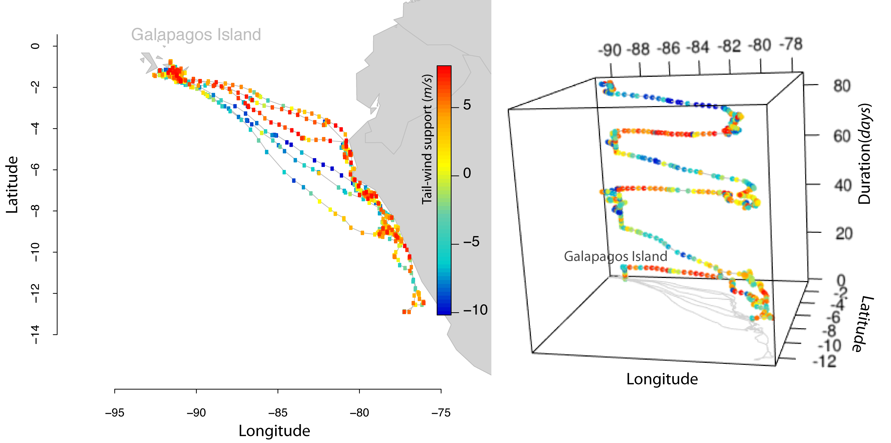
Track annotation – linking environmental data to observed track points
Albatross movement to Galapagos

Slide 5
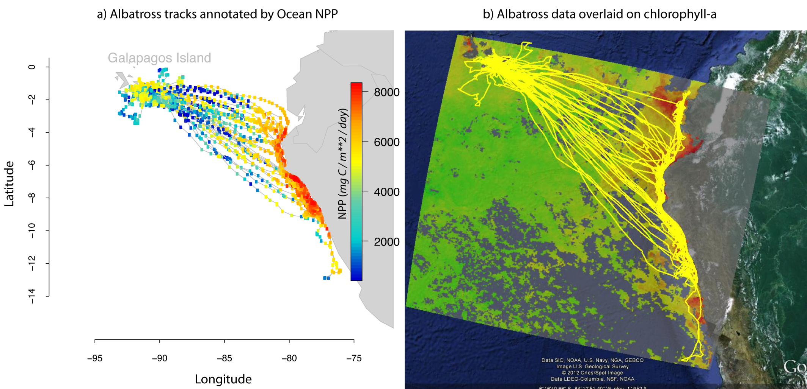
Env-DATA– Environmental Data Automated Track Annotation system in MoveBank
NASA Biological Monitoring, project #NNX11AP61G

Slide 6
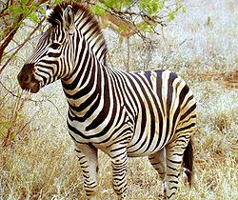
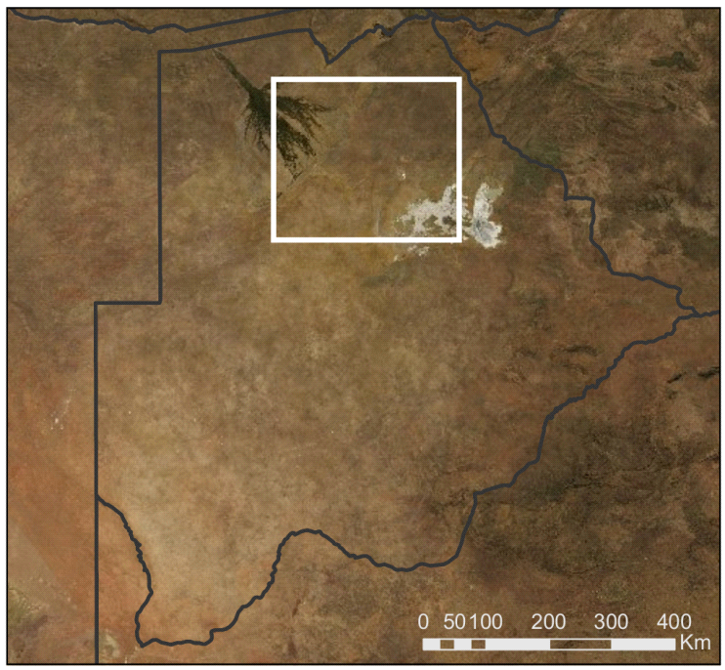
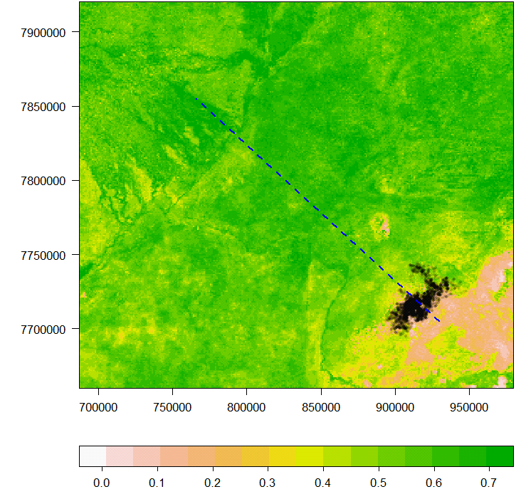
Zebras at the Okavango Delta: Moving to greener pastures
Bartlam-Brooks et al JGR 2014 (in press)
Zimbabwe
Okavango river delta
Namibia
Botswana
Makgadikgadi salt pans
South Africa

Slide 7
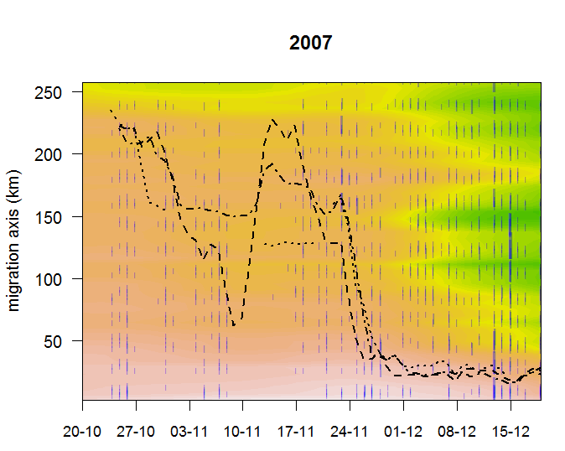
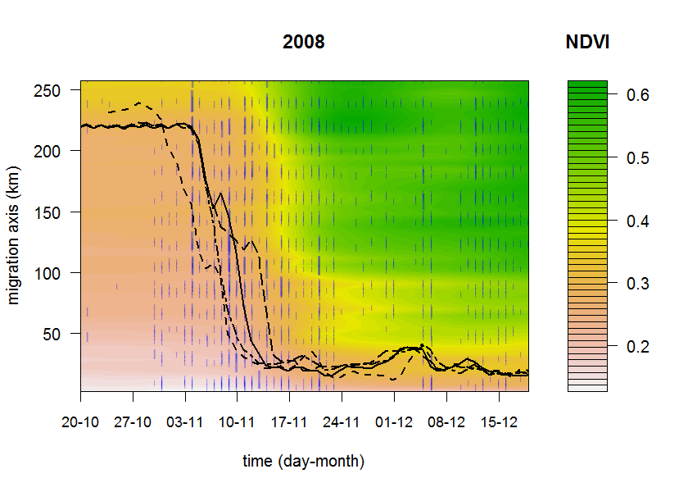
Zebras surf the green wave Consider precipitation as well
A
)
m
(
e
d
u
t
i
t
a
L
Time dd-mm
Time dd-mm
Aborted migration

Slide 8
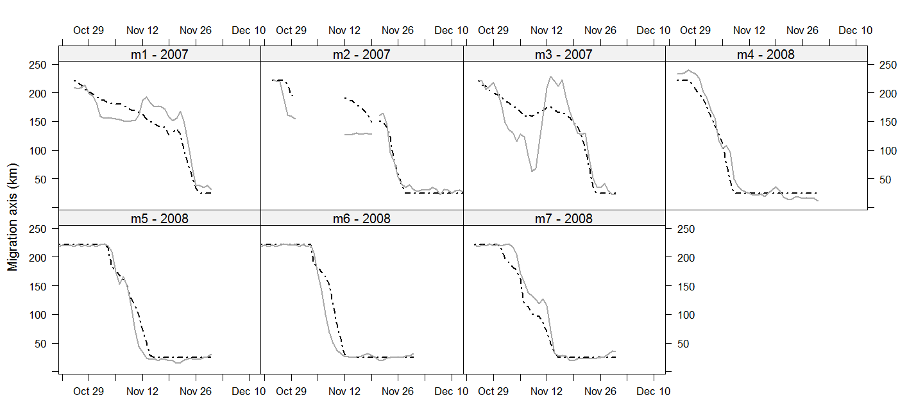
Our data allowed developing a very good model of zebra movement

Slide 9
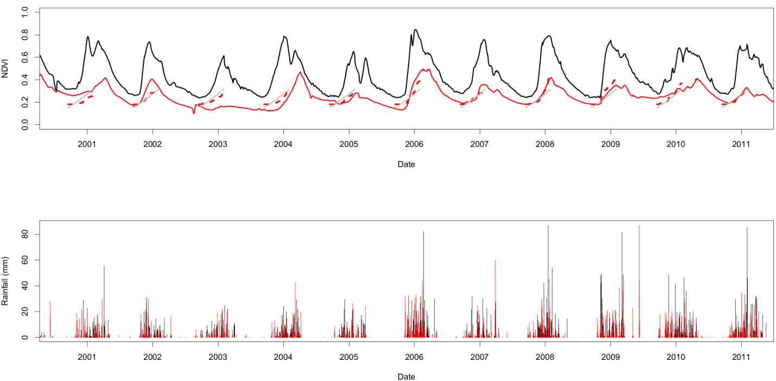
Zebras use rain in the dry-season habitat to predict grass growth at the destination wet-season habitat

Slide 10
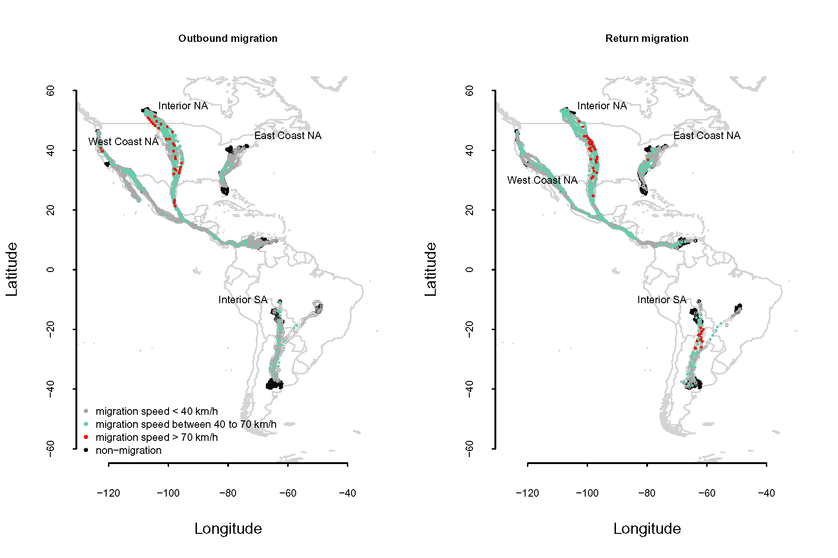
Going global - Trans-American migration of Turkey Vulture

Slide 11
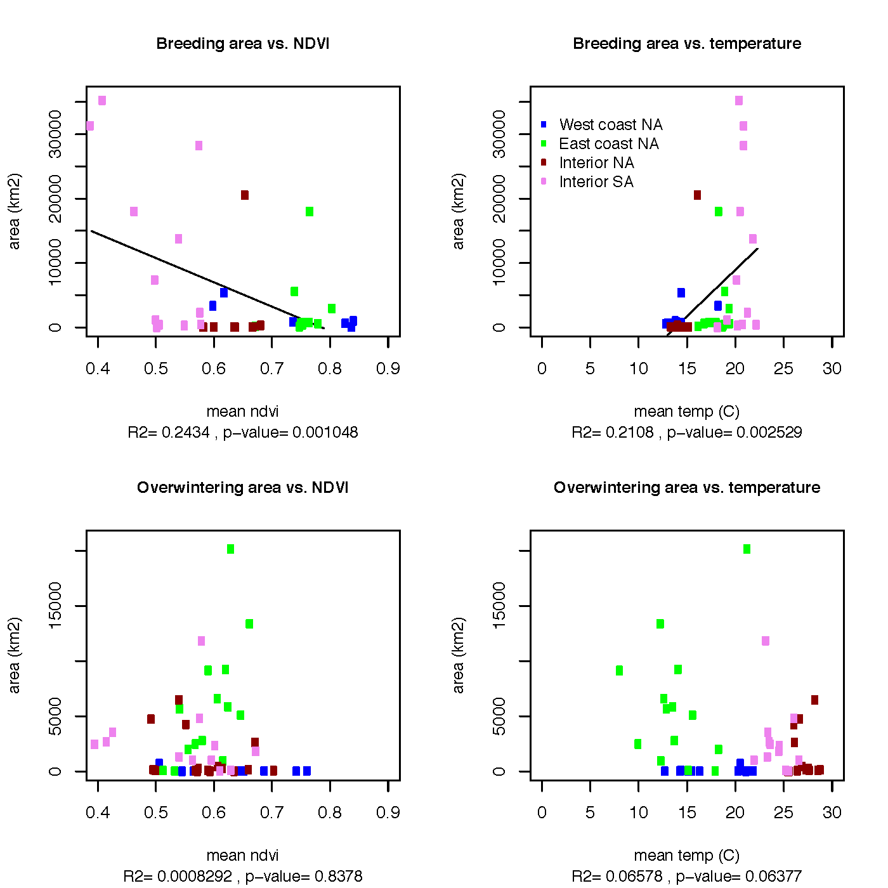
Breeding home-range size is affected by environment – NDVI and Temperature
Northern/Southern range precluded us from testing precipitation using TRMM

