Slide 1
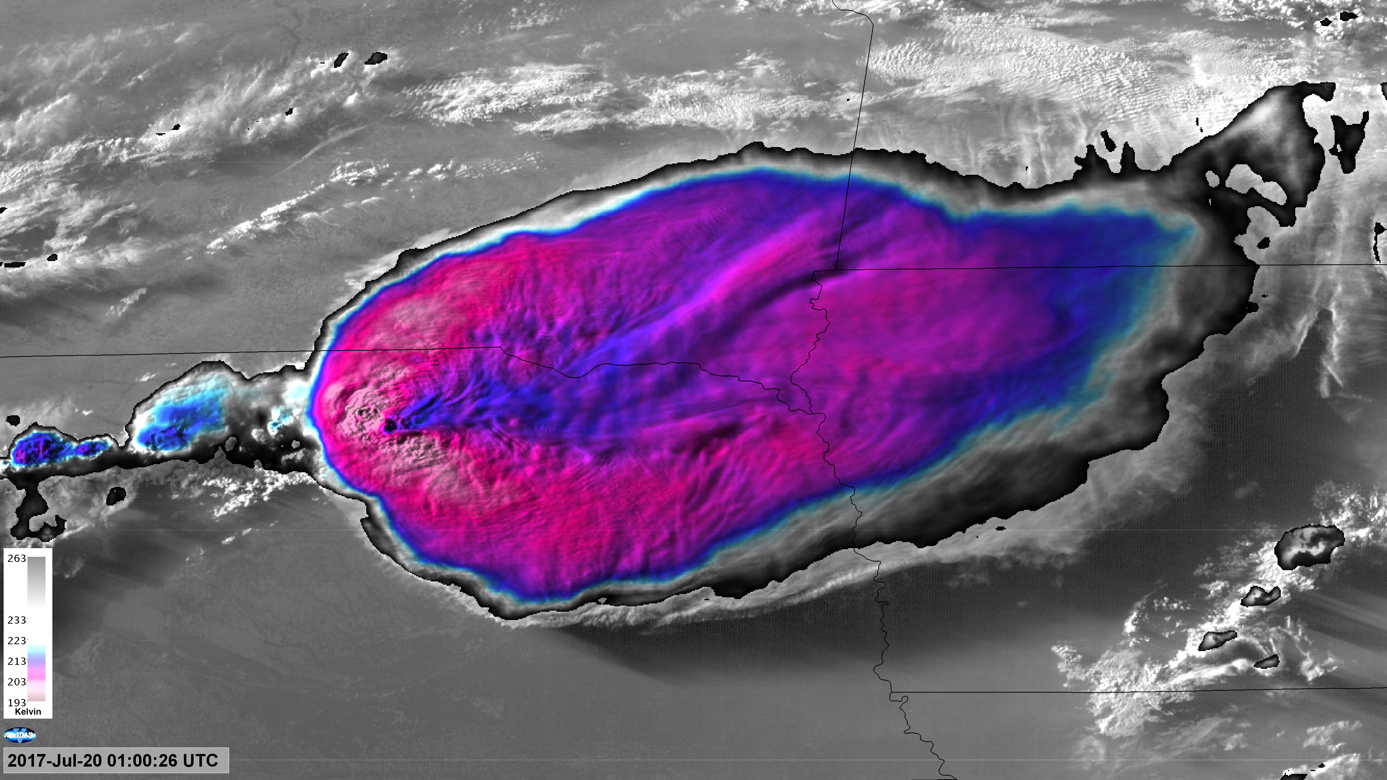
Severe Convection Mapping and Climatologies
With Geostationary Imager Observations
Kristopher Bedka
Science Directorate, NASA Langley Research Center
GPM-ACCP Transport and Logistics Virtual Workshop

Slide 2
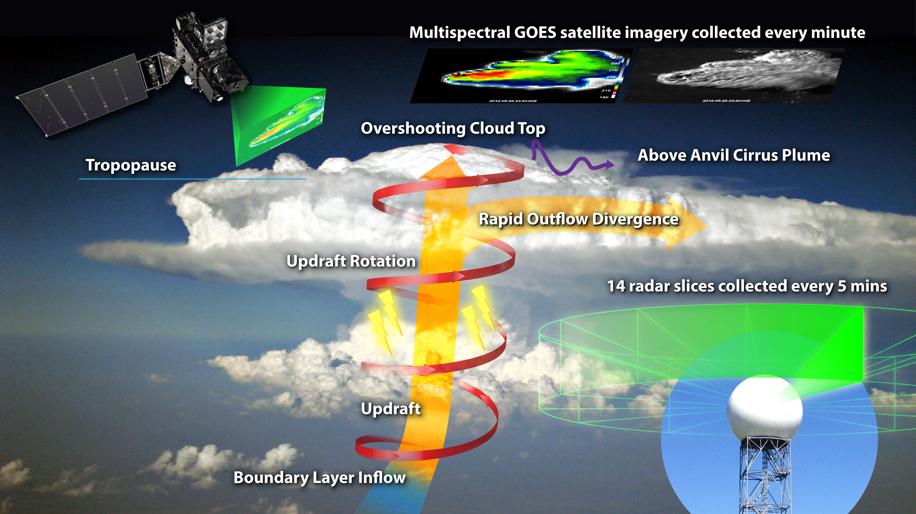
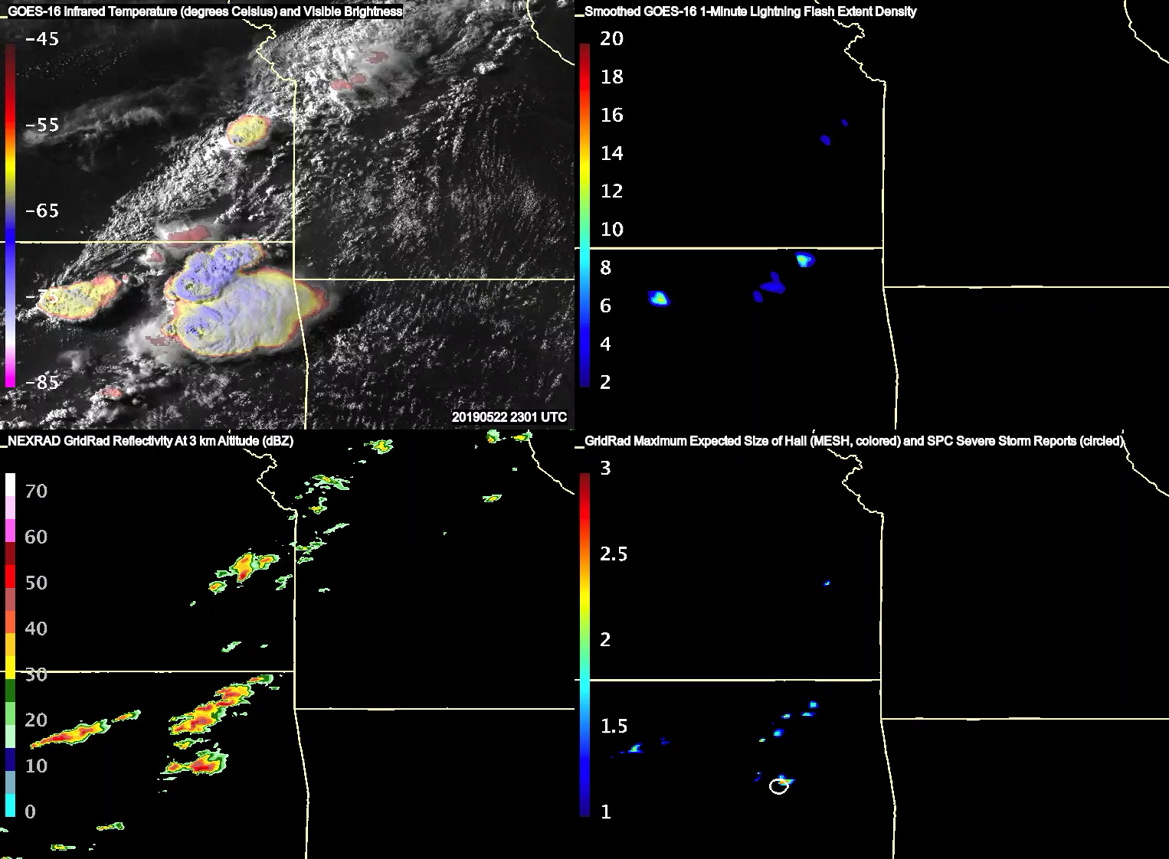
How Do Geostationary Imagers Observe Hazardous Storms?
Kansas
Missouri
What Signifies a Hazardous Storm In Geostationary Imagery?
1) Extremely cold and textured updraft “overshooting” cloud tops and time evolution at 30 sec to 1 min intervals
2) Injection of cirrus into the stratosphere, indicative of the most intense updrafts and severe storms
3) Rapid cloud top divergence and updraft rotation
4) High* lightning flash rates (*there have been noted decrease in GOES GLM flash detections in storms with high ice water path (e.g. Borque et al. (JGR, 2020))
What Can’t Geostationary Imagers Provide?
1) Ability to definitively identify severe vs non-severe storms and differentiate storm hazards (hail vs wind vs tornado)
2) Hail size estimation
3) Precision on exactly where a storm hazard is occurring (i.e. which road or rail track?)
4) Reliable cloud top height retrievals immediately downwind of the most intense storms, important for aviation
Arkansas
Oklahoma

Slide 3
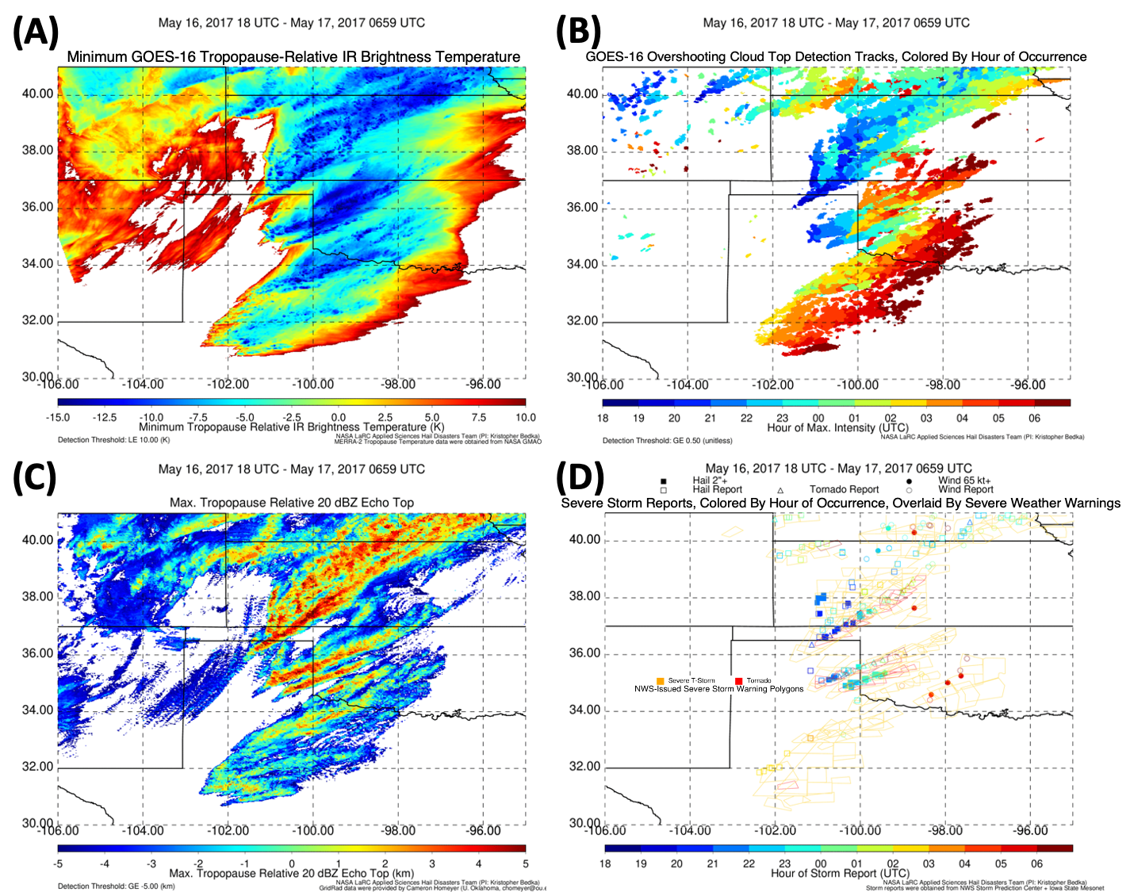
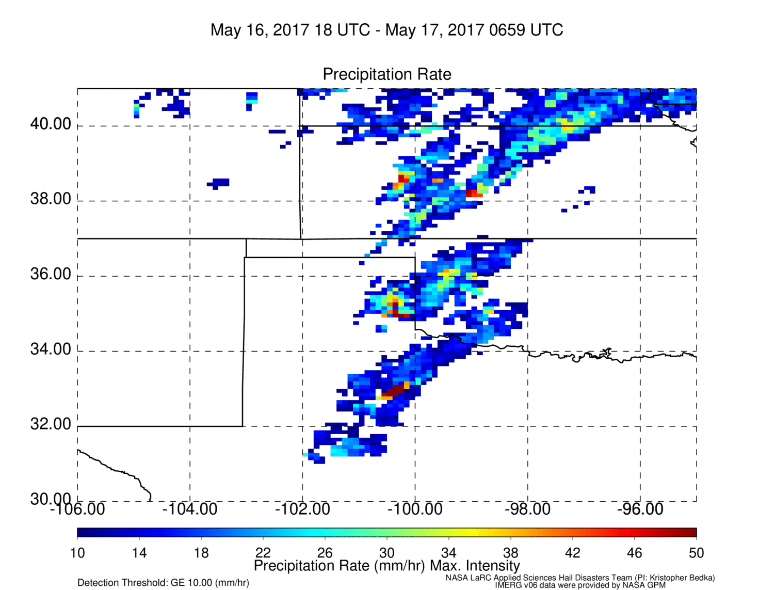
Automated Geostationary Infrared Overshooting Cloud Top Detection
GOES-16 data aggregated at 1-minute intervals shows that overshooting cloud top detections are well correlated with precipitation echo tops at or near the tropopause (top and lower-left)
Severe weather reports and warnings across several states are best correlated with the coldest cloud tops (lower-middle)
The IMERG Version 6 calibrated precipitation rate retrieval (lower-right) is correlated with the coldest clouds, but local maxima not well linked to the most intense parts of storm lifetimes. This suggests that improvements are possible with advanced A-CCP era observations
(E)
IMERG Version 6 PrecipCal Max Precip Rate

Slide 4
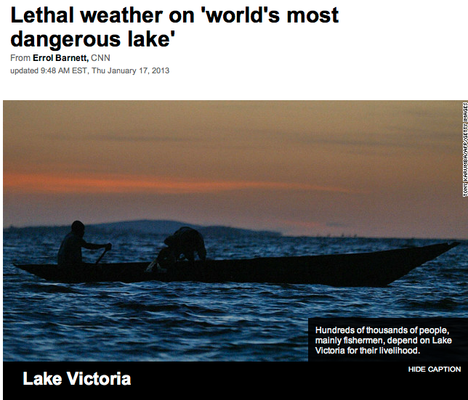
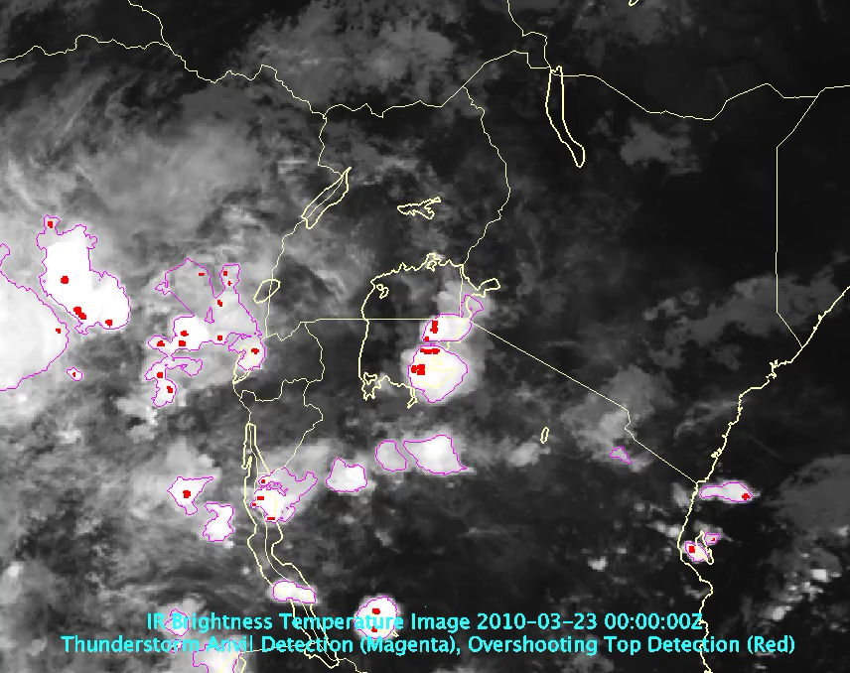
Lake Victoria: A Hotspot For Hazardous Thunderstorm Activity
CNN Article: 13 January 2013
https://www.cnn.com/2013/01/17/world/africa/lake-victoria-weather-deaths/index.html
With a surface area of 26,564 km², Lake Victoria is the largest lake in Africa, slightly larger than West Virginia
The lake directly sustains 30 million people living near its coasts, and its fishing industry is a critical for communities in East Africa
Lake Victoria in East Africa is a dangerous place for the 200,000 people who fish, often overnight
The International Red Cross estimates that 3,000-5,000 people per year lose their lives in violent thunderstorms on the lake
Geostationary infrared data can be used to map intense updraft regions in near real time, and also be compiled to form climatologies to better understand hazardous storm development (bottom)
Automated Geostationary Infrared Deep Convection (magenta) and Overshooting Top (red) Detections Across a 24-Hour Period Over East Africa

Slide 5
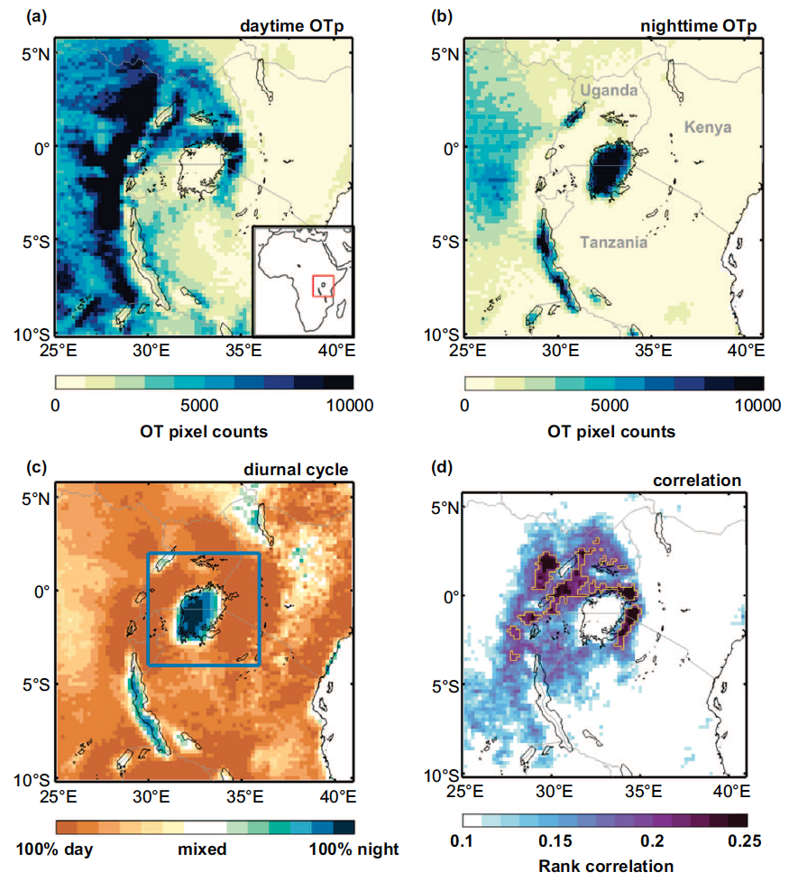
Mapping Climatological Thunderstorm Activity Over
Lake Victoria Using Geostationary Infrared Data
Daily Cycle of Lake Victoria Region Thunderstorms Based on a 9-Year Overshooting Top Updraft Database
The daily cycle of hazardous thunderstorms over the Lake Victoria and other African Great Lakes are dominated by lake/land breeze circulations
  During day, air flows from lake to land, causing storms to form along the shoreline
  During night, air flows from land to lake, causing storms to form over the lakes
Night-time storm maximum over Lake Victoria also depicted by IMERG precipitation (Tan et al. (JGR, 2019)) and ground-based lightning sensors (Virts and Goodman (MWR, 2020))
Night-time hazardous storm activity over Lake Victoria is extremely well correlated with storm activity over the lake shoreline during the day
  If many storms occur over land during day, many storms will also occur at night over the lake
  Offers the opportunity to predict activity several hours in advance which could help save lives (Thiery et al. (ERL, 2017))
Night-time maxima are also occur on the other smaller African Great Lakes, Lake Maracaibo, the Amazon River, and warm ocean currents such as the Gulf Stream and Agulhas, areas of frequent shipping/fishing activity
Thiery, W., E. L. Davin, S. I. Seneviratne, K. M. Bedka, S. Lhermitte, and N. van Lipzig, 2016: Hazardous thunderstorm intensification over Lake Victoria. Nature Communications, 7, 12786, http://dx.doi.org/10.1038/ncomms12786.
Thiery, W., L. Gudmundsson, K. M. Bedka, F. Semazzi, S. Lhermitte, P. Willems, N. van Lipzig, and S. Seneviratne, 2017: Early warnings of hazardous thunderstorms over Lake Victoria. Environ. Res. Lett.

Slide 6
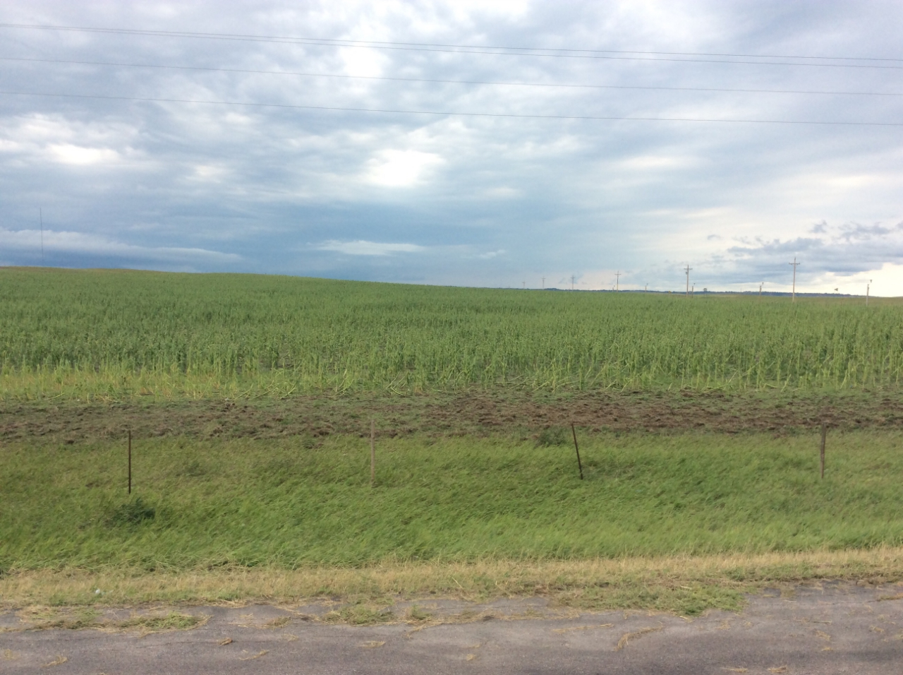
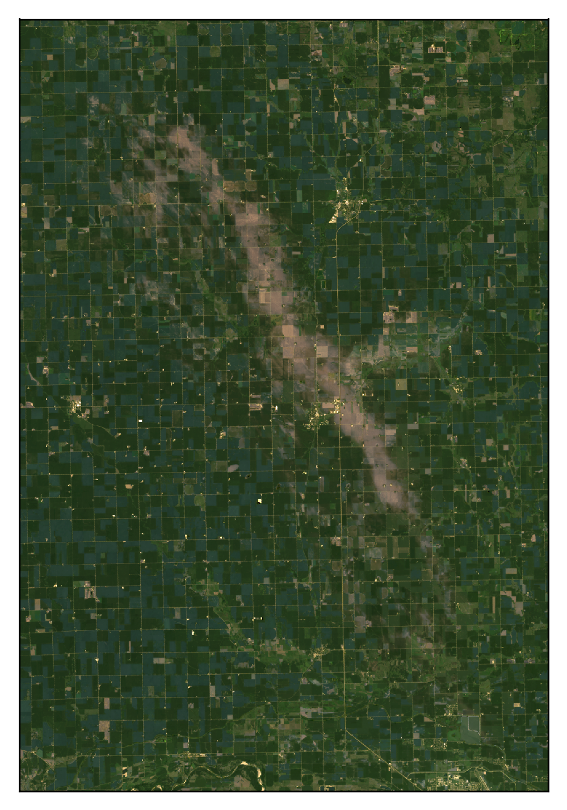
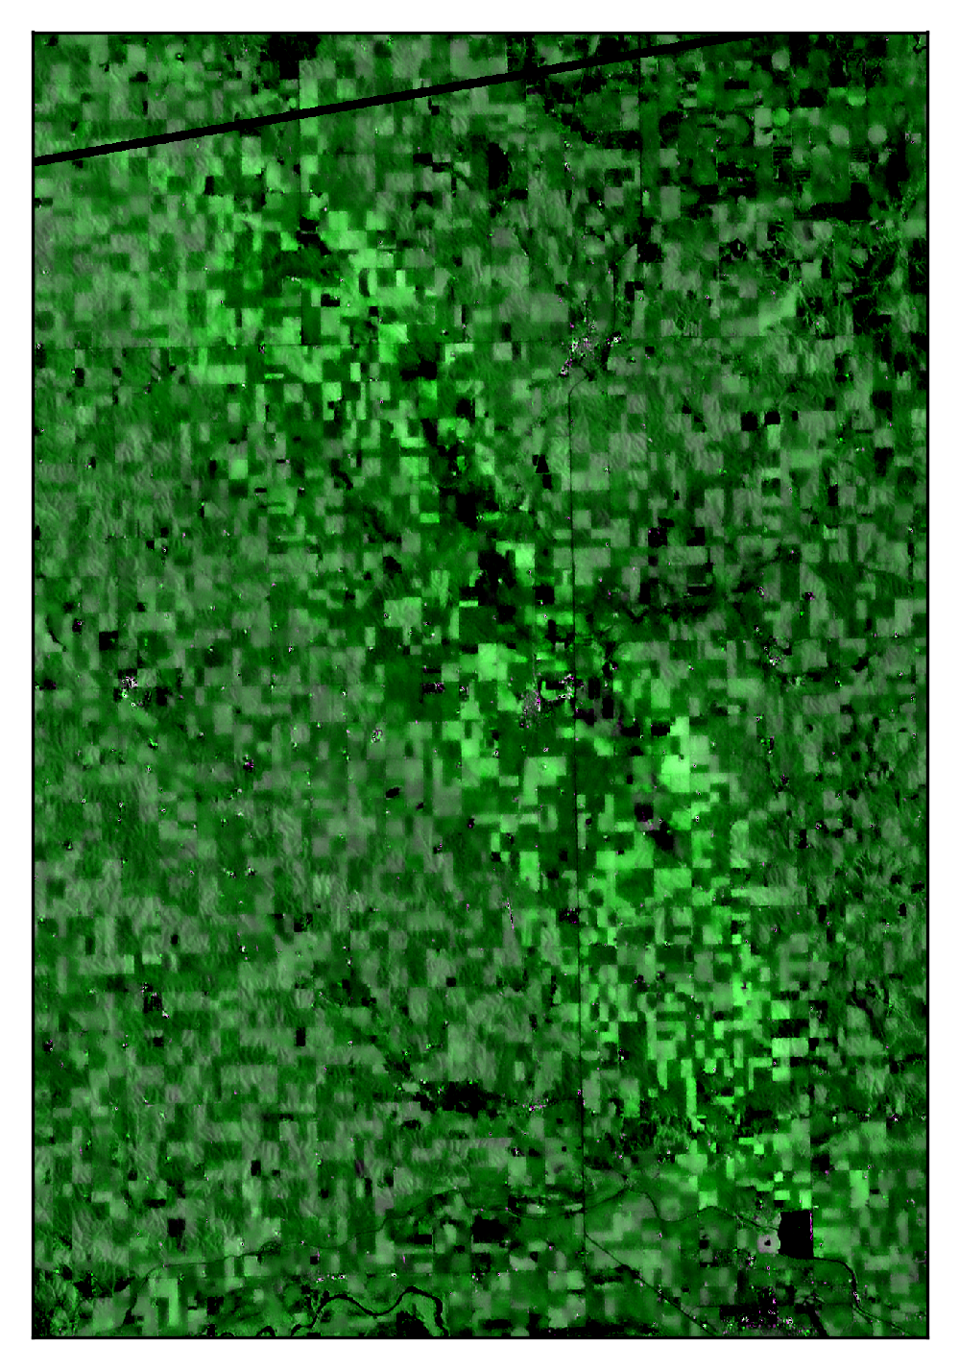
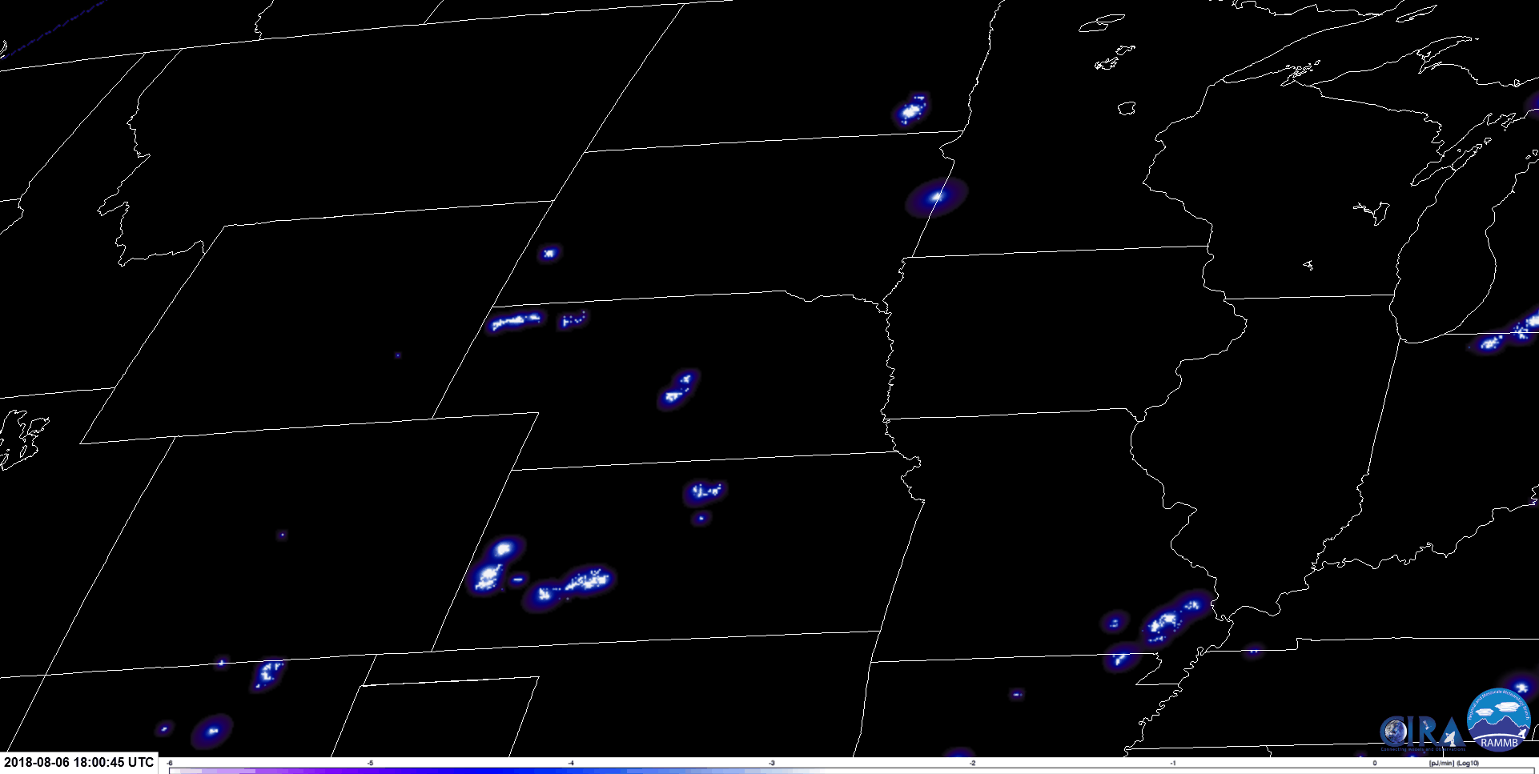
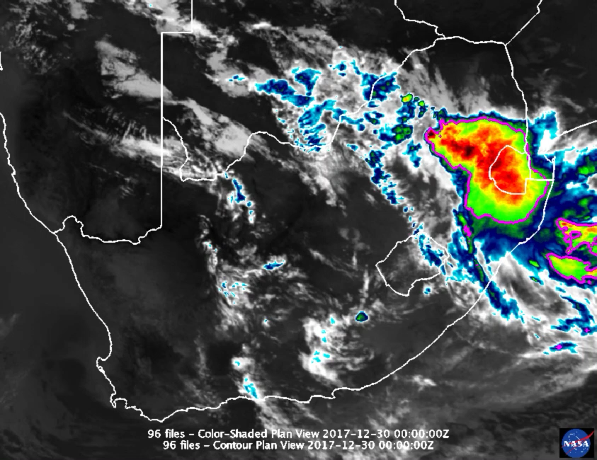
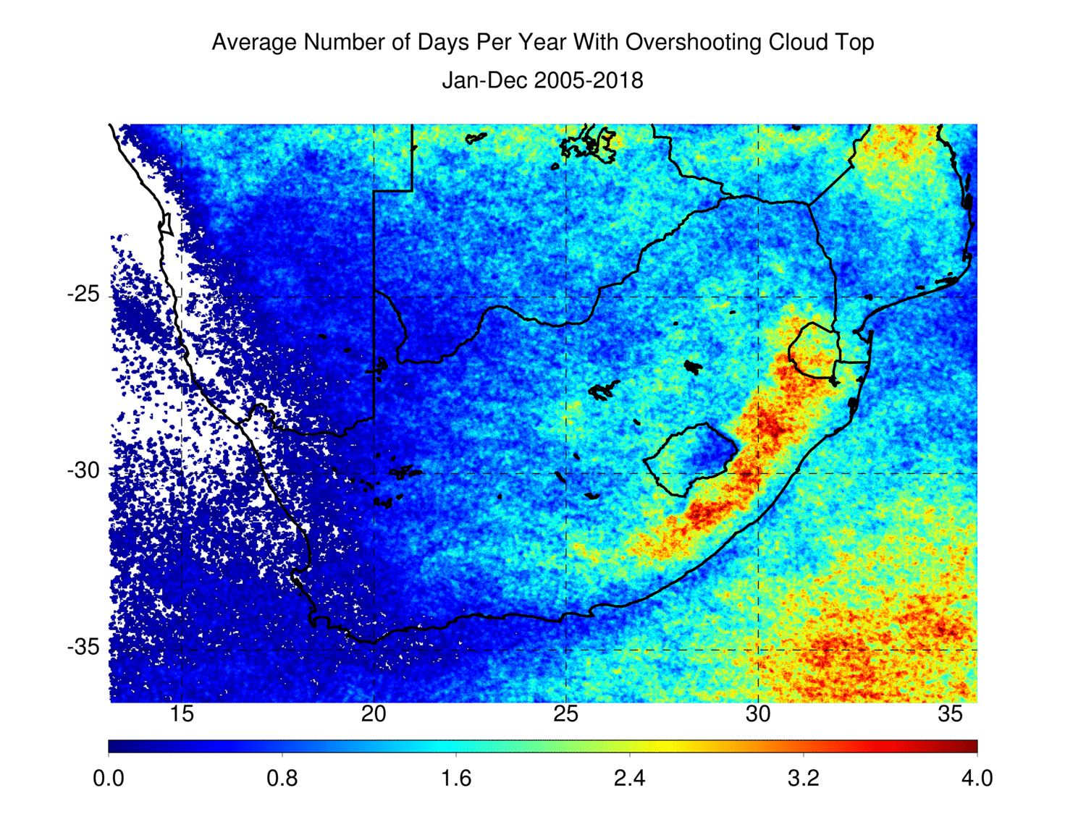
Hail Storm Risk Assessment Using Space-Borne Remote Sensing
Observations and Reanalysis Data
Contains modified
Copernicus Sentinel data (2019)
Hail Damage To Corn
Up to 30-Year Duration
Global Passive Microwave Hailstorm Database
Geostationary Lightning Flash Rates
and Flash Characteristics Consistent With Hailstorms
Optical Imager (e.g. LandSat-8) and SAR (e.g. Sentinel-1)
Observations of
Hail Damage Swaths
Demonstrate Use of High Resolution Optical Imager and SAR Data To Identify Hail Damage Swaths For Post-Event Response and Insurance Claim Analysis
Hailstorm Environment Climatologies
From Reanalyses
Develop the Highest Possible Resolution and Longest Duration Satellite and Reanalysis-Based Hail and Severe Storm Climatologies, Tested and Validated With Spotter Reports, Doppler Radar Hail Detection, and Insured Losses
Use Climatologies To Develop Reinsurance Hail Catastrophe Models, Improve Understanding of Hailstorm Distributions at High Spatio-Temporal Resolution, and Address Important Decadal Survey Science Questions
Provide Near-Real Time Geostationary Products To Aid Severe and Aviation Weather Forecasting
Visualize and Provide Data to The International Community With GIS-Based Tools
Up to 25 Year Duration,
~4 km and 10-30 min Resolution Regional GOES and Meteosat Visible and Infrared Detections of Hailstorm Clouds
Project Partners
NASA LaRC and MSFC, U. Alabama in Huntsville, Willis Towers Watson,
Karlsruhe Institute of Technology, University of Buenos Aires,
Brazil National Institute for Space Research CPTEC,
National Meteorological Service of Argentina, University of Pretoria,
Insurance Institute for Business & Home Safety

Slide 7
What Satellite Observations Could We Collect During the
A-CCP Era To Improve Hazardous Storm Prediction/Understanding?
More frequent (30 mins or better), higher spatial resolution passive microwave and cloud/precipitation radar observations
  Better observe storm vertical structure and dynamics, microwave/radar-based flooding rainfall detection, and identify possible hailstorms
Convective updraft intensity and vertical motion profile observations
  Aviation turbulence detection and identify storms likely to be hail or tornado-producing which have the strongest updrafts on average (Sandmael et al. (JAMC, 2019))
More frequent, and higher precision/resolution temperature, moisture, and wind profiles especially in the Planetary Boundary Layer (PBL)
  Monitor/Predict storm initiation locations, identify environments supportive of hazardous storms and predict storm types (e.g. supercells, MCSs, squall lines), and directly observe damaging downdraft winds hazardous to transportation
Global geostationary lightning mapping observations
  Real-time monitoring of intense updraft regions and a proxy for cloud microphysical processes
  Sun-synchronous orbits at times aside from 10 AM and 130 PM to better observe the most intense storms, typically present between 4-7 PM
    Both 10 AM and 130 PM are near the minimum for storm activity over land

