Slide 1
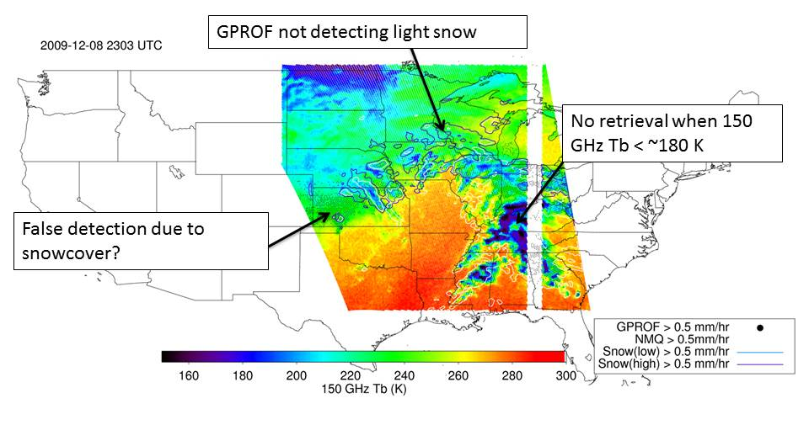
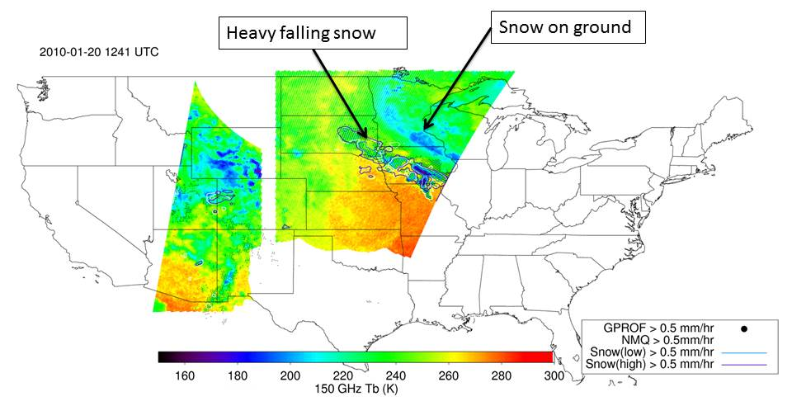
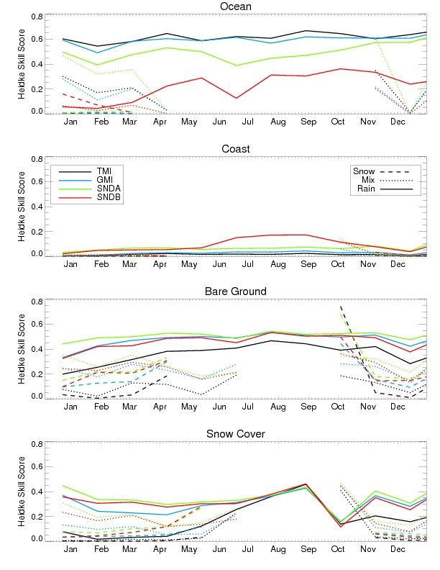
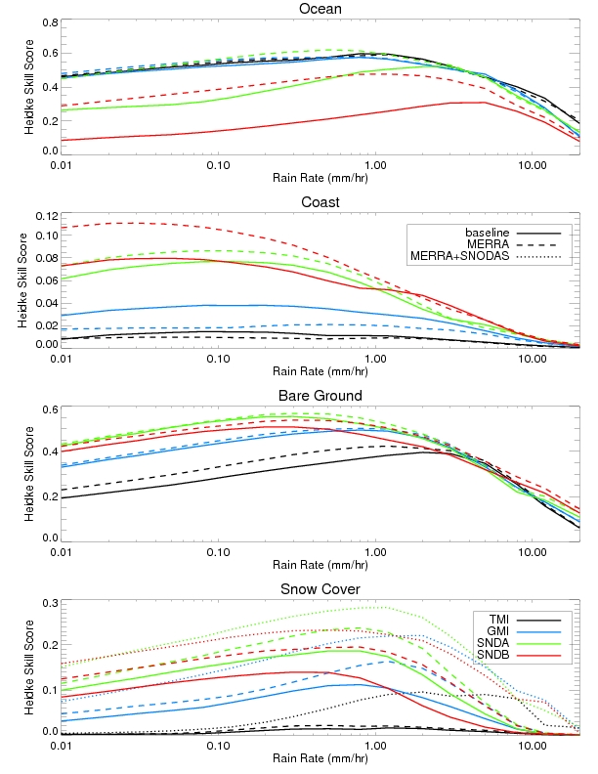
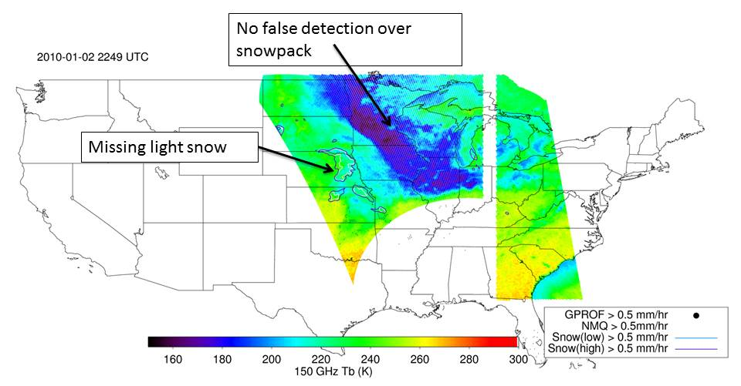
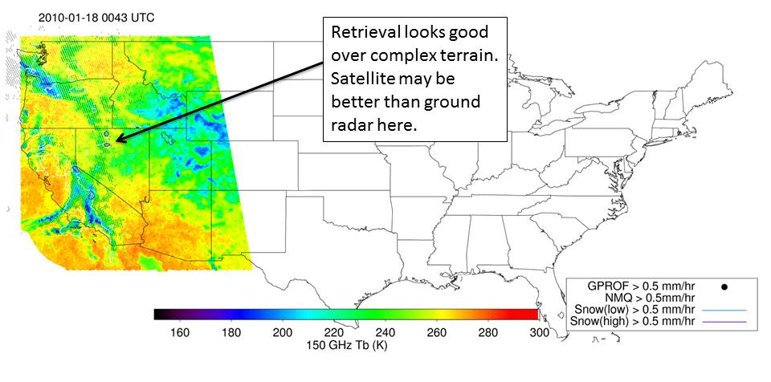
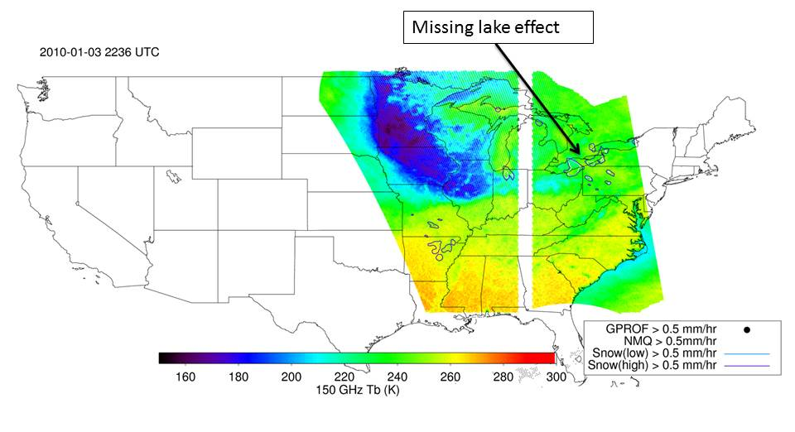
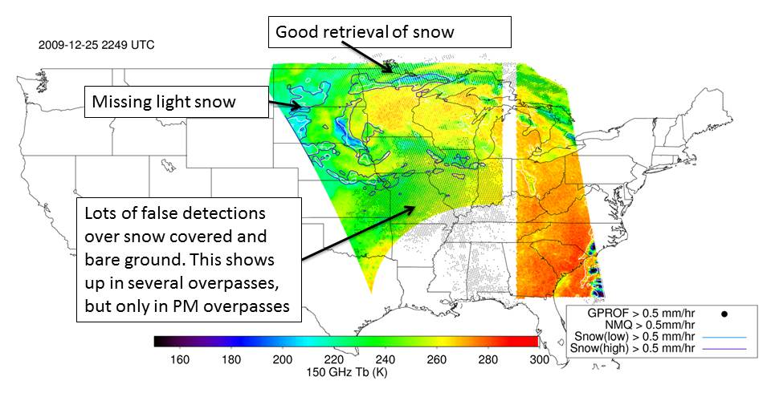
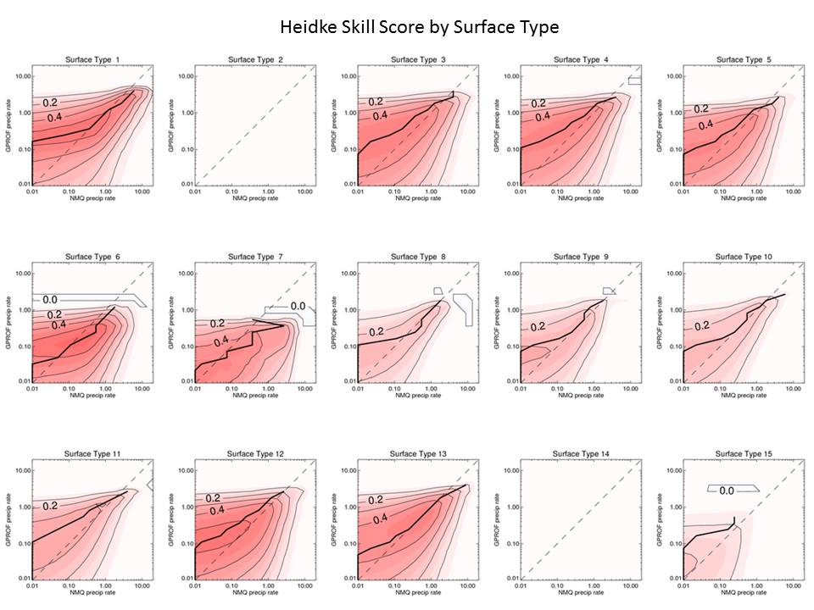
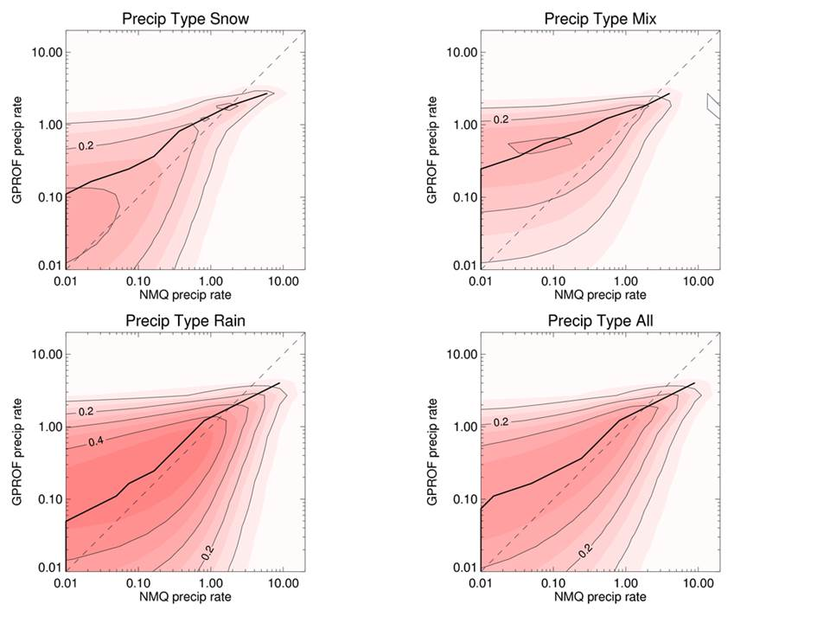
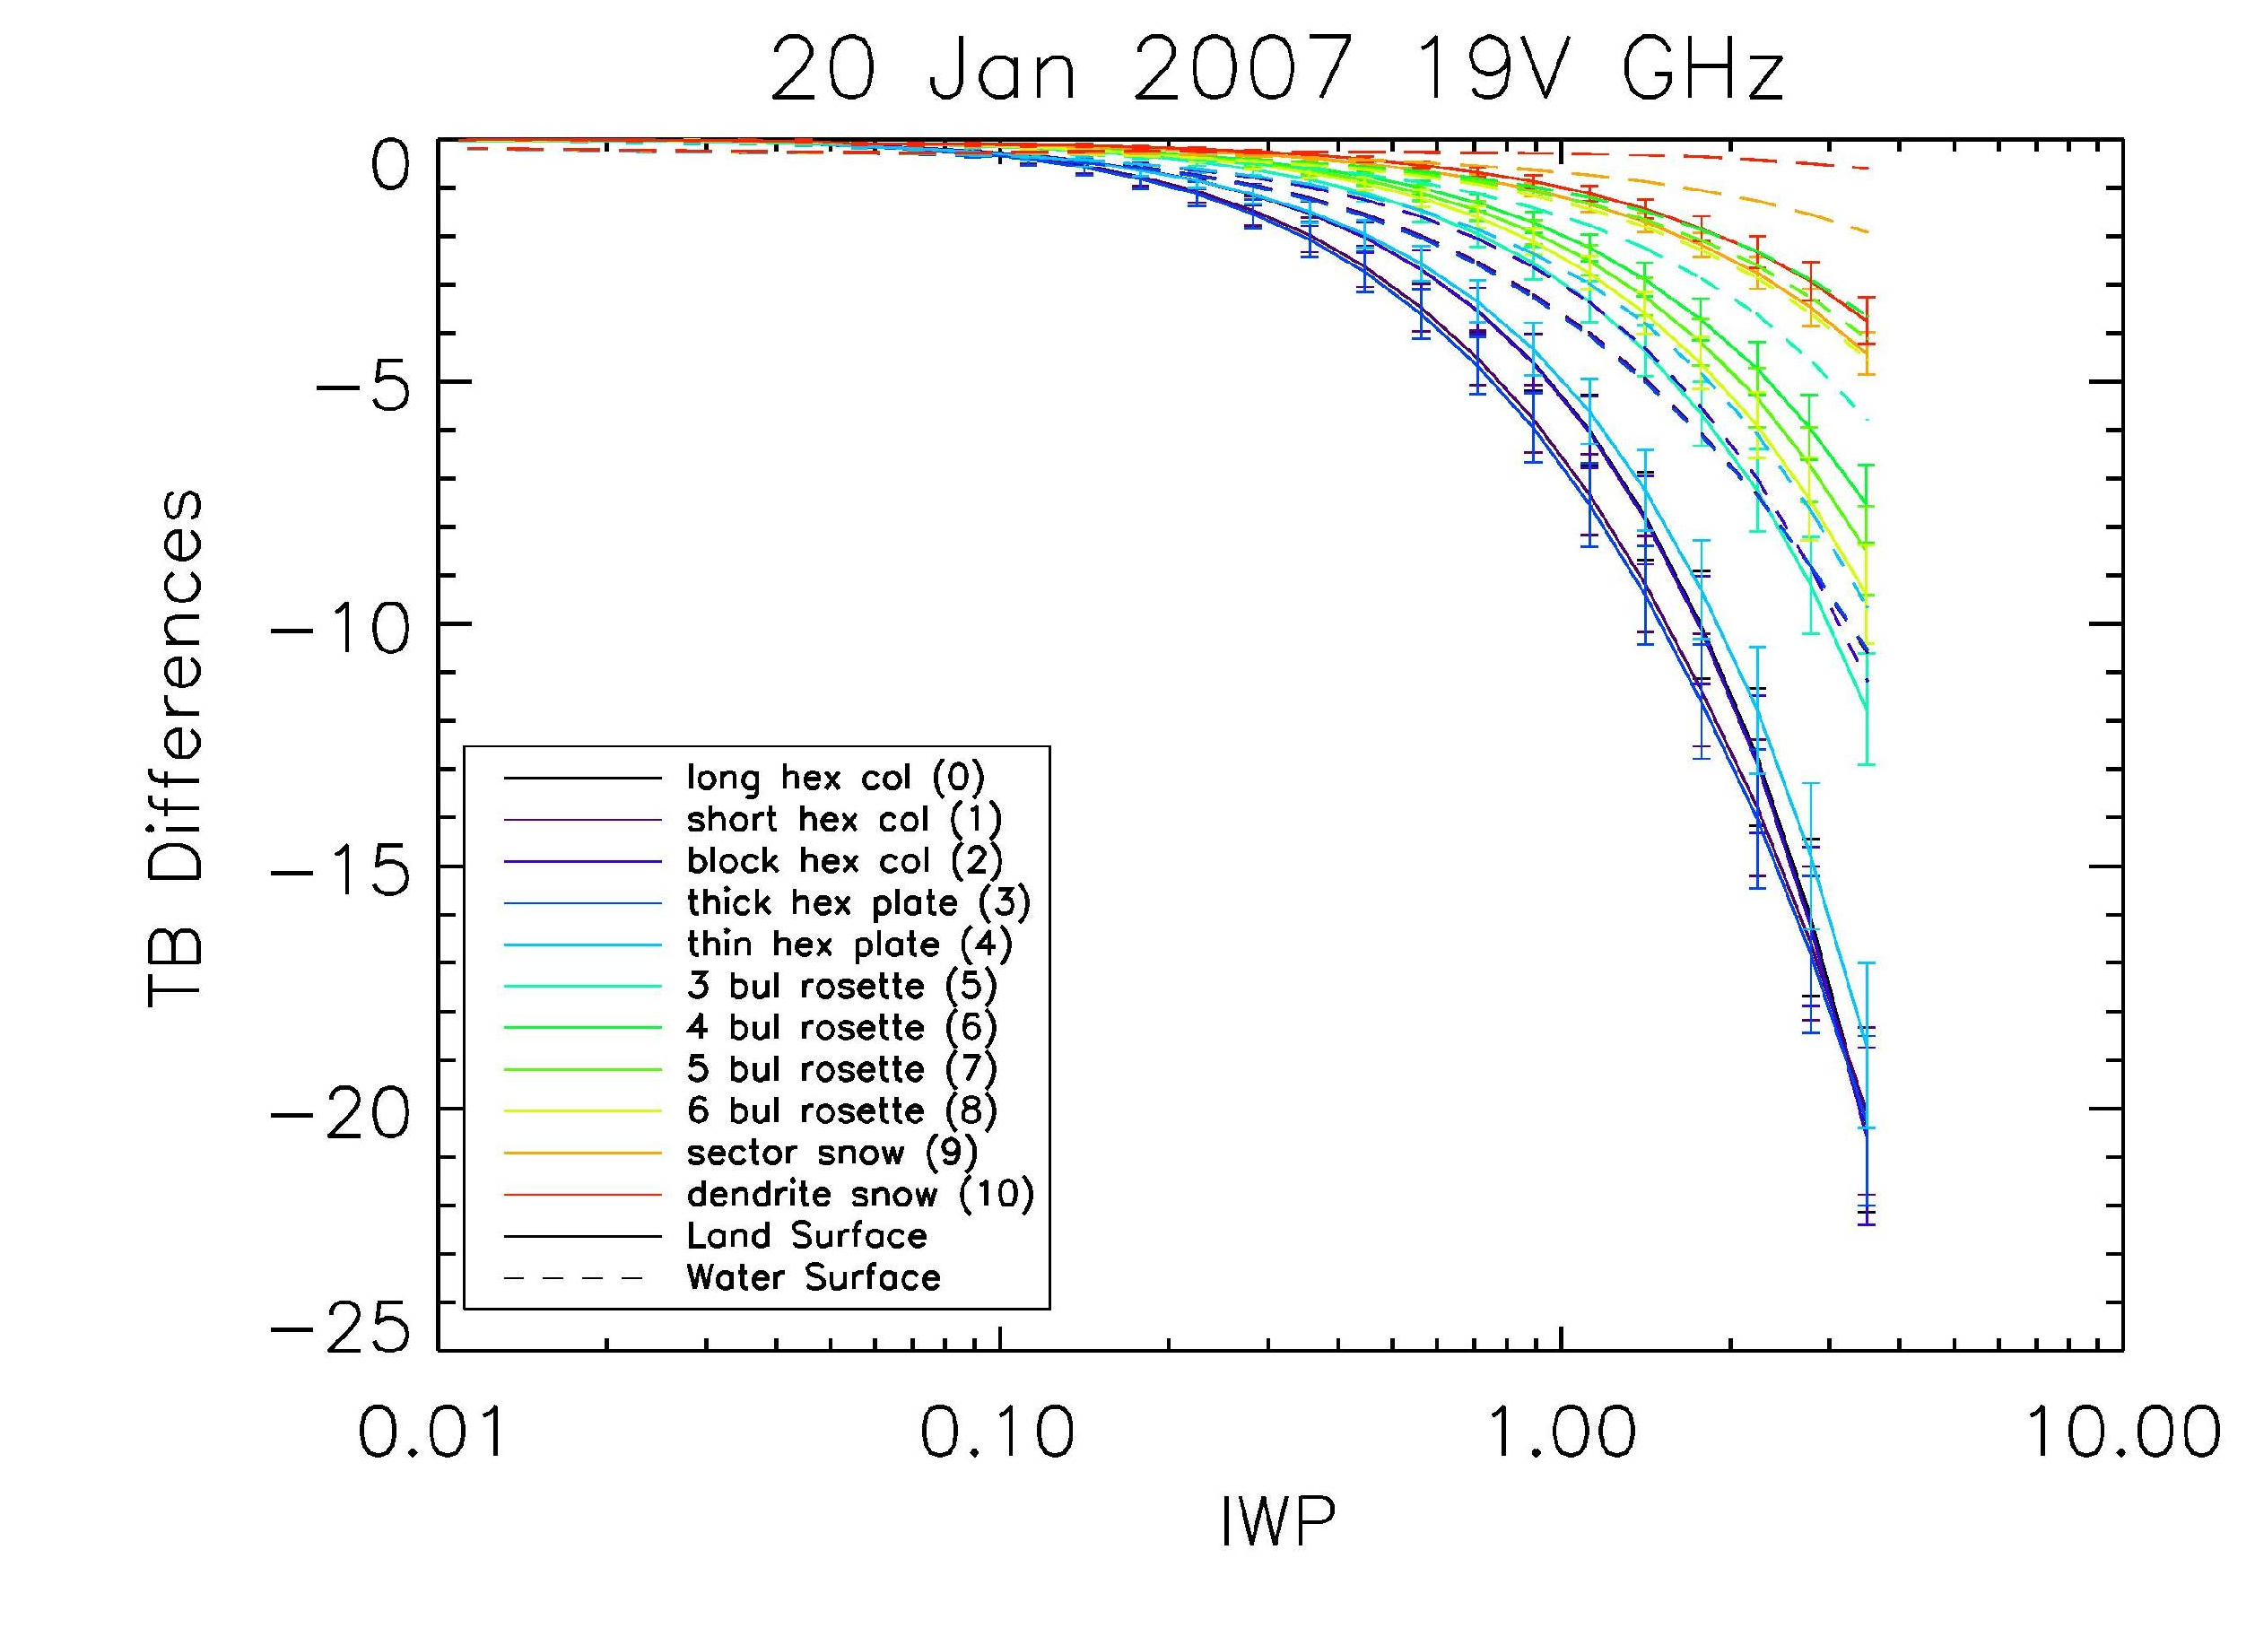
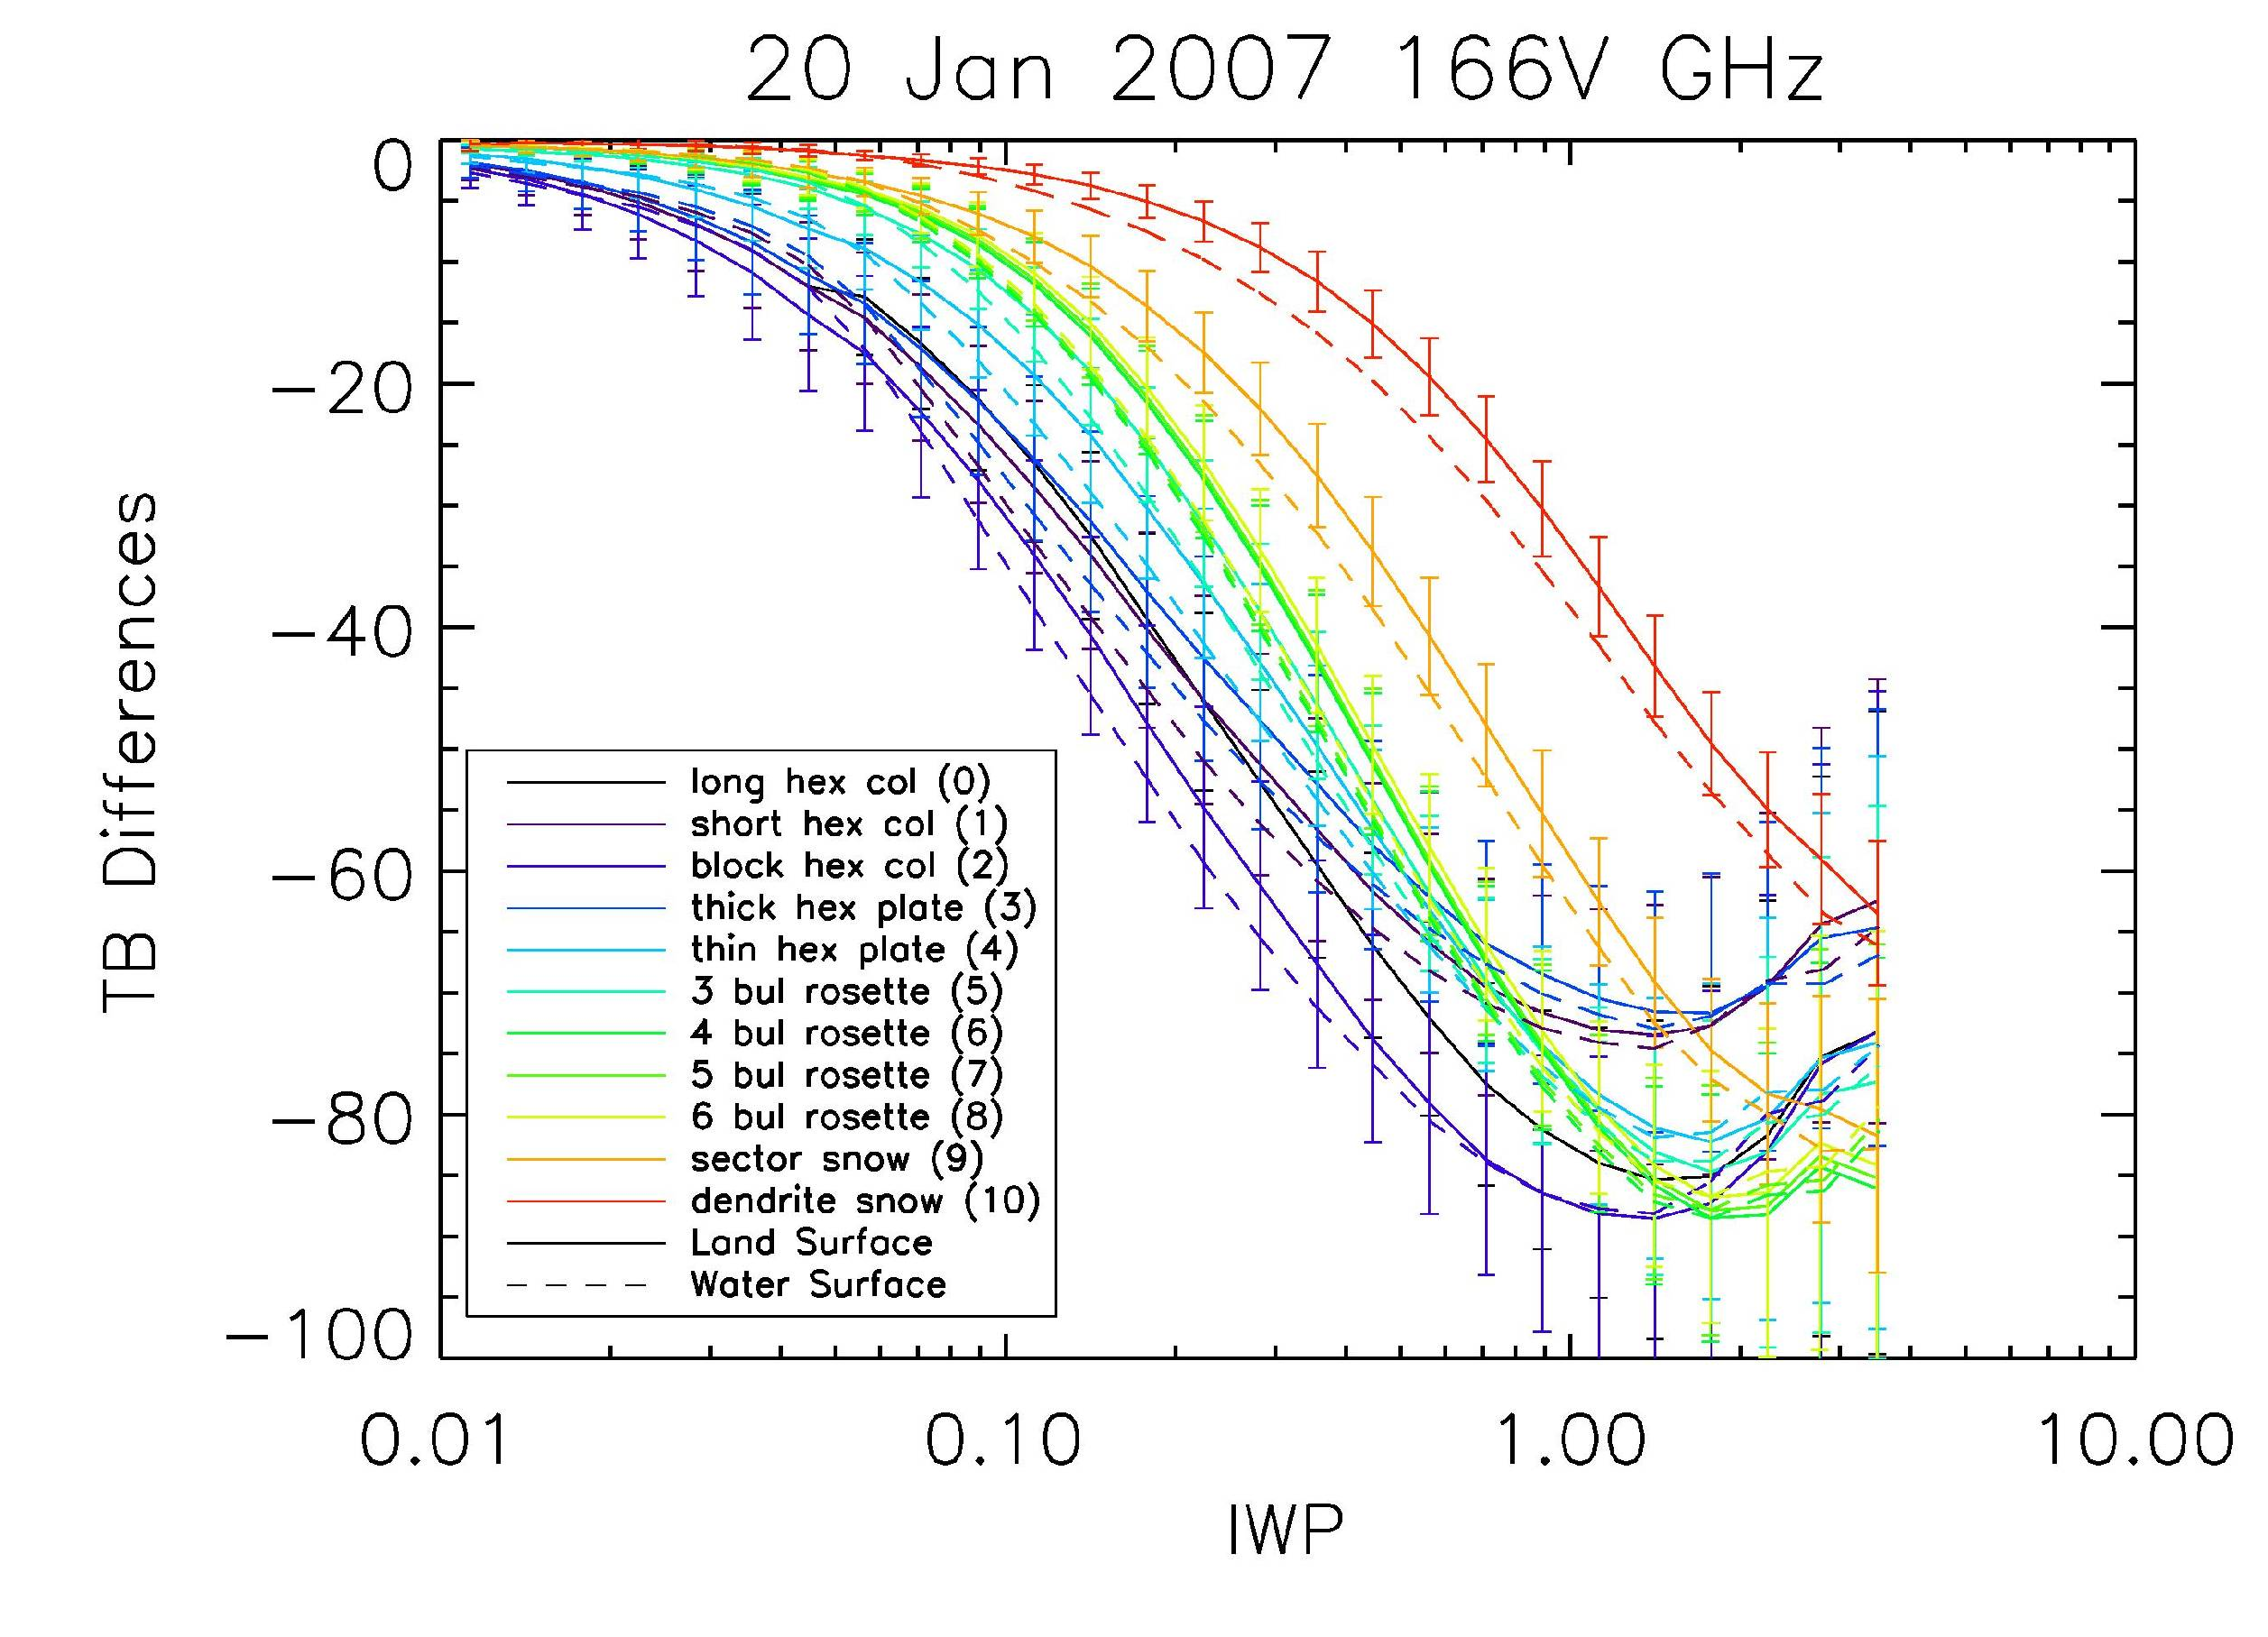
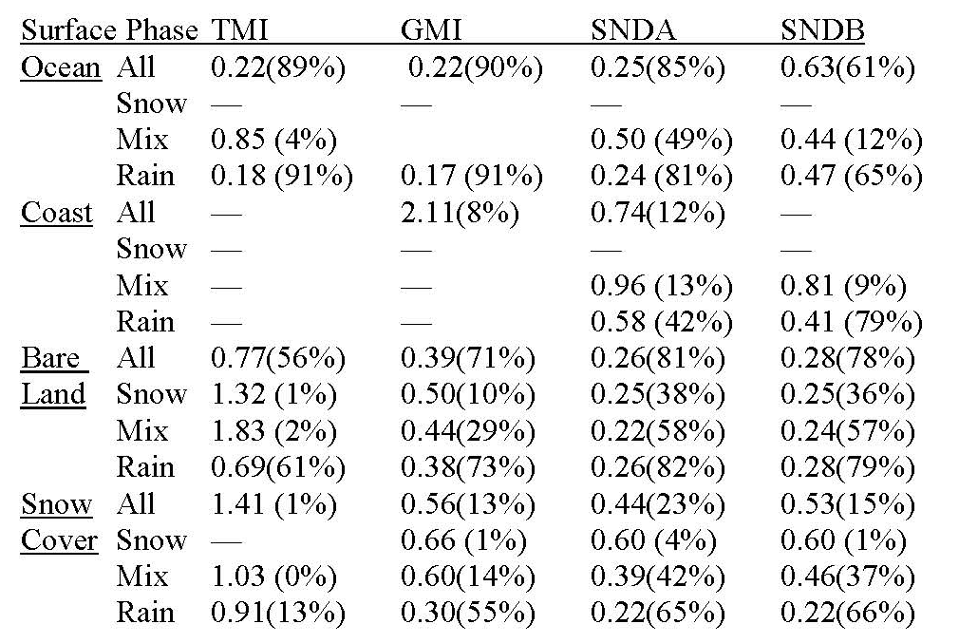
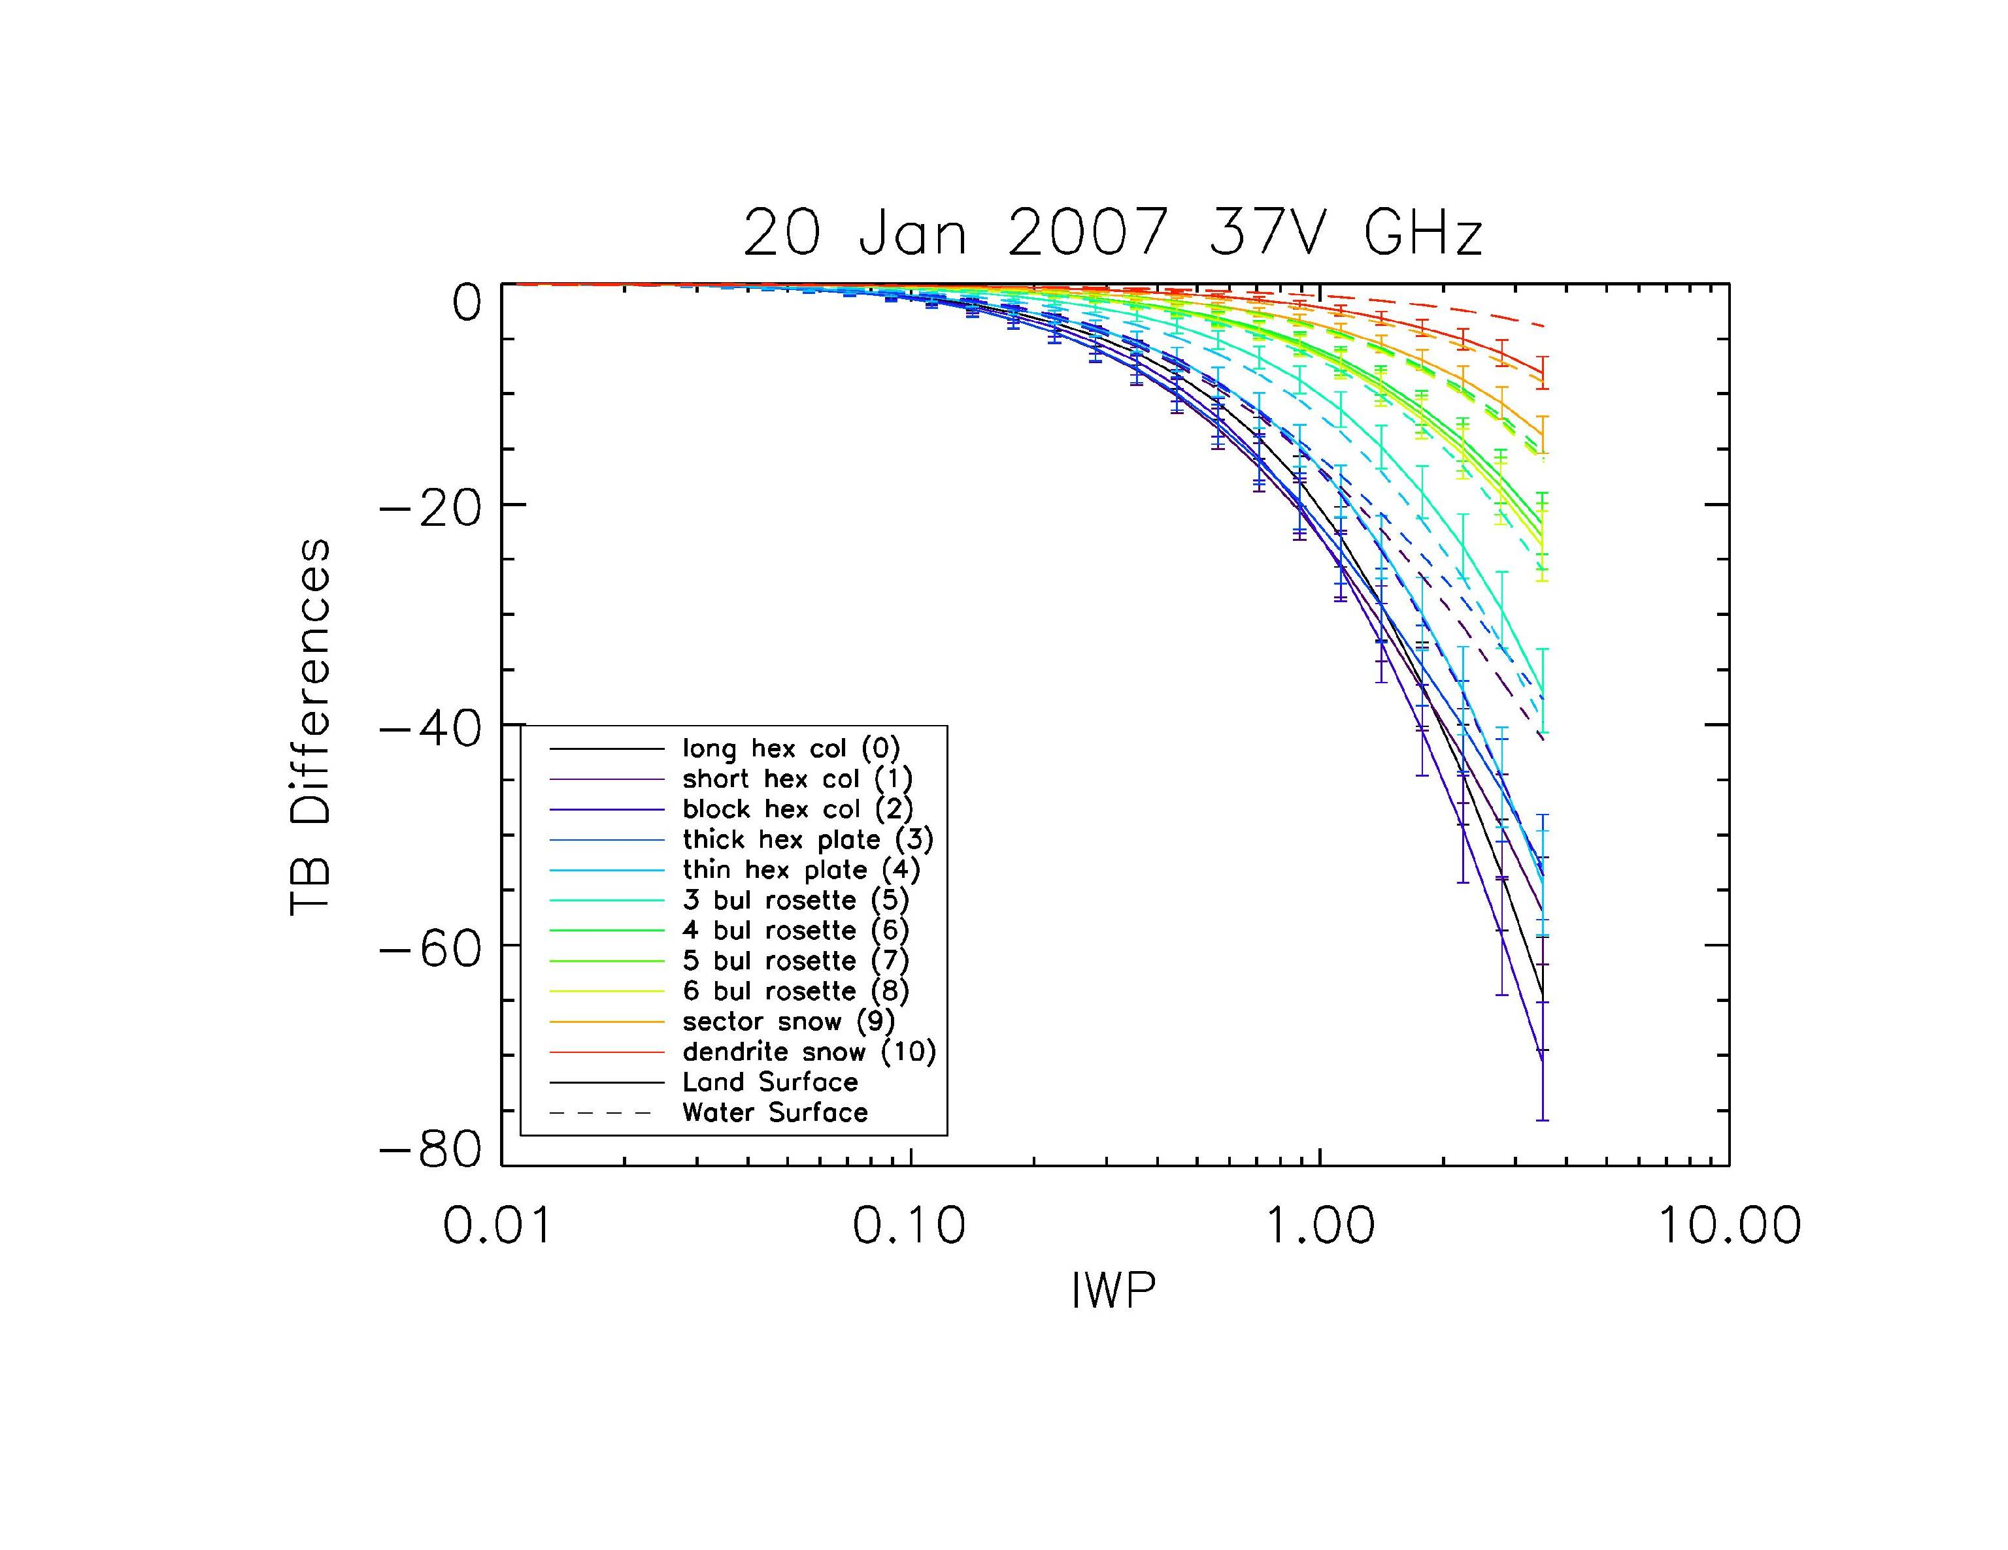
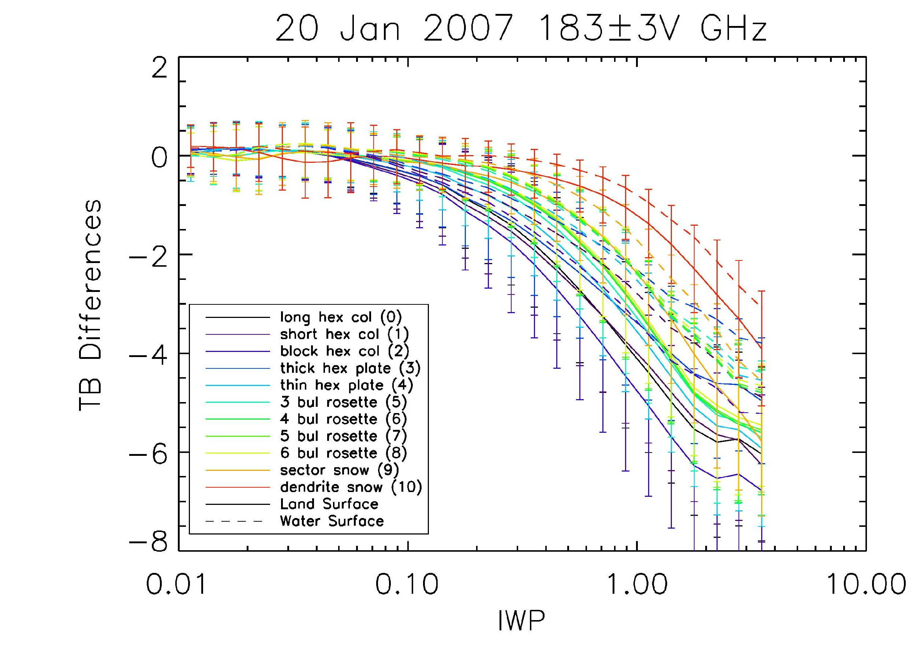
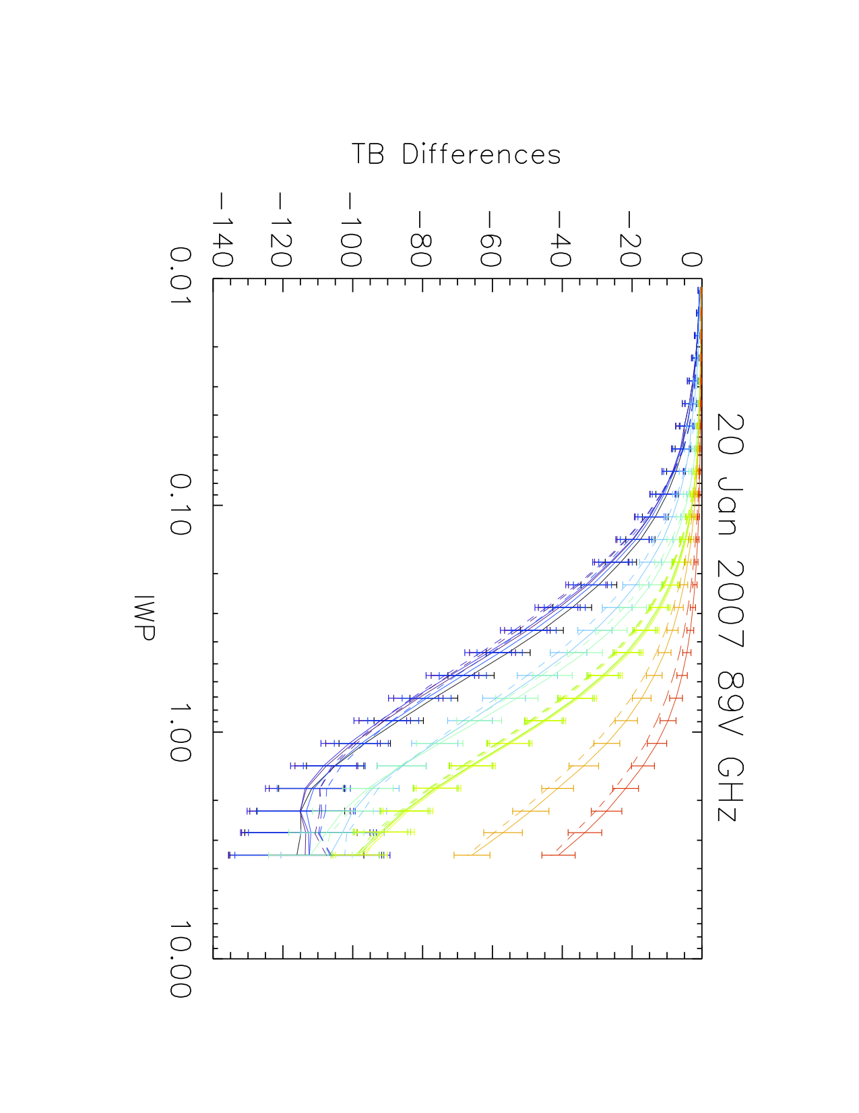
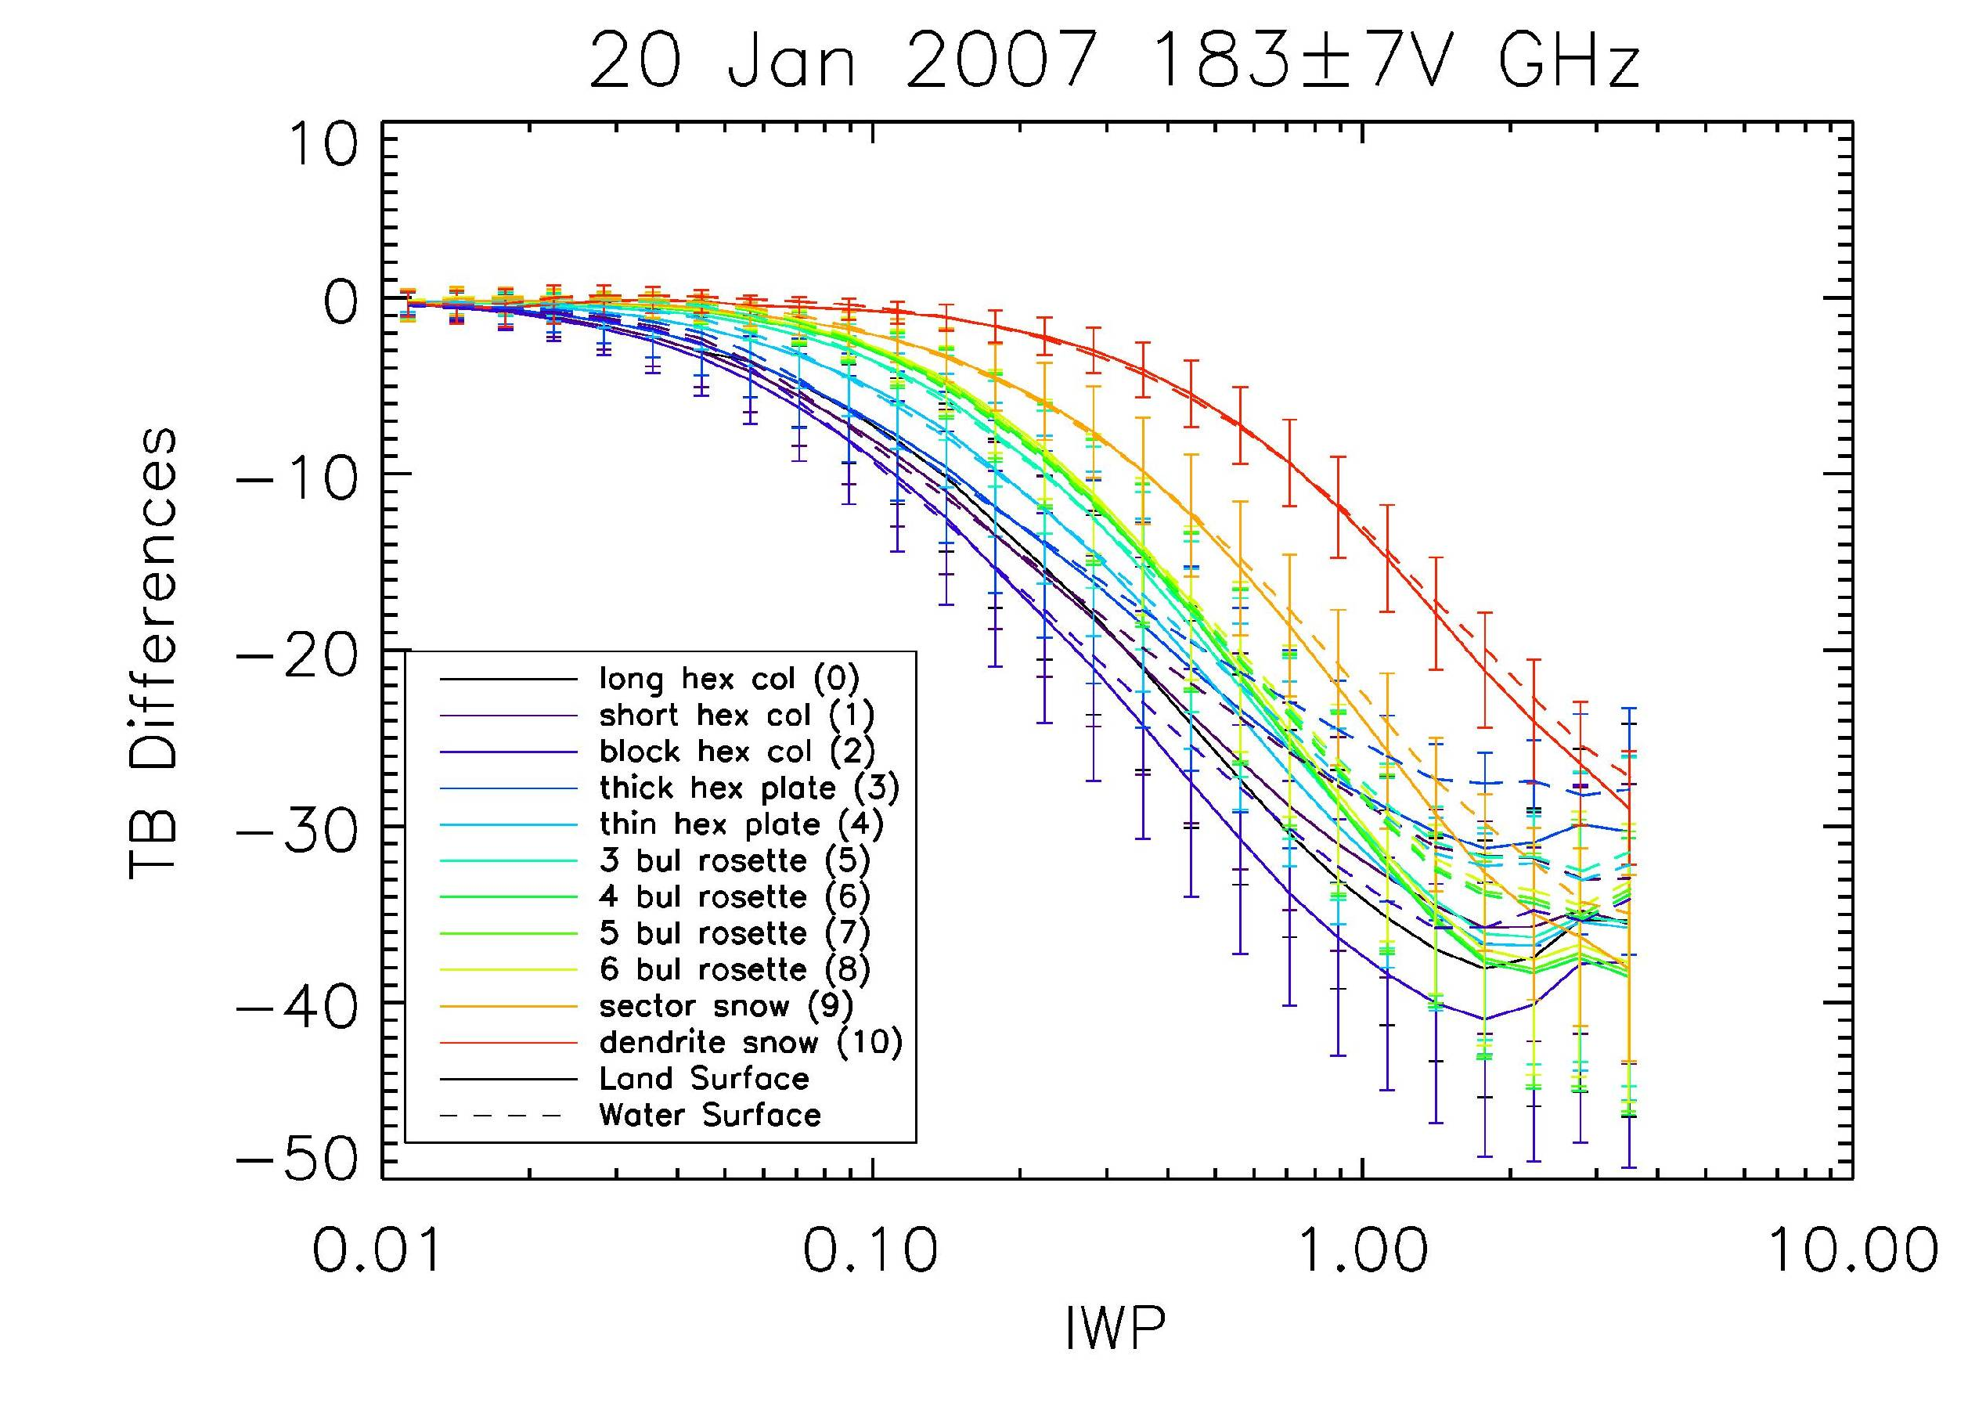
Falling Snow and Light Rain Radiometer Retrieval Algorithms
Gail Skofronick-Jackson¹, S. Joseph Munchak², Chris Kidd²,Benjamin Johnson³
¹NASA Goddard Gail.S.Jackson@nasa.gov, ²ESSIC, ³University of Maryland Baltimore County (JCET/GEST)
Introduction: Precipitation, including rain and snow, is a critical part of the Earth’s energy and hydrology cycles. In order to collect information on the complete global precipitation cycle and to understand the energy budget in terms of precipitation, uniform global estimates of both liquid and frozen precipitation must be collected. Important information to assess for falling snow retrievals includes knowing thresholds of detection for active and passive sensors, various sensor channel configurations, snow event system characteristics (macroscale vertical and horizontal extent), snowflake particle assumptions (microscale physics), and land/ocean surface types/emission. The analysis herein relies on simulated Weather Research Forecasting (WRF) simulations and separately SSMIS observations. Threshold detection results are presented for (Column 1) Modeled passive radiometer channels from 10 to 183 GHz and active radar at Ku, Ka, and W-band (Skofronick-Jackson, et al. IEEE TGRS, in press 2013), (Column 2) SSMIS Observational Threshold Analysis for SSMIS, TRMM, GMI, and MHS channels (Munchak and Skofronick-Jackson, Atmospheric Research, 2013), and (Column 3) Initial GPROF results for falling snow events (Munchak).
Column 1: Modeled Falling Snow Threshold Analysis
This research focuses on determining the thresholds of detection for various falling snow events for both active and passive sensors. We use all GMI channels, emphasizing the use of high frequency passive microwave channels (85-200 GHz) since these are more sensitive to the ice in clouds. For the radar, an analysis is performed for Ku, Ka, and W-band. The results rely on simulated Weather Research Forecasting (WRF) simulations of falling snow cases (Jan 20, 2007 Lake Effect and Jan 22 2007 Synoptic snow). The micro and macro structure (e.g., snowflake shape, PSD, IWP, cloud depth) of the underlying cloud scene was found to affect the results, producing different thresholds for the lake effect, and synoptic snow events.
For the snow and graupel particles, randomly oriented, non-spherical particles from G. Liu’s database [2004] are used described in Skofronick-Jackson and Johnson (2011). TBs and Z were computed for all 11 snowflake shapes.
Column 2: Observational Falling Snow Threshold Analysis
This study quantifies the minimum detectable precipitation rate and fraction of precipitation detected for four representative instruments (TMI, GMI, AMSU-A, and AMSU-B) that will be part of the GPM constellation. Observations for these instruments were constructed from equivalent channels on the SSMIS instrument on DMSP satellites F16 and F17 and matched to precipitation data from NOAA’s National Mosaic and QPE (NMQ) during 2009 over the continuous United States. A variational optimal estimation retrieval of non-precipitation surface and atmosphere parameters was used to determine the consistency between the observed brightness temperatures and these parameters, with high cost function values shown to be related to precipitation. The minimum detectable precipitation rate, defined as the lowest rate for which probability of detection exceeds 50%, and the detected fraction of precipitation, are reported for each sensor, surface type (ocean, coast, bare land, snow cover) and precipitation type (rain, mix, snow). Munchak and Skofronick-Jackson 2013.
Left panel: Time series of monthly Heidke skill score for four sensors (TMI, GMI, SNDA, SNDB) [colors], over four surfaces [top to bottom panels], and for three precipitation types [line type] for precipitation rates between 0.5 and 2 mm hr-1. A Heidke score of 1 means perfect retrieval with no uncertainties. Right panel: Heidke skill score as a function of precipitation rate for each sensor and surface type. The solid, dashed, dotted lines represent varying knowledge of real-time ancillary data where baseline is climatology, MERRA is reanalysis vertical profile T and RH, and SNODAS is real-time snow cover. These retrievals were performed using SSMIS and NMQ data.
Column 3: Initial GPROF Results
These results show retrievals using GPROF compared to NMQ. The GPROF database uses SSMIS observational data. The “satellite” data are SSMIS overpasses. Where GPROF detects no-zero rain or snow the plots show a black dot. Areas where NMQ gauge-adjusted rain rates above 0.5 mm/hr are indicated with thin white line contours. The thin blue line contours indicate NMQ radar using a Z-S relationship that produces low snow amounts for a given Z, while the dark blue/purple contour lines are for a Z-S relationship that produces high snow amounts for the same Z.
Hexagonal plates
Hexagonal columns
Sector snow
Bullet rosettes
dendrite
Radar Perspective
We use the unattenuated WRF simulations and the minimum detectable reflectivity from GPM DPR (Ku at 18 dBZ, Ka at 12dBZ) and CloudSat W-Band at -15 dBZ (for precipitating snow, not the minimum signal of CloudSat). The IWC amounts detected vary considerably for Ku, Ka, W-bands and for the different shapes. The IWC are converted to melted surface snow rates using ~appropriate fall speeds.
Snowflake Shape (#) | Ku-Band | Ka-Band | W-Band
Long Hex Col. (0) | 0.035 | 0.017 | 0.0017
Short Hex Col. (1) | 0.035 | 0.016 | 0.0017
Block Hex. Col. (2) | 0.036 | 0.017 | 0.0017
Thick Hex Plate (3) | 0.035 | 0.015 | 0.0017
Thin Hex Plate (4) | 0.032 | 0.016 | 0.0020
3-Bullet Rosette (5) | 0.058 | 0.032 | 0.0018
4-Bullet Rosette (6) | 0.065 | 0.048 | 0.0022
5-Bullet Rosette (7) | 0.062 | 0.043 | 0.0023
Six Bullet Rosette (8) | 0.060 | 0.041 | 0.0024
Sector Snowflake (9) | 0.075 | 0.046 | 0.0018
Dendrite Snow (10) | 0.080 | 0.154 | 0.0035
Radiometer Perspective
Because retrieval algorithms are not mature enough for fully accurate detection, we use a simple differencing ΔTB = TBsnow-TBclearair. Based on how accurate we expect the Tbclearair to be, we set threshold cutoffs (red lines below). To convert IWP (kg m⁻²) to surface IWC, we divide by the thickness of the cloud layer. To estimate snow rate we use various fall speeds.
Heidke Skill Scores for GPROF Retrievals
19V
166V
Modeling Analysis Perspective
Multiple & appropriate fall speeds were used based on particle shape
Active
Avg. Surface IWC Detected: Ku Ka W Units
0.08 0.07 0.002 g m⁻³
Simple falling snow conversion (melted snow rate)
(Shape dependent fall velocities*)
0.13-0.54 0.11-0.48 mm hr⁻¹ 0.01-0.02 mm hr⁻¹
Passive over land
Avg. Columnar IWP Detected: 89 166 183±7 Units
Land V-Pol Lake Eff 0.38 0.19 0.42 kg m⁻²
Land V-Pol Synoptic 0.45 0.34 0.60 kg m⁻²
Simple IWC conversion (IWCsurface = 25%IWP**)
Lake (3 km clouds) 0.09 0.05 0.11 g m⁻³
Synoptic (6 km) 0.11 0.08 0.15 g m⁻³
Simple falling snow conversion (melted SR/shape dependent fall speeds*)
Lake(3 km clouds) 0.03-1.5 mm hr⁻¹
Synoptic (6 km) 0.07-1.15 mm hr⁻¹
*Fall velocities: Langleben (1954), Locatelli and Hobbs (1974), Kulie and Bennartz 2009
**Analysis of WRF profiles show that 25% of the IWP is in the lowest 500 m
Minimum detectable precipitation rate (mm hr −1) and percentage of precipitation volume detected (in parentheses) for each sensor, surface type, and precipitation type. The minimum detectable rate is defined as the mean rainfall rate at the lowest ϕ value where at least 50% of retrievals have R >= 0.01mm hr−1. Here, MERRA atmospheric state was substituted for climatology as the a priori atmospheric state and, for snow covered surfaces the SNODAS database was substituted for TELSEM emissivities. (Munchak & Skofronick-Jackson et al., 2012)
37V
183±3V
The most noticeable results in these Heidke skill score plots are that:
-Good skill over ocean, vegetated land/desert (classes 1-7), and coast(!)
-Poorer over snow cover/frozen surfaces (8-11). Note that this version of GPROF did not have a working snow cover flag or snow cover database that I'm aware of.
-Positive biases in snow and mixed precipitation. This is true even though the NMQ snowfall rate is a fairly aggressive Z-S relationship (Z=75S^2).
183±7V
Relevant References
89V
Overall Threshold Perspective
G. Skofronick-Jackson, Ben Johnson, and Joe Munchak, “Detection Thresholds of Falling Snow from Satellite-borne Active and Passive Sensors,” IEEE Trans. on Geoscience and Remote Sensing, in press Dec 2012.
Munchak, S.J. and G. Skofronick-Jackson, “Evaluation of Precipitation Detection over Various Surfaces from Passive Microwave Imagers and Sounders,” Atmospheric Research, in press, Dec 2012.
B. Johnson, W. S. Olson, G. Skofronick-Jackson, The Simulated Microwave Response to Melting Ice-Phase Precipitation, GRSL, Submitted February 2013
G. Skofronick-Jackson and B. T. Johnson, “Surface and Atmospheric Contributions to Passive Microwave Bright-ness Temperatures for Falling Snow Events,” J. Geophys. Res., 116, D02213, doi:10.1029/2010JD014438, 2011.
G. M. Skofronick-Jackson, M.-J. Kim, J. A. Weinman, and D.-E. Chang, “A Physical Model to Determine Snowfall over Land by Microwave Radiometry,” IEEE Trans. Geosci. Remote Sens, vol. 42, pp. 1047-1058, 2004.
Liu, G., 2004: Approximation of single scattering properties of ice and snow particles for high microwave frequencies. J. Atmospheric Sci., 61, 2441–2456.
Passive microwave retrievals over land are challenging due to the contamination from surface emission, but falling snow detection is achievable. The notable results show: (1) the W-Band radar has detection thresholds more than an order of magnitude lower than the future GPM sensors, (2) the cloud structure macrophysics influences the thresholds of detection for passive channels, (3) the snowflake microphysics plays a large role in the detection threshold for active and passive sensors, (4) with reasonable assumptions, the passive 166 GHz channel has detection threshold values comparable to the GPM DPR Ku and Ka band radars with ~0.05 g m⁻³ detected at the surface, or an ~0.5-1 mm hr⁻¹ melted snow rate (equivalent to 0.5-2 cm hr⁻¹ solid fluffy snowflake rate). Additional efforts will constrain the process to improve algorithms to distinguish rain, clear-air, snow, and indeterminate cases.
Chan (GHz) | From ±0.02* error in emissivity | From ±2K* error in surface T | From difference in summer versus winter profile | Total Threshold Cutoff
10 | 12 K | 4 | 0 | 16 K
19 | 12 | 4 | 1 | 17
23 | 11 | 4 | 1 | 16
37 | 11 | 4 | 3 | 18
89 | 10 | 4 | 3 | 17
166 | 8 | 4 | 10 | 22
183±3 | 0 | 1 | 5 | 6
183±7 | 4 | 2 | 10 | 16
Red Lines use table at right:
*two times the error values in Ruston and Vonderhaar 2004, Aires et al., 2001, and Prigent et al., 2003
Acknowledgments
Funding for this work comes from NASA Headquarters (Ramesh Kakar) for PI (Skofronick-Jackson) for PMM grants. Partial funding for Munchak work was obtained from TRMM/GPM algorithm sources.
PMM Science Team Mtg, March 2013, Annapolis, MD

