Slide 1
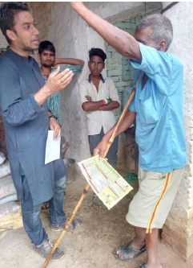
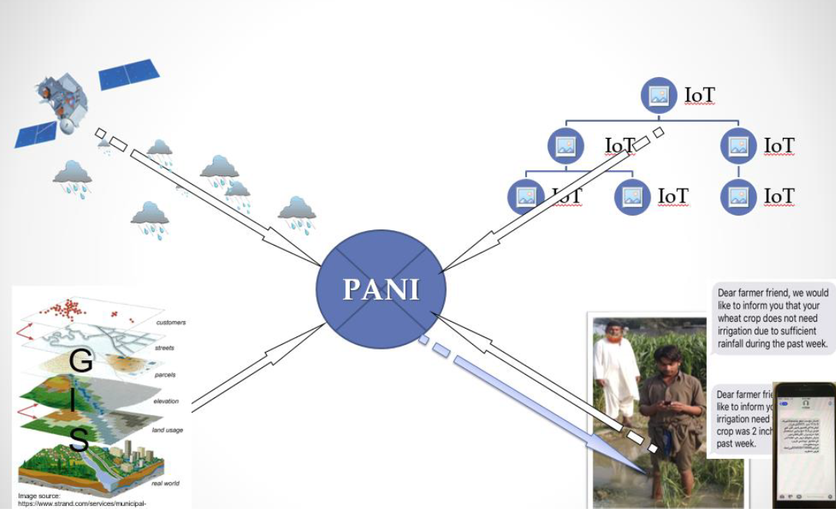
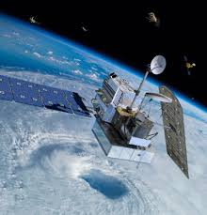
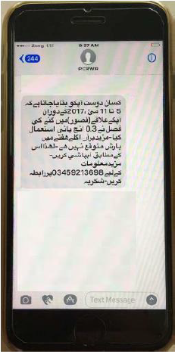
Empowering Small Farmers with Satellite Data in India
Building on the successful development of an operational irrigation advisory system based on satellite and weather model data for farmers in Pakistan, a pilot project termed Provision of Advisory for Necessary Irrigation (PANI) system was developed and implemented in India.
PANI is enabling conservation of water and nationwide smart-farming practices!
Check out more information at SASWE.net
GPM
The PANI enables farmers to receive real-time information on water resources in their area to know when and how much to water their crops.
Information is customized to each plot of land and communicated via cellphones.
An example text message in Pakistan. PANI text messages in India were similar and in Hindi
The PANI concept, combining satellite and weather model data (upper left) with finer resolution geographic data (lower left) and personalized farm data (upper right) to generate irrigation advisories via cellphones.
Image and text resources provided by Faisal Hossain (UW CEE)

