Slide 1
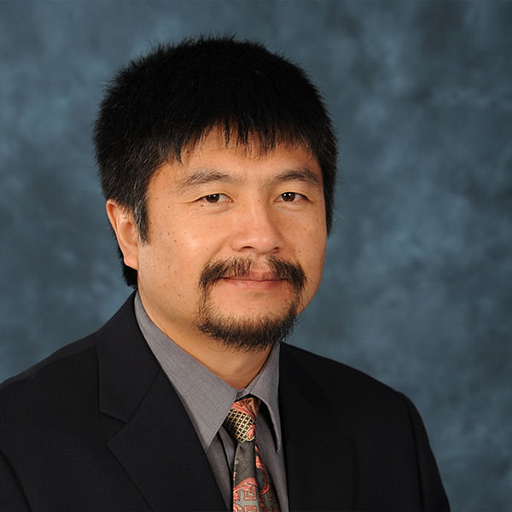
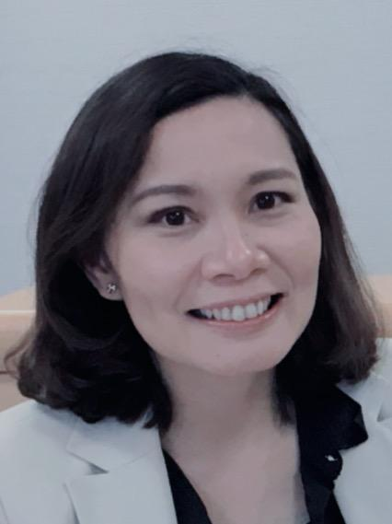
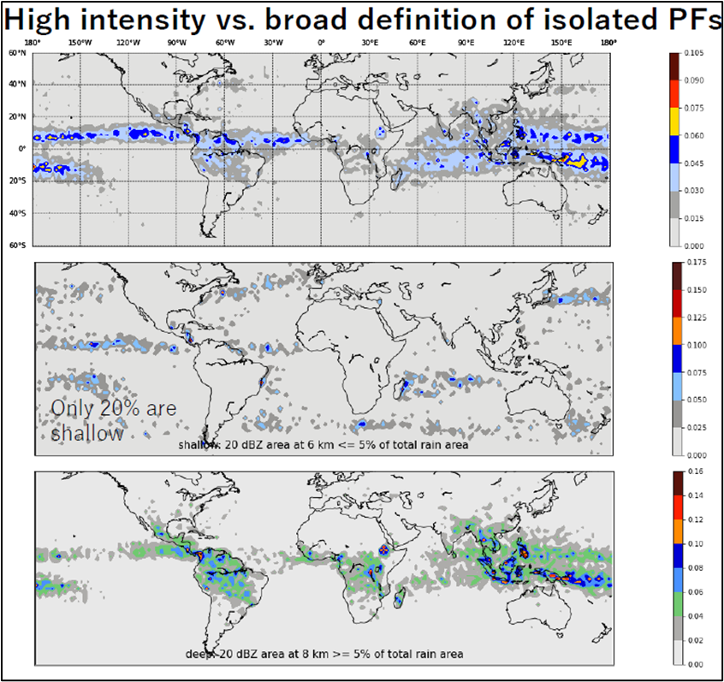
High Intensity Isolated Precipitation Features (PFs)
2022 NASA GPM Mentorship Program
Mentee:
Eva Yamamoto,
Kyoto University
PMM Mentor:
Chuntao Liu, Texas A&M University- Corpus Christi
Numerous isolated PFs can have similar rain intensities as organized ones and thus have potential to cause catastrophic flooding, landslides, and infrastructure damage.
The team conducted a global analysis to sort out when and where high intensity isolated PFs were formed using GPM DPR data and indirect measurements of latent heating from GPM.
Preliminary findings show that the multiple isolated PFs with high intensity rain are mostly formed in the tropics.
Understanding where and when these form are beneficial for the scientific community and hydrological modelers as it can help elucidate more about the life cycle of these storm systems in greater detail and provide valuable information for improving forecasts of weather and climate.
Figure: (Top) A global analysis of where high intensity isolated PFs were formed. (Middle) An evaluation of general PFs, highlighting that about 20% are shallow. (Bottom) An evaluation of high intensity isolated PFs, highlighting that they form deeper PFs. (Credit: E Yamamoto).
Check out more details at https://gpm.nasa.gov/applications/2022-gpm-mentorship/!

