Slide 1
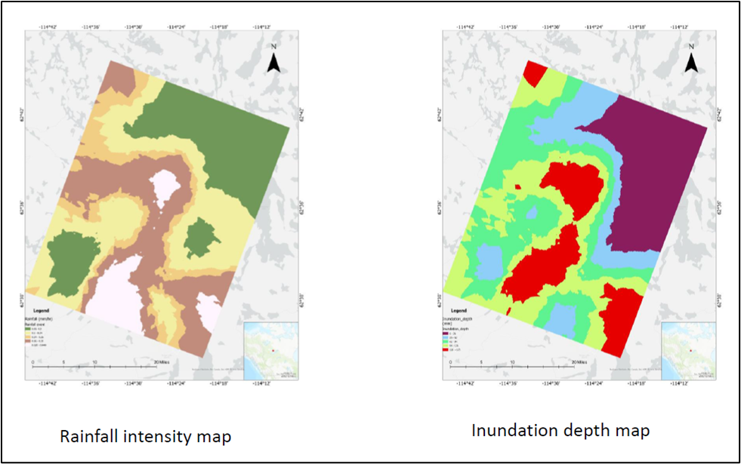
Mapping the Drainage Pattern of Canadian Shield (Baker Creek) with Rainfall Data
2022 NASA GPM Mentorship Program
Mentee:
Nimisha Wagle,
Brown University
PMM Mentor:
Chuntao Liu, Texas A&M University- Corpus Christi
For this project, the team analyzed rainfall data using IMERG along with data from DEMs to find the inundation depth of the Baker Creek region in the northern part of the Canadian shield area and map newly formed drainage patterns after extreme precipitation events.
Results showed that 45% of the total depression storage is filled due to realistic rainfall after an extreme event. The study also highlighted that the Canadian Shield surface water depression storage and hydrological connectivity are susceptible to rainfall events.
Understanding these changes will be critical in predicting and managing water resources in this region.
This work is ongoing. Future work includes using rainfall data and climate models to find the potential sensitivity of the depression storage to the regional water balance.
Figure: GPM IMERG data along with DEMs were used to help calculate inundation depth. Understanding fundamental hydrologic changes after rainfall events will be critical for predicting and managing water resources (Credit: N Wagle).
Check out more details at https://gpm.nasa.gov/applications/2022-gpm-mentorship/!

