Slide 1
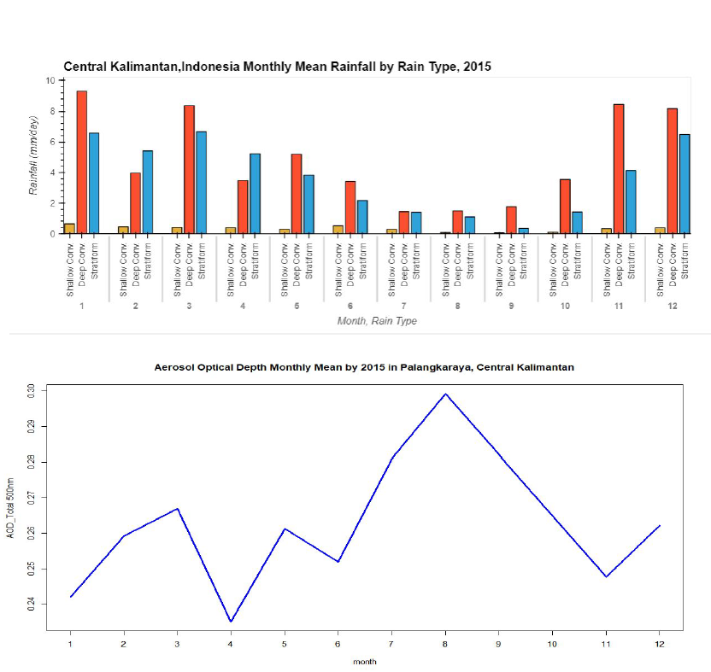
Convective Rainfall and AOD in Central Kalimantan, Indonesia
2022 NASA GPM Mentorship Program
PMM Mentor:
Courtney Schumacher
PMM Mentor:
Aaron Funk
Mentee:
Ayuna Santika,
BMKG
Texas A&M University- College Station
Deep convective rainfall and wildfires are a common occurrence in Indonesia’s Central Kalimantan region. Previous studies show that aerosols can affect and/or influence the forming of convective clouds.
For this project, the team analyzed shallow, deep convective and stratiform events from 2015 over Central Kalimantan using GPM DPR data and comparing it to the amount of atmospheric aerosols using AOD retrievals from ground-based measurements from AERONET.
Project findings show that Central Kalimantan has a monsoonal rainfall pattern in which both wet season and dry season are dominated by deep convective rainfall events and low AOD appears linked to enhanced deep convective rainfall (Nov – Jan).
This type of analysis provides an opportunity for the BMKG (Met Agency of Indonesia) to understand more about the relationships among active fires, AOD and convective rainfall events throughout the Central Kalimantan region.
Figure: An analysis of monthly convective shallow, deep convective and stratiform events over Indonesia’s Central Kalimantan region using GPM DPR (top) and monthly AOD profiles using data from AERONET (bottom) (Credit: A Santika).
Check out more details at https://gpm.nasa.gov/applications/2022-gpm-mentorship/!

