Slide 1
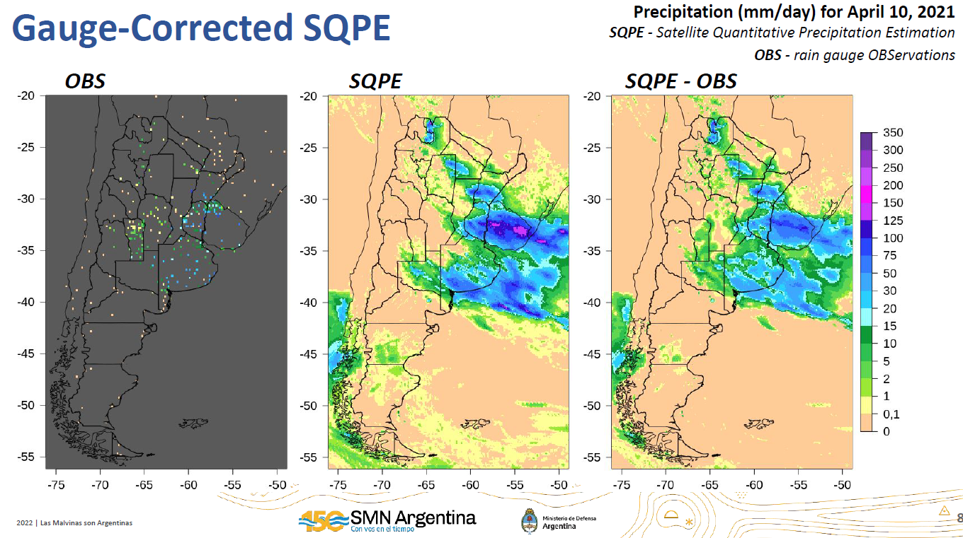
Analysis, Validation, and Correction of Satellite Quantitative Precipitation Estimation (SQPE) in Argentina
2022 NASA GPM Mentorship Program
Mentee:
Paula Hobouchian, National Met Service of Argentina
PMM Mentor:
Joe Turk, JPL
The team explored different gauge bias correction methods of SQPE products using IMERG E with the goal to improve the current Gauge-corrected SQPE product that the Argentina Met Agency uses within its systems.
The project is still ongoing, with next steps including a comparison of the current local bias correction applying the Zhang et al (2011) inverse distance weight technique and the Kriging with External Drift technique. The activities considered are adapting code, practice, and discussion of the methods. Also, the results considered are computing summary statistics and mapping daily precipitation for heavy rainfall events in Argentina.
These methods for improving SQPE products can provide better daily precipitation estimates in regions with a sparse rain gauge network, providing valuable information for meteorological agencies such as the National Meteorological Service in Argentina.
Evaluating alternative methods using rain gauge observations and SQPE products to improve precipitation estimates in Argentina (credit: MP Hobouchian).
Check out more details at https://gpm.nasa.gov/applications/2022-gpm-mentorship/!

