Slide 1
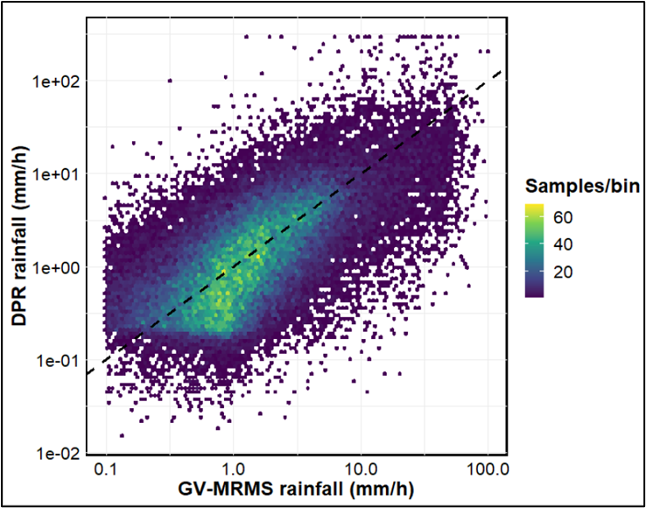
Ground Validation Analysis of GPM DPR Product
2022 NASA GPM Mentorship Program
PMM Mentor:
Yagmur Derin
PMM Mentor:
Pierre Kirstetter
Mentee:
Odinakachukwu Echeta,
Kwame Nkrumah University of Science and Technology
University of Oklahoma
For this project, the team validated the DPR merged scan product against a quality-controlled ground reference data (GV-MRMS) in the continental U.S.
Knowledge and skills learned from this concept study will be applied to evaluating and selecting remotely sensed satellite rainfall products that could be useful for rainfall estimation in data scarce regions such as West Africa.
“Understanding how to evaluate the accuracy of satellite precipitation data against ground data as well as accurately select the appropriate satellite precipitation estimate can greatly improve precipitation estimation over a given region. As a result of this, valuable information for improved weather and climate forecasts needed by meteorological, hydrological and disaster management bodies can be provided.” -Echeta
Figure: Validating GPM DPR against a quality-controlled ground reference data (GV-MRMS) in the continental U.S. Using a density scatter plot helps depict the relationship between DPR and GV dataset. (Credit: O. Echeta).
Check out more details at https://gpm.nasa.gov/applications/2022-gpm-mentorship/!

