Slide 1
Rain Gauge Lesson
Global Precipitation Measurement Mission
Developed by
Dorian Janney
GPM Education Specialist
SMAP/GPM Workshop
June 26th, 2013
Notes:
Introduce ourselves

Slide 2
Earth’s Water Cycle

Slide 3
Consider these questions-
Where does the water cycle begin?
Where did the water come from?
How can we get more water into our water cycle?
Does any water ever leave the water cycle?
Notes:
Ask the students to consider these questions. You might let them talk to each other about the answers for one minute.

Slide 4
Where did the water come from?
Notes:
Explain to the students that the water they drink and that composes from 50 to 75% of the human body. The water that they drink is the exact same water that has been on Earth for billions of years. At one point in time, the very same water was possibly dinosaur pee or Einstein sweat. They love this fact…

Slide 5
Earth’s Water
We aren’t 100% sure!
Most experts think much of it came from space- comets and other objects hitting Earth during early formation
Some may have been in Earth’s interior and in rocks and been outgassed from volcanoes as Earth began to cool.
Some experts are thinking the solar wind’s interaction with Earth’s oxygen could play a part

Slide 6
Latest Research Findings
As much as 98 percent of the water on the young Earth is believed to have come from ice-bearing meteorites - debris from the formation of the solar system that rained down on the still-cooling planet 4.5 billion years ago.
“Essentially the Earth when it formed, formed with water by the coalescence of these very early solid materials that formed from the solar nebulae," said Saal.
May, 2013 Journal Science

Slide 7
Drinking Water
Where does the water we drink come from?
What is a “watershed”?
How does water get into our watershed?
What happens to our drinking water if we don’t have enough precipitation?
How much precipitation does our area usually receive?
http://pmm.nasa.gov/education/interactive/floods-iquest

Slide 8
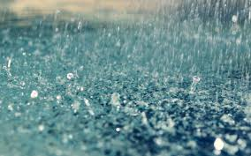
Measuring Rain
Let’s make rain gauges. These are used to measure how much it rains in a specific place.
Work with a partner, and use the materials on the table to try to make something that you could use to measure how much rains falls in one day.

Slide 9
Rain Gauge Discussion
What did you find difficult while making your rain gauge?
What are some important things to consider when making a rain gauge?
Why might the rain gauge data vary if they were placed together during a rain storm?
Where should you place your rain gauge to get the most accurate data?
How often should the data be checked?

Slide 10
Citizen Science and Precipitation Data
You can help scientists collect and monitor precipitation data. On your SmartPhone or IPad, download the app called “mPING”
http://www.nssl.noaa.gov/projects/ping/
Another neat Citizen Science group is CoCoRaHS, but you need a $30. standardized rain gauge to collect and submit data. http://www.cocorahs.org

Slide 11
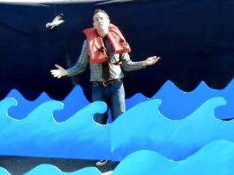
“For Good Measure”
http://pmm.nasa.gov/education/videos/for-good-measure

Slide 12
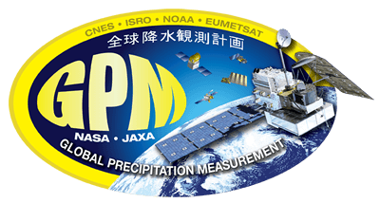
“Precipitation Education”
http://pmm.nasa.gov/education/

