Slide 1
Welcome to GPM- Help us with a NASA mission!
Global Precipitation Measurement Mission
Developed by the GPM
Education and Communications Team
NASA/GSFC- August 2014
For use by GPM Teachers for High School/College students
Notes:
This presentation has been developed to enable high school and college students to learn about their role this school year in learning about how NASA studies our home planet, and specifically how the GPM mission will learn about Earth’s water cycle. The audience is for students of teachers who are working with the GPM Education and Communications Team as GPM Pilot Teachers, Rain Gauge teachers, GLOBE Field Campaign teachers, and Master Teachers.

Slide 2
Welcome aboard!
Your teacher has been selected to help NASA improve some of the educational materials that they make for students around the world.
You will get to learn more about what NASA does, and how it uses science, technology, engineering, and mathematics to learn about our world and our universe.
This presentation was developed by NASA Education Specialists to invite you aboard, and to tell you a little bit about the NASA mission that you will be helping this school year.
Notes:
Use this slide to help your students understand that they are going to be involved in assisting NASA-improve and expand their educational materials this school year. You might talk a little bit about how you applied and what it means to be a “pilot tester” of educational resources.

Slide 3
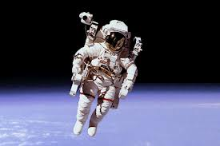
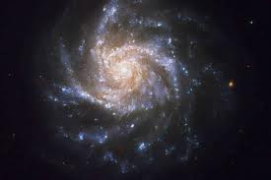
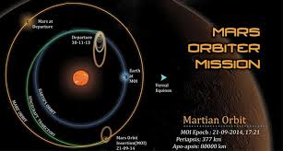
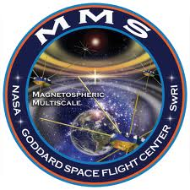
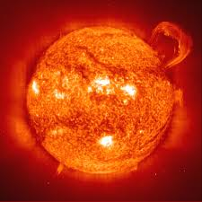
What does NASA do?
Notes:
Use this slide to generate a conversation about what the students already know about what NASA does. NASA studies many different aspects of space- including sending humans into space, learning about planets, moon, comets, asteroids, meteors, etc… NASA also studies our universe; looking at things like what is the universe made up of, when did it begin, how far does it go, is there more than one universe, and on and on.

Slide 4
NASA is also studying this planet-
Notes:
Explain that NASA also studies Earth. Steer their conversation to noting the presence of water on Earth. Ask if other planets have water, and talk about the importance of having water to the existence of life. Explain that as we look at other planets and moons for the existence of life, we search for places that have liquid water as life as we know it depends on having liquid water. It is an important concept to understand that our water isn’t produced by anyone- even though we know the “recipe” for water (two hydrogen atoms and one oxygen atom). We can’t make water, as it would be too dangerous to mix hydrogen and oxygen together. Ask if they know where our water came from, and explain that it came from asteroids and comets hitting Earth billions of years ago. Reinforce the fact that water is actually billions of years old and was created our in space when stars exploded. There is a good article that discusses this fact at http://1.usa.gov/1pPFqPs that students could read in class or as a homework assignment.

Slide 5
Current Earth-Observing NASA satellites
http://earthobservatory.nasa.gov/IOTD/view.php?id=81559
Notes:
Explain that NASA istudies Earth in a myriad of ways- from space. The next slide shows the current NASA missions that are studying Earth. You can find out more by going to Earth Right Now at http://www.nasa.gov/content/earth-right-now/. There is also a neat app, also called “EarthNow” that is free, easy to understand, and has real-time data from many of these satellites.
“When most people think about NASA, Earth is not the first thing that comes to mind. Ours agency conjures up thoughts of leaving Earth behind, so it is usually Apollo astronauts, the Moon, Mars, and Hubble views of stars and galaxies that people associate most strongly with NASA’s brand.
However, many astronauts have found the view back at Earth is as compelling as anything else they’ve seen. Nearly a half-century later, studying Earth from space is a critical part of NASA’s mission. There are currently sixteen Earth-observing satellites operating in orbit around our planet. The oldest, the Tropical Rainfall Measuring Mission (TRMM) was launched in 1997; the youngest, Landsat 8, was launched in February 2013. Together the fleet monitors a wide range of environmental phenomenon relevant to climate change, weather prediction, fire monitoring, and the health of vegetation.” from EarthRightNow website

Slide 6
How much water is on Earth’s surface?
Notes:
Show this image again, and this time ask them to estimate how much of Earth’s surface is covered by water. Help them understand that 70-75% is covered by water. Fill a clear cup up 70-75% full, and explain that this is how much of Earth’s surface that is covered by water (if the whole cup was a model of Earth’s surface volume). Take out one eye-dropper full of water, and put it in a smaller container, and tell them that if the cup represented how much of Earth’s surface was covered with water, then amount in the eye-dropper represents how much of that water is freshwater- only ~ 2.5 %. Then take out one drop of the freshwater, and put it on your hand, and tell them that only a small portion of freshwater, less than 1% of all water, is easily accessible to us.

Slide 7
Freshwater is a precious resource.
http://ga.water.usgs.gov/edu/earthwherewater.html
Notes:
In the pie charts above, the top pie chart shows that over 99 percent of all water (oceans, seas, ice, most saline water, and atmospheric water) is not available for our uses. And even of the remaining fraction of one percent (the small brown slice in the top pie chart), much of that is out of reach. Considering that most of the water we use in everyday life comes from rivers (the small dark blue slice in the bottom pie chart), you'll see we generally only make use of a tiny portion of the available water supplies. The bottom pie shows that the vast majority of the fresh water available for our uses is stored in the ground (the large grey slice in the second pie chart). http://ga.water.usgs.gov/edu/earthwherewater.html

Slide 8
Where is all the water on Earth?
Notes:
Where is Earth's water located and in what forms does it exist? You can see how water is distributed by viewing these bar charts. The left-side bar shows where the water on Earth exists; about 97 percent of all water is in the oceans. The middle bar shows the distribution of that three percent of all Earth's water that is freshwater. The majority, about 69 percent, is locked up in glaciers and icecaps, mainly in Greenland and Antarctica. You might be surprised that of the remaining freshwater, almost all of it is below your feet, as groundwater. No matter where on Earth you are standing, chances are that, at some depth, the ground below you is saturated with water. Of all the freshwater on Earth, only about 0.3 percent is contained in rivers and lakes—yet rivers and lakes are where most of the water we use in our everyday lives exists.

Slide 9
Uses of Freshwater in USA
Notes:
This pie chart shows how freshwater resources are used in the USA. You can see many more charts and more information looking at human appropriation of the world’s freshwater supply at http://bit.ly/1l7ltF2.

Slide 10
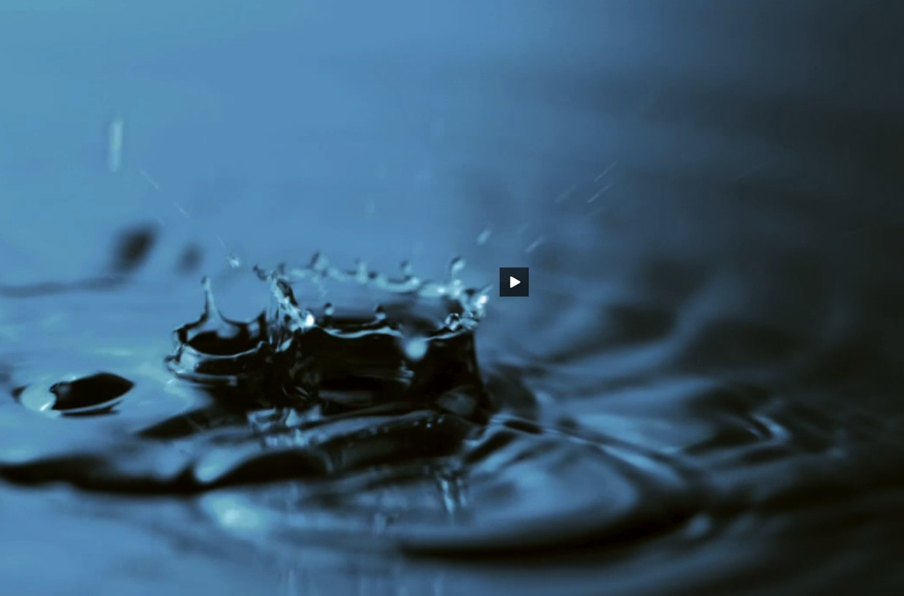
The Big Picture
The Freshwater Connection
Link to GPM movie
Notes:
Short video (1:24) that introduces idea of limited freshwater resources and concept behind GPM mission (is linked- need internet access or to embed video clip before showing PP if you don’t have internet access.) The url to download this video is http://pmm.nasa.gov/video-gallery/what-is-global-precipitation-measurement.

Slide 11
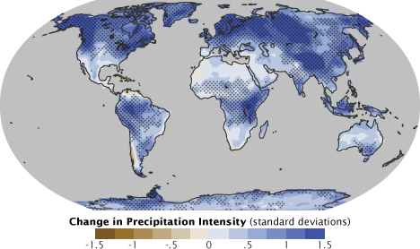
Why does NASA measure precipitation?
Improved knowledge of Earth’s water cycle and its link to climate change
http://earthobservatory.nasa.gov/Features/Water/page3.php
Notes:
http://earthobservatory.nasa.gov/Features/Water/page3.php: “The Water Cycle and Climate Change
Among the most serious Earth science and environmental policy issues confronting society are the potential changes in the Earth’s water cycle due to climate change. The science community now generally agrees that the Earth’s climate is undergoing changes in response to natural variability, including solar variability, and increasing concentrations of greenhouse gases and aerosols. Furthermore, agreement is widespread that these changes may profoundly affect atmospheric water vapor concentrations, clouds, precipitation patterns, and runoff and stream flow patterns.”

Slide 12
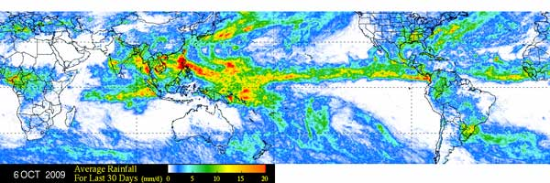
Weather and Climate:
New insights into precipitation microphysics, storm structures and large-scale atmospheric processes-
T
Monthly average rainfall for September 2009 from the TMI instrument on the TRMM satellite
Notes:
The mission that came before GPM, TRMM (Tropical Rainfall Measurement mission) launched in 1997 and is still collecting data. However, it only measures precipitation in the tropical regions. GPM will now extend that coverage to include the mid-latitude regions, allowing us to measure precipitation all over the globe, with the exception of the North and South Pole regions. This image shows TRMM data, and includes some mid-latitude data that was available from other sources. However, many sections of the map have no colors- indicating a lack of data for that area. As GPM begins to publish data, in mid-September, we will have more complete worldwide precipitation measurement maps.

Slide 13
Weather and Climate:
Extended capabilities in monitoring and predicting hurricanes and other extreme weather events-
Animation of Hurricane Arthur on July 3rd, 2014. The animation begins with global infrared data showing the progression of the storm as it forms into a hurricane. Then GPM flies overhead measuring rain rates on the ground. GPM's Dual frequency Precipitation Radar (DPR) then dissolves in to reveal the internal structure of the hurricane. Next, a cutting plane appears to dissect the storm and show the inner rain patterns.
Notes:
http://svs.gsfc.nasa.gov/vis/a000000/a004100/a004186/HurrArthur720p.mp4- : “The five GPM passes over Arthur are the first time a precipitation-measuring satellite has been able to follow a hurricane through its full life cycle with high-resolution measurements of rain and ice. In the July 3 image, Arthur was just off the coast of South Carolina. GPM data showed that the hurricane was asymmetrical, with spiral arms, called rain bands, on the eastern side of the storm but not on the western side.”

Slide 14
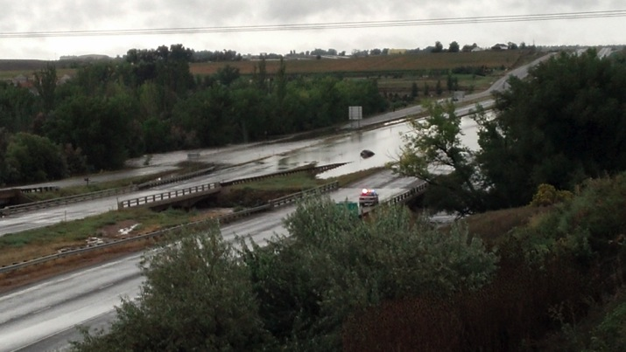
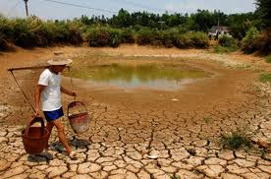
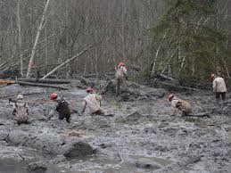
Weather and Climate:
Improved forecasting abilities for natural hazards, including floods, droughts, and landslides-
Notes:
“All life relies on the availability of water. Knowing when, where, and how much it rains or snows is vital to understanding how weather and climate impact our environment, and in turn human society. The movement of water and energy around Earth affects agriculture, fresh water availability, and the occurrence of natural disasters.
In many parts of the world, rain is the only source of water for both drinking water and agriculture. Rain also recharges ground water aquifers, and spring snowmelt replenishes rivers and streams for the summer. Having too much or too little water often results in natural disasters for populations around the world, where tropical cyclones, floods, droughts, and landslides can wreak havoc on local communities. Having accurate information on rain and snow is critical for estimating when to plant crops, where to build houses, how to plan transportation routes, and to what extent we need assistance during extreme weather.” from http://pmm.nasa.gov/education/societal-applications

Slide 15
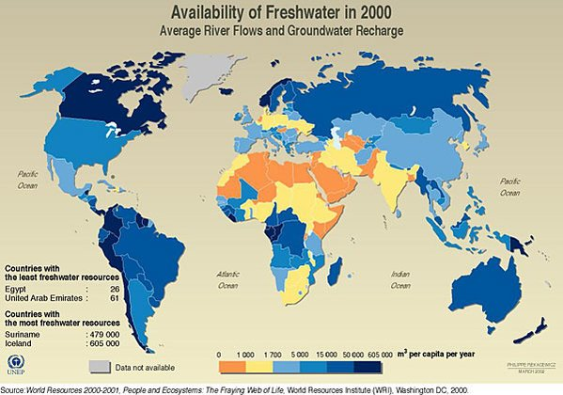
Societal Applications:
Improved agricultural crop forecasting and monitoring of freshwater resources-
Notes:
There is a good article about the unequal distribution of freshwater resources and its impact on societies athttp://pmm.nasa.gov/education/sites/default/files/lesson_plan_files/Precious%20Freshness.pdf. For more information on this subject, you can go to http://pmm.nasa.gov/education/images/world-droughts-2005-2009-versus-where-crops-are-grown.

Slide 16
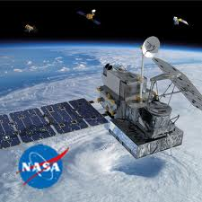
“Our Wet, Wide World”
http://pmm.nasa.gov/education/videos/our-wet-wide-world-gpm-overview
Notes:
Show them this image of the GPM satellite, and explain a few things to them about the Core Observatory. It is about as big as a fire engine, and has no people on it. People control it from Earth, using the high gain antenna to give signals and retrieve data. The satellite was launched in a rocket on Feb. 27th, 2014 from Japan, as Japan and the US are working together on this mission. GPM flies all day and all night, and is about 250 above Earth’s surface. They might be able to see it flying overhead at night if they stare at the sky for awhile. You can tell if it is an airplane and not a satellite if it has lights on it, as satellites look more like stars that are moving across the sky in a steady motion, but have no lights that blink. The solar arrays use the sun’s energy to give the satellite power, and the star tracker helps it to know where it is going because there aren’t any street signs in space! GPM uses two main instruments to measure precipitation that is falling down to Earth- the GMI and the two DPR instruments.

Slide 17
How will you be involved?
Every month, your teacher will get a few new NASA educational resources that are related to the work that the GPM mission is doing.
Your teacher will share the resources with you, and will get your opinion about how well the resource worked to teach you about the science, technology, engineering, and mathematics behind this mission.
Your teacher will report back to us with your reactions and your advice.
We will improve our educational resources using your feedback!

