Slide 1
GPM Applications in Japan
-- Current activities and Future possibilities
Riko Oki
JAXA
GPM Applications Workshop
@NOAA Center for Weather and Climate Prediction

Slide 2
GPM ‘Applications’ in Japan
In the beginning of GPM project, we called GPM as ‘a bridge mission’ from science to application in Japan.
However, expectations for GPM applications were more than we imagined. No one uses ‘a bridge mission” any more!
A new Basic Plan on Space Policy has been established in January, 2013. Ensuring autonomy, Development industry, and Improvement of People’s lives are its key words. (GPM is categorized into one of the science missions and its priority is not necessarily high. )
It is expected for GPM that its data will be utilized for more applications. At the same time, more scientific results are expected, because its classification.

Slide 3
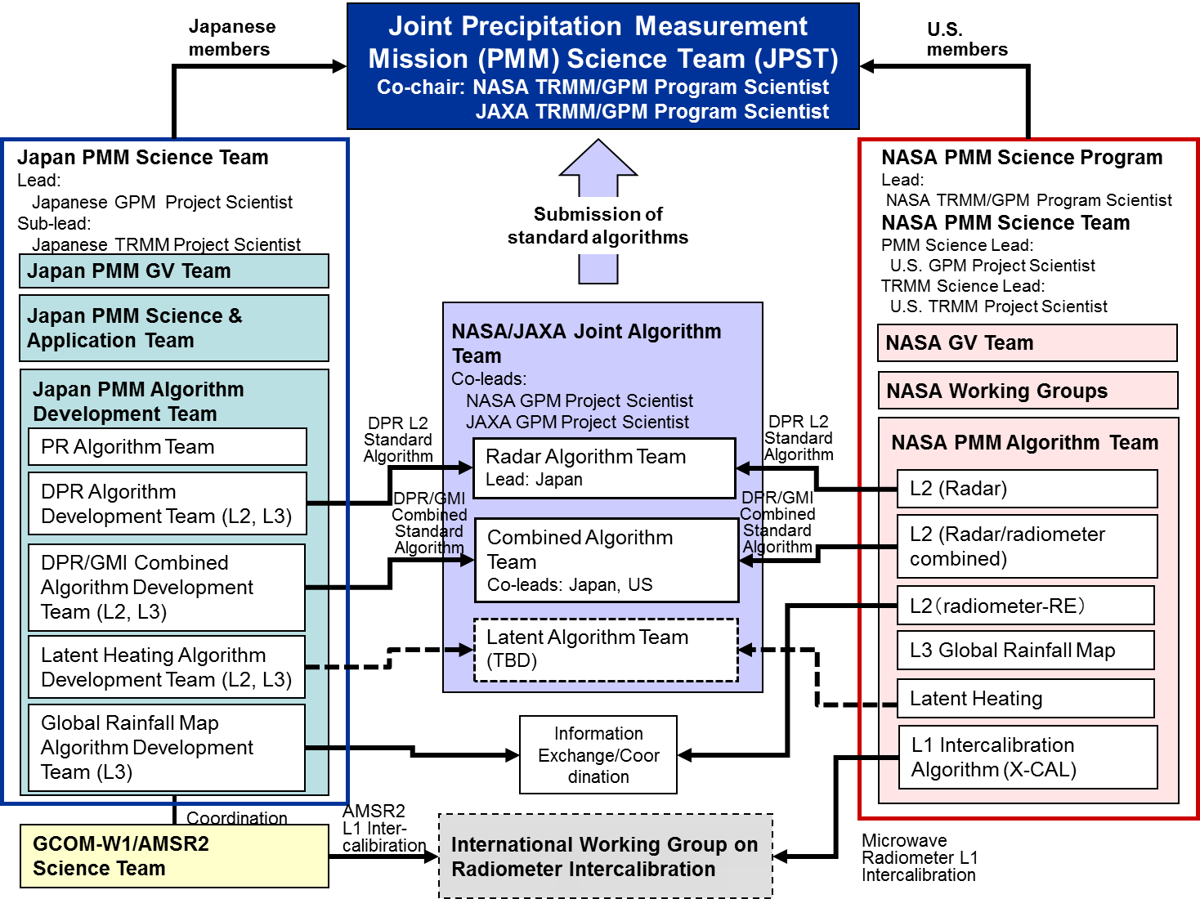
Japan-US Science Framework
-- Joint Algorithm Development --

Slide 4

Photo of Dual-frequency Precipitation Radar (DPR) instruments
Notes:
This is the DPR flight model. The bigger one in front of the person is the KuPR, and smaller one is the KaPR.
Size of the KuPR is about 2.5 m square and about 0.6 m height and mass is about 400 kg.
KaPR size is about 1.4 m square, 0.8 m height and about 300 kg mass.
Position of each radar is same as flight configuration on the GPM core observatory.
4

Slide 5
JAXA GPM Products
Level | Product | Physical value | unit | coverage | resolution
1 | KuPR L1⁽*²⁾ | RX Power Profile | orbit | 245km | 5km (horizontal), 125m (vertical)
 | KaPR L1⁽*²⁾ | RX Power Profile | orbit | 125km | 5km(horizontal), 125/250m (vertical)
2 | KuPR L2 ⁽*¹⁾ | Radar reflectivities, Sigma-zero,Rain Type, BBH, Precipitation rate, etc. | orbit | 245km | 5km (horizontal), 125m (vertical)
 | KaPR L2 ⁽*¹⁾ | Radar reflectivities, Sigma-zero,Rain Type, BBH, Precipitation rate, etc. | orbit | 125km | 5km (horizontal), 125m (vertical)
 | DPR L2 ⁽*¹⁾ | Precipitation intensity profile, DSD, etc. | orbit | 245km | 5km (horizontal), 250m (vertical)
 | DPR/GMI Combined L2 ⁽*¹⁾ ⁽*³⁾ | Precipitation intensity profile, Surface precipitaion, etc. | orbit | 125km | 5km (horizontal), 250m (vertical)
 | DPR Latent Heating L2 | Latent heating profile, Rain type, etc. | orbit | 245km | 5km (horizontal), 250m (vertical)
3 | DPR L3 ⁽*¹⁾ | Surface precipitation, Time info., etc. | daily | Global | 0.1-deg
 |  | Surface precipitation (DPR only), BB, Radar reflectivities, etc. | daily | Global | 0.25-deg
 |  | Surface precipitation (Ku, Ka, DPR), BB, Radar reflectivities, histgram, etc. | Monthly | Global | 0.25-deg
 | DPR/GMI combined L3 ⁽*¹⁾ ⁽*³⁾ | Average Precipitation distribution, etc. | daily, monthly | Global | 0.5-deg
 | DPR Latent Heating L3 | Latent heating profile, etc. | daily, monthly | Global | 0.5-deg, 19-layer (TBD)
 | Global Precipitation Map ⁽*²⁾ | Rainfall map, gauge-calibrated rainfall, etc. | hourly, monthly | Global | 0.1-deg
^{(*1)} shall be approved by JPST. ^{(*2)} shall be endorsed by JPST. ^{(*3)} shall be processed by PPS.

Slide 6
JAXA GPM Near Real Time Products
Level | Product | Physical value | unit | coverage | resolution
1R | Each microwave radiometer | Brightness temperature | - | Depend on each sensor | Depend on each sensor
2R | DPR | Precipitation intensity profile, radar reflectivity profile, DSD, etc. | - | 245km | 5km (horizontal), 250m (vertical)
 | DPR/GMI Combined ⁽*³⁾ | surface precipitaion, etc. | orbit | 125km | 7km
3R | Global Precipitation Map | Rainfall map, gauge-calibrated rainfall, etc. | hourly | global | 0.1-deg
^{(*1)} shall be approved by JPST. ^{(*2)} shall be endorsed by JPST. ^{(*3)} shall be processed by PPS.

Slide 7
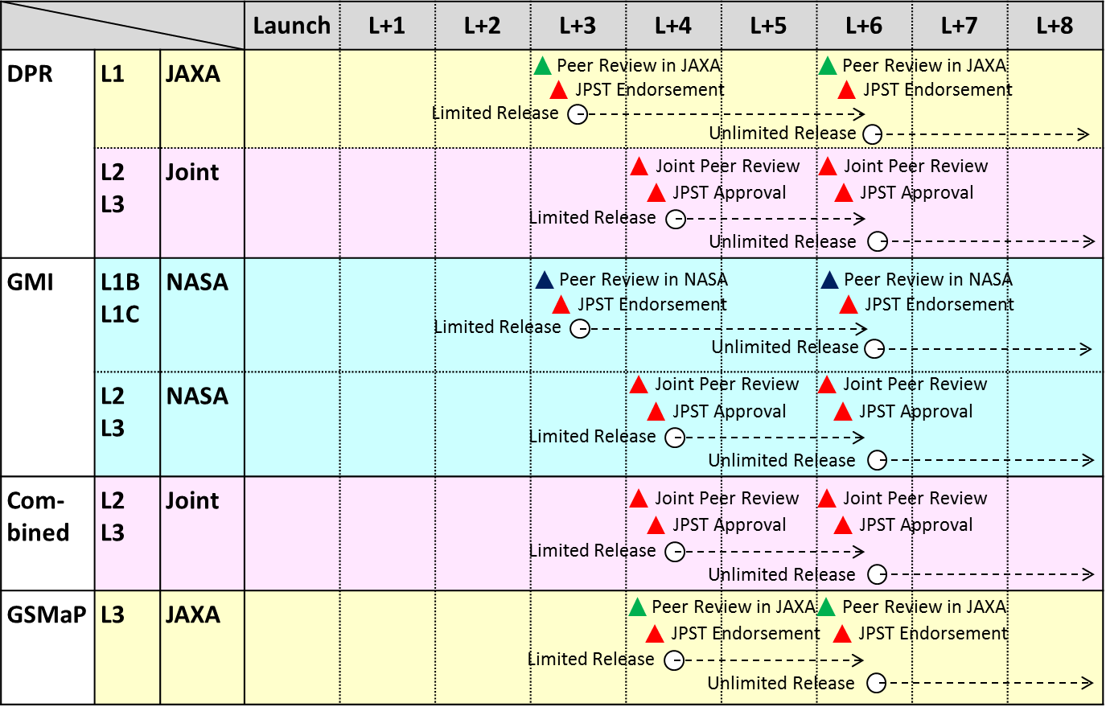
GPM Data Release Schedule
Launch + 3-4 month：
Limited Release
for algorithm developers
Launch + 6 month：
Release for public
JAXA
NASA
Joint

Slide 8
Japan’s two focusing products
DPR → research
  research progress by GPM/DPR from TRMM/PR
    Dual frequencies
    Mid-High latitude precipitation
    Combined information with GMI multi frequencies
  Continuous and consistent satellite precipitation record by from TRMM/PR to GPM/DPR
GSMaP → applications
  Original plan was that to start with GPM core satellite launch and algorithm had been developed 2002-2007 under CREST.
  Started to release images and products including near-real time at JAXA/EORC using existing satellites in Nov. 2007.
  Number of registrations is increasing everyday.

Slide 9
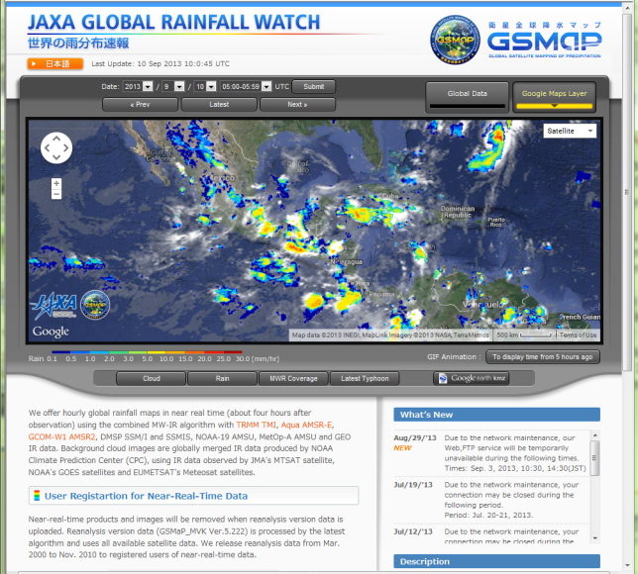


JAXA/EORC Global Rainfall Watch
http://sharaku.eorc.jaxa.jp/GSMaP/
GSMaP (Global Satellite Mapping of Precipitation) near-real-time version is available via internet.
0.1-deg and hourly global rainfall are available 4-hour after observation.
Binary and text data has been available via password protected ftp site.
AMSR2 on GCOM-W1 has been introduced to the system since Jul. 2013.
Reanalysis data (GSMaP_MVK V5.222) is available from the same ftp site.
  Mar. 2000 - Nov. 2010 by latest algorithms introducing SSMIS and AMSU has been available to registered users.
  Test product of gauge corrected version (GSMaP_Gauge) is also available .
New web site in Google Map mode
Notes:
9
9

Slide 10
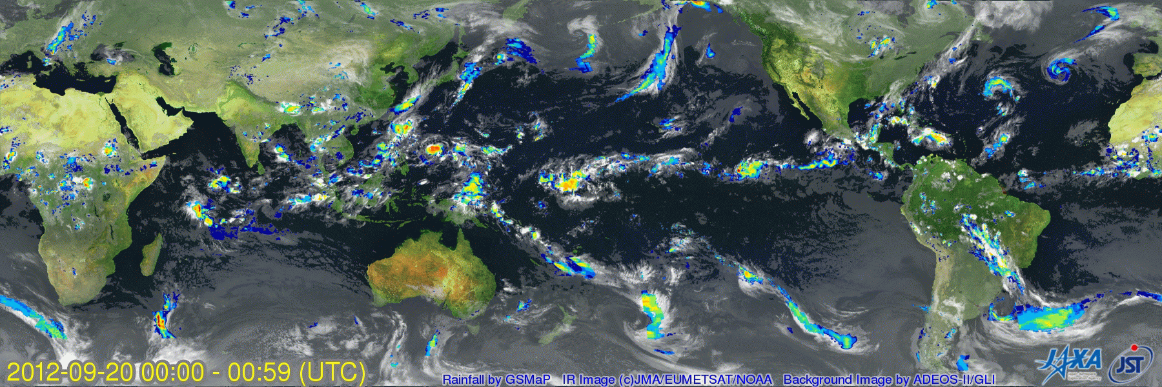
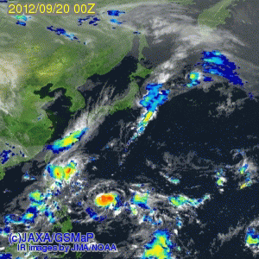
Example of GSMaP Animation
Sep. 20 – 1 Oct. 2012 (3-hourly) – Super Typhoon No.17 “JELAWAT” can be seen south of Japan
Notes:
10
10

Slide 11
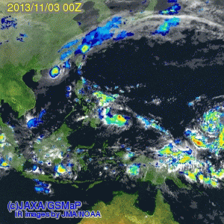
Recent this year strongest typhoon 30 passing through Philippians

Slide 12
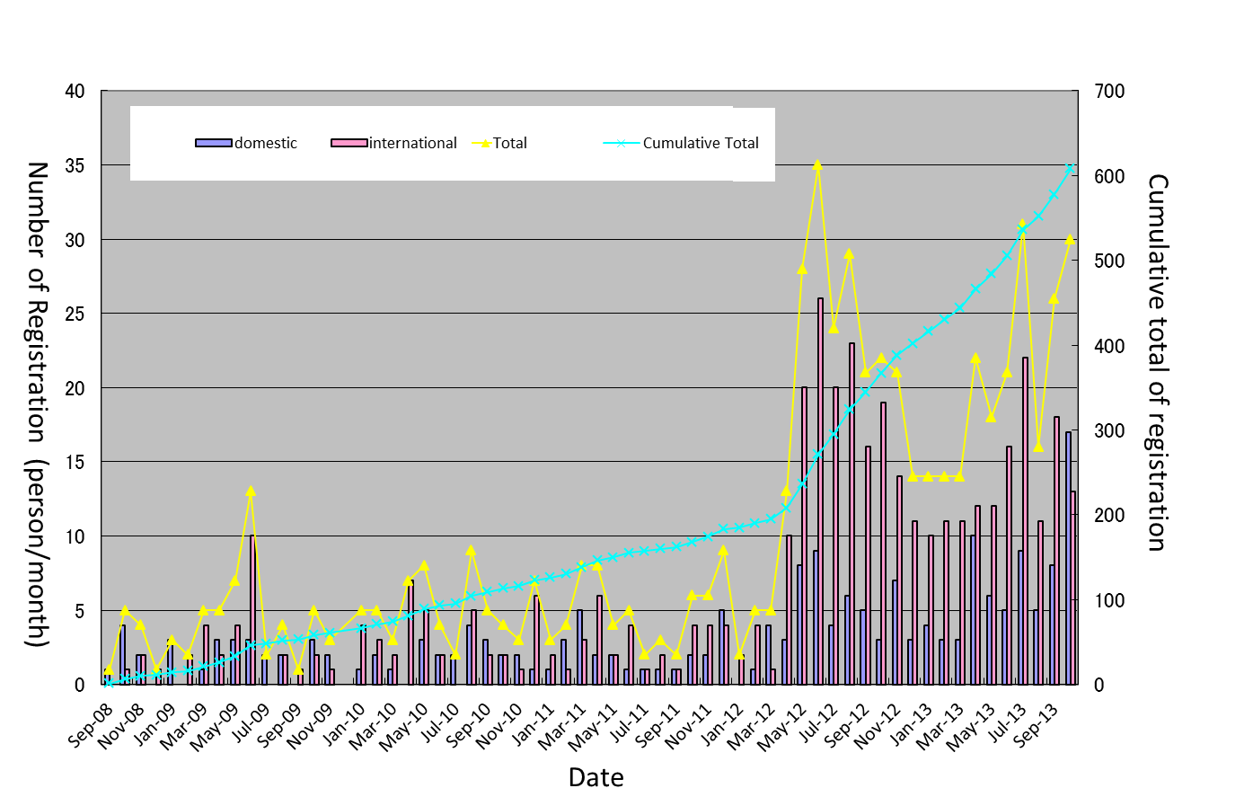
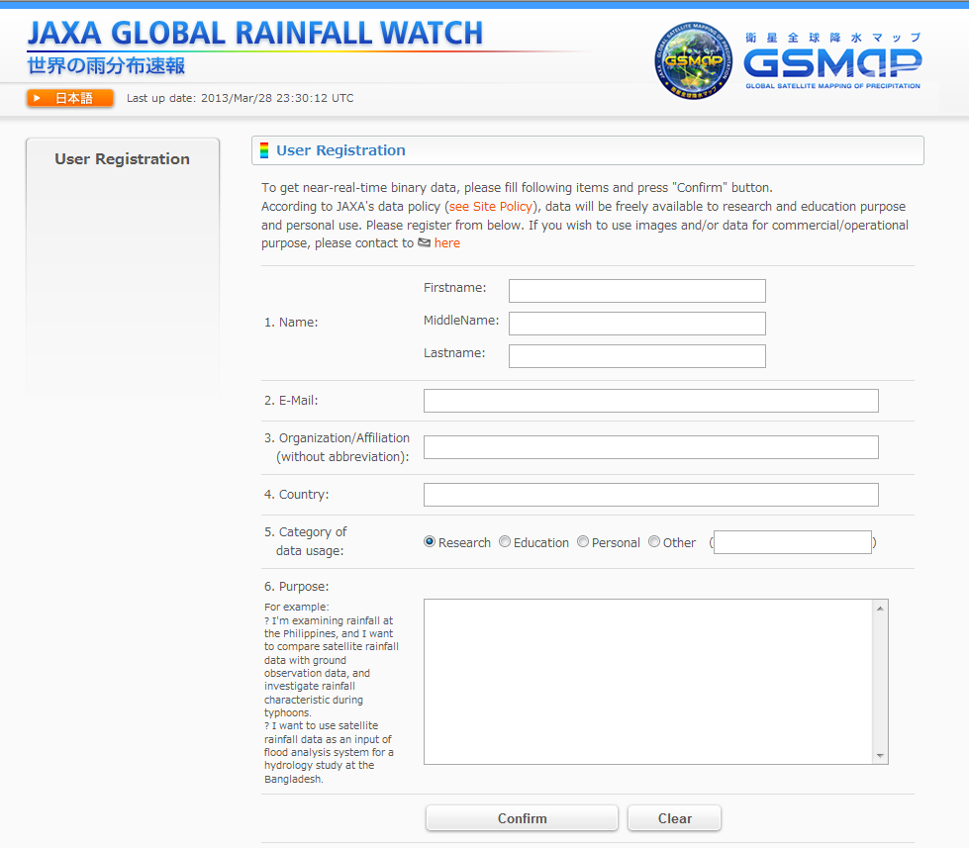
Increase of Registration
To use GSMaP data, we’re asking users to register.
At first, registration method is to send an request e-mail to JAXA contact point.
In April 2012, we have introduced User Registration Form (right below) on the web site. This change dramatically increased number of user registration from 5 per month to 20 per month.
Change of Registration Form
Current User Registration Form on the GSMaP Web Site

Slide 13
GSMaP and GPM Applications in Various Areas
Weather forecast/monitoring
  Japan Meteorological Agency (JMA) : NWP system, typhoon analysis
  Meteorological Research Institute : Future NWP system
  Japan Weather Association (JWA) : Mobile phone, weather information
Flood warning/prediction
  International Flood Network (IFNet), Infrastructure Development Institute (IDI) : Global Flood Alert System (GFAS)
  International Centre for Water Hazard and Risk Management (ICHARM) : Integrated Flood Analysis System (IFAS)
  Japan Water Association : flood potential monitoring
  UNESCO-IHP (Pakistan) : flood warning system using IFAS
  Asia Development Bank (ADB) (Philippines, Bangladesh, and Viet Nam) : River management including flood risk
  Japan International Cooperation Agency (JICA) (Nigeria, Mozambique, etc.) : Water resource management in river-basin, flood monitoring
Agriculture
  Chiba University : food security
Education

Slide 14

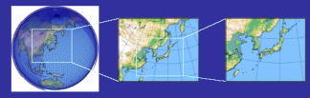
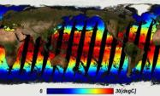

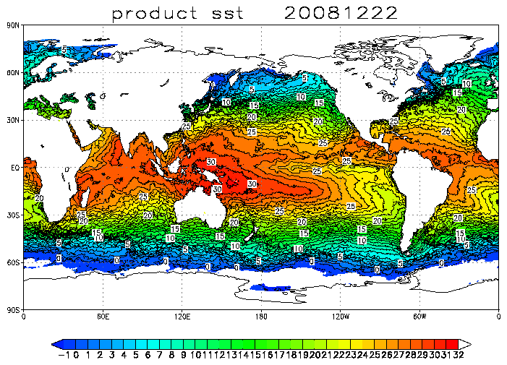
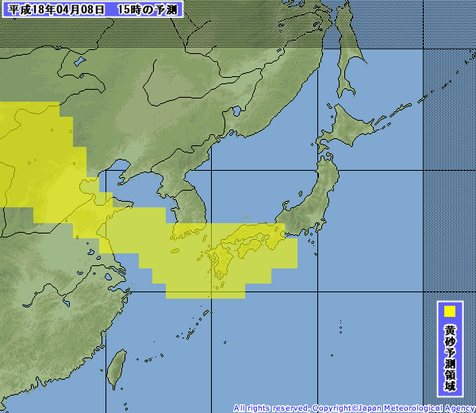
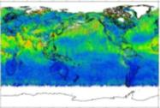
Satellite Data Utilization in Meteorological Agency
Development of technologies to utilize satellite data in numerical weather prediction, and monitoring of Typhoon, sea ice and El Nino has been implemented by Japan Meteorological Agency (JMA), and TRMM, AMSR-E and other satellite data has been utilized in their operational system in contributing improvements of forecast accuracy. In addition, new application such as forecast of yellow sand is under preparation.
Weather information distributed by JMA is received by various end users including public, disaster prevention agencies, local government, private weather companies, media, shipping/airplane companies. In local government, disaster/evacuation warnings are announced officially based on information distributed by JMA.
End users
JMA
JAXA
Public
Disaster prevention agencies
Local government
Private weather companies
Medias
Foreign meteorological agencies
Shiplines
Airlines
Etc.
Numerical Weather Prediction
Provide
satellite
data
Microwave imager
TB, SST, Sea Ice. etc.
Forecast result/data
Validation
cooperation
Global Model
Meso-scale Model
Local Model
Example of Sea Surface Temperature (SST)
Analysis and evaluation of current status
Optical imager
Radiance, aerosol, etc.
Provide
weather
data
SST analysis
Forecast of yellow sand
Example of aerosol distribution
Provided by JMA

Slide 15
Data Utilization in Weather Forecast
Collaboration with Japan Meteorological Agency (JMA) since 1996.
  TRMM/TMI, AMSR-E, and AMSR2 brightness temperature products have provided to Japan Meteorological Agency by JAXA in near-real-time basis.
  JAXA and JMA recently have started joint studies to explore possibility of assimilation of passive microwave rainy area and/or space-borne precipitation radar for the next-generation numerical weather forecast.
JMA uses microwave radiance and precipitation data for the purposes of data assimilation, model evaluation, and typhoon analysis.
  Used in operational data assimilation system for numerical weather prediction.
  Used in typhoon analysis/monitoring in decision of typhoon center/intensity.
  Used in long-term reanalysis (JRA-55).
  Evaluation of JMA global precipitation forecasts using TRMM data.
JMA is planning to introduce GPM data into the NWP after data release.

Slide 16
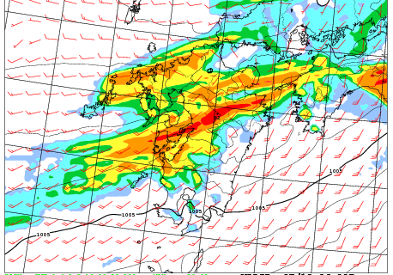
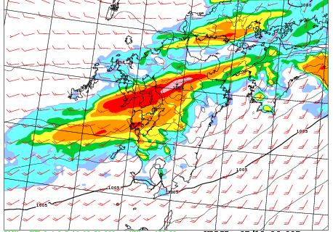
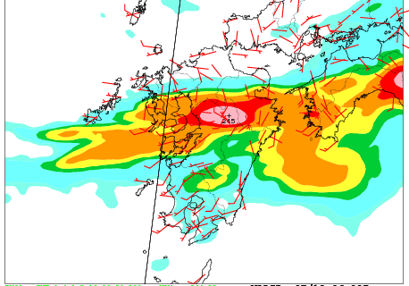
Effect of Microwave Imager Data in the NWP
AMSR2 data has been introduced to the NWP system on Sep. 12, 2013.
Impact study of introduction of AMSR2 into the JMA Meso Scale Model for the case of Kyushu Heavy Rainfall in July 2012.
Without AMSR2 data (left), heavy rainfall forecast in Kyusyu area is not well expressed compared to observation (right). When introducing AMSR2 data in data assimilation (middle), heavy rainfall is forecasted well.
This result is supposed that better water vapor analysis accuracy over the East China Sea with AMSR2 resulted in improving rainfall forecast accuracy.
Forecast rainfall without AMSR2
Forecast rainfall with AMSR2
Observed rainfall
[mm/3hr]
3-hour rainfall at 6 JST on 12 July 2012. Forecast is 21 hour forecast with initial time of 9 JST on 11 July 2012.
Images provided by JMA

Slide 17
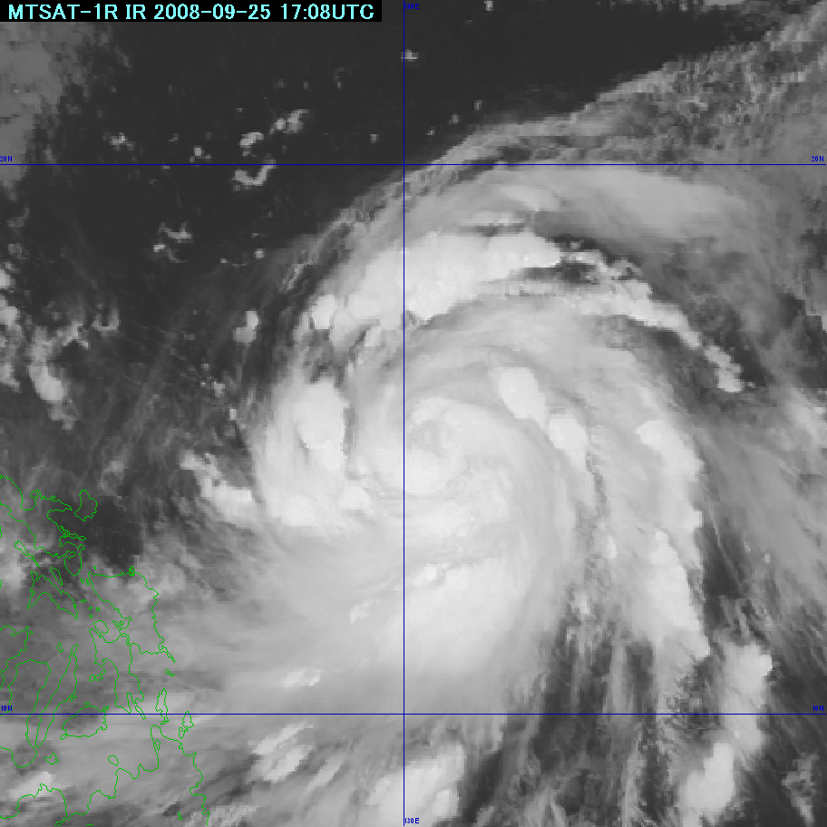
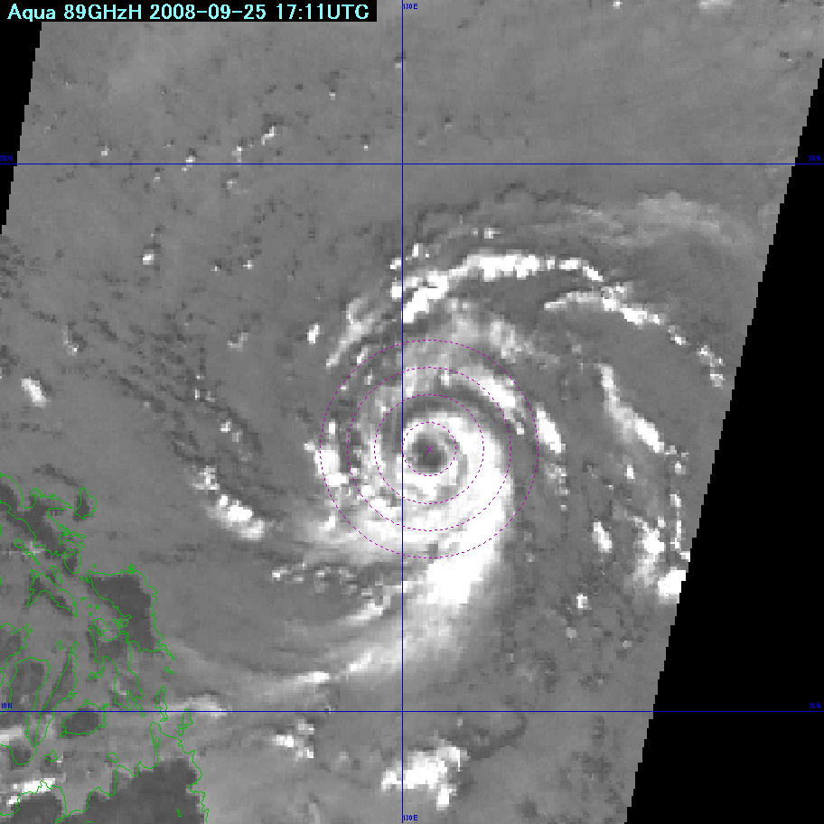
Utilization in Operational Typhoon Analysis
Winds speed retrieved by microwave imager data (AMSR-E, TMI) has been used in operational typhoon analysis in JMA since April 2008.
  At first, microwave imager data was used as reference in producing best track of typhoon in offline basis, and validated when it was utilized in real-time analysis
  Validation results showed that method to correct traditional typhoon intensity analysis using geo-stationary IR data (Dvorak method) by maximum wind speed obtained from AMSR-E data was good, and the method has been installed to operational analysis.
MTSAT-1R IR1
AMSR-E 89GHz H
Example of typhoon analysis using AMSR-E on Aqua (Typhoon No.15 in 2008. 25 Sep. 2008, 18YTC) applied to obtain maximum wind speed (Image provided by JMA).

Slide 18
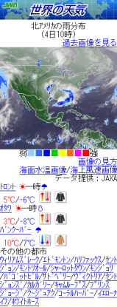
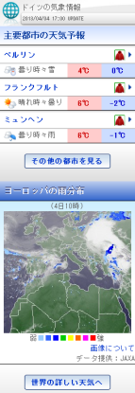
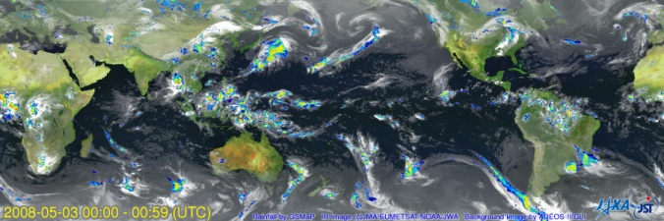
GSMaP on the Mobile Phone
Under the joint study between JAXA and Japan Weather Association (JWA), JWA has provided near-real-time rainfall information as one of ‘world weather’ information in their website for mobile phone. (The site is written by Japanese.)
JWA Mobile Site
(JWA produces regional images of GSMaP and clouds)
JAXA Global Rainfall Watch
ftp server
Web Image © JWA

Slide 19
Data Utilization in Flood Warning
Collaboration with International Flood Network (IFNet) and Infrastructure Development Institute (IDI) (secretariat of IFNet) since 2003.
  Utilization of TRMM and GPM satellite-based rainfall data as input to their Global Flood Alert System (GFAS).
  Current system uses TRMM 3B42RT (provided by NASA) as inputs, but they plan to switch it to GSMAP near-real-time product for its advantages in data latency of 4-hour after observation.
Collaboration with International Centre for Water Hazard and Risk Management (ICHARM) since 2005.
  Utilization of hourly GSMaP near-real-time data in their flood forecasting system, Integrated Flood Analysis System (IFAS).
  Development of self-collection method for GSMaP as input to IFAS.
Joint collaboration has been started among JAXA, IDI and ICHARM since 2011.
  To explore utilization and applicability of satellite observation data in the field of water-related hazards, including floods.

Slide 20
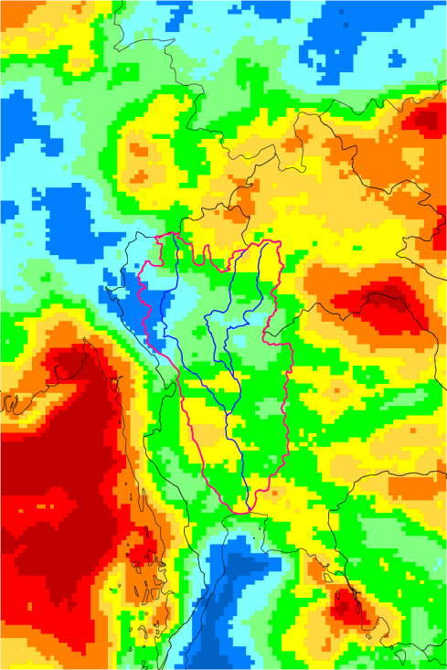
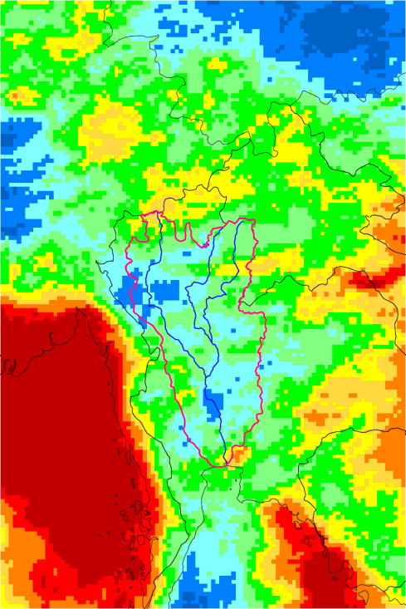
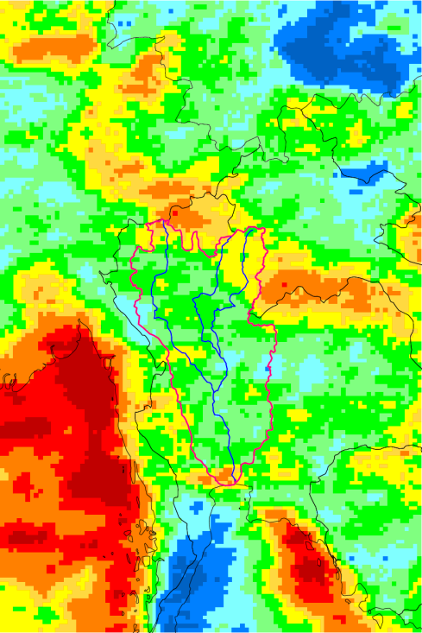
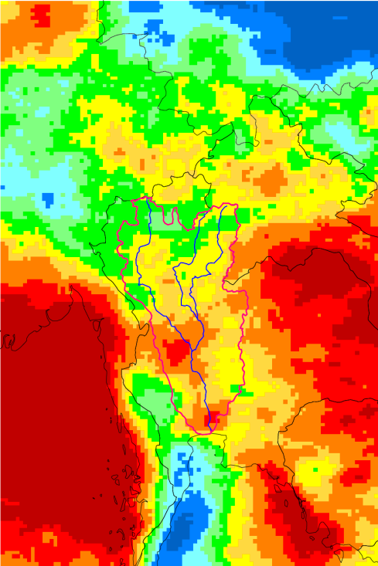
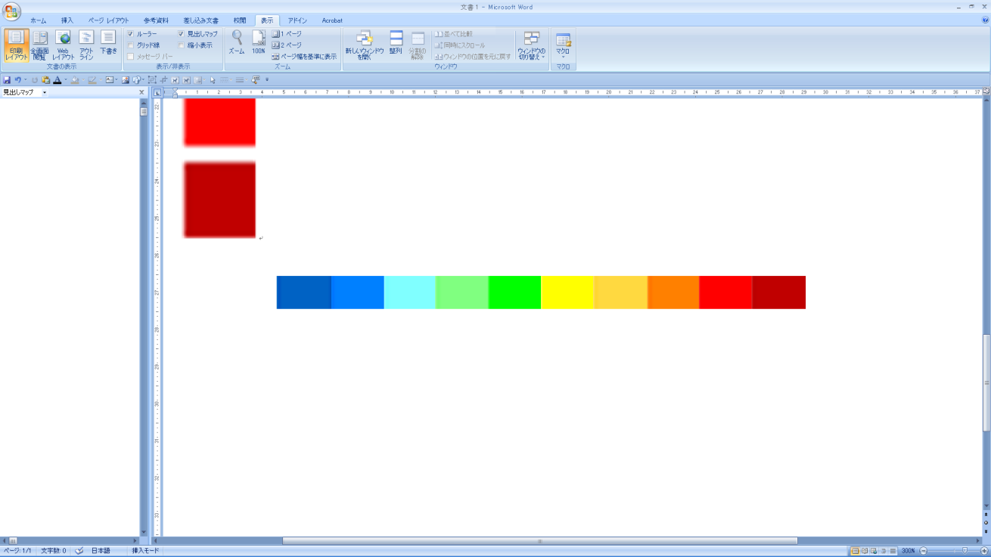
Analysis of GSMaP for Flood in Thailand in 2011 by IDI
By using satellite-monitoring data from GSMaP, 3 month’s basin-average precipitation (July-September of 2008-2011) over the Chao Praya River was analyzed without using any ground-observed rainfall data.
2008
2009
2010
2011
Basin mean precipitation in Chao Phraya River Basin from July to September
518mm
424mm
527mm
710mm
Average(Bangkok)
DATA/ GSMaP MVK(2008)
GSMaP NRT(2009-2011)
0 200 300 400 500 600 700 800 1,000 1,200(mm)
Images provided by Infrastructure Development Institute (IDI), secretariat of IFNet

Slide 21
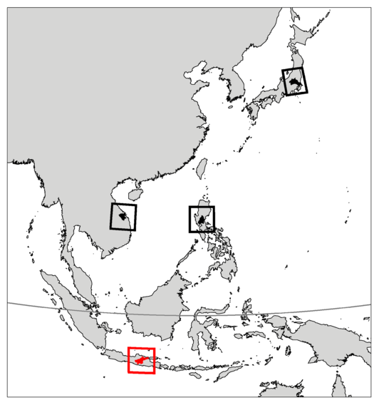
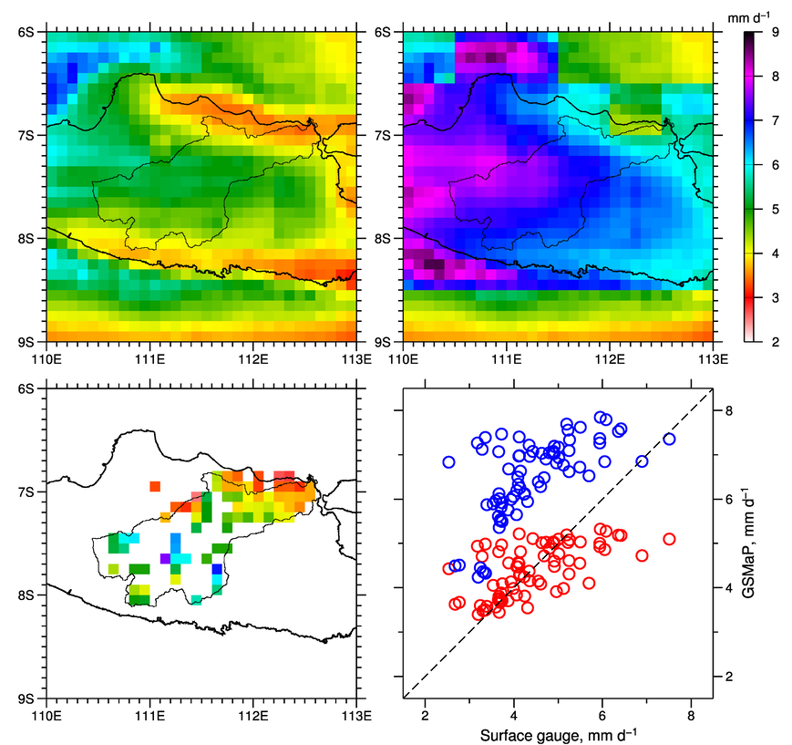
Validation of GSMaP Data in River Basin for Flood Prediction by ICHARM
GSMaP data is validated in some river basins in Asian countries to examine applicability of satellite-based rainfall in future flood prediction.
GSMaP_MVK (reanalysis version of GSMaP) shows good agreement with surface observation (rain gauge), while GSMaP_Gauge (gauge-calibrated GSMaP) shows over estimation.
  Result indicates that CPC daily gauge data, which is used in GSMaP_Gauge product, does not well represent rainfall in this region. Local customize may be needed in future improvement.
GSMaP_MVK
GSMaP_Gauge
Mean daily rainfall
2002–2009
Rain-Gauge
GSMaP_Gauge
GSMaP_MVK
Solo River basin
16,100 km²
Images provided by ICHARM

Slide 22
Asia Development Bank (ADB) Project Overview
TA-8047 REG “Applying Remote Sensing in River Basin Management
  JFPR funded, 2 million US$
  Target countries: Philippines, Bangladesh, and Viet Nam
  Duration - 2012/4 to 2014/12
Impact:
  reduction in losses from flooding events
Outcome:
  improved river basin management including flood risk management using Space Based Technology (SBT) and ICT
JAXA’s tasks:
  JAXA implement the project as the implementing agency with ADB and related agencies, also conduct ALOS DSM generation.

Slide 23
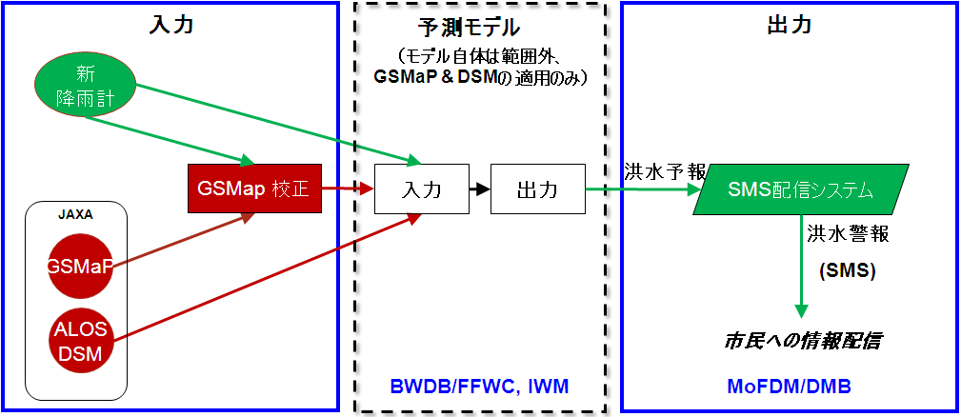

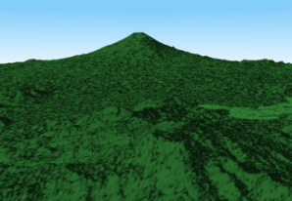
ADB Project: “Remote sensing application for river basin management” (2012～2014)
Purpose - To improve flood prediction by using a flood analysis model, space based data (GSMaP, DSM), together with capacity development and to distribute flood alert information to public in Bangladesh, Philippines, and Viet Nam.
Input
Improved
flood prediction
model
Output
New Rain Gauge
Flood
Prediction
GSMaP calibration
Input
Output
SMS distribution system
Flood Alert
Precipitation data by satellite
Geographical
Data by satellite
Evacuation
Information distribution to citizens
Bangladesh case
Notes:
図はバングラデシュのケース。
洪水予測モデルは、フィリピンはIFASを使う予定。
バングラデシュは独自。ベトナムは東大(小池)モデル。

Slide 24
UNESCO Project Overview
“Strategic Strengthening of Flood Warning and Management Capacity of Pakistan”
  Duration - 2011/6 to 2014/3
Activities:
  flood early warning system development
  development and implementation of flood hazard maps at the community level
  development in both international and local platforms for timely sharing of hydrometeorological observations.
Outcome:
  improved river basin management including flood risk management using flood analysis model and GSMaP
JAXA’s tasks:
  GSMaP local customize & ALOS DSM generation

Slide 25
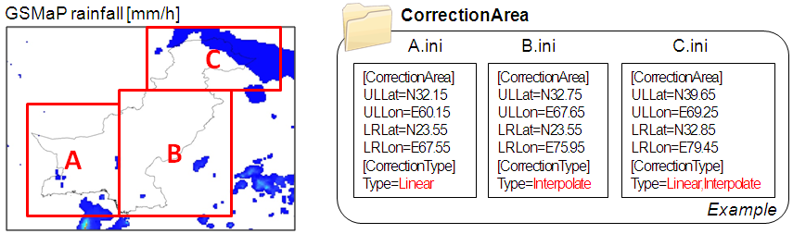
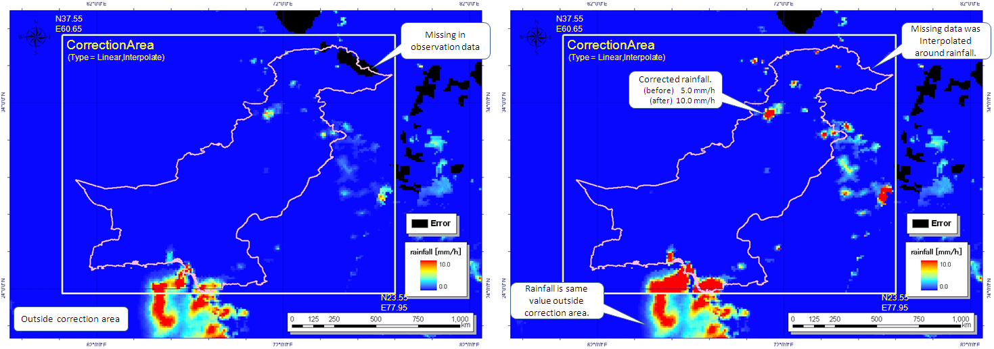
GSMaP Local Customize
GSMaP Local Customize Interface
  In order to reflect the characteristics of area into correction, GSMaP Local Customize Interface can change the correction methods based on area. In the setting files several area can be defined as rectangular area together with correction type. The correction result is saved in completely same format with original GSMaP data.
Real time correction function will be added in the final phase of the project.
Setting of GSMap Data Correction
Original
Corrected
Sample of GSMap Data Correction Result
Notes:
パキスタンの場合。
GSMaPデータをPMD(パキスタン気象局)に渡すと、パキスタン側でIFASを運用して洪水予測を実施する仕組み。
図は、現地で雨量データで構成したもので、そのようなシステムを構築した。
今は過去事例で、JAXAが(NTTデータ委託で)開発したシステム。(今後の委託先はパスコらしい)
まだ準リアルタイムになっておらず、これからである。

Slide 26
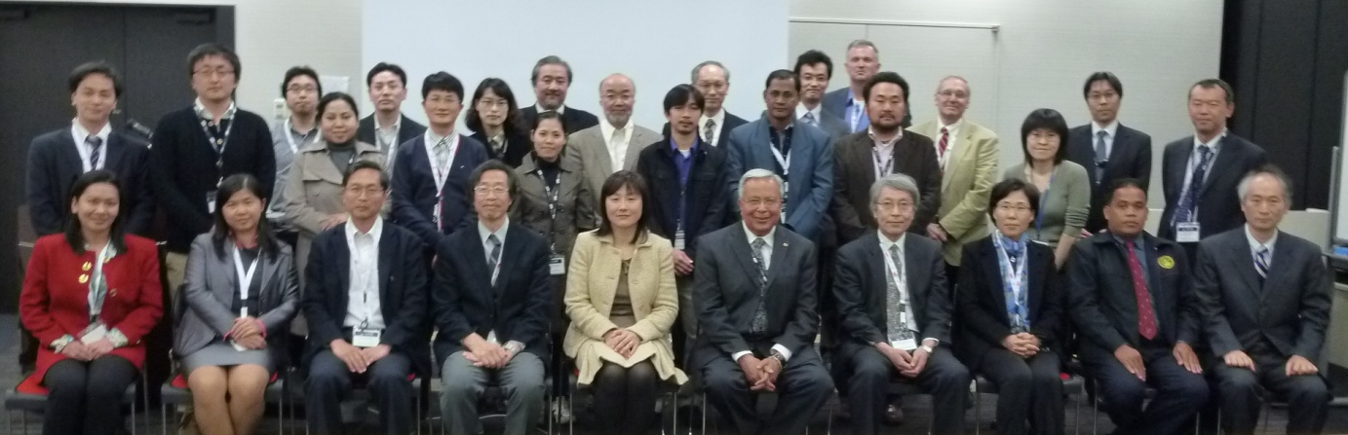
Promotion of data utilization in Asian countries
GPM Asia Workshop
  Held every year in Japan since , inviting 5-10 meteorological, hydrological or remote sensing agencies in Asian countries.
  Promote satellite precipitation data utilization in Asia.
  Utilization of GSMaP, TRMM, and/or GPM data and their comparison with ground-based data in Asian countries, including in Viet Nam, Bangladesh, Philippines, Lao PDR, ICIMOD, Thailand, Indonesia, etc.
  Next workshop is scheduled in January 2014.
The 3rd GPM Asia Workshop on Precipitation Data Application Techniques, 7and 9 Dec. 2011, Tokyo, Japan

Slide 27
Summary
In Japan, GPM Applications would be promoted more and more.
Satellite Precipitation Mapping data usage is expanding in number of users and in various application areas.
Especially requirement for monitoring precipitation and severe weather caused by global warming (?) can be increasing.
More detailed precipitation data with finer resolution in time and space has been required. More quick data delivery is also required.

Slide 28
Future
Future GSMaP improvement
  Use of rapid scan IR data from next GMS
  Combined model & 4DDA technique
Future satellite precipitation mission after GPM
  Continuation of frequent observation concept of GPM together with the most advanced science.
  We have continued to study missions after GPM. There have been a few ideas in Jana’s study team.
  At the same time, JAXA started internal study activities on possible next satellite precipitation radars since last year.
    Increase swath widths(eliminate ground clutter affects), low-cost PR, combination of two or three frequencies etc.,
SATELLITE GLOBAL RAIN MONITORING → “BASIC SOCIAL INFLUSTRUCTURE”

