Slide 1
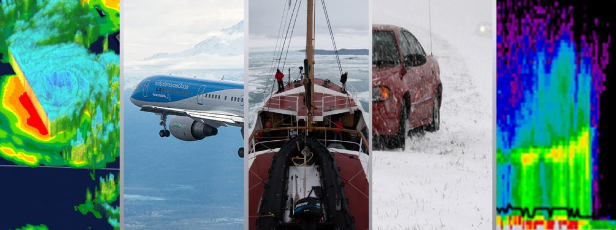
NASA Transportation and Logistics Workshop November 2nd , 4th and 5th 2020
https://gpm.nasa.gov/science/meetings/2020-transportation-workshop

Slide 2
Why we are here?
NASA Earth science uses unique global observations from space, air, sea and on land to help us better understand our planet’s interconnected systems.

Slide 3
Why we are here?
NASA Earth science uses unique global observations from space, air, sea and on land to help us better understand our planet’s interconnected systems.
The NASA Applied Sciences Program works with individuals and institutions worldwide to inform decision-making, enhance quality of life and strengthen our economy.

Slide 4
Why we are here?
NASA Earth science uses unique global observations from space, air, sea and on land to help us better understand our planet’s interconnected systems.
The NASA Applied Sciences Program works with individuals and institutions worldwide to inform decision-making, enhance quality of life and strengthen our economy.
Build and enhance connections with stakeholders across industries, companies, government, international groups, and academic colleagues to inform how current and future NASA satellite data can be used within different societal benefit areas.

Slide 5
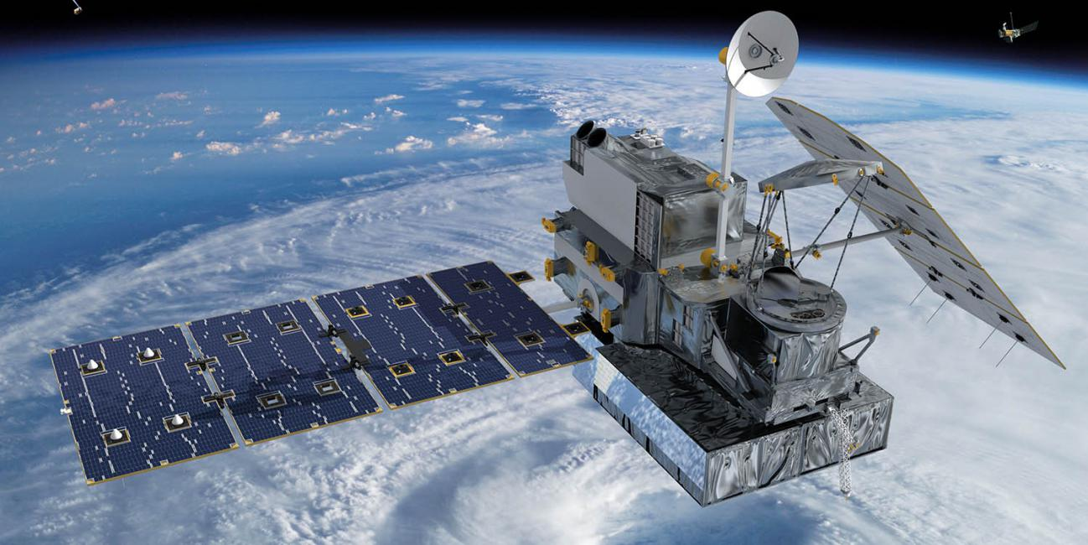
Topics for this week: precipitation and clouds
Global Precipitation Measurement (GPM)
Launched in 2014 and follows on from the Tropical Rainfall Measuring Mission (TRMM)
Provides consistent 20-year estimates of precipitation
Large user community across thematic areas
Future Missions: Aerosols, Clouds, Convection and Precipitation (ACCP)
NASA Earth Science Decadal Survey Designated Observables
Applications engagement early in the mission planning

Slide 6
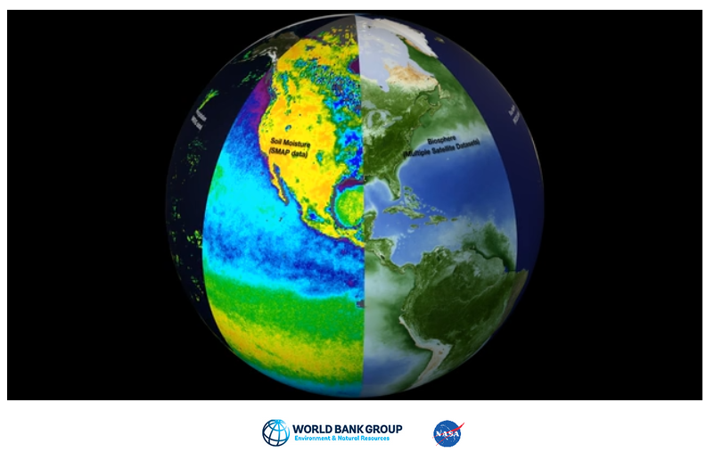
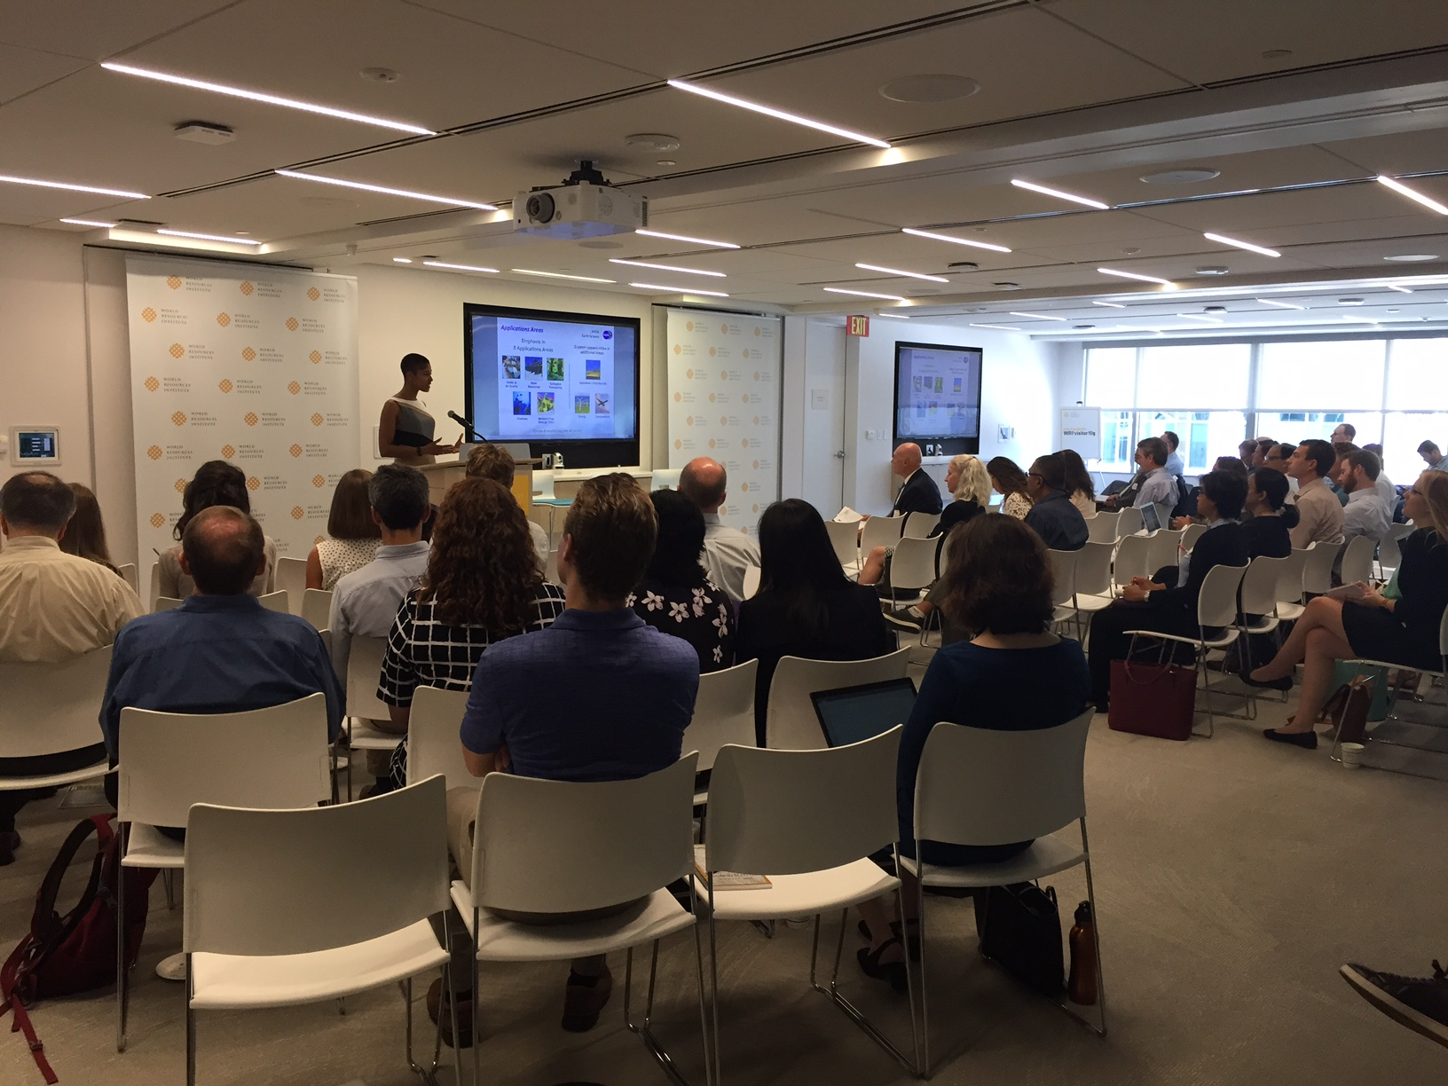
Building on a legacy
World Bank Water Workshop
2017
NASA/Wilson Center Disease Workshop 2018
NASA/WRI Agriculture Workshop 2017
Weather and Air Quality Forecasting Workshop 2019
https://gpm.nasa.gov/science/meetings

Slide 7
Workshop Overview
Day 1
Nov 2nd
Introductory session on the GPM Mission
Overview NASA Decadal Survey ACCP Mission Study
Day 2
Nov 4th
Transportation- Aviation Panel and Discussion
Transportation-Roads, Railways and Maritime Management Panel and Discussion
Day 3
Nov 5th
Morning GPM Training
Logistics and Supply Chain Panel and Discussion
ACCP Applications Overview
Keynote Presentation: Randy Bass (FAA)
Q&A
Breakout Sessions
Breakout Sessions
Report out from breakouts and workshop conclusion

Slide 8
Workshop Goals
Share information on current and planned NASA missions and data products, specifically focusing on precipitation and clouds
Engage with the user communities in the transportation, aviation and logistics sectors to better understand user needs through:
Panel presentations and discussion
Breakout sessions
Provide a training on how to use current satellite precipitation data
Build a community of practice around the transportation, aviation and logistics sectors to inform current data use, identify gaps in existing and planned data products, and identify opportunities and challenges for use of data from future planned missions.

Slide 9
Workshop Details
Please make sure to mute your microphone and disable video when you are presenting
Please DO show your video and unmute your microphone during breakout discussions
If you have a question or comment in the discussions or Q&A sessions please use the raise the hand feature or put your comment in the chat.
All presentations (that have presenter approval) will be posted at the Workshop website: https://gpm.nasa.gov/science/meetings/2020-transportation-workshop

Slide 10
Charge to workshop participants
Please share your experiences and stories during panel discussions and breakout conversations
Please ask questions or seek clarifications of what is being said
Please contact us during or after the workshop with follow-up questions, comments, or perspectives
Please consider being involved in these communities of practice after this workshop concludes
Please fill out the workshop survey

