Slide 1
Aviation Weather Division
Presented to:
NASA GPM-ACCP Transportation and Logistics Workshop
November 4, 2020
Jason Baker
Aviation Weather Division
NextGen Organization
Federal Aviation Administration

Slide 2
Outline
Weather across the FAA
NextGen Aviation Weather Division Overview
Vision and Mission
Branches
Aviation Weather Research
New Weather Concept Development
Weather Engineering and Evaluation
Policy and Requirements
Offshore Precipitation Capability (OPC)
Summary and Questions

Slide 3
Weather Across the FAA
Administrator
(AOA)
Red outline box: Meteorological Authority for ICAO
Yellow boxes: Weather research, international standards, and NextGen weather requirements
Green boxes: Weather acquisition & O&M responsibilities
Deputy
Administrator
(ADA)
Assoc Admin for
Aviation Safety
(AVS)
Approve
Operational
Av Wx Req
Chief Operating
Officer (ATO)
AJO-0
Assistant Admin
for NextGen
(ANG)
Flight
Standards
Service (AFS)
Aircraft
Certification
Service (AIR)
Air
Traffic Services
(AJT)
Mission
Support
(AJV)
Program
Mgt Org
(AJM)
System
Operations
(AJR)
Management
Services
(ANG-A)
NAS Systems
Eng & Int
(ANG-B)
Adv Concepts &
Tech Dev
(ANG-C)
William J Hughes
Tech Center
(ANG-E)
NextGen Collab
& Messaging Office
(ANG-M)
Flight
Technology
Requirements
Branch
(AFS-430)
Systems &
Equipment
Standards
Branch
(AIR-6B2)
Technical Advisory
Group
(Contract Wx
Observer)
(AJT-22)
ATO Operational
Concepts,
Validation &
Requirements
(AJV-7)
Aviation
Weather &
Aeronautical
(AJM-33)
Flight
Services
Program Ops
(AJR-B)
Engineering Devel
Services Division
(ANG-C3)
Aviation Weather
Division
(ANG-C6)
Air Traffic
Control
Sys Command
Center
(AJR-11)
Aviation Weather
Branch
(ANG-C34)
Weather Research
Branch
(ANG-C61)
New Wx Concept
Devel Branch
(ANG-C62)
Wx Engineering &
Evaluation Branch
(ANG-C63)
Policy & Req Branch
(ANG-C64)

Slide 4
Aviation Weather
Division
(ANG-C6)
Bill Bauman
Weather Research
Branch
(ANG-C61)
Randy Bass
New Wx Concept
Development Branch
(ANG-C62)
Everette Whitfield
Wx Engineering &
Evaluation Branch*
(ANG-C63)
Starr McGettigan
Policy & Req Branch
(ANG-C64)
Pat Murphy
Aviation Weather Research Program
Weather Technology in the Cockpit
Research for Service Analyses
Aviation Weather Integration
Contracts & Budget
Weather Forecast Improvement
Safety Risk Management
Aviation Weather Demonstration and Evaluation
Weather Observation Improvements
NextGen Weather Processor/Common Support Services-Wx
Runway Visual Range
International
Space Weather
Requirements
New ATM-Wx Trans
WIMAT
FAA Wx Expert Service
* Located at the FAA William J. Hughes
Technical Center in Atlantic City, NJ

Slide 5
Vision: A National Airspace System (NAS) free of weather caused delays, cancellations, diversions and accidents/incidents
Mission: Assure the development, enhancement, dissemination, and integration of productive weather information into Air Traffic Management decisions by pilots, controllers, flight operations and airport operators

Slide 6
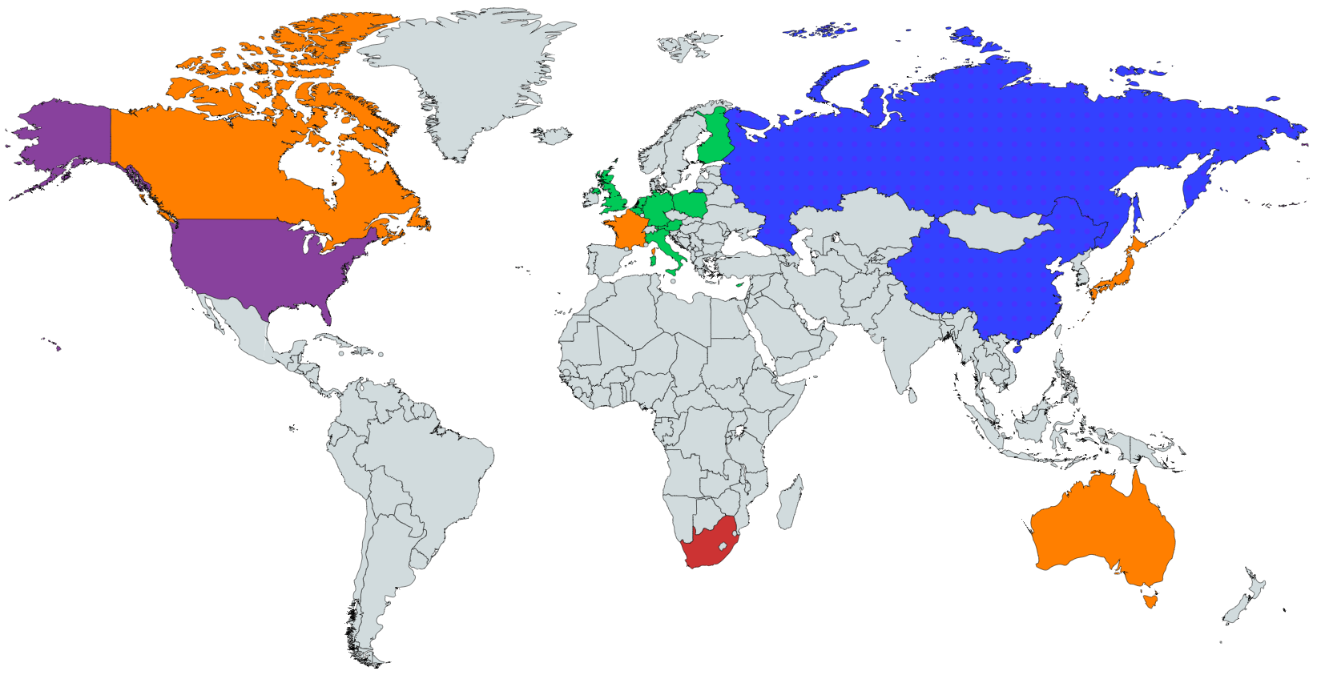
Policy and Requirements Branch
Identifies and coordinates domestic and international weather requirements
Core Functions:
Collaboration with international partners to develop weather requirements
Entry point for new weather service requests
Leads Weather Information Modernization and Transition

Slide 7
Weather Needs Portal (WNP): https://www.faa.gov/nextgen/programs/weather/suggestions/
Aviation stakeholders can use the WNP to submit requests for weather-related products and services to the Policy & Requirements Branch (ANG-C64).
In addition to contact information, we ask for:
A description of the aviation weather problem
Existing operational gaps
Benefits to aviation
Potential users
The proposed solution (optional)
Other background information
The WNP is currently in the beta-testing phase—there will be further development in the coming months, but please feel free to use the form now to submit your weather needs and become a beta tester.
Scan this QR Code to go directly to the WNP Submission Form
Notes:
FAA Weather Requirements Program Manager.
The NextGen Aviation Weather Division has recently launched what we refer to as the Weather Needs Portal.
It’s a webpage in which aviation stakeholders can go to and populate a form to transmit weather needs. The general public can access this form from any computer or mobile device and populate their weather needs information, including a desc… gaps.. Benefits… etc
That information is then received by my branch, the Policy and & Requirements Division, put into our Requiremnts process, prioritized, and the concept is validated.
The portal is still in its beta-testing phase, so we are still solidifying the process and receiving inputs from the beta-testers, meaning anyone who is currently using the form… our goal for the end of the beta-testing phase is September 2020

Slide 8
FAA Systems & Users
Stakeholders
Researchers
What’s the Problem?
Requirements Portal
Is the Problem Valid?
Validated Requirement
Solution
Leverage Existing Tech
Engineering & Evaluation
Research
Deliver Results
Transition to NWS
Translate for FAA
Transfer to Industry
Provide to Users
Users

Slide 9
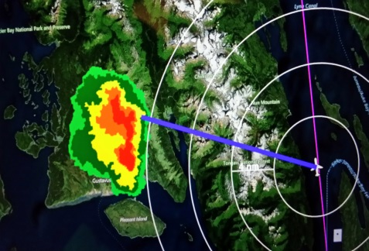
Weather Research Branch
Performs applied research intended to mitigate the impact of weather on the NAS, focusing on advancing the state of weather information such that it can be exploited for integration into NextGen decision-support tools. It also conducts research to develop, verify, and validate requirements for incorporation into Minimum Weather Service (MinWxSvc) standards.
Core Functions:
Manages Aviation Weather Research Program
Manages Weather Technology in the Cockpit Program
Coordinates research with other Federal agencies

Slide 10
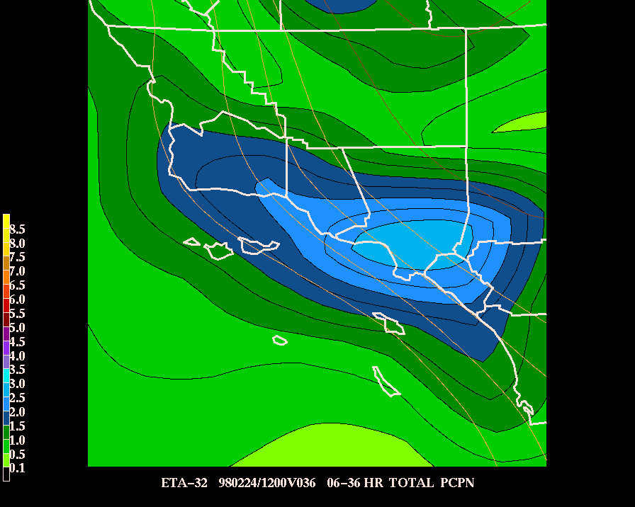
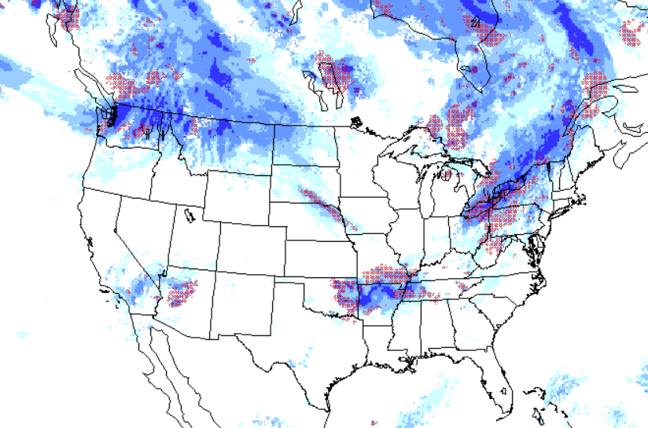
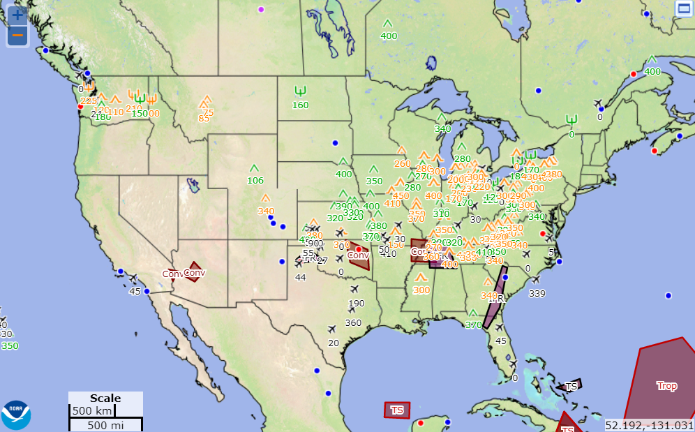
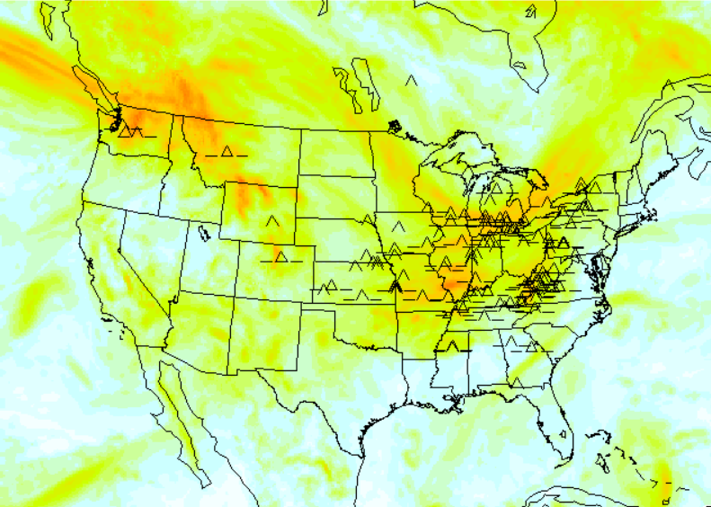
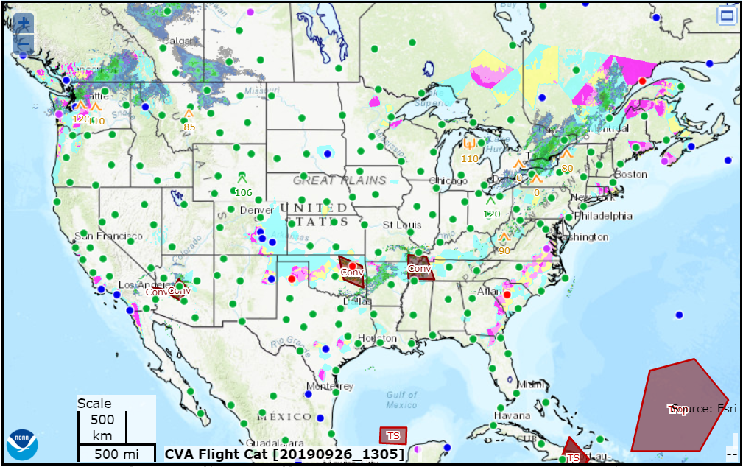
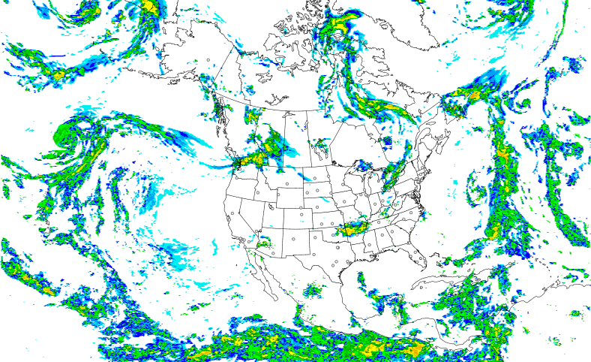
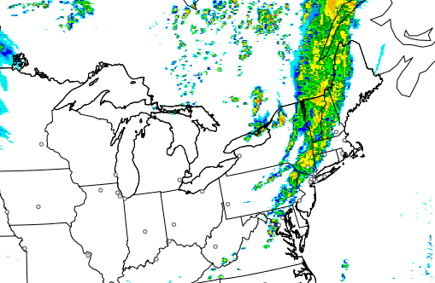
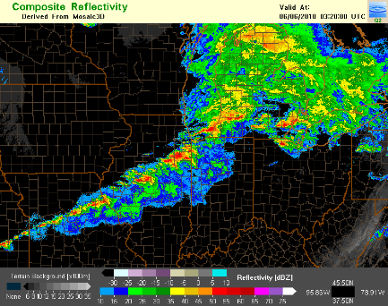
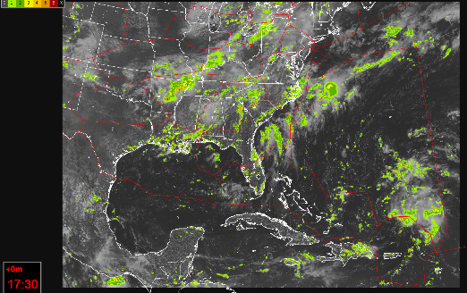
AWRP 20 Year History of Success
2002: CIP; 2004: FIP; 2011: FIP Severity; 2012: CIP/FIP RAP; 2014: CIP/FIP High Res; 2018; IP Alaska
2003: Aviation Digital Data Service (ADDS); 2016: aviationweather.gov
2003: GTG; 2010: GTG2 (Mid-Levels); 2015 GTG3 (MtnWv & Low Lvl);
2019 GTG-N (Experimental)
1998: 40KM; 2002: 20KM;
2005: 13KM
2001
Rapid Update Cycle (RUC)
National Convective Wx Forecast
Icing Forecasts
Web-based Products
Turbulence Forecasts
2007: Experimental ADDS
2015: Operational ADDS
2012; Updated 2018
2014; Updated 2018
2014
2017
Helicopter Emergency Medical Services
Rapid Refresh (RAP)
High-Resolution Rapid Refresh (HRRR)
Multi-Radar, Multi-Sensor (MRMS)
Offshore Precipitation Capability (OPC)

Slide 11
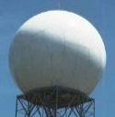
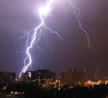
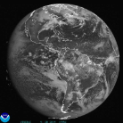
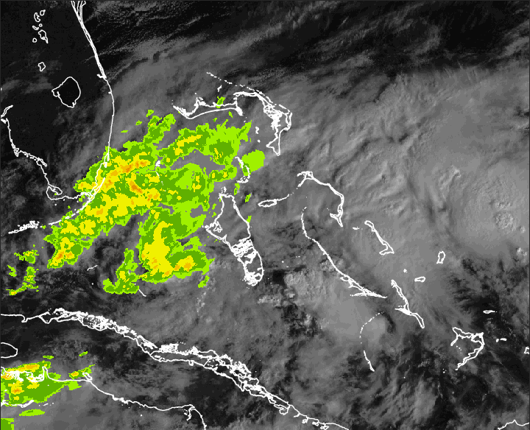
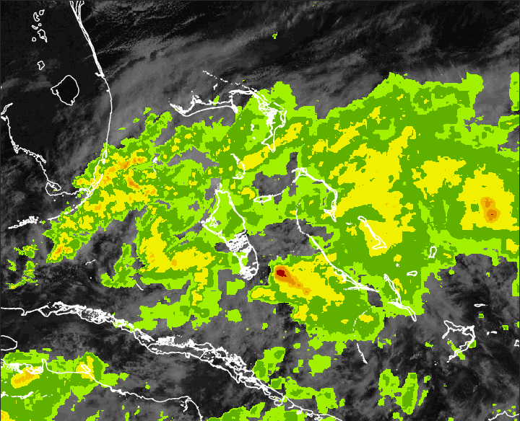
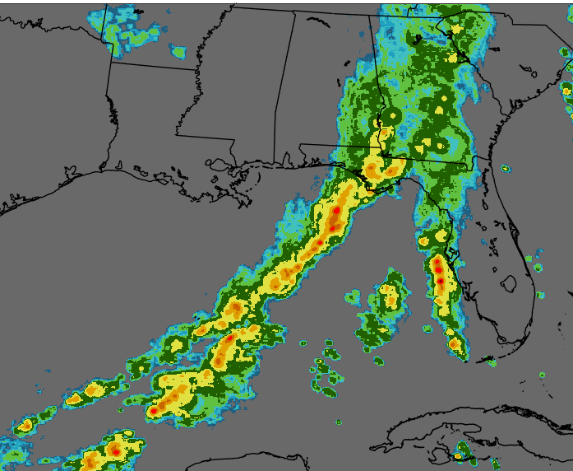
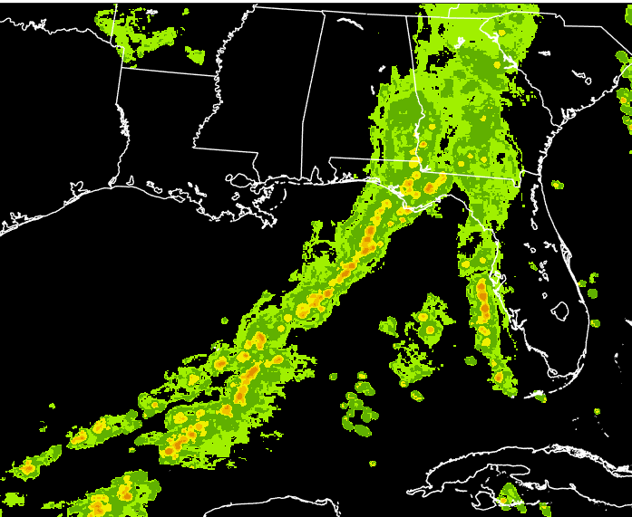
Offshore Precipitation Capability Overview
Offshore Precipitation
Capability (OPC)
Multi-Sensor Data Collection
Weather Radar
Lightning
Satellite
Numerical Model
No
Radar
Machine Learning
…
Convolutional Neural Network (2016)
Offshore Storm Height and Precipitation Intensity
Detects weather outside radar coverage
High spatial resolution
Accuracy of location
Rapid update, low latency
Storm Height Analysis (kft)
6-Level Precipitation Intensity
Notes:
This slide provides an overview of the OPC system. The goal of OPC is to detect hazardous weather outside radar range and present it to users in a way that resembles traditional weather radar. OPC was built to be rapidly updating, have a high spatial resolution, and to be accurate in both storm placement and intensity.
[Top Right] OPC works by fusing together data from multiple weather sensors. Radar, lightning, satellite and numerical model data are combined using advanced machine learning and artificial intelligence to estimate radar-derived fields in regions outside weather radar range. This estimated field is then combined with existing radar mosaics to fill in radar coverage gaps in areas like the Gulf of Mexico, Caribbean, Atlantic Ocean, and many other regions.
[Bottom Right] Two products are created by OPC, a storm height field, and a precipitation intensity field. The precipitation intensity can be viewed in either a 6 color green to red scale as shown here on the bottom right, or can be shown in the 3 color blue presentation commonly seen on the WARP display.
[Back to top left] By applying OPC, the radar analysis seen in the top left, which fails to detect any weather away from the Florida coast, is extended…
[Click forward]
…and now includes weather throughout the region.

Slide 12
NEXRAD/OPC Comparison
NEXRAD Only
Merged OPC and NEXRAD

Slide 13
OPC Video – Laura

Slide 14
Activities
Recent:
OPC output merges seamlessly with existing radar at the boundaries of radar coverage
Incorporated Geostationary Lightning Mapper (GLM) lightning feed into OPC; improving depiction of storm intensity
Near Term:
Expand domain of OPC to CONUS plus Hawaii and Guam later this year
Incorporate up to 12 hour forecast element into OPC

Slide 15
Summary
Weather is threaded throughout the FAA’s Mission
Multiple FAA Lines of Business touch weather
Aviation Weather Division has four branches, working together, to address aviation weather problems
Our policy and requirements are driving our research
OPC uses and is reliant upon GOES imagery and senor information

Slide 16
Jason Baker
Aviation Weather Division
Jason.M.Baker@faa.gov

