Slide 1
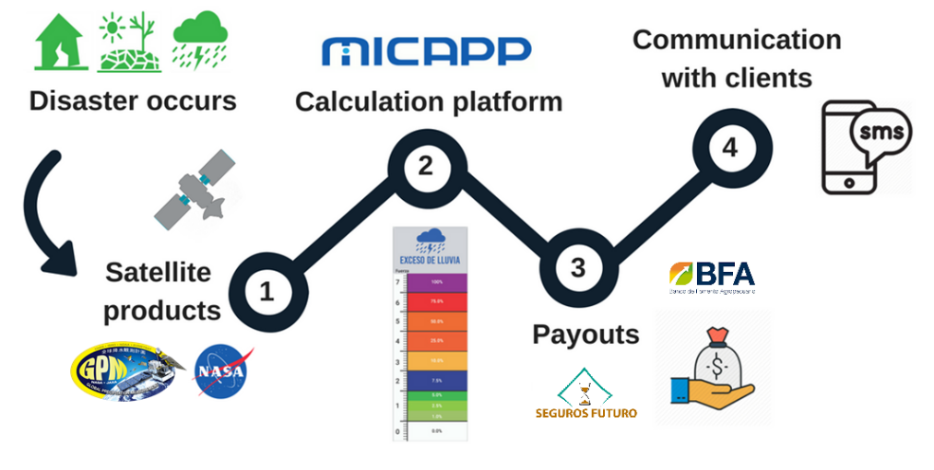
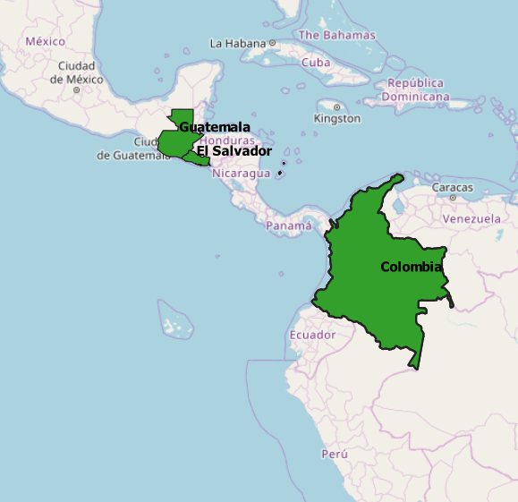
Building Climate Resilience with Satellite Data
The Earth observing satellite data from NASA is used to determine whether a client will receive a payout from a climate event (such as drought or excess rainfall). This data is processed in real-time in order to allow objective, transparent and efficient payouts. -Iker Llabres, MiCRO
MiCRO, a reinsurance company, is increasing climate resilience to extreme events among 25K+ individuals and small and micro-entrepreneurs throughout Latin America with the help of NASA satellite data.
Through data modeling, MiCRO develops index-based insurance products that are based on analysis of environmental parameters. As such, NASA GPM precipitation data was used to create a reliable and credible index on which to trigger a policy and client payouts when severe drought or excess
precipitation occurs.
MiCRO’s payout process depicting actions taken when a disaster strikes: NASA satellite data (1) is used to design payout triggers through a calculation platform (2). When a disaster occurs and depending on its severity, payment is determined (3) and clients are informed via text (4).
Image credits: MiCRO (www.microrisk.org).

