Slide 1
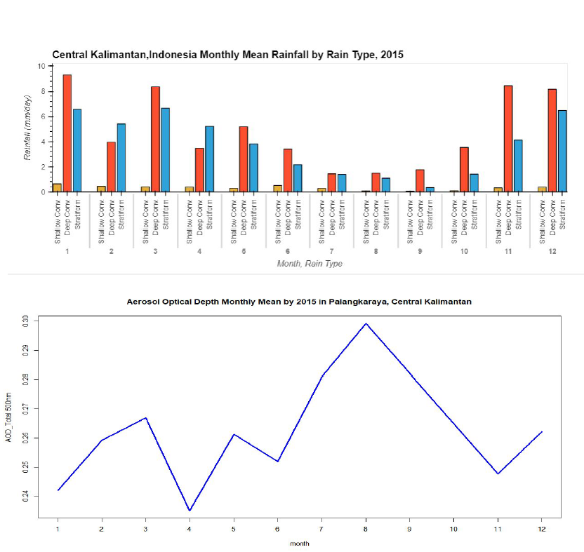
Convective Rainfall and AOD in Central Kalimantan, Indonesia
2022 NASA GPM Mentorship Program
PMM Mentor:
Courtney Schumacher
PMM Mentor:
Aaron Funk
Mentee:
Ayuna Santika,
BMKG
Texas A&M University- College Station
Deep convective rainfall and wildfires are a common occurrence in Indonesia’s Central Kalimantan region. Previous studies show that aerosols can affect and/or influence the forming of convective clouds.
For this project, the team analyzed shallow, deep convective and stratiform events from 2015 over Central Kalimantan using GPM DPR data and comparing it to the amount of atmospheric aerosols using AOD retrievals from ground-based measurements from AERONET.
Project findings show that Central Kalimantan has a monsoonal rainfall pattern in which both wet season and dry season are dominated by deep convective rainfall events and low AOD appears linked to enhanced deep convective rainfall (Nov – Jan).
This type of analysis provides an opportunity for the BMKG (Met Agency of Indonesia) to understand more about the relationships among active fires, AOD and convective rainfall events throughout the Central Kalimantan region.
Figure: An analysis of monthly convective shallow, deep convective and stratiform events over Indonesia’s Central Kalimantan region using GPM DPR (top) and monthly AOD profiles using data from AERONET (bottom) (Credit: A Santika).
Check out more details at https://gpm.nasa.gov/applications/2022-gpm-mentorship/!

Slide 2
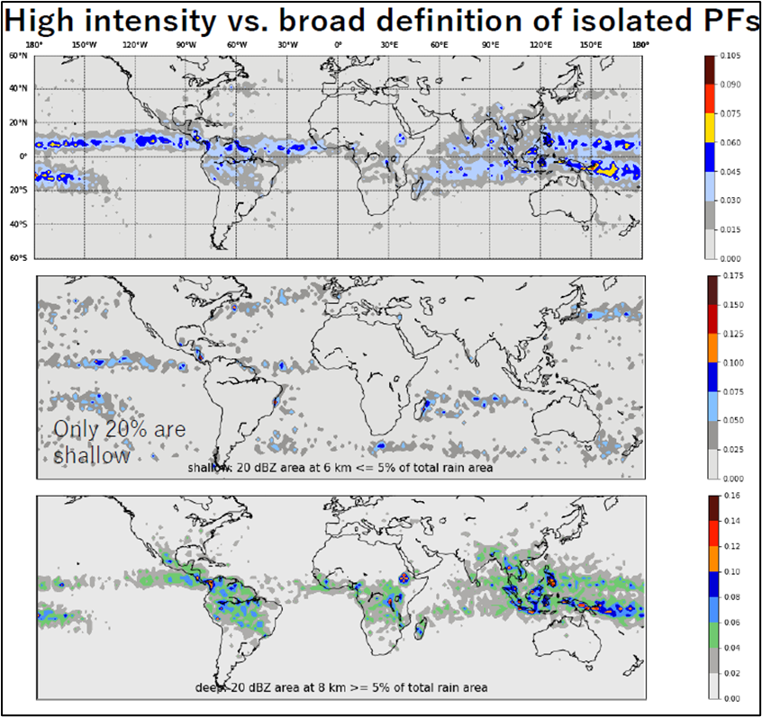
High Intensity Isolated Precipitation Features (PFs)
2022 NASA GPM Mentorship Program
Mentee:
Eva Yamamoto,
Kyoto University
PMM Mentor:
Chuntao Liu, Texas A&M University- Corpus Christi
Numerous isolated PFs can have similar rain intensities as organized ones and thus have potential to cause catastrophic flooding, landslides, and infrastructure damage.
The team conducted a global analysis to sort out when and where high intensity isolated PFs were formed using GPM DPR data and indirect measurements of latent heating from GPM.
Preliminary findings show that the multiple isolated PFs with high intensity rain are mostly formed in the tropics.
Understanding where and when these form are beneficial for the scientific community and hydrological modelers as it can help elucidate more about the life cycle of these storm systems in greater detail and provide valuable information for improving forecasts of weather and climate.
Figure: (Top) A global analysis of where high intensity isolated PFs were formed. (Middle) An evaluation of general PFs, highlighting that about 20% are shallow. (Bottom) An evaluation of high intensity isolated PFs, highlighting that they form deeper PFs. (Credit: E Yamamoto).
Check out more details at https://gpm.nasa.gov/applications/2022-gpm-mentorship/!

Slide 3
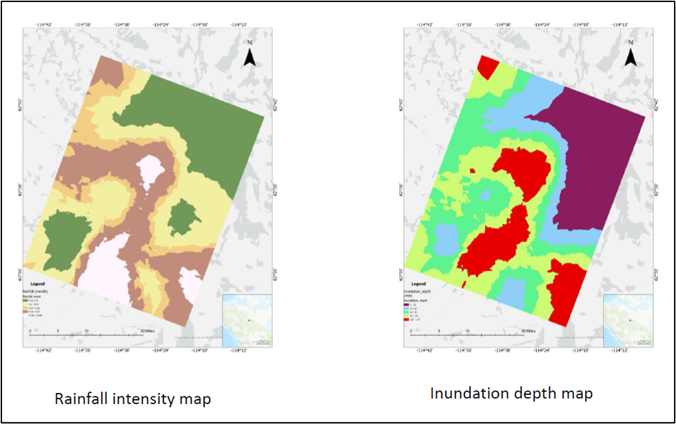
Mapping the Drainage Pattern of Canadian Shield (Baker Creek) with Rainfall Data
2022 NASA GPM Mentorship Program
Mentee:
Nimisha Wagle,
Brown University
PMM Mentor:
Chuntao Liu, Texas A&M University- Corpus Christi
For this project, the team analyzed rainfall data using IMERG along with data from DEMs to find the inundation depth of the Baker Creek region in the northern part of the Canadian shield area and map newly formed drainage patterns after extreme precipitation events.
Results showed that 45% of the total depression storage is filled due to realistic rainfall after an extreme event. The study also highlighted that the Canadian Shield surface water depression storage and hydrological connectivity are susceptible to rainfall events.
Understanding these changes will be critical in predicting and managing water resources in this region.
This work is ongoing. Future work includes using rainfall data and climate models to find the potential sensitivity of the depression storage to the regional water balance.
Figure: GPM IMERG data along with DEMs were used to help calculate inundation depth. Understanding fundamental hydrologic changes after rainfall events will be critical for predicting and managing water resources (Credit: N Wagle).
Check out more details at https://gpm.nasa.gov/applications/2022-gpm-mentorship/!

Slide 4
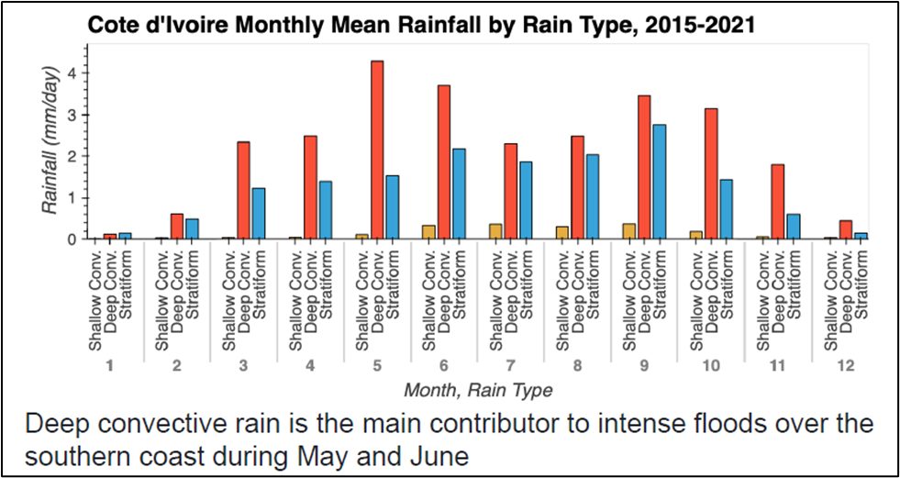
Evaluating Extreme Precipitation Events Over West Africa using GPM DPR
2022 NASA GPM Mentorship Program
PMM Mentor:
Courtney Schumacher
PMM Mentor:
Aaron Funk
Mentee:
Armand Kablan,
Université Félix Houphouët-Boigny
Texas A&M University- College Station
Extreme precipitation events have caused catastrophic flooding throughout West Africa.
For this project, the team analyzed monthly convective shallow, deep convective and stratiform events over West Africa region and compared rainfall totals using GPM DPR data to understand how different events contribute to intense flooding in the region.
Results showed that all three rain types contribute to high rainfall over the south part of Cote d'Ivoire. However, deep convective rain is the main contributor to intense floods over the southern coast.
Figure: An analysis of monthly convective shallow, deep convective and stratiform events over the West Africa region against rainfall totals using GPM DPR data (Credit: A Kablan).
Check out more details at https://gpm.nasa.gov/applications/2022-gpm-mentorship/!
Understanding more about how deep convective events play a role in contributing to severe flooding over West African urban areas can help enable the scientific community and policy planners in West African governments to build an effective flood early warning system and make informed decisions for extreme weather events and climate mitigation efforts.

Slide 5
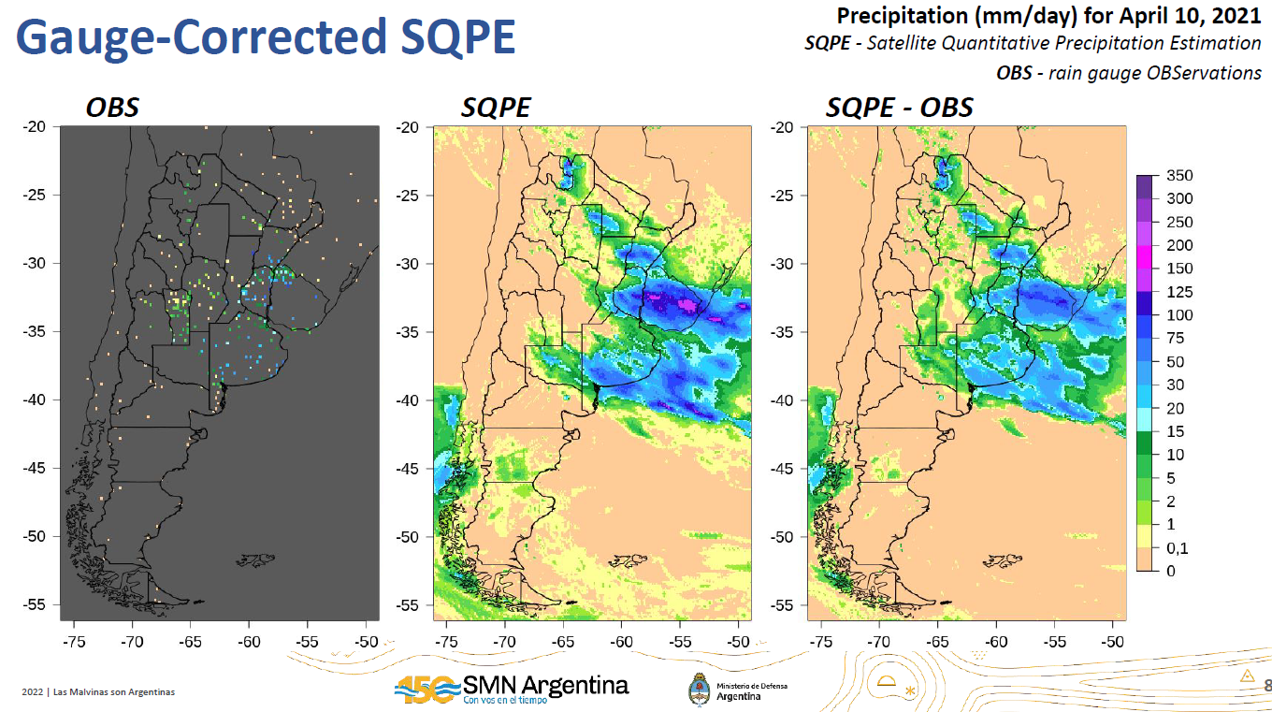
Analysis, Validation, and Correction of Satellite Quantitative Precipitation Estimation (SQPE) in Argentina
2022 NASA GPM Mentorship Program
Mentee:
Paula Hobouchian, National Met Service of Argentina
PMM Mentor:
Joe Turk, JPL
The team explored different gauge bias correction methods of SQPE products using IMERG E with the goal to improve the current Gauge-corrected SQPE product that the Argentina Met Agency uses within its systems.
The project is still ongoing, with next steps including a comparison of the current local bias correction applying the Zhang et al (2011) inverse distance weight technique and the Kriging with External Drift technique. The activities considered are adapting code, practice, and discussion of the methods. Also, the results considered are computing summary statistics and mapping daily precipitation for heavy rainfall events in Argentina.
These methods for improving SQPE products can provide better daily precipitation estimates in regions with a sparse rain gauge network, providing valuable information for meteorological agencies such as the National Meteorological Service in Argentina.
Evaluating alternative methods using rain gauge observations and SQPE products to improve precipitation estimates in Argentina (credit: MP Hobouchian).
Check out more details at https://gpm.nasa.gov/applications/2022-gpm-mentorship/!

Slide 6
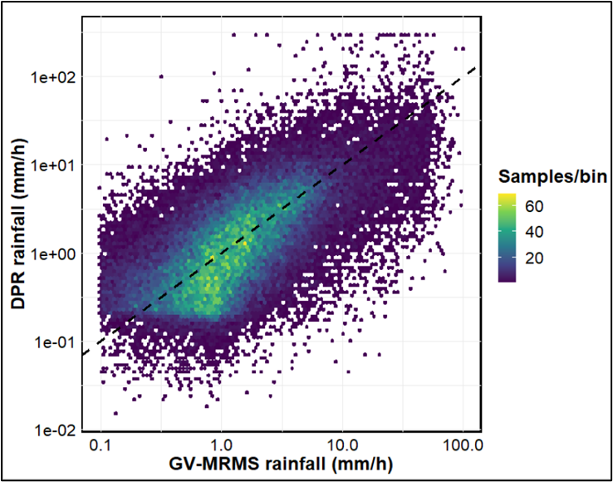
Ground Validation Analysis of GPM DPR Product
2022 NASA GPM Mentorship Program
PMM Mentor:
Yagmur Derin
PMM Mentor:
Pierre Kirstetter
Mentee:
Odinakachukwu Echeta,
Kwame Nkrumah University of Science and Technology
University of Oklahoma
For this project, the team validated the DPR merged scan product against a quality-controlled ground reference data (GV-MRMS) in the continental U.S.
Knowledge and skills learned from this concept study will be applied to evaluating and selecting remotely sensed satellite rainfall products that could be useful for rainfall estimation in data scarce regions such as West Africa.
“Understanding how to evaluate the accuracy of satellite precipitation data against ground data as well as accurately select the appropriate satellite precipitation estimate can greatly improve precipitation estimation over a given region. As a result of this, valuable information for improved weather and climate forecasts needed by meteorological, hydrological and disaster management bodies can be provided.” - Echeta
Figure: Validating GPM DPR against a quality-controlled ground reference data (GV-MRMS) in the continental U.S. Using a density scatter plot helps depict the relationship between DPR and GV dataset. (Credit: O. Echeta).
Check out more details at https://gpm.nasa.gov/applications/2022-gpm-mentorship/!

Slide 7
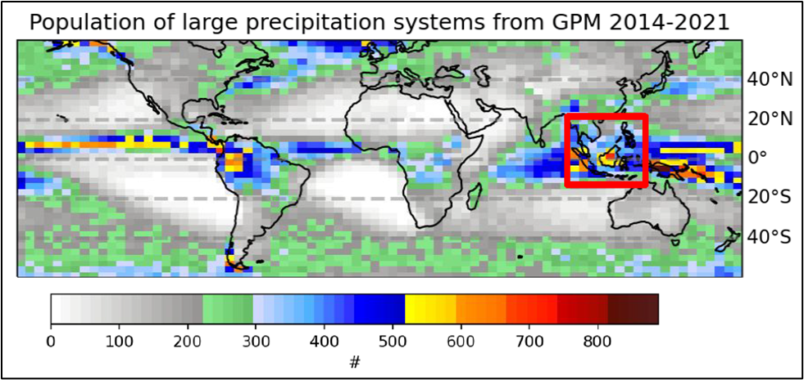
Investigating Large Precipitation Systems with GPM
2022 NASA GPM Mentorship Program
PMM Mentor:
Chuntao Liu, Texas A&M University- Corpus Christi
Mentee:
June Choi,
Stanford University
Check out more details at https://gpm.nasa.gov/applications/2022-gpm-mentorship/!
Understanding how the behavior of large-scale precipitating systems is impacted by atmospheric variables can yield important insights about subseasonal variability and predictability across different regions.
For this project, the team explored the relationship between atmospheric variables and the characteristics of large precipitating systems using the Texas A&M-CC dataset of precipitation features greater than 2500km² over the time period 2014-2020 and variables from ERA5.
Figure: A global analysis of large precipitation systems. The majority of large precipitating systems are found around Southeast Asia and along the ITCZ (see red box) (Credit: J Choi).
Results showed majority of large precipitating systems were centered around Southeast Asia and along the ITCZ.
Next steps include investigating additional ERA5 variables and training an AI model that relates the formation of large-scale systems to relevant variables. This model may then be applied to CMIP6 results to forecast large system formation in future climate change scenarios.
This type of research can help to understand shifting regional precipitation patterns, providing important inputs for researchers aiming to quantify precipitation-related risks associated with climate change.

Slide 8
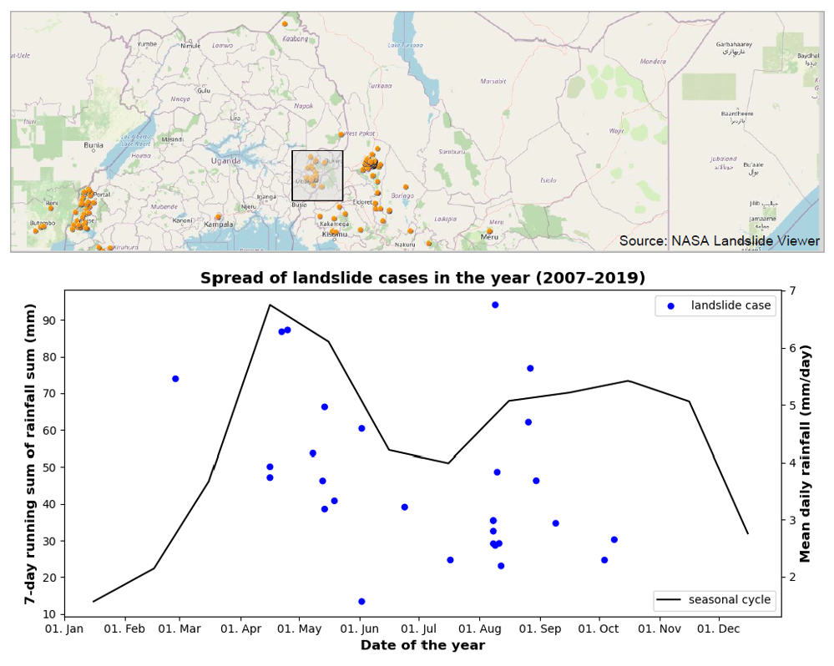
Using the NASA Global Landslides Catalogue and GPM IMERG for Early Warning – Case of Elgon, Uganda
2022 NASA GPM Mentorship Program
PMM Mentor:
Vasco Mantas, U. of Coimbra
PMM Mentor:
Zhong Liu, NASA GES DISC
PMM Mentor:
Andrea Portier, NASA/SSAI
PMM Mentor:
Dorian Janney, NASA/ADNET
Mentee:
Simon Ageet, Karlsruhe Inst. of Tech.
Mt Elgon is a landslide hot spot in Uganda, displacing thousands of people and causing loss of lives.
The team introduced the mentee to key NASA resources. Specifically, S. Ageet evaluated landslide cases from the NASA Landslide catalogue against IMERG-F to determine a precipitation threshold for landslides in the region.
Project findings showed a relationship between landslide events to rainfall, where exceptional precipitation events preceded landslides. However, setting a precipitation threshold for this region was not easy as the amount of rainfall that triggered the landslides highly varied.
Project findings will continue to be communicated to colleagues at Uganda’s Weather Service and Uganda Red Cross, with the goal to improve landslide forecasting and mitigation efforts over this region.
(Top) Inset map showing location of Mt. Elgon, Uganda, and highlighting the 29 landslide cases used for this study. (Bottom) Analysis of seasonal precipitation against landslide cases (Credit: S Ageet).
Check out more details at https://gpm.nasa.gov/applications/2022-gpm-mentorship/!

