Slide 1
NASA’s OLYMPEX Field Campaign
Developed for elementary school audiences to help them learn about NASA’s upcoming ground validation campaign, OLYMPEX.
October 2015
Dorian Janney
GPM Education Specialist
Notes:
This presentation has been developed to use to help explain why NASA studies Earth from space, and to give them a general sense of how that is accomplished. They will also learn about an upcoming ground validation campaign, known as “OLYMPEX”, that will take place in Washington State this winter.

Slide 2
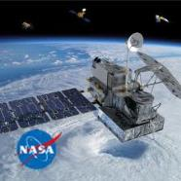
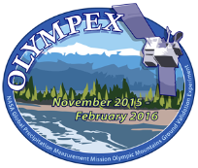
What We Will Learn
In this presentation, we will learn:
What NASA studies
About Earth’s “spheres”
How NASA studies Earth from space
About measuring precipitation
About ground validation campaigns
About the next GPM ground validation campaign- called “OLYMPEX”
And finally, how you can measure precipitation too!

Slide 3
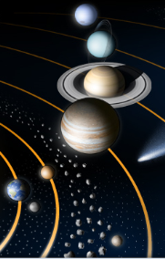
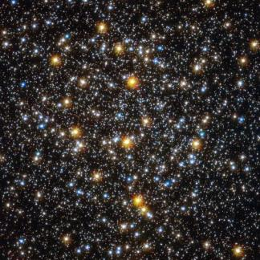
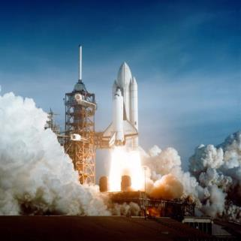
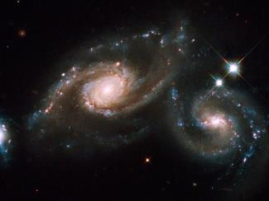
What does NASA study?
Notes:
Ask the students if they have ever heard of “NASA”. Have them share some of the things that they think NASA studies, and then click one by one and five images of various topics that NASA scientists study.

Slide 4
NASA is also studying this planet
Notes:
Explain to the students that NASA is also studying this planet, and have them identify which planet it is. Ask them to give specific observations that support their claim that this is the planet Earth. As they talk about how they know it is Earth, begin to steer their conversation to noting the presence of water on Earth. Ask if other planets have water, and talk about the importance of having water to the existence of life. Explain that as we look at other planets and moons for the existence of life, we search for places that have liquid water as life as we know it depends on having liquid water. Ask them to identify the different forms of water they see on Earth- liquid (oceans), gas (clouds), and solid (ice caps at North Pole).

Slide 5
Earth’s “Spheres”
Notes:
Explain that scientists use a “sphere” approach to help them understand how our home planet works. Talk a little bit about each sphere, and ask them what things they can name from each sphere. Give them the scientific name for each sphere- “Air” is called the “atmosphere”, and includes clouds, nitrogen, oxygen, birds, etc. Water is called the ”hydrosphere” and includes oceans, glaciers, lakes, and all bodies of liquid and frozen water on Earth. Land is known as the “geosphere” and includes soil, mountains, layers of Earth’s interior, and so on. Life is called the “biosphere” and includes all living things.

Slide 6
Earth’s Interacting Spheres
Let’s see if you can name the spheres that are interacting in this situation. When you see the underlined word, name the sphere the word belongs in.
A little girl planted an apple seed in the soil. The sun and rain helped the seed to sprout, and soon roots made their way into the ground. After many years, an apple tree grew. When the girl was grown and had a son, she took him to pick apples from the tree. They ate an apple and left the core to decompose and turn into soil after it had been exposed to wind and rain for a few months.
Notes:
You may need to put the four spheres and their definitions up on the board to help the students remember them, or they could write them down. Answers: girl- biosphere, apple seed- biosphere, soil- geosphere, sun- atmosphere, rain- hydrosphere, ground- geosphere ,tree- biosphere, son- biosphere, apples- biosphere, core- biosphere, soil- geosphere, wind- atmosphere, rain- hydrosphere. Help them to understand that Earth’s spheres are always interacting. The reason that scientist look at each of the spheres as a system is to help them understand how each of these systems work, and to better understand their interactions.

Slide 7
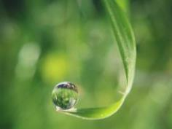
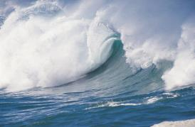
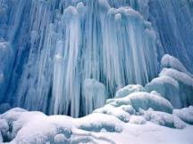
Studying Earth from Space
Let’s think about one of Earth’s spheres: the hydrosphere.
How much of Earth’s surface is covered by water?
How much of that water is freshwater?
What do we need freshwater for?
Notes:
For this slide, it is helpful if you can use a globe as a model of Earth’s surface, and help them to understand that most of Earth’s surface is covered by water- ~ 75%. You can also have a plastic cup and fill it up about ¾ full, and use that to demonstrate how much of Earth’s surface is covered by water. Then ask them how much of Earth’s water is actually freshwater- which it turns out is only about 2.5%. You can take out one eyedropper of the water in the cup, and place that in a little cup or petri dish, and explain that hardly any of Earth’s water is freshwater. Then ask if they know where the water that comes out of their faucets comes from, and explain that it is the water that is in our water cycle- sometimes it is rain, then it may go into a river or lake, and then it goes to their local water treatment facility where it is cleaned and then sent through pipes to their homes. Take out two drops of the water in the little freshwater cup, and show them that less than 1% of all Earth’s water is actually in our water cycle- as the rest is either deep underground or is in the form of ice in glaciers and ice caps.

Slide 8
Where is Earth’s Water?
Notes:
You can use this graph to show them another way of looking at the information that you discussed on the previous slide. You may note that the percentages vary a little, and you can explain that sometimes scientists may use different values, but they should be very close to each other. Help them understand that 2.5% and 3% are very close, and may just be the different way that the person who was developing the image chose to convey the information. In any case, although we have a lot of water on Earth, hardly any of it is freshwater that is in our water cycle.

Slide 9
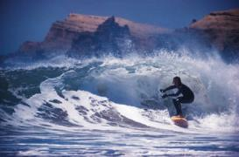
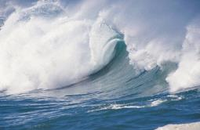
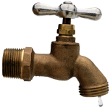
How do we know if we have enough freshwater?
We can measure how much it rains and snows to make sure that we have enough freshwater to meet our needs.
What are some ways that we can measure precipitation that falls on land?
What if we want to measure how much precipitation is falling over the oceans? Can we do that?
How can we tell how much precipitation is falling on the top of tall mountain ranges?
Notes:
Help them to understand that “precipitation” refers to rain, snow, sleet, etc. Have them suggest some ways that we can measure how much precipitation is falling from the sky. Let them consider the questions that come on the slide, and give their ideas. Tell them they will find the answers in a short movie that they will see next.

Slide 10
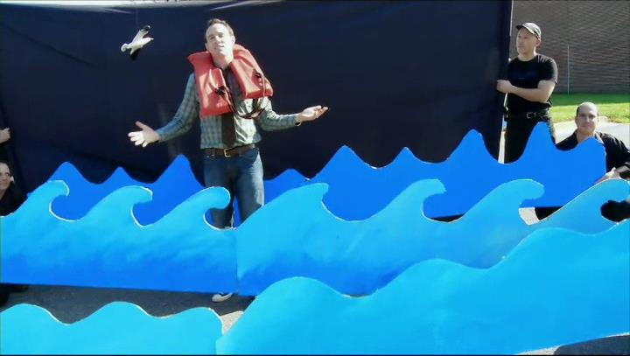
Measuring Earth’s Precipitation
“For Good Measure”
Notes:
Have students watch tis short video (2:01) to learn how we measure precipitation from space using a satellite called “GPM”. You can click on the name to open it from the internet, or download it ahead of time at this url: http://pmm.nasa.gov/education/videos/for-good-measure

Slide 11
The Global Precipitation Measurement Satellite
Notes:
Ask the students a few questions about satellites, including” What is a satellite?” (a piece of technology that travels in orbit around something in order to study it), “Do satellites have people on them?” (no), “How do satellites collect data?”- they have instruments on board that are designed by engineers to study specific things and gather data), “How do they know where to go?”- people on the ground control them using computers. You can explain that this satellite, GPM, has only two instruments that it uses to collect data, and the data that it collects is measuring how much precipitation is falling all over the world.

Slide 12
Ground Validation Campaigns
Satellites make their measurements using very complicated instruments. In order to be sure that the instruments are making accurate measurements, scientists and engineers need to conduct special tests, known as “ground validation campaigns”.
In these campaigns, large groups of scientists and engineers make a plan to figure out how to best make measurements from the ground so they can compare them with what the satellite is “seeing”- the data the satellite is collecting.
The goal is to make sure that the satellites' instruments are accurately collecting data for lots of different types of locations.

Slide 13
OLYMPEX Ground Validation Campaign
Notes:
Show the students this patch for the upcoming campaign, and ask them what they can tell by looking at the image. When is the campaign going to take place? What is it called? Where will it take place? Explain that this campaign will focus only on the GPM satellite mission.

Slide 14
OLYMPEX
What is OLYMPEX?
Ground Validation field campaign to verify and validate a precipitation measuring satellite called Global Precipitation Measurement Mission (GPM)
Will take place November 2015 through February 2016 on Olympic Peninsula
Will measure the rain and snow amounts and precipitation characteristics over the ocean, the coast, and the mountains.
Will track storms, their clouds and precipitation characteristics and their modification as they move from the ocean to the windward then to the leeside of the Olympic mountains
Notes:
This slide gives information about the basics of the campaign.

Slide 15
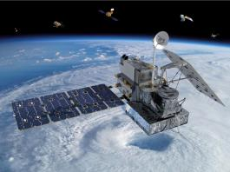
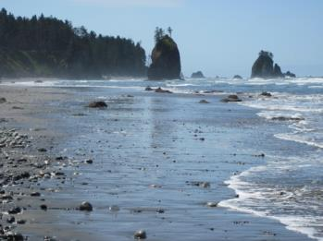
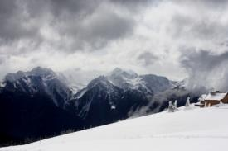
OLYMPEX
How can we measure rain?
Hard to measure precipitation in remote locations – such as over the oceans and mountains
A good way to monitor these locations is using satellites
Need to calibrate these satellite measurements to insure good data.
GPM Core Satellite
Hurricane Ridge
Olympic Nat’l Park
Notes:
This wraps up some of the information they learned in the previous slides.

Slide 16
Where will this campaign be?
Notes:
Have the students look at the map and talk about some of the geological features they observe: mountains, rivers, oceans, lakes, forests, etc. Ask them about the kind of weather they think might occur in this location between November and February. Ask them to think about how the surface features they observed might impact the weather in that region.

Slide 17
GPM and OLYMPEX Ground Validation Campaign
In this ground validation campaign, scientists will make measurements from aircraft that have instruments that are similar to the two instruments that are flying on the GPM mission.
They will wait for clouds and storms to come, and then will measure the precipitation in those clouds and storms from the GPM satellite, from the aircraft that have the similar instruments, and from the ground using many different kinds of instruments that measure precipitation.
Notes:
This slide shows some of the technology that will be used in this ground validation campaign.

Slide 18
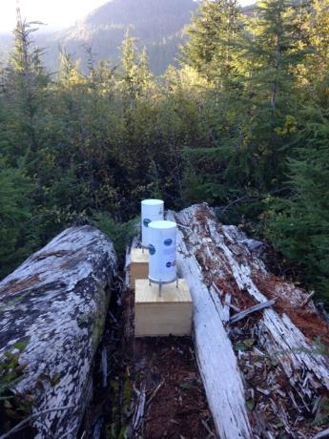
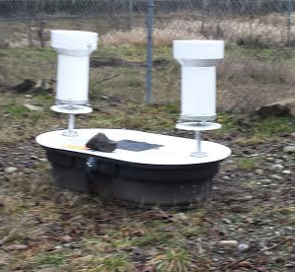
Ground Instruments – Measuring Rain
Rain Gauges
Tipping Bucket style (single and Dual)
Need to be in lower elevations
Notes:
Here are some of the ground-based instruments.

Slide 19
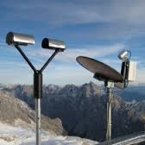
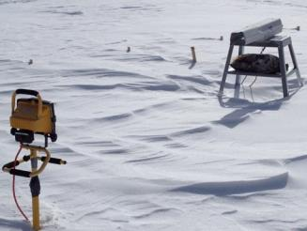
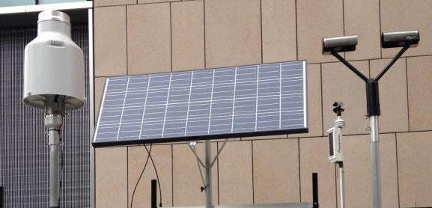
Ground Instruments – Measuring Rain
Instruments that measure characteristics of the precipitation – drop size, reflectivity, etc.
PIP – Can measure snow crystal shapes
MRR – Micro Rain Radar, a radar that looks up only
MRR
PIP
Pluvio: Weighing rain gauge for rain/snow
Parsivel – Can measure the number of drops and their sizes
Notes:
And a few more ground-based instruments.

Slide 20
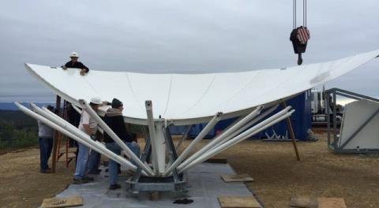
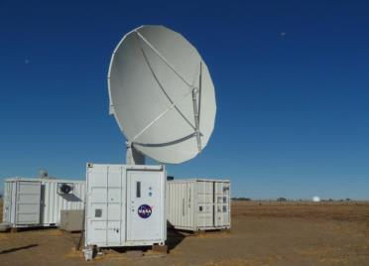
Ground Sites NPOL – Weather Radar on Coast
Ocean View
Olympics
Just installed NPOL Radar on the Quinault Indian Nation near the coast with clear views towards the Ocean and towards the Olympic Mountains
Putting together the reflector
The NPOL radar when operating
Notes:
And some of the ground-based radar instruments that will be used

Slide 21
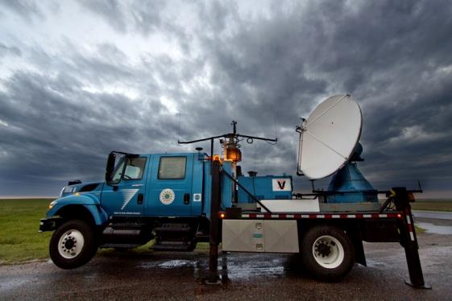
Ground Sites Radar: Doppler on Wheels (DOW)
Will be installed at Lake Quinault so it can make measurements where the NPOL cannot see up the Quinault Valley.
Notes:
Even a radar instrument on wheels!

Slide 22
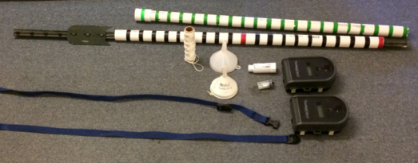
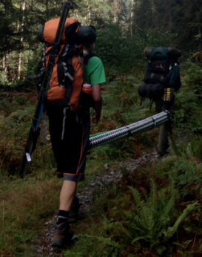
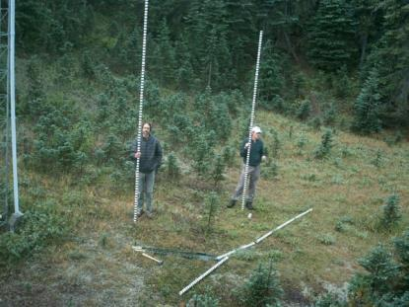
Ground Instruments – Measuring Snow
Using marked poles and time-lapse cameras to measure snowfall accumulation and melt-off.
Notes:
We will also measure snow.

Slide 23
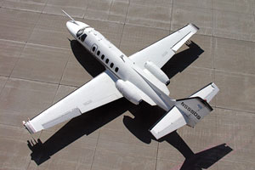
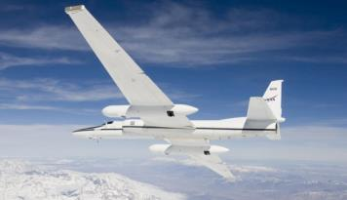
Measuring Rain and Snow from Aircraft
Citation
DC-8
Satellite Simulator instruments
Dropsondes over the ocean
Flies at ~30,000 ft
ER-2
Cloud Microphysics instruments
Flies at 2000 ft above highest obstacle
Satellite Simulator instruments and Flies at ~60,000 ft
Notes:
There are the aircraft that will carry instruments.

Slide 24
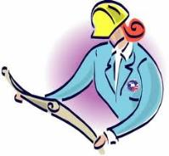
You can collect precipitation data too!
How do you think you could measure the rain that fell in your yard over a week of time?
How could you measure how much snow falls every day?
Try to make some instruments that you can use to measure the amount of precipitation that falls in your home or your schoolyard.
Notes:
You can have students do design challenges to make rain gauges, and will find all the directions at this url: http://pmm.nasa.gov/education/interactive/rain-gauge-design-challenge. You can learn more about the OLYMPEX ground validation campaign from these websites: http://pmm.nasa.gov/OLYMPEX and http://olympex.atmos.washington.edu/. We also have webquests for both elementary and secondary students which are available at the url: http://pmm.nasa.gov/education/interactive/ground-validation-webquest

