Slide 1
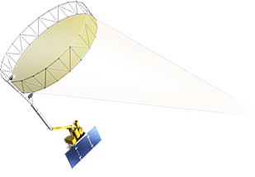
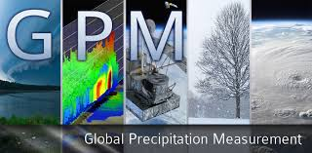
What are “SMAP” and “GPM” and how are they connected to the Water Cycle??
Karen Mohr
Research Meteorologist
Mesoscale Atmospheric Processes Laboratory
NASA-Goddard Space Flight Center

Slide 2
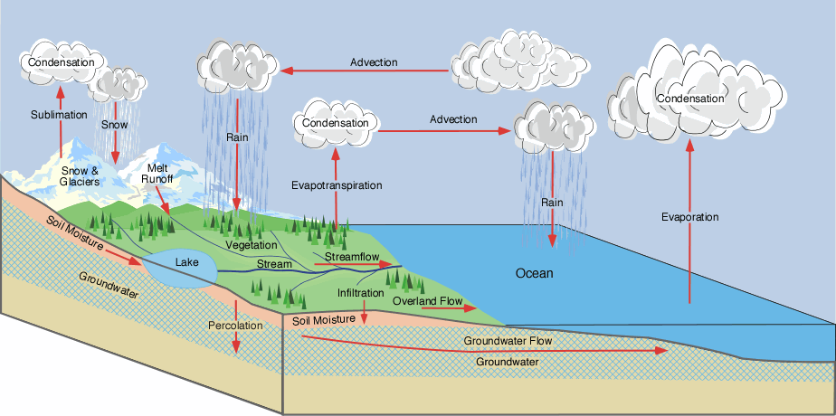
The Water Cycle

Slide 3
The Water Cycle
The physical components

Slide 4
The Water Cycle
Precipitation
and processes of the Water Cycle

Slide 5
The Surface Water Balance
The surface water balance describes in the inputs and outputs of water at a point on the surface
ΔS = change in storage
P = precipitation
E = evapotranspiration
Q = streamflow
G = percolation to
ΔS = P − E − Q − G
Precipitation
soil moisture and
groundwater

Slide 6
My Objective:
Focus on SOIL MOISTURE and PRECIPITATION

Slide 7
Why Study Precipitation?
It is the fundamental input to the surface water balance.
Accurate assessment of water resources critical to
Weather forecasting/climate prediction
Disaster management
Agriculture
Ecosystem health
Public health
Energy production
Transportation networks

Slide 8
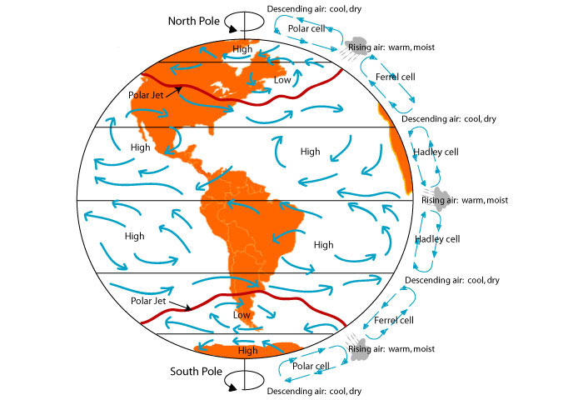
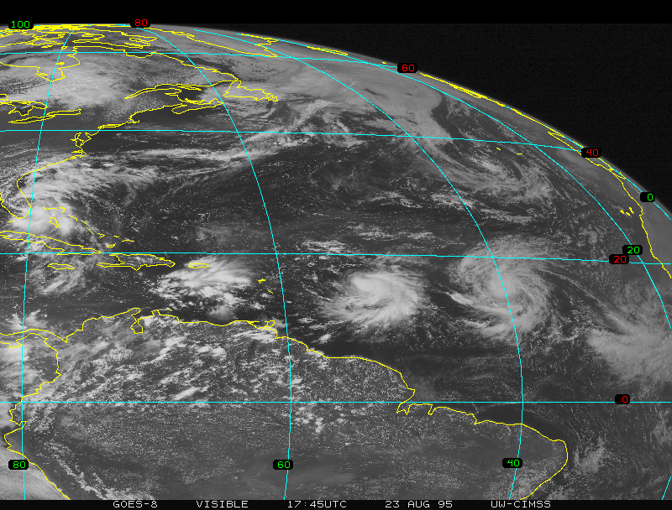
Why Study Precipitation?
There is a transfer of latent heat to the atmosphere through the
Formation of clouds and precipitation
The evaporation of surface water
Transpiration from plants
Energy from latent heat release supplies 30% of the energy for the global atmospheric circulation.
Also important in local and regional circulations.

Slide 9
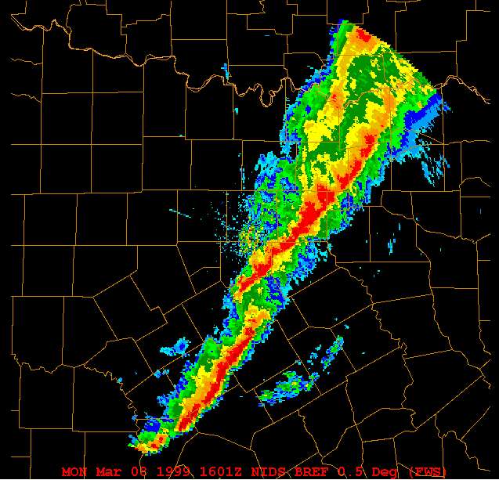
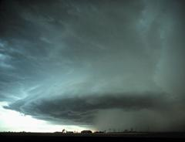
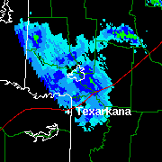
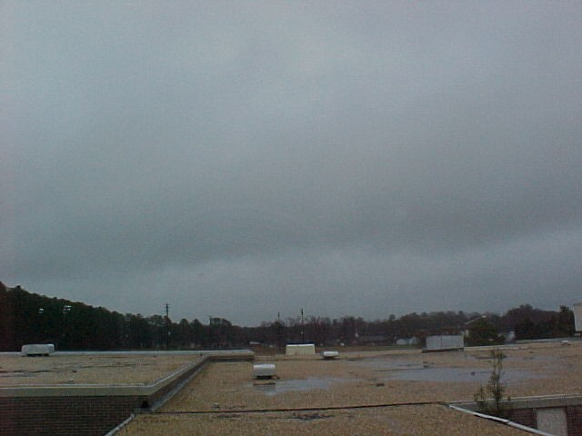
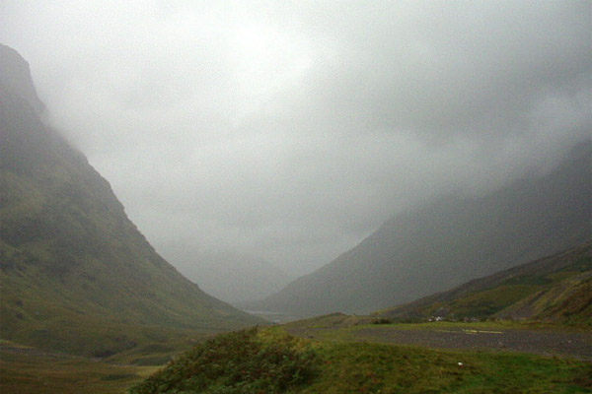
Precipitation: Liquid
Convective rain
Stratiform rain
Drizzle

Slide 10
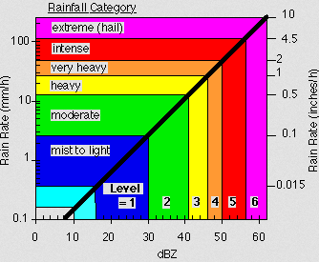
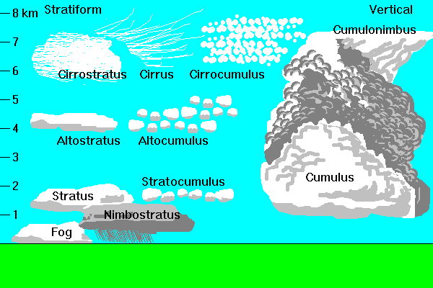
Precipitation: Liquid
Convective rain
Stratiform rain
Convective
Stratiform

Slide 11
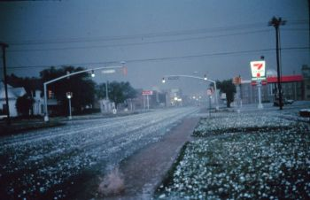
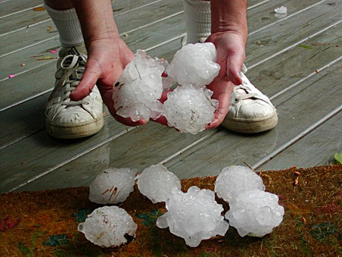
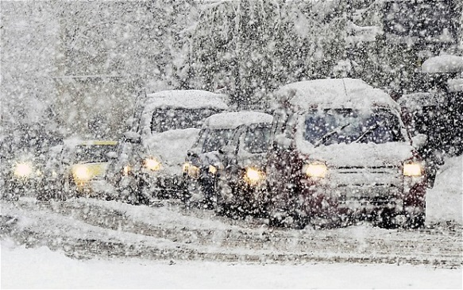
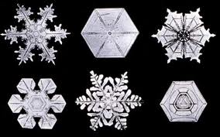
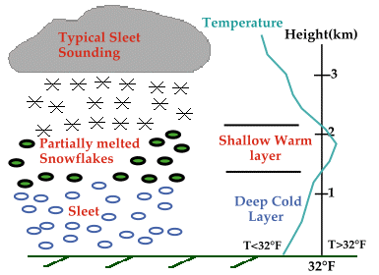
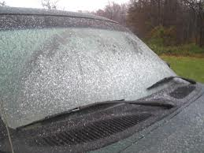
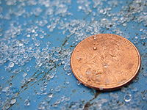
Precipitation: Solid
Hail
Snow
Sleet/ice pellets

Slide 12
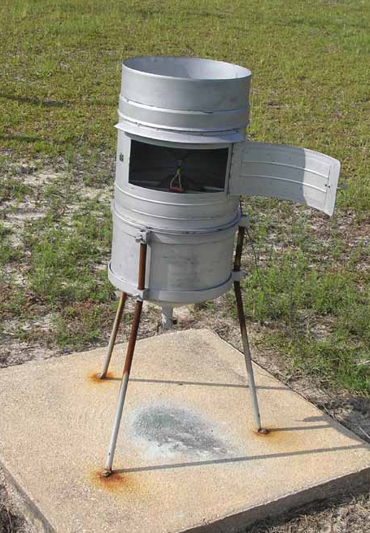
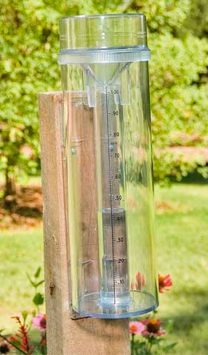
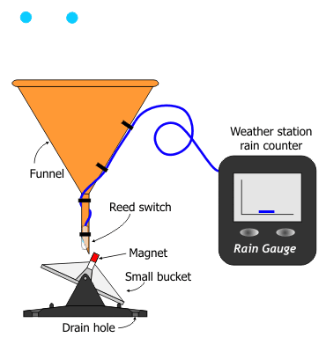
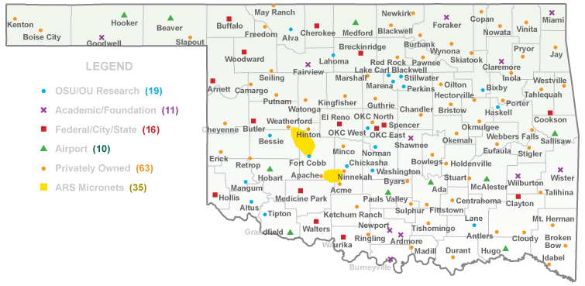
Measuring Precipitation: Surface
Rain Gauges
Recording gauge
Storage gauge
Example of a recording gauge, a tipping bucket
Example network of gauge observations

Slide 13
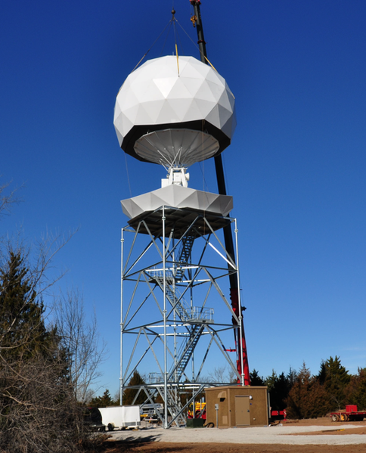
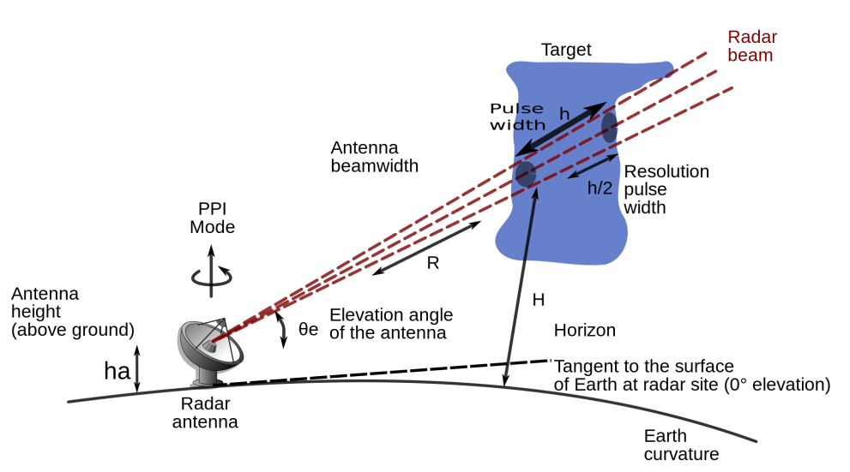
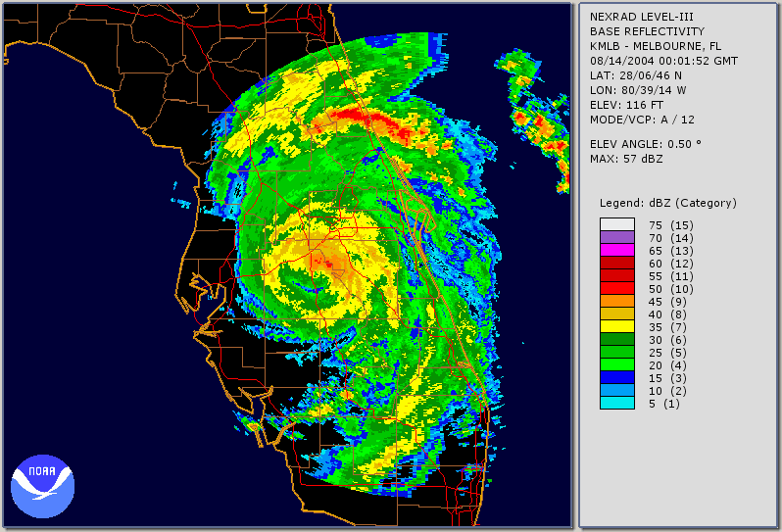
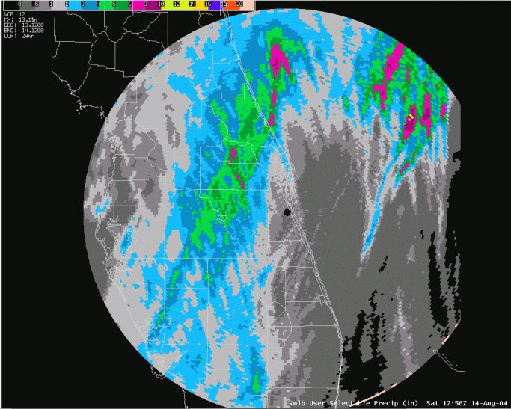
Measuring Precipitation: Surface
Weather Radar
Data available at http://nmq.ou.edu/
Charley
Radar reflectivity measurements can be transformed into rainfall estimates.

Slide 14
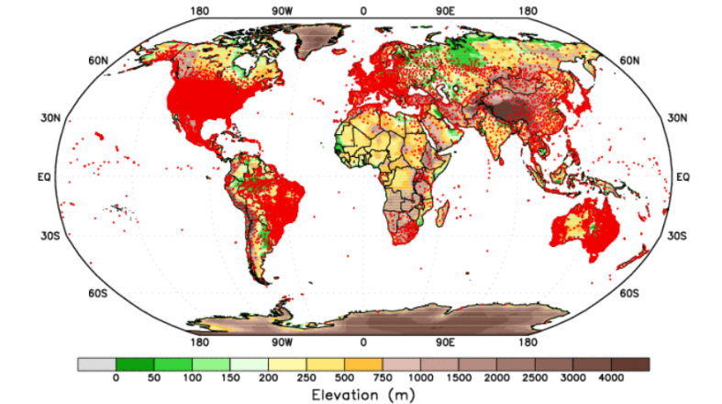
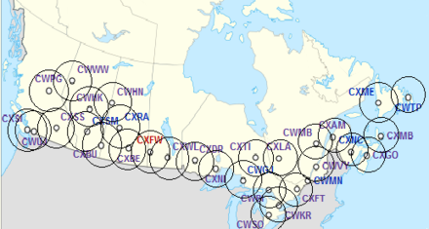
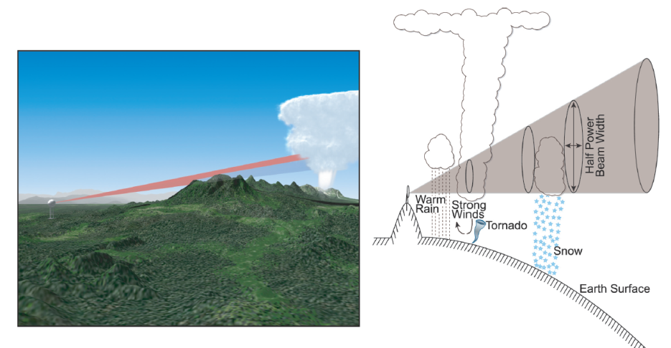
Why Measure Precipitation from Space?
Large areas of Earth are not covered by gauges.
Even less of Earth is covered by radar.
Problems with operations in complex terrain.
Example: Canadian coverage

Slide 15
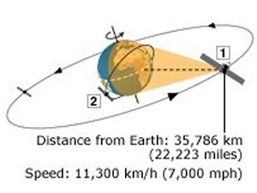
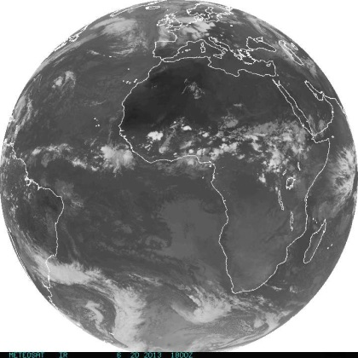
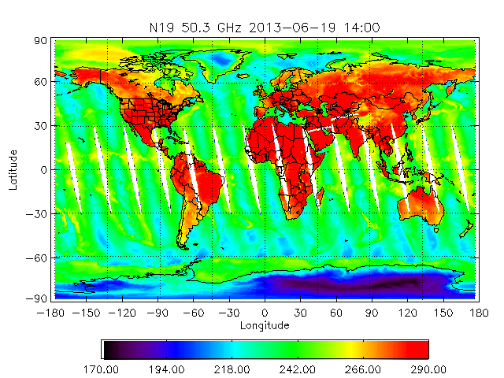
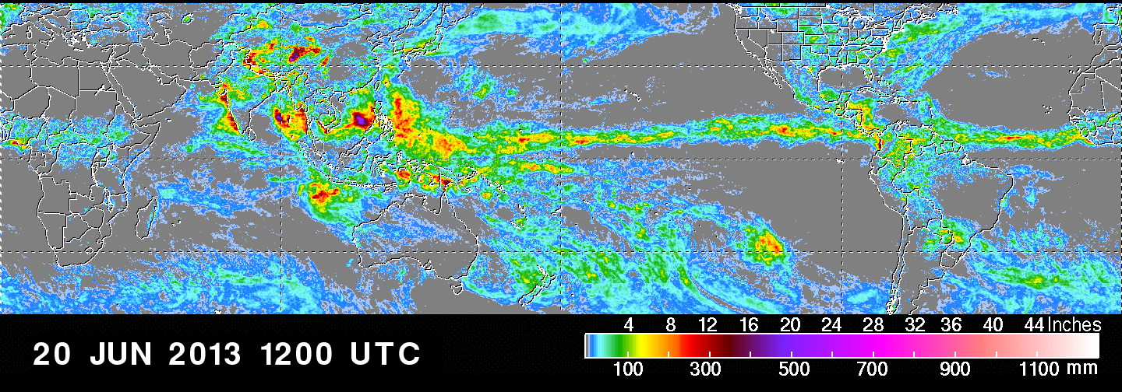
Measuring Precipitation from Space
Infrared: relating cloud-top temperatures from geostationary satellites (1) to rainfall coverage, duration, and movement.
Microwave: relating information from low-Earth orbiting satellites (2) about emitted and scattered radiation within clouds at a variety of wavelengths to rainfall rate and coverage.
(1)
(2)
Multi-satellite global rainfall maps

Slide 16
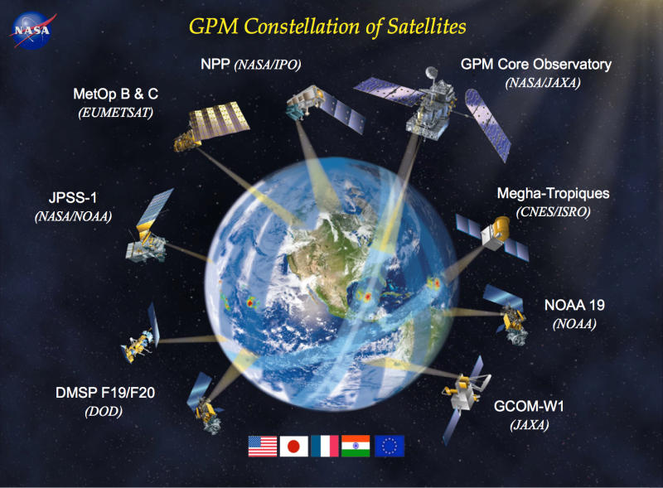
Why GPM?
The Global Precipitation Mission is an international network of low-Earth orbiting satellites.
A core satellite is being developed by NASA to leverage and improve upon previous successful missions.
Critical advantages:
Higher temporal resolution
Higher spatial resolution
Improved spatial coverage
Greater sensitivity

Slide 17
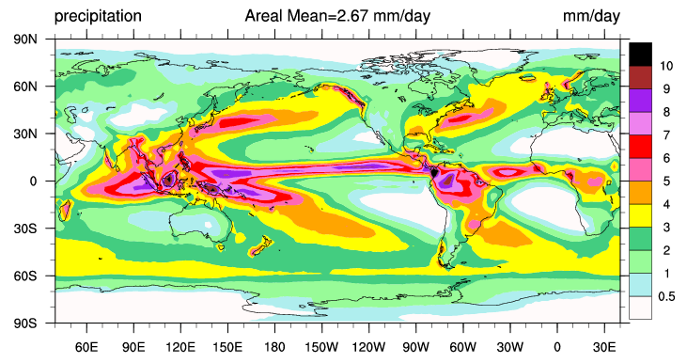
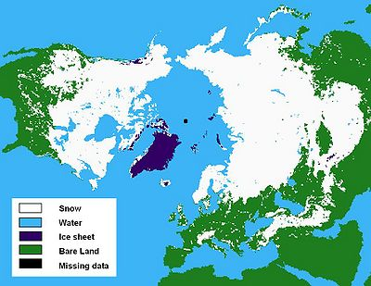
What Can We Learn?
Frozen precipitation and light precipitation represent technical challenges due to
Small particles, often densely packed
Multitude of crystal shapes
Background masking and interference
→ GPM will observe in a wide range of microwave frequencies and polarizations to improve our ability to detect light and frozen precipitation.

Slide 18
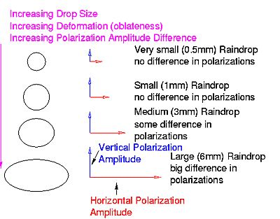
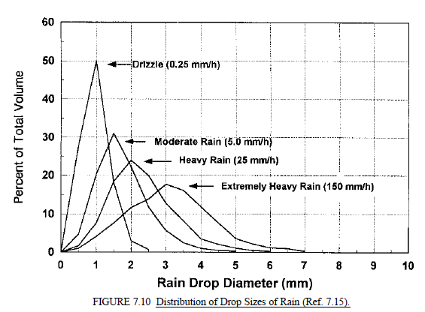
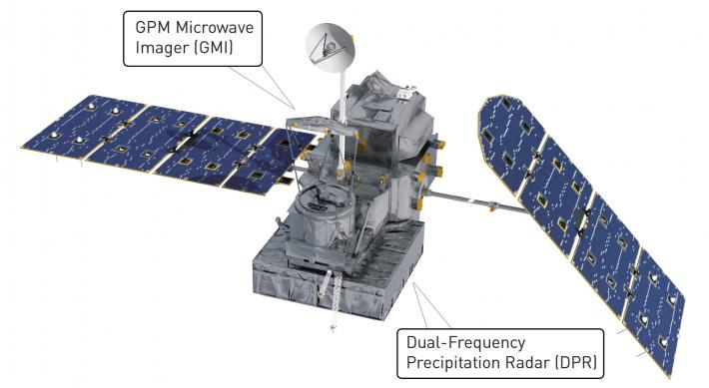
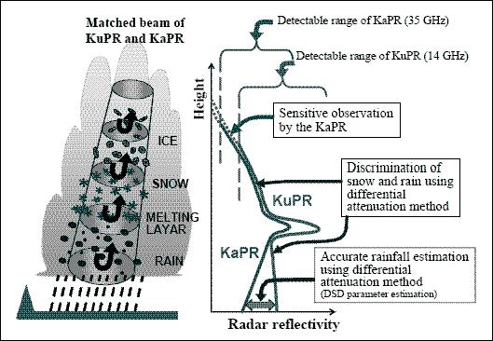
What Can We Learn?
Snow/rain discrimination and
Drop size distributions (DSD)
Better rate estimates
Improved understanding of cloud structures

Slide 19
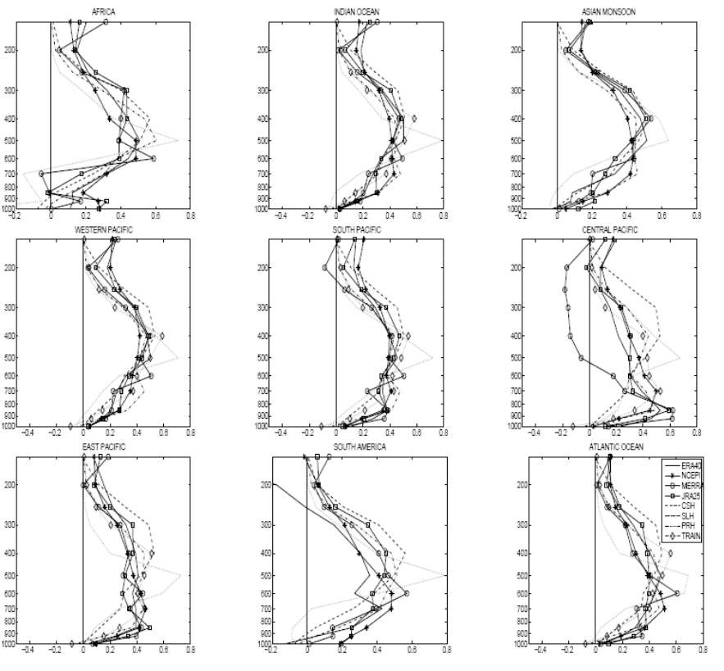
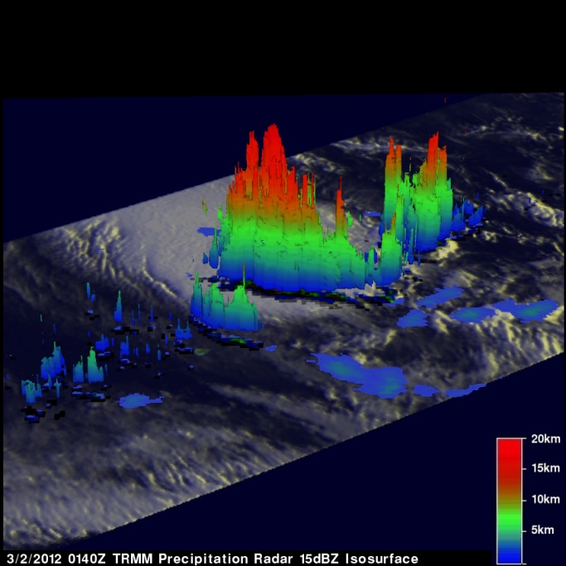
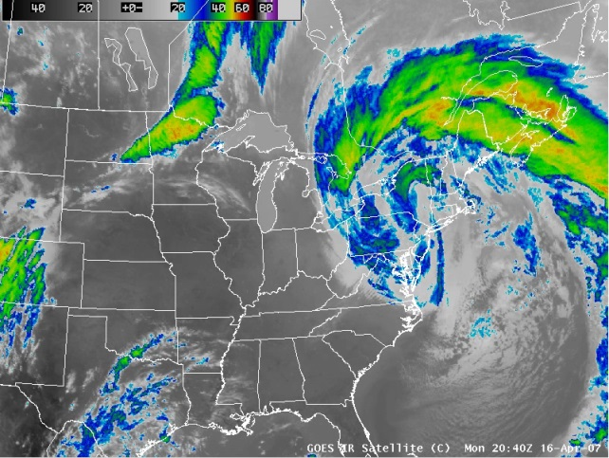
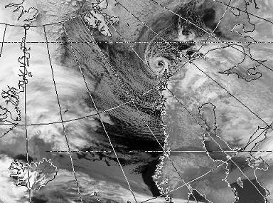
What Can We Learn?
Improved latent heating estimates globally
3D macroscopic view of precipitating systems
Currently available only in the Tropics
?
Polar Low
Nor’easter

Slide 20
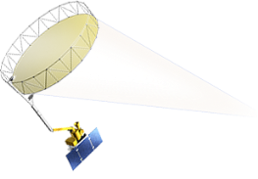
Why Study Soil Moisture?
Soil moisture is the accumulated precipitation in the continental, near-surface soil reservoir.
Involved in energy transfers of latent heat to the atmosphere by evapotranspiration.
Soil moisture data have the same list of applications:
Weather forecasting/climate prediction
Disaster management
Agriculture
Ecosystem health
Public health
Energy production
Transportation networks

Slide 21
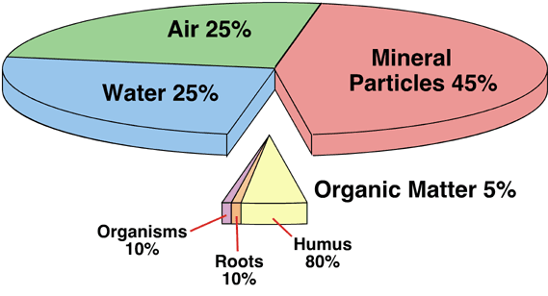
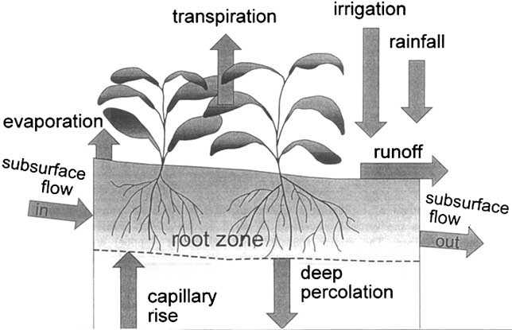
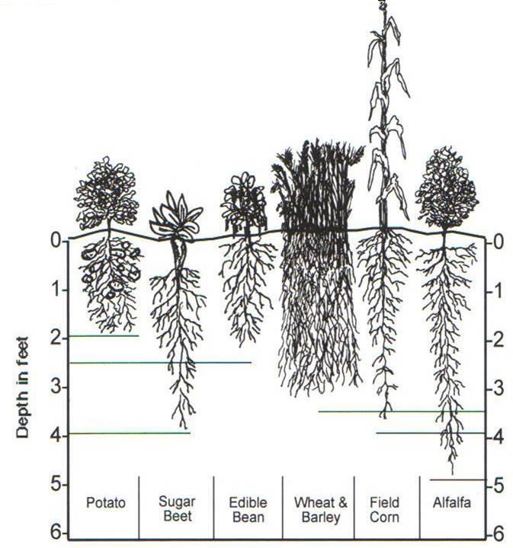
Soil: A complex system
Pie chart is a typical breakdown of soil components.
Water can be frozen and/or liquid.
The root zone is the key reservoir.
Soil Moisture
Water Table
Root zone depth varies with climate, soil texture, and vegetation type.
Groundwater

Slide 22
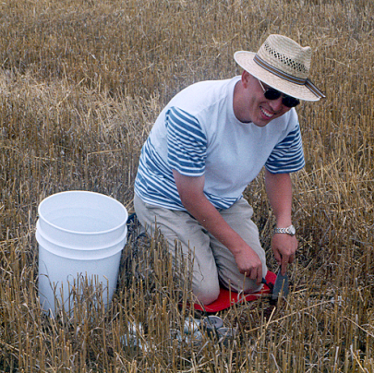
Measuring Soil Moisture: Surface
1.
Gravimetric method
Time-Domain Reflectometry (TDR)
Neutron probe
Gamma ray attenuation
2.
3.
4.

Slide 23
Why Measure from Space?
Surface soil moisture measurement methods are expensive and networks are limited.
Soil moisture is well-correlated with emission at the microwave frequency 1.4 GHz (L-Band).
Also well-correlated with radar backscatter.
radar
radiometer

Slide 24
What Can We Learn?
Monitor soil moisture globally
Improved estimation of surface water balance and fluxes.
Monitor freeze/thaw cycles
Improved estimation of carbon sources and sinks.
Better drought and flood prediction and monitoring
ΔS = P − E − Q − G

Slide 25
SMAP/GPM Synergy
Microwave emission from the surface can confound rain rate estimates from GPM.
Provide better warning capability for disasters involving surface conditions.
Weather forecasting/climate prediction depends upon assimilation of space-based observations to constrain and improve models.
ΔS = P − E − Q − G

Slide 26
Questions???

